Slide 1
Supporting Your Child’s Literacy Development
Elementary
[insert - Presenter Name]
[insert - Presenter Title]
If you have questions after the presentation, please contact: [insert contact name and email]
or
Contact | National Center on Improving Literacy at nciliteracy@gmail.com
Notes:
How to present this slide deck:
This slide deck is intended to be use and modified to meet the needs of your organization. The following information should be used to assist you, the presenter, as you modify the slides to meet the needs of your audience. At the bottom of the notes on this slide is the script to introduce this presentation.
Text coding:
Bold text = Presenter Script (what the presenter should say)
Italic text = Ideas for activity or interaction
Underlined text = specific contexts (e.g., zoom vs in-person)
Yellow highlighted text is for you to customize based on your state/grade for the presentation
Regular text = Presenter notes (reminders or instructions)
Regular text with bullet = specific instruction
Information in Notes:
* Asterisks indicate hints or ideas for customization
If there is a video, the link will be provided in the slide notes. The transcript for the video is provided so that you can decide if you want to show the video, or if you want to cover the topic through a discussion.
CLICK, directions for animated slides
Slides Information:
Hidden slides are optional and may be used at the presenter's discretion based on the needs of the audience.
The pink backpack on a slide indicates there are resources to either be distributed during the workshop, or to provide for participants to review later. You can click on the icon directly from the slide to access the online version. The URL is included in the speaker notes. If the training is in person, you may choose to print some out and distribute as handouts.
---
Greet participants and begin workshop with introductions as needed. Follow the facilitation procedure notes appropriate for the workshop session.
Welcome to the National Center on Improving Literacy’s workshop on learning about your child’s reading development. Children who struggle learning early literacy skills are at risk for reading and academic difficulties later. As a parent or caregiver, being informed about the parts of literacy, how your child learns to read, and why he or she might struggle can help you make better decisions about your child’s education. This workshop is part two of a four-part series on key roles that families can play for children’s literacy success.

Slide 2



The National Center on Improving Literacy (NCIL) is a partnership among literacy experts, university researchers, and technical assistance providers, with funding from the United States Department of Education.
Our mission is to increase access to, and use of, evidence-based approaches to screen, identify, and teach students with literacy-related disabilities, including dyslexia.
Notes:
Today’s workshop was created by the National Center on Improving Literacy. The National Center on Improving Literacy’s mission is to increase access to, and use of, evidence-based approaches to screen, identify, and teach pre-K to grade 12 students with literacy-related disabilities, including dyslexia.

Slide 3
Learn About Supporting Your Elementary Child's Literacy Development
This workshop is part of a series on the key roles families play in supporting children’s literacy success. It is designed for parents and caregivers of students in grades Pre-K to 5 who want to better understand how reading develops and how to strengthen it at home. Families will learn the basics of the Science of Reading and the essential skills elementary students need to become confident, capable readers.
The research reported here is funded by a grant to NCIL from the Office of Elementary and Secondary Education, in partnership with the Office of Special Education Programs (Award 3: S283D160003). The opinions expressed are those of the authors and do not represent views or policies of OESE, OSEP, or the U.S. Department of Education. You should not assume endorsement by the Federal government.
Notes:
Children who struggle learning early literacy skills are at risk for reading and academic difficulties later. Being informed about the parts of literacy, how children learn to read, and why they might struggle can help you make better decisions about your child's education.

Slide 4
Learning Objectives
By the end of this session, participants will have learned:
A general understanding of the Science of Reading and the critical skills needed for children to be successful readers.
Evidence-based strategies, tips, and activities to help develop children’s interest in and engagement with reading, listening and reading comprehension skills, ability to recognize speech sounds and identify letter-sound relationships, and word identification and oral reading skills.
How to interact with children in ways that support and monitor their language and early literacy development.
How families can partner with schools to support reading success.
Notes:
Read through objectives
Note: Participant learning objectives to display and communicate when the workshop begins.

Slide 5

Agenda
Science of Reading and the Simple View of Reading Overview
Reading with Your Child
Helping Your Child Understand What is Read
Helping Your Child with Speech Sounds
Helping Your Child Blend Sounds to Figure Out Words
Reading Together to Develop Fluency
The Family-School Partnership

Slide 6
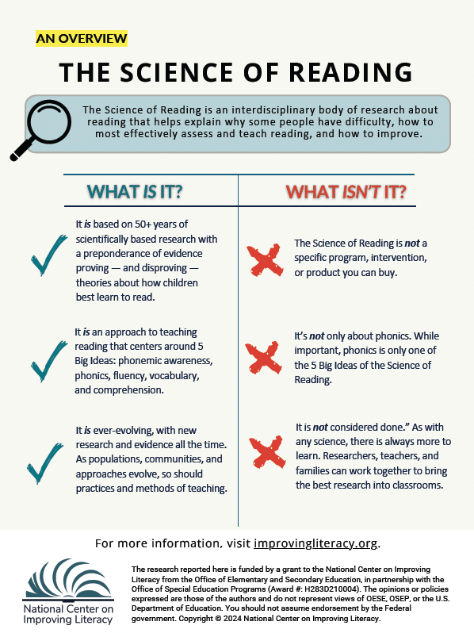
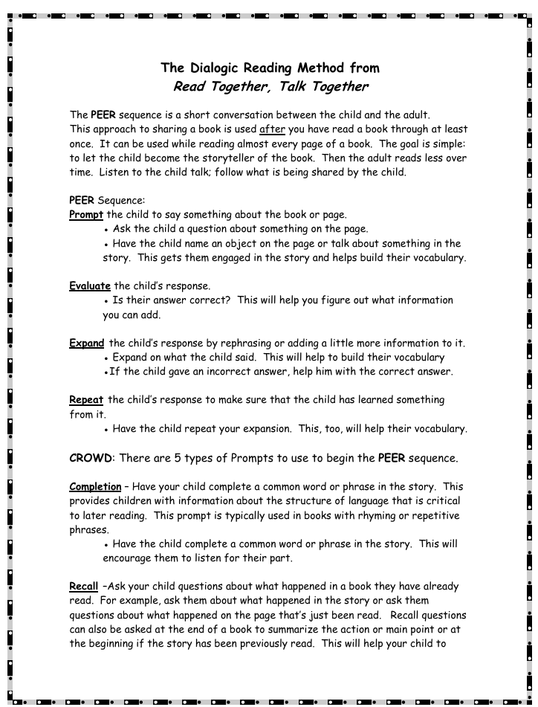
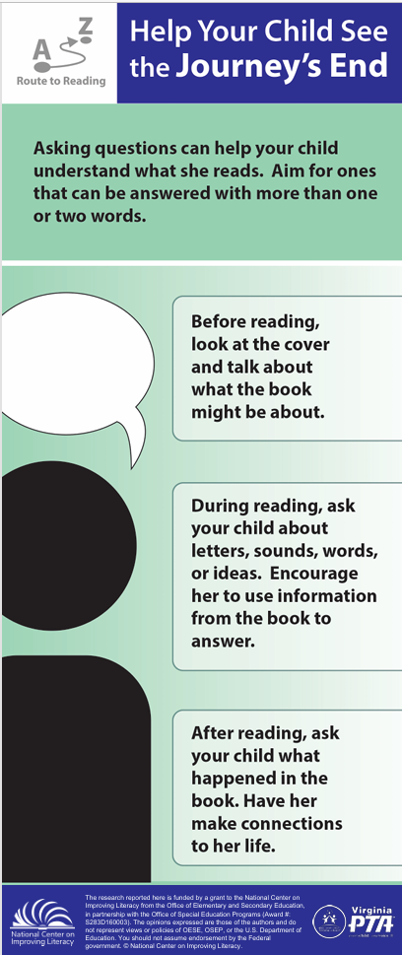
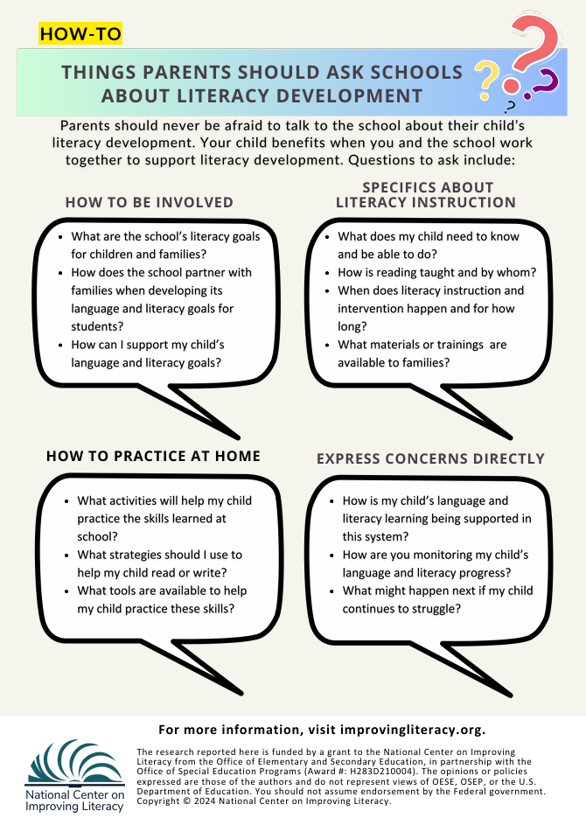




Workshop Materials
Science of Reading and the Simple View of Reading Overview
The Dialogic Reading Method
Route to Reading: Help Your Child See the Journey’s End
The Family-School Partnership
Notes:
Materials links:
The Science of Reading - https://improvingliteracy.org/resource/the-science-of-reading-an-overview/
The Dialogic Reading Method from Read Together, Talk Together – https://bookem-kids.org/wp-content/uploads/2025/10/Dialogic-Reading-Handout.pdf
Route to Reading: Help Your Child See the Journey’s End - https://vapta.org/~documents/programs/readingnight/route-reading-child-see-journey-end/?layout=file
The Family-School Partnership - https://vapta.org/~documents/programs/readingnight/route-reading-child-see-journey-end/?layout=file

Slide 7
Science of Reading and the Simple View of Reading Overview

Slide 8
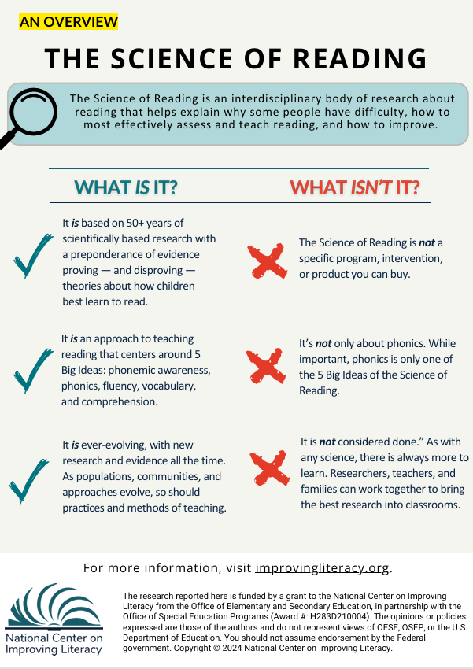

The Science of Reading:
What It Is and What It Isn’t
What It Is
Grounded in 50+ years of research on how children learn to read
Built on the 5 Big Ideas: phonemic awareness, phonics, fluency, vocabulary, comprehension
Continually evolving as communities, populations, and instructional methods change
What It Isn’t
Not a specific program, intervention, or product you can purchase
Not only about phonics—phonics is just one of the 5 Big Ideas
Not “finished”; like any science, it continues to grow as researchers, educators, and families contribute
Notes:
Handout link: The Science of Reading: An Overview – National Center on Improving Literacy
There are so many pieces to the Science of Reading that it can be difficult to know where to start. Here are a few highlights about what the Science of Reading is — and what it’s not. This knowledge will help you on your journey to teaching all children, including those with diverse needs and cultural backgrounds, to read.
The Science of Reading: What It Is and What It Isn’t
What It Is
Based on 50+ years of scientifically grounded research that confirms and disproves theories about how children learn to read
An instructional approach centered on the 5 Big Ideas: phonemic awareness, phonics, fluency, vocabulary, and comprehension
An evolving body of research that grows as communities, populations, and instructional methods change
What It Isn’t
Not a specific program, intervention, or product you can purchase
Not only about phonics—phonics is just one of the 5 Big Ideas
Not “finished”; like any science, it continues to grow as researchers, educators, and families contribute

Slide 9
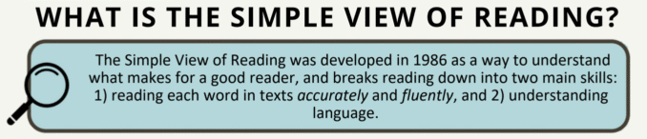
Learning to Read: The Simple View of Reading
Word Recognition
Language
Comprehension
Reading
Comprehension
Notes:
Read what is on the slide

Slide 10
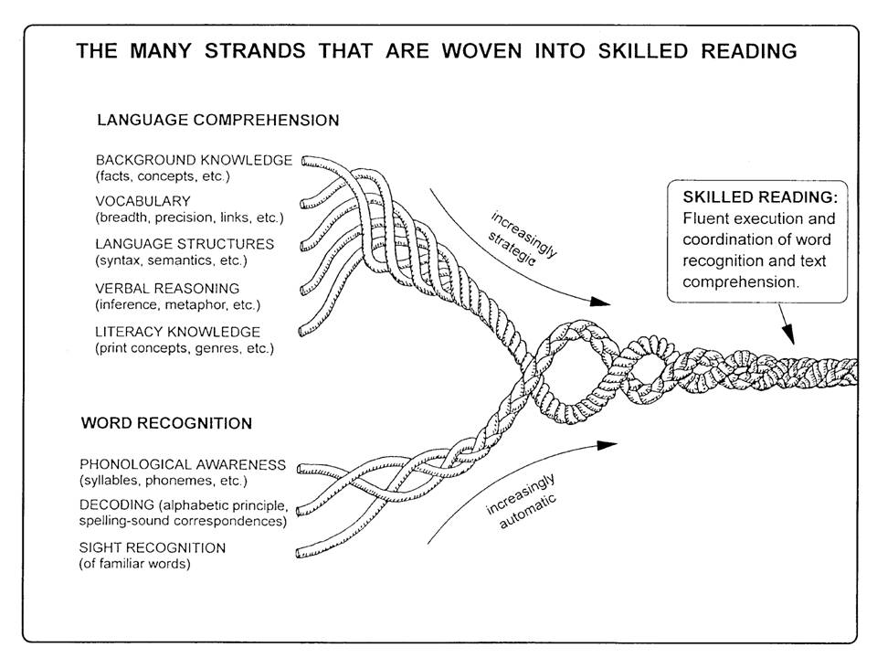
Reading involves two critical skills:
Language Comprehension:
Comprehending the meaning of the text
Students need strategies to read unfamiliar words
They must also recognize previously encountered words
Fluency supports better comprehension
Word Recognition:
Reading each word accurately and fluently
Understanding vocabulary and sentence structure is key
Requires strong language comprehension skills
Image Credit: The image, courtesy of the author, originally appeared in the following publication: Scarborough, H. S. (2001). Connecting early language and literacy to later reading (dis)abilities: Evidence, theory, and practice. In S. Neuman & D. Dickinson (Eds.), Handbook for research in early literacy (pp. 97–110). New York, NY: Guilford Press.
Notes:
Image link: https://institute.aimpa.org/resources/readingrope
Read skills from slide, then add this brief description of Scarborough’s rope:
These critical reading skills are also the strands that create what is know as Scarborough’s Reading Rope. Basically, Scarborough’s Reading Rope is a visual model showing that skilled reading develops when word recognition skills (like phonological awareness, decoding, and recognizing familiar words) are woven together with language comprehension skills (such as vocabulary, background knowledge, and understanding sentence structure). As each strand becomes stronger and more automatic, they intertwine to form a fluent, proficient reader.

Slide 11
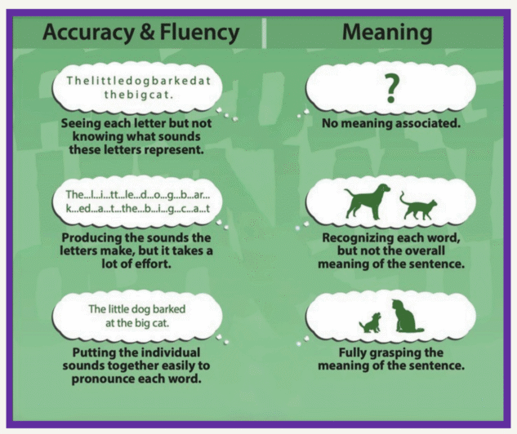
What do these skills look like in the classroom?
Word Recognition Skills
Language Comprehension Skills
Notes:
Read through the progression of building skills as presented on the slide.

Slide 12
Reading with Your Child

Slide 13
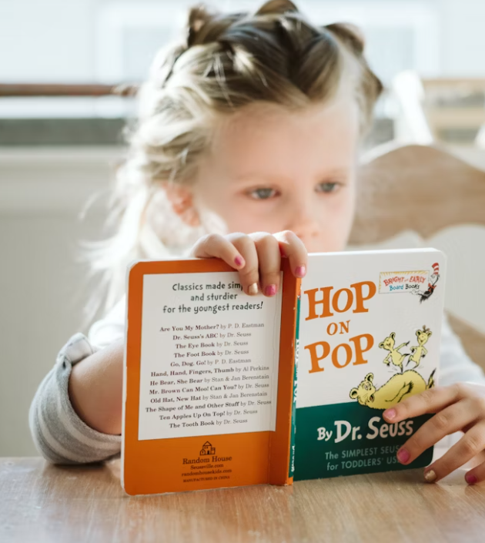
READING WITH YOUR CHILD
Helps your child:
Learn new words and ideas
Understand the purposes for reading
Hear what reading sounds like
Develop thinking and problem-solving skills
Enjoy reading and learning
Notes:
Note: This slide explains why the topic is important/the session big ideas for elementary children.
Reading with your child helps your child learn new words and ideas; understand the purposes for reading; hear what reading sounds like; develop thinking and problem-solving skills; and enjoy reading and learning.

Slide 14


READING WITH YOUR CHILD
Watch on YouTube:
Reading with your child can promote their reading development. Listen to Dr. Jeanne Wanzek discuss how you can support your child's literacy development at home.
Watch Video
Video provided by:
Notes:
Reading with your child can promote their reading development. Let’s listen to Dr. Jeanne Wanzek discuss how you can support your child’s literacy development at home.
Video Link: https://youtu.be/yAwDAjBDM5A?si=l-u5t7t2R3x_KoXp
Video: Play What are some things that we as parents can do to help our children at home? (1:22)
Yeah, I think at home, you know it's really important to focus on your child's strengths as well as their weaknesses. It's easy when students are struggling, our children are struggling to think about their weaknesses. But really celebrate their strengths and do things that, you know, continue to build on those strengths. And one of the most important things you can do is to read with and to your child, and make a reading enjoyable at home. And that can be you know, reading to them, reading with them, audiobooks, and really discussing that and making it enjoyable. Talk about the interesting words that are in the books, what the words mean, what’s happening in the story or the information that is being given, what is the author trying to convey to the reader through this through this book or through this text, and really, you know, having discussions with your child about books and really making it an enjoyable experience. And children who receive really good effective instruction in school and find reading enjoyable become successful readers and can think critically about the text and really can thrive in those environments.
Guiding Question to Check for Understanding: In what ways have you focused on your child’s strengths related to reading at home?
​
​
​

Slide 15

READING WITH YOUR CHILD
Get Ready to Read
Find a quiet, cozy spot so you both can listen.
Let your child choose a book or you pick one
that matches her interests. It can be a book
slightly harder than what your child can read on her own.
Follow your child's lead and keep it fun.
Notes:
You can get ready to read by finding a quiet, cozy spot so you both can listen and talk, let your child pick a book or choose one that matches her interests. It can be a book slightly harder than she can read on her own. Finally, follow your child’s lead and keep it fun.
Guiding Questions to Check for Understanding: How does talking about books help your child learn to read? How has what you’ve learned influenced your thinking about reading with your child?
​

Slide 16
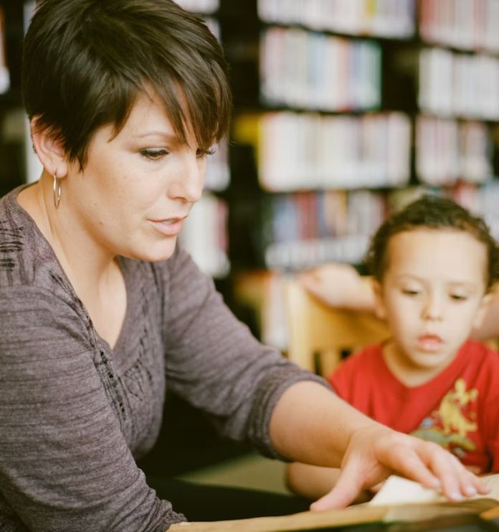
READING WITH YOUR CHILD
Reading with your child means you and your child read and talk about the book together. It is interactive.
Use these tips to read with your child:
Read pictures, words, or use audio books.
Read and talk in the language you and your child feel most comfortable.
Try reading both fiction and informational books.
Engage in Dialogic Reading with your child.
Notes:
What does it mean to read with your child?
Reading with your child means you and your child read and talk about the book together. It's interactive. This interactive conversation is a fun, purposeful way to share ideas.
Use these tips to read with your child:
You can read pictures, words, or use audiobooks.
Read and talk in the language you and your child feel most comfortable.
Try reading both fiction and informational books.
Engage in Dialogic Reading with your child.
In just a moment we're going to practice using dialogic reading, but first we need to learn more about it.

Slide 17

READING WITH YOUR CHILD
What Is Dialogic Reading?
A way of reading with your child, not to your child
Uses conversation to build language and thinking
Builds on what families already do naturally
ThePhoto by PhotoAuthor is licensed under CCYYSA.
Notes:
Dialogic reading is simply a way of reading with your child instead of just reading to them. It turns book time into a conversation. Many families already do pieces of this without realizing it—pointing to pictures, asking questions, repeating what a child says, or adding a little more detail.
Dialogic reading takes those natural habits and uses them with purpose. When we slow down, talk about the pictures, ask questions, and build on our child’s ideas, we help them grow vocabulary, comprehension, and confidence. It’s not about reading the book perfectly—it’s about talking together.

Slide 18


READING WITH YOUR CHILD
The Power of Dialogic Reading
Watch the video to learn more.
Watch Video
Watch on YouTube:
Video provided by:
Notes:
This video is a quick overview of dialogic reading and how it supports literacy development.
Video: Stephanie Berman The Power of Dialogic Reading (0:33)
Video link: https://youtu.be/CqwZgvj2YhE
Transcript: So dialogic reading is really important when you're reading with a child because it engages the child in a conversation about the book. (0:09) Basically, when the parent is reading the book, they're asking the child questions about what they're encountering, the unfamiliar words, and helping the child relate the book to their everyday experience. It's basically using the book to create a conversation, and through that, they're able to make connections to their daily lives, explore new vocabulary, and discuss topics they may not be very familiar with.

Slide 19
READING WITH YOUR CHILD
Dialogic Reading with PEER
PEER: A Simple Way to Guide Book Conversations
Prompt
Evaluate
Expand
Repeat
Notes:
In the video we just watched, we learned that dialogic reading is an interactive way of reading with your child. Instead of just reading the words, you turn the book into a conversation—something parents already do naturally when they point to pictures, ask questions, or add little comments.
Today we’re focusing on the acronym PEER, a simple way to guide those conversations:
P is for Prompt — You start by asking your child a question or inviting them to notice something.
E is for Evaluate — You listen to their response and think about what they understood.
E is for Expand — You add a little more information, a new word, or a fuller idea.
R is for Repeat — You ask your child to say the new idea or word again so it sticks.
Why does PEER matter? It encourages children to participate, strengthens comprehension, builds critical thinking, and exposes them to richer vocabulary than everyday conversation. When adults expand a child’s response, they model new words and fuller sentences, which boosts confidence and oral language skills.
Here’s how the PEER sequence works in action:
If I ask, ‘What kind of toy does Henry have?’ I give my child time to think. If they answer, ‘A stuffed animal,’ I evaluate that response and then expand it: ‘Yes, that’s right—Henry has a stuffed animal.’ Then I repeat it and invite them to say it with me: ‘Henry has a stuffed animal.’
PEER is simple, but it helps us slow down, add detail, and give children the chance to use complete sentences and new vocabulary. It turns reading into a powerful back‑and‑forth learning moment and keeps the conversation going and helps children learn language in a natural, playful way.

Slide 20
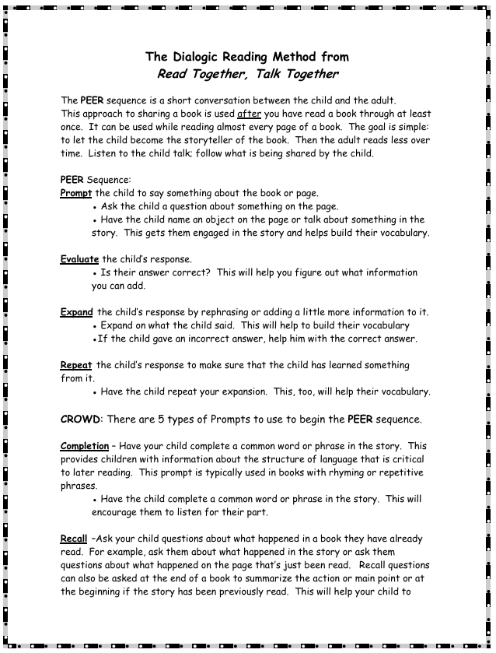
READING WITH YOUR CHILD
Activity
Find a partner and get a picture book.
Use the picture book to apply the PEER sequence following The Process of Dialogic Reading handout.
Use sticky notes to mark the places in the book where you would apply part of the sequence, noting which part and what you would ask.
Be prepared to share out.
Notes:
Activity: Distribute the Process of Dialogic Reading handout and make sure participants have a book. Read the directions below. Then, provide time for participants to pair up and use a picture book to apply the PEER sequence following The Process of Dialogic Reading handout. Have pairs use sticky notes to mark the places in the book where they would apply part of the sequence, noting which part and what they would ask. Have participants share out.
Now we’re going to shift from learning about dialogic reading to actually doing it.
Step 1 — Find a Partner and Choose a Picture Book
Go ahead and pair up with someone near you. Together, select one picture book from the table. Any book will work for this activity.
Step 2 — Apply the PEER Sequence
Using your book, walk through the PEER sequence just like it’s described in The Process of Dialogic Reading handout.
Remember:
P — Prompt your child with a question
E — Evaluate what they say
E — Expand their idea with a new word or detail
R — Repeat the new idea or word together
Your goal is simply to practice noticing where natural conversation can happen in the book.
Step 3 — Mark Your PEER Moments with Sticky Notes
As you turn the pages, use your sticky notes to mark places where you would use each part of the sequence. On each sticky note, write:
which part of PEER you’re using
the question or prompt you would ask
For example:
“P — What do you think she’s looking for”
“E — Child says ‘a dog’”
“E — Expand: ‘Yes, she’s searching for her lost puppy’”
“R — ‘Can you say lost puppy’”
Step 4 — Prepare to Share Out
When you and your partner finish marking your book, choose one or two examples you feel good about. We’ll come back together as a group to share what you noticed, what felt natural, and what you might try with families or students.
Take about 8–10 minutes to work through the book together
Handout link: Microsoft Word - Dialogic Reading Handout.doc
https://bookem-kids.org/wp-content/uploads/2025/10/Dialogic-Reading-Handout.pdf

Slide 21
READING WITH YOUR CHILD
Activity Share Out
Where did you apply the PEER sequence?
Which parts?
What types of questions did you and your partner use?
Notes:
Activity Share Out:
Let’s come back together and talk about what you and your partner discovered while practicing the PEER sequence.
Who’d like to start us off? Where did you apply the PEER sequence?
Share a page or moment in your book where the PEER sequence felt like a natural fit. As you listen to each other, notice the kinds of moments that invite conversation—pictures with action, emotion, or something to predict.
(after a few participants respond move to the next question)
Which parts of PEER did you use?
Think about the sticky notes you placed. Which parts of the sequence showed up most often—Prompt, Evaluate, Expand, or Repeat? Did any part feel especially easy or especially challenging to apply?
(after a few participants respond move to the next question)
What types of questions did you use?
Let’s hear a few examples of the questions you and your partner tried. Were they:
Prediction questions (“What do you think will happen next”)
Wh‑ questions (“Why is he hiding behind the tree”)
Labeling questions (“What is this called”)
Connection questions (“Does this remind you of anything you’ve done”)
As you share, think about how these question types help children talk more, think more, and stay engaged with the story.
(after a few participants respond close out the share out)
Thank you for sharing your examples. What you just practiced—spotting natural conversation moments and choosing the right type of prompt—is exactly what helps families feel confident using dialogic reading at home.
Handout link: Microsoft Word - Dialogic Reading Handout.doc
https://bookem-kids.org/wp-content/uploads/2025/10/Dialogic-Reading-Handout.pdf

Slide 22
Helping Your Child Understand What is Read

Slide 23
HELPING YOUR CHILD UNDERSTAND WHAT IS READ
Ask smart questions to help your child understand what they read.
Ask questions that your child can answer with more than one or two words.
Ask questions that have your child use information from the story to answer.
Ask "Wh" questions (Who, What, When, Where, and Why) and "How" questions.
Ask questions about characters, ideas, or words in the story.
Notes:
Ask smart questions to help your child understand what she reads. Ask questions that your child can answer with more than one or two words. Ask questions that have your child use information from the story to answer. Ask “wh” questions - who, what, where, when, and why - and how questions. Ask questions about ideas or words from the book.

Slide 24
Dialogic Reading with CROWD
HELPING YOUR CHILD UNDERSTAND WHAT IS READ
CROWD: Five Types of Prompts
C — Completion - Finish a familiar phrase or sentence.
  “Brown bear, brown bear, what do you… see.”
R — Recall - Ask about something that already happened in the story.
  “What happened to the caterpillar?”
O — Open‑Ended - Invite the child to describe what they see.
  “Tell me what’s happening in this picture.”
W — Wh‑ Questions - Ask who, what, where, when, why, or how.
  "What’s the name of this?”
D — Distancing - Connect the story to the child’s own life.
  “Remember when we went to the farm. Which animals did we see?”
Notes:
Now that we’ve practiced the PEER sequence in the previous activity, let’s look at the five types of prompts we can use to start that sequence. These five prompts make up the acronym CROWD. Each one gives children a different way to think, talk, and engage with the story. We will use these prompts in our next activity.
C — Completion Prompts
Completion prompts invite children to finish a familiar phrase or sentence in the book. These work especially well with rhyming books or stories that repeat the same line.
You might pause and say: ‘And the caterpillar turned into a beautiful…’ Children love jumping in with the missing word, and it helps them learn how language is structured.
Completion prompts encourage careful listening and help children notice patterns in language.
R — Recall Prompts
Recall prompts ask children to remember something that already happened in the story. These are great for building memory, sequencing, and understanding the plot—especially for children around ages four and five. You might ask: ‘Can you tell me what happened to the caterpillar in this story’ Recall prompts can be used at the end of a book to summarize, or at the beginning if it’s a story the child has heard before. They work with almost any book—except alphabet books, which don’t have a storyline to recall.
O — Open‑Ended Prompts
Open‑ended prompts encourage children to talk more and describe what they see. These are perfect for pages with rich, detailed illustrations. You might say: ‘Tell me what is happening in this picture.’ There’s no right or wrong answer. The goal is to get children talking, using new words, and building their narrative skills.
W — Wh‑ Questions
Wh‑ questions ask children who, what, where, when, why, or how about the story. These help children learn new vocabulary and understand details in the text or pictures. For example: ‘What’s the name of this’ while pointing to an object in the picture. These prompts work especially well with children ages four and five, who are ready for more detailed questions.
D — Distancing Prompts
Distancing prompts help children connect the book to their own life. This builds vocabulary, conversation skills, and the ability to tell stories. You might say: ‘Remember when we went to the farm last week. Which of these animals did we see there’
These prompts help children make meaning by linking the story world to the real world. So CROWD gives us five different ways to start a conversation during reading: Completion, Recall, Open‑Ended, Wh‑ questions, and Distancing. Each one helps children talk more, think more, and build the language skills they need for reading.

Slide 25
HELPING YOUR CHILD UNDERSTAND WHAT IS READ
Activity
Work with a partner and get a picture book.
Use the picture book to apply the CROWD prompts following The Process of Dialogic Reading handout.
Use sticky notes to mark the places in the book where you would apply a prompt, noting which prompt and what you would ask.
Be prepared to share out.
Notes:
Activity:
Have participants revisit the Process of Dialogic Reading handout. Read through the directions on the screen.
Provide time for participants to pair up and use a picture book to apply the CROWD prompts following The Process of Dialogic Reading handout. Instruct participants to use sticky notes to mark the places in the book where they would apply a prompt, noting which one and what they would ask. Remind participants they will be asked to share out.
Handout link: Microsoft Word - Dialogic Reading Handout.doc
https://bookem-kids.org/wp-content/uploads/2025/10/Dialogic-Reading-Handout.pdf

Slide 26
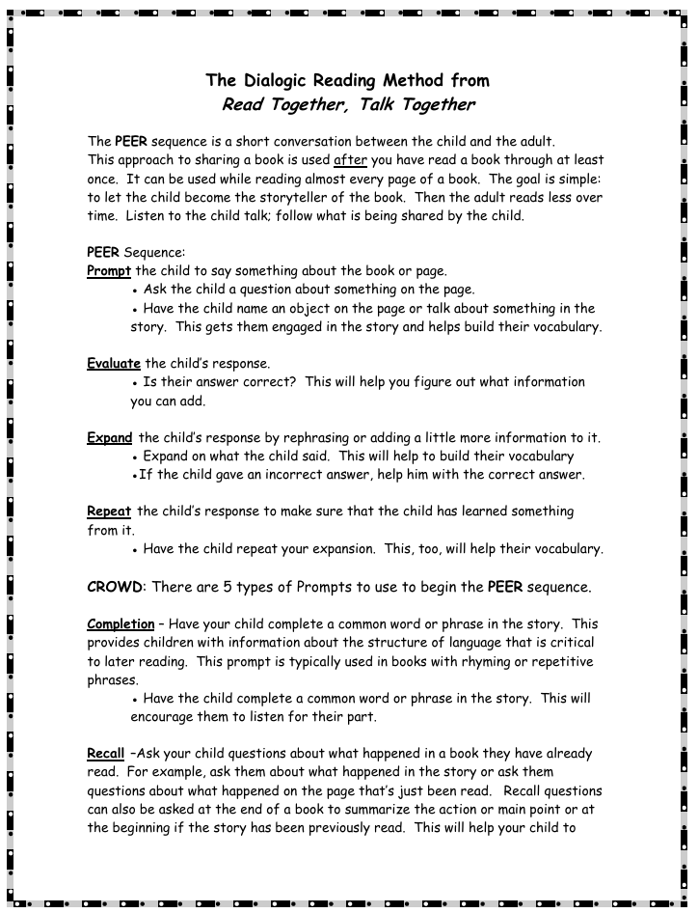
HELPING YOUR CHILD UNDERSTAND WHAT IS READ
Activity Share Out
Which CROWD prompts do you and your partner use?
What did you ask?
Notes:
Activity Share Out:
Let’s come back together and talk about the CROWD prompts you and your partner used during your practice.
Which CROWD prompts did you use?
Who’d like to start us off. Share which of the five prompts—Completion, Recall, Open‑Ended, Wh‑ questions, or Distancing—showed up most naturally as you worked through your book. As you listen, notice which prompts felt easiest to use and which ones you might want to practice more.
What did you ask?
Now let’s hear a few examples of the actual questions or prompts you tried. Think about the sticky notes you placed and share one or two:
What was the Completion phrase you invited the child to finish
What Recall question you asked about something that already happened
What Open‑Ended prompt helped the child describe the picture
What Wh‑ question helped name or explain something
What Distancing question connected the story to real life
As you share, pay attention to how each type of prompt opens up a different kind of conversation with children.
(Close out the share out)
“Thank you for sharing your examples. Hearing the range of prompts helps us see how CROWD gives families and educators simple, powerful ways to spark talk, build vocabulary, and deepen engagement during reading
Handout link: Microsoft Word - Dialogic Reading Handout.doc
https://bookem-kids.org/wp-content/uploads/2025/10/Dialogic-Reading-Handout.pdf

Slide 27


HELPING YOUR CHILD UNDERSTAND WHAT IS READ
Stories
have a made-up chain of events.
Informational Materials
tell facts about the world.
Notes:
You can ask questions about stories or fiction books, which have a made-up chain of events, or informational or nonfiction reading material, which tell facts about the world. Children often read stories and informational reading material for different reasons and use different strategies to make sense of what they’re reading.
Note: Click the Stories and Informational Material tiles so participants can see questions for each. (see the next two slides for pop out information)

Slide 28
HELPING YOUR CHILD UNDERSTAND WHAT IS READ
Stories
Why did the character do what he did?
What else could he have done?
If you were in the story, what would you have done?
Notes:
Here are examples of questions you can ask your child about narrative stories to help them build their comprehension.
Why did the character do what he did? What else could she have done? If you were in the story, what would you have done?

Slide 29
HELPING YOUR CHILD UNDERSTAND WHAT IS READ
Informational Materials
Why do birds fly south for the winter?
What would happen if you planted a tree in the desert?
Why is it important to recycle?
Notes:
Likewise, here are example questions to support your child's comprehension when reading informational materials.
Why do birds fly South for the winter? What would happen if you planted a tree in the desert? Why is it important to recycle?

Slide 30
HELPING YOUR CHILD UNDERSTAND WHAT IS READ
Why should I read informational books with my child?
Watch on YouTube:
Watch Video
Watch the video to learn more.
Video provided by:
Notes:
Try to read both stories and informational material with your child, like magazines, newspapers, and instructional manuals. Informational reading material, especially on topics matched to your child’s interests, can motivate and help her persist when reading is difficult. It also builds your child’s background knowledge on topics she wants to know more about. Why else should you read informational books with your child? Click watch video to learn more.
Video link: https://youtu.be/oi1FE67SH5o?si=wXMtMpkF1108l3hb
Video: Play Bringing Nonfiction to Life (3:43)
Shakara Helaire volunteers for The Reading Connection in Washington, D.C. Her assignment: get these three girls excited about reading, and vegetables. Reading with enthusiasm is a great start. Non-fiction books with interesting facts and bright, vivid pictures help kids get excited about science and other subjects they'll learn about in school. Turns out Shakara’s got a good crowd. She encourages their participation, which is great for their comprehension skills. Stephanie Berman is the program manager at The Reading Connection. They’re asking the child questions about what they're encountering, the unfamiliar words, and helping the child to relate the book to their everyday experience. Always remember to read with expression, not only because it makes reading exciting, but also because it provides a model of fluent reading. The vocabulary that's in picture books is often different than the vocabulary that's used in conversation, so it really helps to build vocabulary.
Guiding Question to Check for Understanding: How did Shakara engage the girls in the reading experience? How could you tell the girls were engaged?
​
​
​

Slide 31


HELPING YOUR CHILD UNDERSTAND WHAT IS READ
You can ask questions that help your child to:
Make Connections
Take a Guess
Use book titles, pictures, or information you read as clues.
Notes:
You can ask questions that help your child to make connections or take a guess. Using book titles, pictures, or information as you read are good clues to help build understanding for children as they read.
Click Make Connections and Take a Guess so participants can find out more. (see next slide for the pop out information)
Note: This slide explains why the topic is important/the session big ideas.

Slide 32
HELPING YOUR CHILD UNDERSTAND WHAT IS READ
You can ask questions that help your child to:
Make Connections
To their life
To what your child knows
To the ideas in the books
Take a Guess
About what the story might be about
About what might happen next
About why a character did something
Use titles, pictures, and information you read as clues.
Notes:
Questions can direct your child to make connections to her life, what your child knows, or the ideas in the book. Questions can direct your child to take a guess about what the story might be about, what might happen next, or why a character did something. Help your child use the book title, pictures, or information read as clues.

Slide 33
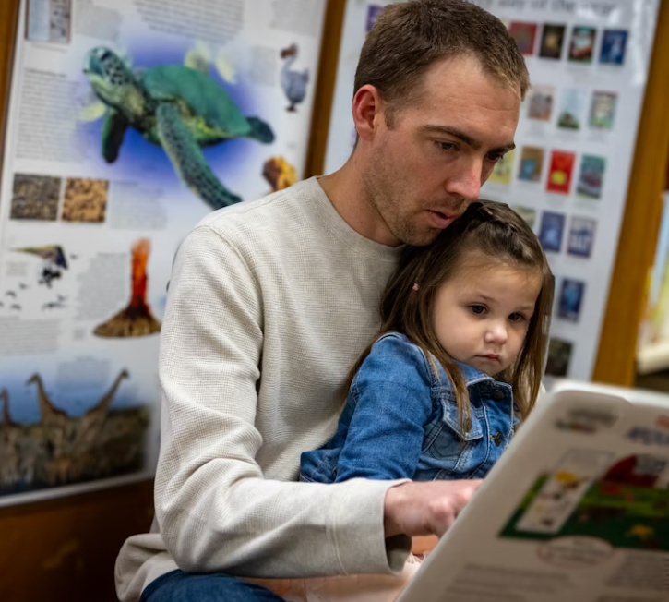
HELPING YOUR CHILD UNDERSTAND WHAT IS READ
Engage your child by asking questions before, during, and after reading.
Before Reading
During Reading
After Reading
Notes:
Before we explore each strategy in detail, I want to highlight one simple habit that makes a big difference in your child’s literacy development: asking questions before, during, and after reading.
Asking questions turns reading into a conversation. It helps children think about the story, use new words, make predictions, and connect what they read to their own lives. And the great news is—you don’t need special training to do this. Just a few well‑timed questions can open the door to rich learning.
On this slide, you’ll see three moments when questions can make reading more powerful:
Before reading
During reading
After reading
Each one supports a different part of your child’s thinking. Let's take a look at each idea to learn more about the kinds of questions you can ask and how they help children grow as readers and thinkers

Slide 34
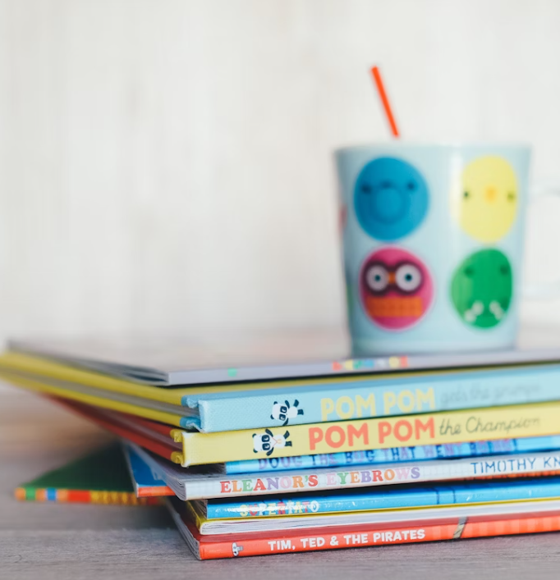
HELPING YOUR CHILD UNDERSTAND WHAT IS READ
Before Reading
Look at the cover and talk about what the story might be about.​
For example:
"Let's read the title and look at the picture. What do you think this story might be about?"
Notes:
Before reading, look at the cover and talk about what the story might be about. For example, let’s read the title and look at the picture. What do you think this story might be about?

Slide 35

HELPING YOUR CHILD UNDERSTAND WHAT IS READ
During Reading
Ask your child about letters, sounds, or ideas. Make connections between the books and what your child knows. Look for words your child doesn't know and talk about what the words mean.
For example:
"That's the word exhausted. It means to feel so tired you can hardly move. What's the word?"
Notes:
During reading, ask your child about letters, sounds, words, or ideas. Make connections between the book and what your child knows. Look for words your child doesn't know and talk about what the words mean. For example, that’s the word exhausted. It means to feel so tired you can hardly move. What’s the word?

Slide 36
HELPING YOUR CHILD UNDERSTAND WHAT IS READ
After Reading
Ask your child what happened in the story. Have them make connections.​​
For example:
"What's the story about?"
"Why is it important to know about . . . ?"
"What was the problem?"
"How was the problem solved?"
Notes:
After reading, ask your child what happened in the story. Have her make connections. For example, what was the story about? Why is it important to know about...? What was the problem? How was the problem solved? Let’s look at questions you can ask your child when reading fiction and information books or nonfiction.
Handout: Distribute, review, and discuss Route to Reading: Help Your Child See the Journey’s End with participants. Tell participants they can use bookmark when reading together with their child to support his or her understanding.
Handout link: https://vapta.org/~documents/programs/readingnight/route-reading-child-see-journey-end/?layout=file​
Note: This completes Section 1: Reading with Your Child and Helping Your Child Understand What is Read.

Slide 37
Helping Your Child with
Speech Sounds

Slide 38
Helping Your Child with Speech Sounds
Learning how speech can be broken into parts lays the foundation for breaking down smaller sound parts in speech.
​
Notes:
Learning how speech can be broken into parts lays the foundation for breaking smaller sound parts in speech. Be sure to check with your child’s teacher to see what skills your child is learning so you can practice at home.
Note: This slide explains why the topic is important/the session big ideas.

Slide 39
Helping Your Child with Speech Sounds
Show your child how they can break down sentences into words:
Say a sentence aloud and ask your child to count or tap the number of words in the sentence.
For example, say slowly "the boy ate two pieces of pizza."
Your child then says each word while counting or tapping them.
Notes:
Show your child how she can break down sentences into words. Say a sentence aloud and ask your child to count or tap the number of words in the sentence. For example, say slowly, the boy ate two pieces of pizza. Your child then says each word while counting or tapping them. Let’s see how you can do it yourself.

Slide 40
Helping Your Child with Speech Sounds
Next, talk about:
How some words can be broken down into smaller words
How to put two words together to make another word
Adult: Sometimes you can put two words together to form another word. For example, if I put straw and berry together, I get strawberry. What do you get if you put book and shelf together?
Child: Bookshelf.
Adult: That's right! You can also break some words into smaller words. What do you get if you take the cow out of cowboy?
Child: Boy?
Adult: That's right!
Notes:
Some words can be broken down into smaller words and how to put two words together to make another word. You say, sometimes you can put two words together to form another word. For example, if I put straw and berry together, I get strawberry. What do you get if you put book and shelf together? Your child says, bookshelf. You say, that’s right! You can also break some words into smaller words. What do you get if you take the cow out of cowboy? Your child says, boy? You say, that’s right!
Handout: Distribute, review, and discuss Route to Reading: Help Your Child Fuel Up with participants. Tell participants they can use this bookmark when reading together with their child to help him or her with speech sounds.
Handout link: https://vapta.org/~documents/route%3A/download/2759/

Slide 41

Helping Your Child with Speech Sounds
Once your child is successful, help them break words into syllables:
A syllable is a part of a word that has one vowel sound
Place your hand under your chin and notice together the number of times your chin moves down as you say a word slowly.
Now have your child try.
Hold up or tap a finger for each syllable as you say a specific word.
Now have your child try.
Notes:
Once successful, help your child break words into syllables. A syllable is a part of a word that has one vowel sound. Place your hand under your chin and notice together the number of times your chin moves down as you say a word slowly. Now have your child try. Hold up or tap a finger for each syllable as you say a word. Now have your child try. Let’s look at some syllable games and information.
Guiding Questions to Check for Understanding: How do speech sounds relate to reading and writing? How has what you’ve learned influenced your thinking about helping your child with speech sounds and letters?

Slide 42
Helping Your Child Blend Sounds to Figure Out Words

Slide 43
Helping Your Child Blend Sounds to Figure Out Words
Correctly linking sounds to letters to sound out words helps your child:
Read new words
Recognize familiar words
Understand what is being read
Notes:
Correctly linking sounds to letters to sound out words helps your child read new words, recognize familiar words, and understand what is being read. Be sure to check with your child’s teacher to see what skills your child is learning so you can practice at home.
Note: This slide explains why the topic is important/the session big ideas.

Slide 44
Helping Your Child Blend Sounds to Figure Out Words
Want to check your letter sound pronunciations?
Watch these videos to hear the correct way to say each consonant and vowel sound.
Vowels
Consonants
Watch Video
Watch Video
Notes:
Want to check your letter sound pronunciations?
Click each video to hear the correct way to say each consonant and vowel sound.
Video Link: https://youtu.be/YGMmZx1fQZQ?si=JNAa2KjCDAg3y8Qm
Video: Play Vowels (1:07) Now let's think about the vowel sounds. Each vowel has a long sound and a short sound. For example, the letter ‘A’ has the short sound /ă/as in apple, and the long sound /ā/ as in ape. The letter ‘E’ has a short sound /ĕ/ as in egg, and a long sound /ē/ as in eagle. The letter ‘I’ has the short sound /ĭ/ as in itch, and the long sound /ī/ as in ice. The letter ‘O’ has the short sound /ŏ/ as in otter, and the long sound /ō/ as in ocean. And the letter ‘U’ has the short sound /ŭ/ as in up, and the long sound /ū/ as in unicorn.
Review the check for understanding at the end of the video and ask participants to discuss the answer with their tablemates. Poll participants on the answer and click Submit to see if correct. Question: Together, how many sounds do the vowel letters make? -6 -10 (correct answer) -26
Video Link: https://youtu.be/Le9KrUfwmFk?si=wAvyRcA2JlklYhx_
Video: Play Consonants (3:13) So let's think about the sounds that the consonant letters make. As teachers, when we're working with students we want to be careful when we're saying the consonant sounds to just say the consonant sound and not add a vowel sound at the end of the consonant.
You'll see what I mean as I go through the examples. The letter B says, /b/as in bug. The letter C has two sounds, a hard sound as in cup and soft sound as in celery. The Letter D says /d/ as in dog. The Letter F says /f/ as in fan. The letter G also has two sounds, a hard sound /g/ as in gasps and /j/ as in giant. The letter H says /h/ as in hot. The letter J says /j/ as in jump. The letter K says /k/ as in kite. The letter L says /l/ as in light. The letter M says /m/ as in moon. The Letter N says /n/ as in net. The letter P says /p/ as in pot. Q usually appears as the letter pattern ‘qu’ and has a quote sound as in the word queen. The Letter R says /r/ as in rug. The letter S says /s/ as in sock. The letter T says /t/ as in tub. The letter V says /v/ as in van. The letter w says /w/ as in web. X has several sounds depending on where it appears in the word. At the beginning of the word, x has a sound like in the word xylophone. When it appears at the end of the word, it takes on a /Ks/ sound as in the word box. And when it appears in the middle of a word, it takes on a sound like in the word exit. The letter Y says /y/ as in yell. And the letter Z says /z/ as in Zipper.
Review the check for understanding at the end of the video and ask participants to discuss the answer with their tablemates. Poll participants on the answer and click Submit to see if correct. Question: What three consonant letters can make more than one sound? -W -G (correct answer) -K -J -X (correct answer) -C (correct answer)
Provide time for participants to pair up and practice making the consonant sounds. Note: Encourage participants to “clip” the consonant sounds when saying them. In other words, try not to add a vowel sound at the end (i.e., no schwa)

Slide 45
Helping Your Child Blend Sounds to Figure Out Words
Stretch and connect sounds together as much as possible.
Sounding out words smoothly helps children remember and combine sounds to arrive at the correct word. Here is an example with the word man:
Adult: How does this word start?
Child: /mmmm/
Adult: Then what's the next sound?
Child: /aaaaa/
Adult: And then what sound comes next?
Child: /nnnnn/
Adult: And then what happens when you put them together?
Child: /mmmmaaaannnn/
Adult: What is the word?
Child: Man!
Notes:
Stretch and connect sounds together as much as possible to help your child sound out words. Sounding out words smoothly helps children remember and combine sounds to arrive at the correct word. Here is an example with the word man. You say, how does this word start? Your child says, /mmm/. You say, then what’s the next sound? Your child says, /aaa/. You say, and then what sound comes next? Your child says, /nnn/. You say, what happens when you put them together? Your child says, /mmmaaannn/. You say, what is the word? Your child says, man!
Handout: Distribute, review, and discuss Route to Reading: Keep Your Child’s Engine Running with participants. Tell participants they can use this bookmark when reading together with their child to help him or her sound out words.
Handout link: https://vapta.org/~documents/route%3A/download/2760/

Slide 46
Helping Your Child Blend Sounds to Figure Out Words
After your child connects the sounds together:
Known Word
Ask:
"Does the word make sense?"
"Is it a real word?"
Have your child check that the letters and sounds match
Unknown Word
Have your child read the word again
Make sure they joined all the sounds together correctly
Discuss the word's meaning
Notes:
After your child connects the sounds together for a known word, ask: does the word make sense? Is it a real word? Do you know that word? Have your child check that the letters and sounds match. For an unknown word, have your child read the word again. Make sure he joined all the sounds together correctly. Then, discuss the word’s meaning.

Slide 47
Reading Together to Develop Fluency

Slide 48
Reading Together to Develop Fluency
Fluency is the ability to read words, phrases, sentences, and stories correctly, with enough speed and expression. Reading aloud frequently helps your child develop reading fluency.
Notes:
Fluency is the ability to read words, phrases, sentences, and stories correctly, with enough speed and expression. Reading aloud frequently helps your child develop reading fluency. You can use everyday items around your house or in your community as reading material. Let’s look at some examples.
Note: This slide explains why the topic is important/the session big ideas.

Slide 49
Reading Together to Develop Fluency
When reading aloud together:
Set a steady pace. Slow down for difficult words and speed up when comfortable.
Make sure the book is right for your child's reading ability.
Show how you read like you talk.
Notes:
When reading aloud together, set a steady pace. Slow down for difficult words and speed up once your child is comfortable. Make sure the book is right for your child’s reading ability. Show your child how you read like you talk so she can hear fluent reading.
Note: Provide time to model for participants what fluent reading sounds like by read aloud a picture book.
Guiding Question to Check for Understanding: In what ways did the reading sound like talking?

Slide 50
Reading Together to Develop Fluency
Approaches to Try When Reading Aloud Together:
Take turns reading continuous passages of a book.
Read the same passage of a book aloud at the same time.
Read a passage of a book aloud and then have the child read the same passage aloud.
Notes:
Here are some approaches to try when reading aloud together. Take turns reading continuous passages of a book. For example, you read passage A, your child reads passage B, and you read passage C. Read the same passage of a book aloud at the same time. For example, you and your child read passage A. Or, read a passage of a book aloud and then have your child read the same passage aloud. For example, you read passage A, then your child reads passage A.
Note: Pause and ask participants if they have questions or need clarification on any of the approaches. Then, ask participants to select an approach and practice in pairs with a book.

Slide 51


Reading Together to Develop Fluency
Building reading habits can set the stage for fluency development.
Watch the video to learn more.
Watch Video
Notes:
Building reading habits can set the stage for fluency development. Let’s learn more.
Video Link: https://youtu.be/e2WFJb1WWJs?si=Owq4UkPA1bk7qIhD
Video: Play Raising Readers: Building Reading Habits (3:19)
Welcome to this edition of our Raising Readers series, Building Reading Habits. Research shows that parents can do a great deal to help their children's reading and writing development. In this segment, I will be sharing two easy and effective ways that parents can help their children build better reading habits. Many parents worry that their children do not like to read and do not choose to read during their free time. Children who do not practice reading tend to fall behind in reading, so it is important to build your child's reading habit. When you set aside a daily family reading time, you can help your children get into the habit of reading for fun. Here are some suggestions to set up a family reading time. First, you'll want to pick a 15 to 30 minute time that works well for your family schedule. For example, right after dinner or before your child's bedtime might work for your family. Pledge to have family reading time at least 4 to 5 times per week. Post a schedule for family reading time on the refrigerator or your family calendar so everyone knows when it will take place. Everyone reads during this time, including you. Family members can read independently, with a partner, or as a group. Family members should choose fun, interesting things to read. Finally, you'll want to take a few minutes to discuss what you've been reading. If your child has access to interesting, engaging books, magazines, and other reading materials, he or she will be more likely to read and to enjoy it. Here are some suggestions for how you can make interesting reading materials accessible to your child. Visit the public library on a regular basis. It is a free family outing and most libraries offer storytimes, book clubs, summer reading programs, and special events, free of charge. Librarians are a great resource for locating books and magazines that match your child's interests and reading level. Bookstores are also a great resource. Many bookstores offer storytimes, author presentations, and family activities. Your family may want to take a special outing to a bookstore so your child can select a new book or magazine as a birthday or holiday gift. Another great idea to make reading materials accessible is to get a magazine subscription based on your child's interests or hobbies.
Guiding Questions to Check for Understanding: Which of the ways for building reading habits in the video seem interesting or doable to you and why? Do you have other ideas for building reading habits? How does fluency relate to reading? How has what you’ve learned influenced your thinking about helping your child sound out words?

Slide 52
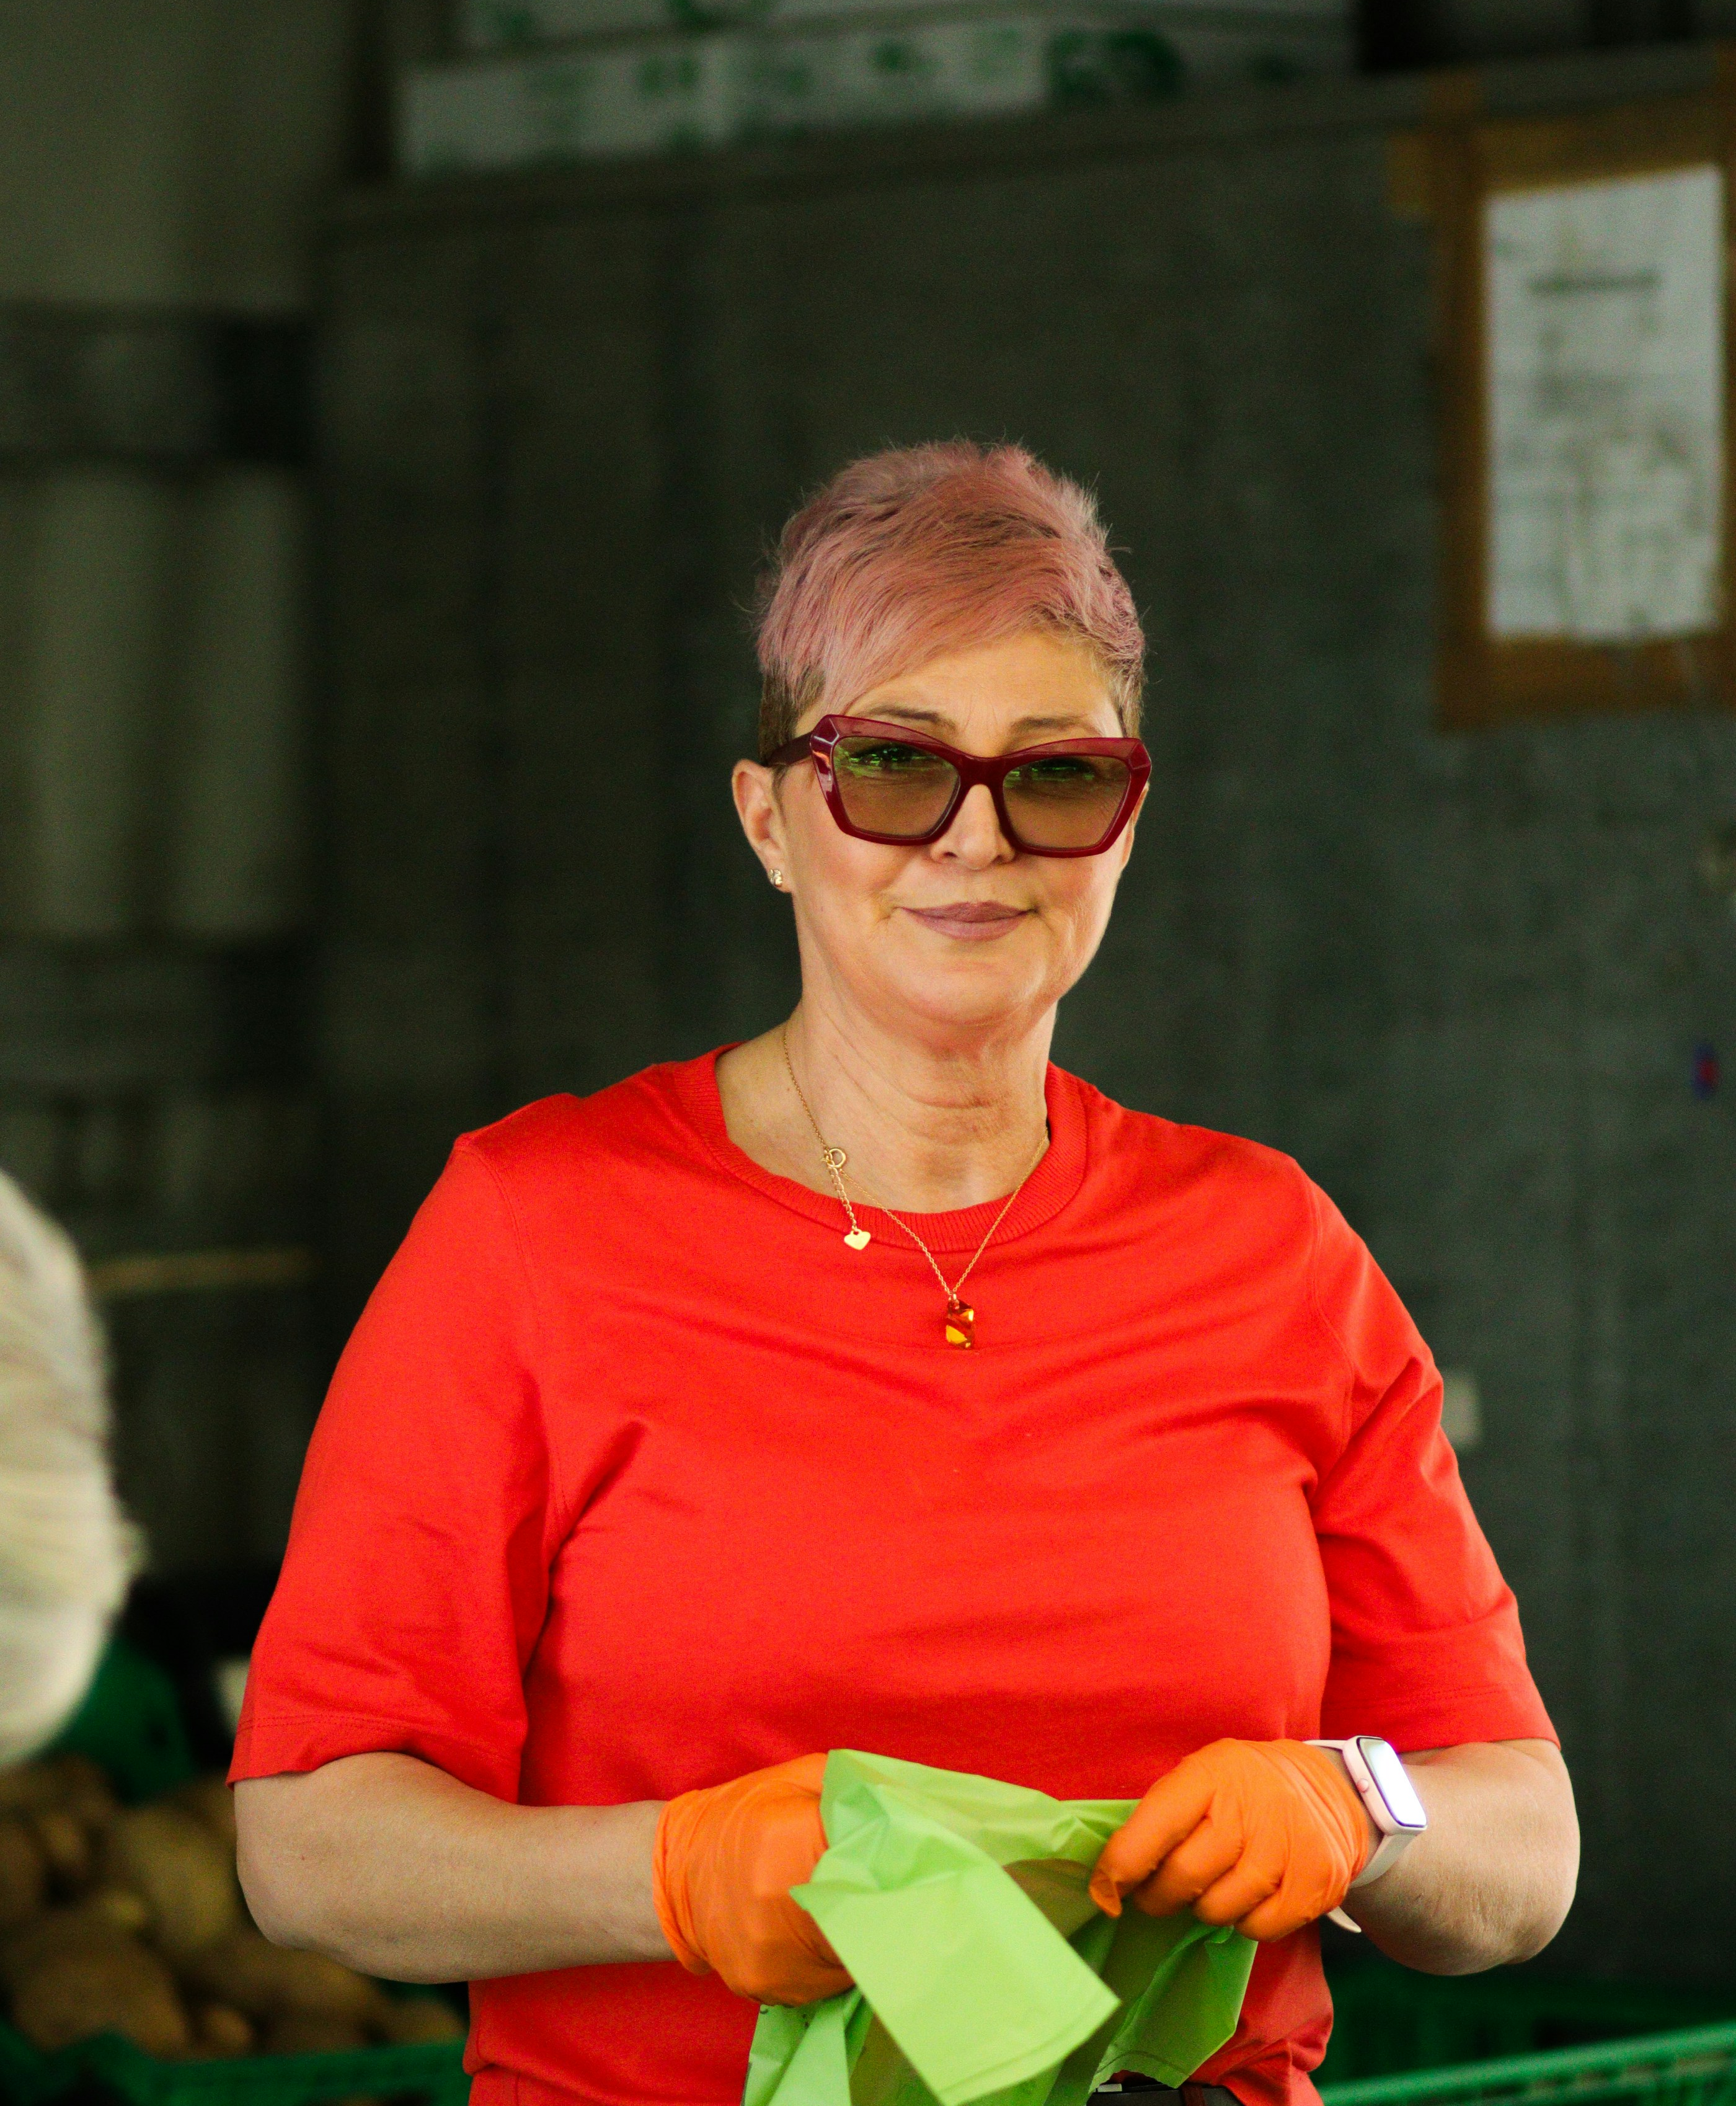

Quiz Question
Jane has a child in fifth grade who is reading to learn in science and social studies. What could Jane do to support her child's word learning and understanding of new ideas?
Play word games and talk about interesting or unfamiliar words.
Read with her child.
Ask questions before, during, and after reading.
All of the above.
Notes:
Think about what you’ve learned about supporting your child’s literacy development at home to help Jane. Jane has a child in fifth grade who is reading to learn in science and social studies. What could Jane do to support her child’s word learning and understanding of new ideas? Choose the answer that best fits. Play word games and talk about interesting or unfamiliar words; read with her child; ask questions before, during, and after reading; or all of the above.
Note: Provide time for participants to review and discuss the scenario. Then, ask participants to discuss the correct answer with their tablemates. Poll participants on the answer and click Submit to see if correct.
Check for Understanding: What could Jane do to support her child’s word learning and understanding of new ideas? Correct answer: All of the above
Resource: Distribute copies, review, and discuss Route to Reading: Be Your Child’s Tour Guide with participants. Tell participants they can use this bookmark when reading together with their child to support his or her literacy development.
Resource link: https://vapta.org/~documents/programs/readingnight/route-reading-child-tour-guide/?layout=file

Slide 53
Quiz Question
Jane has a child in fifth grade who is reading to learn in science and social studies. What could Jane do to support her child's word learning and understanding of new ideas?
Play word games and talk about interesting or unfamiliar words.
Read with her child.
Ask questions before, during, and after reading.
All of the above.
Notes:
Think about what you’ve learned about supporting your child’s literacy development at home to help Jane. Jane has a child in fifth grade who is reading to learn in science and social studies. What could Jane do to support her child’s word learning and understanding of new ideas? Choose the answer that best fits. Play word games and talk about interesting or unfamiliar words; read with her child; ask questions before, during, and after reading; or all of the above.
Note: Provide time for participants to review and discuss the scenario. Then, ask participants to discuss the correct answer with their tablemates. Poll participants on the answer and click Submit to see if correct.
Check for Understanding: What could Jane do to support her child’s word learning and understanding of new ideas? Correct answer: All of the above
Resource: Distribute copies, review, and discuss Route to Reading: Be Your Child’s Tour Guide with participants. Tell participants they can use this bookmark when reading together with their child to support his or her literacy development.
Resource link: https://vapta.org/~documents/programs/readingnight/route-reading-child-tour-guide/?layout=file

Slide 54
The Family-School Partnership

Slide 55
How Families Can Partner With Schools on Literacy Development
Communicate and Interact Often
Discuss Literacy Instruction and Intervention
Practice Literacy Skills at Home
Address Concerns Together
Families should ask the school how best to communicate and should feel comfortable to ask questions if more information is needed.
Families should know what literacy standards their child is working on, review whether those expectations are appropriate, and ask whether the instruction and interventions are evidence‑based and focused on the skills their child needs most.
Families should talk with the school about home literacy activities that match the child’s skill level.
Families should discuss with the school which activities or tasks the child has trouble with at home, and how they helped. Learn about the school’s system of learning support.
Notes:
Resource Link: How Families Can Partner With Schools on Literacy Development – National Center on Improving Literacy
Handout link: https://improvingliteracy.org/resource/how-families-can-partner-with-schools-on-literacy-development/
Families should collaborate with the school to make decisions about a child’s literacy education, promote faster development and catch trouble spots early. Here are four things families do to support their child's literacy development.
Communicate and Interact Often - Here are some ways families can share experiences and thoughts with the school: Help in the classroom, Go to meetings (school/teacher orientation, parent-teacher conferences), Join school groups (Parent-Teacher Association or Organization, Family Advisory Council), Ask questions such as: “What are the school’s literacy goals for children and families?” “How does the school partner with families when developing its language and literacy goals for students?” “How can I support my child’s language and literacy goals?”
Discuss Literacy Instruction and Intervention – Ask questions such as: “What does my child need to know and be able to do?” “How is reading taught and by whom?” “When does literacy instruction and intervention happen and for how long?” “How many other children join?” “What school materials or trainings about literacy are available to families?”
There may be a variety of tools to help a child read and write. A few examples are audio books, screen readers, special keyboards, and speech recognition software. Ad discussion with your child's school might assist in identifying what tools are available.
Practice Literacy Skills at Home – Begin by asking how you can support your child at home with questions like: “What activities will help her practice the skills learned at school?” “What strategies should I use to help my child read or write?” “What tools are available to help my child practice these skills?” At home, families can try out different activities and tools and share with the school what worked well and what did not. Let the school know if more information or support is needed, and discuss other ways to practice the skills learned at school, such as at the library or through literacy services in the community.
Address Concerns Together - Take time to understand the school’s position and openly communicate your view. Work together to find a solution to address your child’s learning needs that you both can support. If you and the school disagree, get advice from others on next steps. Ask questions: “How is my child’s language and literacy learning being supported in this system?” “How are you monitoring my child’s language and literacy progress?” “What might happen next if my child continues to struggle?”
How Families Can Partner With Schools on Literacy Development – National Center on Improving Literacy

Slide 56
Questions ?
Notes:
Slide to use for soliciting questions from participants and discussing answers on session content and related information at the end of the workshop. Review the big ideas from all three sessions and clarify as needed.

Slide 57
Thank You!
[insert personal contact information]
Contact NCIL: https://improvingliteracy.org/contact-us/
Email: info@improvingliteracy.org
Notes:
Slide for inserting contact information so participants can communicate with you after the workshop.

