Slide 1
Supporting Your Child’s Literacy Development
Early Literacy
[insert - Presenter Name]
[insert - Presenter Title]
If you have questions after the presentation, please contact: [insert contact name and email]
or
Contact | National Center on Improving Literacy at nciliteracy@gmail.com
Notes:
How to present this slide deck:
This slide deck is intended to be use and modified to meet the needs of your organization. The following information should be used to assist you, the presenter, as you modify the slides to meet the needs of your audience. At the bottom of the notes on this slide is the script to introduce this presentation.
Text coding:
Bold text = Presenter Script (what the presenter should say)
Italic text = Ideas for activity or interaction
Underlined text = specific contexts (e.g., zoom vs in-person)
Yellow highlighted text is for you to customize based on your state/grade for the presentation
Regular text = Presenter notes (reminders or instructions)
Regular text with bullet = specific instruction
Information in Notes:
* Asterisks indicate hints or ideas for customization
If there is a video, the link will be provided in the slide notes. The transcript for the video is provided so that you can decide if you want to show the video, or if you want to cover the topic through a discussion.
CLICK, directions for animated slides
Slides Information:
Hidden slides are optional and may be used at the presenter's discretion based on the needs of the audience.
The pink backpack on a slide indicates there are resources to either be distributed during the workshop, or to provide for participants to review later. You can click on the icon directly from the slide to access the online version. The URL is included in the speaker notes. If the training is in person, you may choose to print some out and distribute as handouts.
---
Greet participants and begin workshop with introductions as needed. Follow the facilitation procedure notes appropriate for the workshop session.
Welcome to the National Center on Improving Literacy’s workshop on learning about your child’s reading development. Children who struggle learning early literacy skills are at risk for reading and academic difficulties later. As a parent or caregiver, being informed about the parts of literacy, how your child learns to read, and why he or she might struggle can help you make better decisions about your child’s education. This workshop is part two of a four-part series on key roles that families can play for children’s literacy success.

Slide 2



The National Center on Improving Literacy (NCIL) is a partnership among literacy experts, university researchers, and technical assistance providers, with funding from the United States Department of Education.
Our mission is to increase access to, and use of, evidence-based approaches to screen, identify, and teach students with literacy-related disabilities, including dyslexia.
Notes:
Today’s workshop was created by the National Center on Improving Literacy. The National Center on Improving Literacy’s mission is to increase access to, and use of, evidence-based approaches to screen, identify, and teach pre-K to grade 12 students with literacy-related disabilities, including dyslexia.

Slide 3
Learn About Supporting Your Child’s Early Literacy Development
Families who support literacy development at home can strengthen their child’s reading skills, comprehension, language growth, and overall confidence as a reader. These everyday efforts can also boost a child’s interest in reading, improve their attitude toward reading, and help them stay focused. This workshop is part of a larger series highlighting the key roles families play in supporting children’s literacy success.
The research reported here is funded by a grant to NCIL from the Office of Elementary and Secondary Education, in partnership with the Office of Special Education Programs (Award 3: S283D160003). The opinions expressed are those of the authors and do not represent views or policies of OESE, OSEP, or the U.S. Department of Education. You should not assume endorsement by the Federal government.
Notes:
Children who struggle learning early literacy skills are at risk for reading and academic difficulties later. Being informed about the parts of literacy, how children learn to read, and why they might struggle can help you make better decisions about your child's education.
Supporting Your Child’s Emergent Literacy at Home

Slide 4
Workshop Overview

Slide 5

Agenda
Workshop Overview
Science of Reading and the Simple View of Reading Overview
Literacy Development
Supporting Your Child Through Each Literacy Stage
Closing
Notes:
Building Your Child’s Understanding Through Book Conversations

Slide 6

Learning Objectives
By the end of this session, participants will:
Acquire a general understanding of the Science of Reading and the critical skills needed for children to be successful readers.
Use simple, meaningful conversations to help children build strong language and early reading skills.
Try fun activities that help children hear and play with speech sounds and begin connecting those sounds to letters.
Encourage children’s excitement about books and reading through engaging read‑alouds, shared reading routines, and exploring different kinds of books.
Support children’s understanding of stories and information by building background knowledge and talking together about what they hear and read.
Notes:
Read the learning objectives to participants.

Slide 7
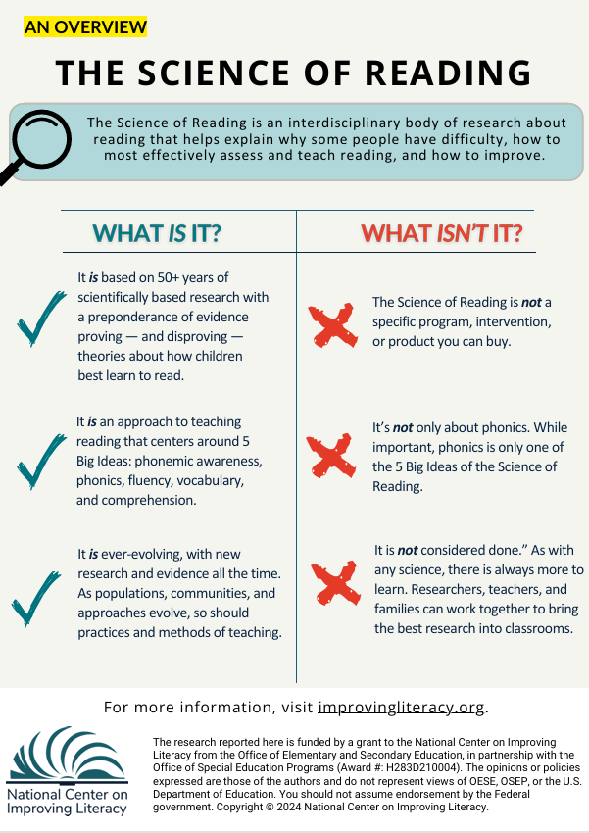
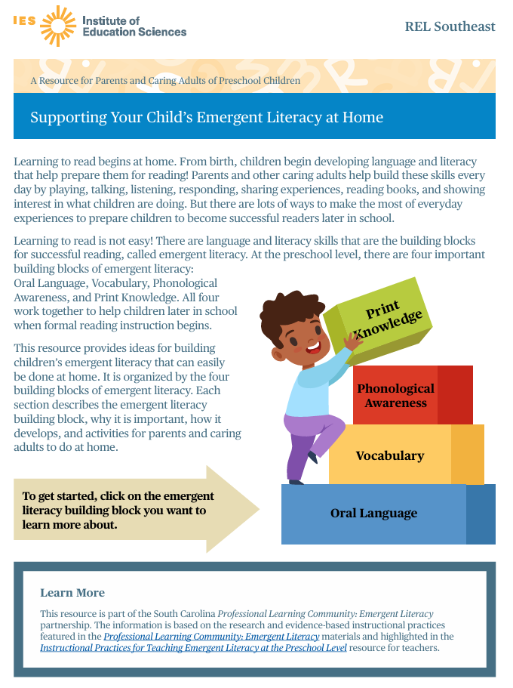
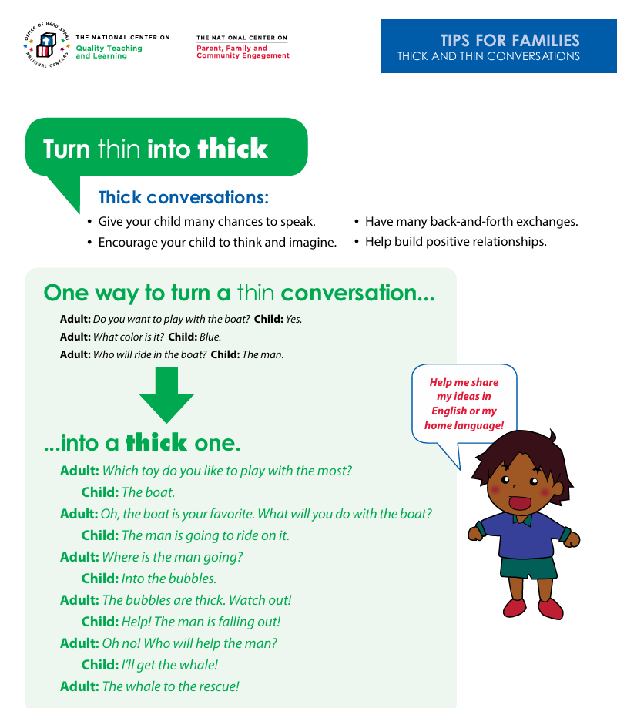
Workshop Materials
The materials for this workshop include:
The Science of Reading
Supporting Your Child’s Emergent Literacy at Home
Tips for Families: Thick and Thin Conversations
Notes:
Note:
Materials: Distribute copies to review and discuss throughout workshop
The Science of Reading Link: The Science of Reading: An Overview – National Center on Improving Literacy
Supporting Your Child’s Emergent Literacy at Home Link: https://ies.ed.gov/sites/default/files/migrated/rel/regions/southeast/pdf/SupportingYourChildsEmergentLiteracyatHome.pdf
Tips for Families: Thick and Thin Conversations Link: TIPS FOR FAMILIES: THICK AND THIN CONVERSATIONS https://headstart.gov/sites/default/files/pdf/no-search/iss/language-modeling-and-conversations/thick-thin-family-tips.pdf

Slide 8
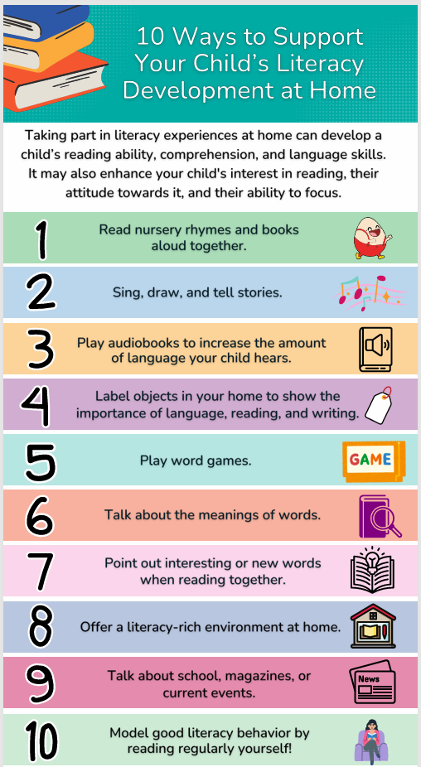

Themes for Today
Supporting Reading at Home
Practice at home the same skills your child is learning at school
Children who find reading challenging make the most progress with frequent practice
Schools can help by sharing simple guidance on what to work on at home
Everyday activities that build literacy:
Talk with your child throughout the day and ask questions
Listen closely to their ideas and responses
Read together and enjoy books as a shared routine
Say the alphabet, play with sounds, and connect letters to their sounds
Explore your community and talk about what you see to build background knowledge
Notes:
Before diving into today’s activities, let's introduce the big themes of our workshop. Everything we’ll talk about today centers on one idea: families play a powerful role in helping children become confident, successful readers.
One of the most important ways to support your child is by practicing at home the same skills they’re learning at school. When children see the same ideas in both places, it strengthens their understanding and builds their confidence.
We also know that children who find reading challenging make the most progress with frequent, gentle practice. Short, everyday moments—five minutes here, ten minutes there—can make a huge difference over time.
Schools can help by sharing simple, clear guidance on what to work on at home, and today’s workshop is designed to do exactly that. We’ll explore easy, practical ways to support reading that fit naturally into your daily routines.
We’ll also look at everyday activities that build literacy, like:
Talking with your child throughout the day and asking questions
Listening closely to their ideas and responses
Reading together and enjoying books as a shared routine
Playing with letters, sounds, and the alphabet
Exploring your community and talking about what you see
These small moments—conversations in the car, noticing signs in the grocery store, reading a favorite book before bed—add up. They build vocabulary, background knowledge, and the early reading skills children need to thrive.
By the end of today’s workshop, you’ll leave with simple strategies you can use right away to support your child’s reading at home.
Resource link: 10 Ways to Support Your Child’s Literacy at Home – National on Improving Literacy
https://improvingliteracy.org/resource/supporting-your-child-s-literacy-at-home/

Slide 9
Science of Reading and the Simple View of Reading

Slide 10
The Science of Reading:
What It Is and What It Isn’t
What It Is
Grounded in 50+ years of research on how children learn to read
Built on the 5 Big Ideas: phonemic awareness, phonics, fluency, vocabulary, comprehension
Continually evolving as communities, populations, and instructional methods change
What It Isn’t
Not a specific program, intervention, or product you can purchase
Not only about phonics—phonics is just one of the 5 Big Ideas
Not “finished”; like any science, it continues to grow as researchers, educators, and families contribute
Notes:
Resource Link: The Science of Reading: An Overview – National Center on Improving Literacy
There are so many pieces to the Science of Reading that it can be difficult to know where to start. Here are a few highlights about what the Science of Reading is — and what it’s not. This knowledge will help you on your journey to teaching all children, including those with diverse needs and cultural backgrounds, to read.
The Science of Reading: What It Is and What It Isn’t
What It Is
Based on 50+ years of scientifically grounded research that confirms and disproves theories about how children learn to read
An instructional approach centered on the 5 Big Ideas: phonemic awareness, phonics, fluency, vocabulary, and comprehension
An evolving body of research that grows as communities, populations, and instructional methods change
What It Isn’t
Not a specific program, intervention, or product you can purchase
Not only about phonics—phonics is just one of the 5 Big Ideas
Not “finished”; like any science, it continues to grow as researchers, educators, and families contribute

Slide 11
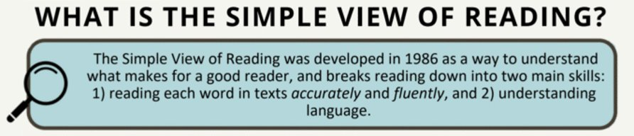
Learning to Read: The Simple View of Reading
Decoding/Word Recognition
Language
Comprehension
Reading
Comprehension
Notes:
Read what is on the slide

Slide 12
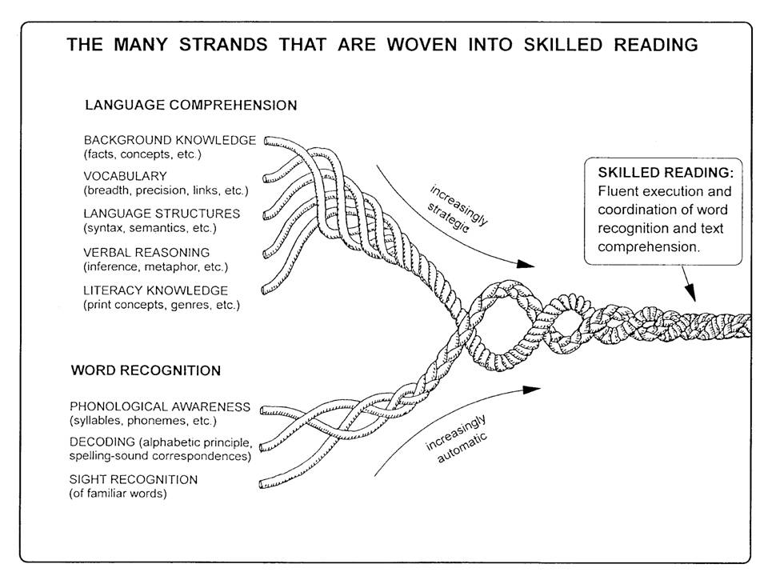
Reading involves two critical skills:
Language Comprehension:
Comprehending the meaning of the text
Students need strategies to read unfamiliar words
They must also recognize previously encountered words
Fluency supports better comprehension
Decoding or Word Recognition:
Reading each word accurately and fluently
Understanding vocabulary and sentence structure is key
Requires strong language comprehension skills
Image Credit: The image, courtesy of the author, originally appeared in the following publication: Scarborough, H. S. (2001). Connecting early language and literacy to later reading (dis)abilities: Evidence, theory, and practice. In S. Neuman & D. Dickinson (Eds.), Handbook for research in early literacy (pp. 97–110). New York, NY: Guilford Press.
Notes:
Image link: https://institute.aimpa.org/resources/readingrope
Read skills from slide, then add this brief description of Scarborough’s rope:
These critical reading skills are also the strands that create what is know as Scarborough’s Reading Rope. Basically, Scarborough’s Reading Rope is a visual model showing that skilled reading develops when word recognition skills (like phonological awareness, decoding, and recognizing familiar words) are woven together with language comprehension skills (such as vocabulary, background knowledge, and understanding sentence structure). As each strand becomes stronger and more automatic, they intertwine to form a fluent, proficient reader.

Slide 13
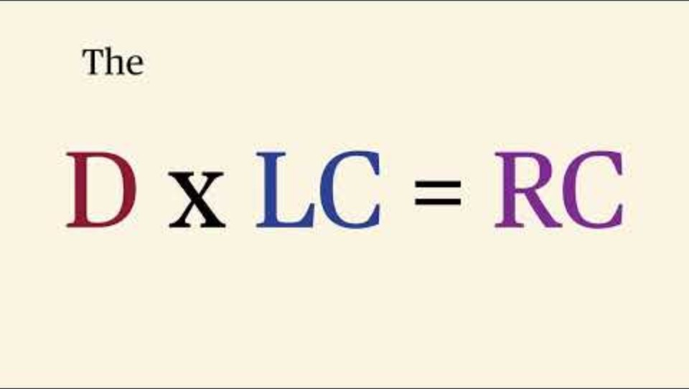
The Simple View of Reading Explained…
Notes:
Video Link: Video 1: The Simple View of Reading
https://youtu.be/OB2rta84XXY?si=X0jQM9ZATVdXlqQN
Transcript: Have you ever wondered what exactly needs to happen in the brain for a person to read and fully understand a text? It's not magic. It's a science, and it can be captured in a simple formula. This concept is called the simple view of reading. First proposed by Goff and Tunmer in 1986. It states that reading comprehension is the product of just two main skills: decoding and language comprehension. Decoding, or D, is the ability to accurately and fluently read the words on the page. This is your foundation. Think of it as word‑level mechanics. Specifically, decoding involves phonological awareness, phonics, and fluency. It's answering the question: can I read these words? Language comprehension, or LC, is the ability to understand spoken language. This is your ability to make sense of the meaning behind the words. This skill is about vocabulary, background knowledge, and sentence structure. It answers the question: do I understand what the words mean when put together? Now, the most critical part. The formula uses multiplication: D × LC = RC, not addition. Why? Because if a student has zero in either category, the final result — reading comprehension — will also be zero. A great decoder who doesn't understand the language can read but won't comprehend. Likewise, a child with great language skills who can't decode words won't be able to access the text. We must teach both. By focusing on both decoding and language comprehension, we set students up for true success in reading. Thanks for watching.
<iframe width="560" height="315" src="https://www.youtube.com/embed/OB2rta84XXY?si=X0jQM9ZATVdXlqQN" title="YouTube video player" frameborder="0" allow="accelerometer; autoplay; clipboard-write; encrypted-media; gyroscope; picture-in-picture; web-share" referrerpolicy="strict-origin-when-cross-origin" allowfullscreen></iframe>

Slide 14
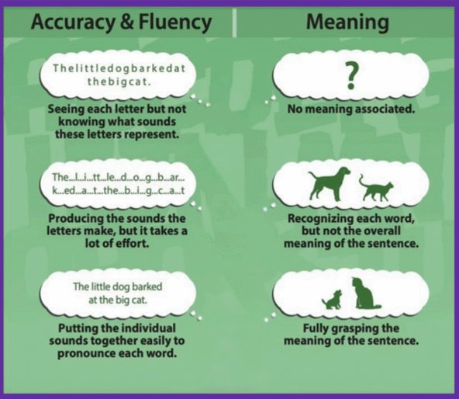
An example of what these skills look like across stages of literacy development
Word Recognition Skills
Language Comprehension Skills
Notes:
So as you begin working with your child to develop their literacy skills it is important to know what these skills look like across stages of literacy development. This graphic shows how children move from early word‑reading skills to full understanding of what they read. It helps us see the difference between accuracy, fluency, and meaning, and how these skills build on each other over time.
On the left side, we see the development of accuracy and fluency—that’s the ability to recognize letters, produce the right sounds, and blend those sounds into real words.
At the earliest stage, a child might look at a string of letters and not yet know what sounds they represent. It’s just a cluster of symbols. As they grow, they begin to say each sound—slowly and with a lot of effort. With practice, they can blend those sounds smoothly and read the words correctly: ‘The little big barked at the big cat.’ That’s accuracy and fluency working together.
On the right side, we see the development of meaning, or comprehension. At first, a child may read the words but not understand what they mean together. Then they may recognize each word—dog, cat—but still not grasp the full idea. Finally, they understand the whole sentence: a dog barking at a cat. That’s when accuracy, fluency, and comprehension come together.
This graphic reminds us that reading isn’t just sounding out words. Children need both strong word‑reading skills and strong language comprehension skills to make meaning from what they read. These two sides grow together and support each other as children become confident, skilled readers.

Slide 15
Literacy Development
Birth – 5 years

Slide 16
Reading Skills at Different Ages
Look at, reach for, or touch the pictures in books
Respond to a story in a book by babbling or making sounds or acting excited
Help turn book pages
Toddlers (ages 1–2 years)
Look at pictures and be able to name familiar items (e.g. dog, cat, baby)
Answer questions about what they hear in stories or see in books
Identify or recognize their favorite books
Narrate or recite words from their favorite books
Pretend to read by pointing at words, turning pages, and making up stories
Preschoolers (ages 3–4 years)
Understand print concepts such as:
Words are read from left to right and pages are read from top to bottom
Start noticing words that rhyme
Retell stories
Recognize about half the letters of the alphabet
Start matching letter sounds to letters (like knowing b makes a /b/ sound)
Recognize their name in print and possible other often-seen words
Babies (ages 0–12 months)
Begin to reach for books
Correctly holding and handling a book
Source: Reading_skills_at_different_ages_English by Understood. org
Notes:
Children’s reading development progresses through predictable stages, beginning with early exposure to language and print, and advancing to fluent, independent reading. Even as babies, your child is building reading skills that set the foundation for learning to read as they get older. Here’s a list of a few reading milestones by age. Please keep in mind that children develop reading skills at their own pace, so your child may or may not be on this exact timetable.
Resource links: Reading_skills_at_different_ages_English by Understood. Org
ROR-Milestones-of-Early-Development-Chart.pdf by Reach Out and Read

Slide 17

The Building Blocks of Early Literacy
Oral Language
Vocabulary
Phonological Awareness
Print Knowledge
Notes:
Regardless of what stage of literacy development your child is in, families and caregivers play an important role in supporting their literacy development. We just talked about the big picture of literacy instruction, but supporting your child at home is crucial for them to become successful readers and developing a love for reading.
Resource: Distribute copies, of the Supporting Your Child’s Emergent Literacy Development at Home - IES literacy brief and infographic with participants. Tell participants that the session topic is related to the literacy brief.
Supporting Your Child’s Emergent Literacy at Home Link: https://ies.ed.gov/sites/default/files/migrated/rel/regions/southeast/pdf/SupportingYourChildsEmergentLiteracyatHome.pdf

Slide 18
Supporting Your Child Through Each Literacy Stage
Birth – 5 years old

Slide 19
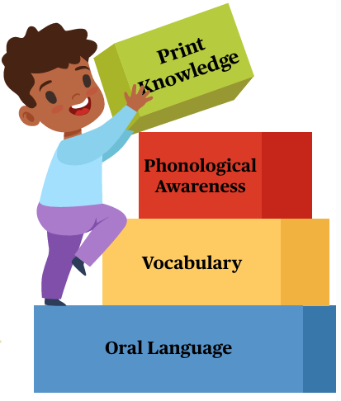
Supporting Reading Skills Across Different Ages
Talking with your child
Helping your child with speech sounds and letters
Reading with your child
Talking about books with your child
Asking questions when talking about or reading books
Image source: Supporting Your Child's Emergent Literacy at Home IES Guide.pdf
Notes:
Before we jump into reading and literacy activities, I want to start with something even more foundational—talking with your child. Everyday conversations are one of the most powerful ways to support learning. When we talk with children, listen to their ideas, and build on what they say, we help them grow their vocabulary, their thinking skills, and their confidence.
You don’t need special materials or extra time. These moments happen naturally—during meals, in the car, while getting dressed, or while looking at a book together. Talking with your child turns ordinary routines into rich learning opportunities, and it lays the groundwork for strong reading development.

Slide 20

TALKING WITH YOUR CHILD
Helps your child:
Learn about letters and letter sounds
Learn new words and ideas
Practice hearing and saying words
Practice talking back and forth
Notes:
​
​

Slide 21
Benefits of talking with your child
TALKING WITH YOUR CHILD
  Increases vocabulary
  Helps children learn more language to understand their actions and to express their ideas
Introducing Novel Words
Engaging in Thick Conversations
  Models back-and-forth exchanges
  Assists children in learning how to communicate more clearly and accurately
Extended Conversations
  Develops knowledge of new concepts and skills
  Enhances children’s understandings throughout the conversation
Expanding on What Children Say
Asking Questions
  Expands higher level thinking skills
  Provides opportunities for children to think about their thinking and evaluate their understandings
Source: Thick and Thin Conversations | HeadStart.gov
Notes:
“On this slide, we’re looking at four powerful ways that everyday conversations help children grow as readers and thinkers. We call these extended conversations—they’re the moments when we slow down, listen closely, and build on what children say.
Let’s start with Introducing Novel Words. When we use new or interesting vocabulary during daily routines—words like ‘enormous,’ ‘predict,’ or ‘investigate’—it not only increases their vocabulary but children also hear language that stretches their understanding. This helps them build a stronger vocabulary and gives them more precise words to understand their actions and express their ideas.
Next is Engaging in Thick Conversations. These are the back‑and‑forth exchanges where we ask follow‑up questions, respond to their ideas, and keep the conversation going. This models how communication works and helps children learn to express themselves clearly, confidently, and accurately.
The third area is Expanding on What Children Say. When a child says something simple—like ‘The truck is big’—we can build on it: ‘Yes, it’s a huge construction truck that carries heavy rocks.’ This kind of expansion helps children learn new concepts and deepens their understanding of the world.
Finally, Asking Questions. Thoughtful questions invite children to think more deeply. Questions like ‘Why do you think that happened?’ or ‘What might happen next?’ help children develop higher‑level thinking skills and encourage them to reflect on their own ideas.
Together, these four practices turn everyday moments—mealtime, car rides, playtime—into rich opportunities for language and literacy growth.”

Slide 22
TALKING WITH YOUR CHILD
Talk with your child during playtime and other daily activities. Here are some ideas to try:
Support Oral Language Development Every Day by…
Talk about everything!
Support Vocabulary Development Every Day by...
Talk about everything!
Use describing words and ask questions to talk about what you and your child are doing.
Support Phonological Awareness Every Day by...
Modeling good language habits
Support Print Knowledge Every Day by...
What are you doing?
How do you do that?
Encourage storytelling.
Tell me more about that.
What did you like about it?
Provide opportunities for your child to play and talk with other children.
Give your child many turns during a conversation by asking questions and making comments about what they say.
What color is this? Shape?
What do we use this for?
Look at that beautiful butterfly! Where do you think it is going?
Explore places with your child and talk about what you are seeing, learning, and feeling.
Pronounce words and letter sounds clearly when playing, talking, and sharing books.
Help your child say sounds that are new or difficult for them. Let them see how you move your mouth when you say a sound.
Point out letters and say their names. Include uppercase and lowercase letters.
Make letters and talk about their name and sound.
Cut letters out of paper.
Trace letters in flour.
Source: Institute of Education Sciences Supporting Your Child’s Emergent Literacy at Home
Notes:
Resource Link: Supporting Your Child’s Emergent Literacy at Home
Talk with your child during playtime and other daily activities. Play with letters and their sounds, make up rhymes, and participate in pretend play and storytelling.

Slide 23

TALKING WITH YOUR CHILD
Aim for thick conversations with your child. Thick conversations are extended back-and-forth exchanges between an adult and child.
Watch the video to learn more.
Watch Video
Video provided by:
Notes:
Aim for thick conversations with your child. Thick conversations are extended back-and-forth exchanges between an adult and child. Let’s watch the video to learn more. Then, we’ll look at an example.​
As you watch the video pay attention to how the adult The adult…
Shows interest in what the child is doing
Expands on the child’s ideas
Extends thinking by asking questions
Connects to prior experiences
Scaffolds language development
Video Link: Thick and Thin Conversations | HeadStart.gov https://headstart.gov/video/thick-thin-conversations
Video: Play Language Modeling and Conversations (.34)​
Thick conversations have many back-and-forth exchanges between the adult and the child. Thick conversations have lots of opportunities for children to hear and use a variety of words and sentences. In thick conversations, adults respond to children's interests and ideas and help to expand on their understanding and help children develop new knowledge. And in thick conversations, adults help children engage in more complex thinking by encouraging children to explain their thinking and make connections.​
​
Resource: Distribute, review, and discuss See Example resource with participants. Ask participants to turn to the person next to them and read the thick conversation script, each taking turns being the adult and child.​
​
​Language Modeling and Conversations (National Center on Quality Teaching and Learning) Tips for Teachers: LANGUAGE MODELING AND CONVERSATIONS
FACILITATING THICK CONVERSATIONS link Tips for Teachers
​
Transcript:
Welcome to this short presentation on thick and thin conversations. This is one in our series of in-services on language modeling and conversations. This presentation is about ways to extend your conversations with children, how to make them longer, and how to increase the number in back and forths in an exchange. It fits into the foundation of our house framework. The foundation represents effective and engaging interactions and environments. The foundation and all the components in the house framework support school readiness for all children. By learning to engage children in long conversations, you can help to foster their cognitive and social development, as well as their language development. Let's think about some of the ways that a focus on extending the conversation can help young children.
Extending the conversation provides models of appropriate conversation skills, supports higher level thinking through questions that are meaningful, expands on children's language and thinking to include new concepts and ideas, and increases children's vocabulary by introducing and using new and appealing words.
Well, what's a thick conversation? What's a thin one? Let's take a moment and listen to a thin conversation.
"One circle? Two? What else do you need? Eyes? Are you putting hair on your snowman? Yeah. Yeah? Wow. What else do you need? Done. All done with your snowman? So good. Or is it a snow girl? What are those? Hands. Hands, oh."
Now, let's listen to a thick conversation.
"All kinds of snowflakes? And snow right here in the house. Oh, you made the snow on the ground! Oh maybe we can make a chimney, do you think? Yeah! You have to stay warm. Are you gonna make it? Make it. Let's see. There. Oh all done? The chimney should be here. Oh you think up here on the top? Should we make it up there? There's snow on your house! Oh no! How come my house got snowed? All around? On the top, on the roof? Oh, we're not going to be able to go outside and play. It's snowing! Now you're under there. Oh you're snowing me in! What are we gonna do inside the house?"
Hear the difference? ‘Thick’ conversations have many back-and-forth exchanges between the adult and the child. Thick conversations have lots of opportunities for children to hear and use a variety of words and sentences. In thick conversations, adults respond to children's interests and ideas and help to expand on their understanding and help children to develop knowledge. And in thick conversations, adults help children engage in more complex thinking by encouraging children to explain their thinking and make connections.
In the earlier module, we talked about getting conversation started. Now, keep the conversation going. Make a comment on the child's intertest or experiences and then let the child take a turn. Aks a question about what the child is saying or doing and then let the child take another turn. Or respond with a bit more information and keep the conversation going. In this presentation, we've highlighted the importance of extending the conversation with children, making them longer, using new words, and guiding children's thinking about new ideas and concepts. Learn more about effective practices for making thick conversations in our other modules in this series from the National Center on Quality Teaching and Learning. Have fun with your conversations. See our helpful resources and tips for teachers. Thank you for listening.

Slide 24
We want “thick” conversations!
TALKING WITH YOUR CHILD
thin:
Thick:
Children use
and hear limited language
Questions only require one-word answers
Stops thinking process
Include multiple two-way exchanges
Children use and hear a variety of language
Respond to children’s interests and ideas
Promote higher level thinking skills
    Explaining
    Connecting
    Comparing
    Imagining possibilities
Source: Thick and Thin Conversations | HeadStart.gov

Slide 25
TALKING WITH YOUR CHILD
Try these strategies to have thick conversations:
Ask your child “WH” questions:
Who? What? Where? When? Why?
TRY IT OUT
Repeat all or part of your child’s answer to encourage them to say more.
TRY IT OUT
Give new information about the topic.
TRY IT OUT
Notes:
Try these strategies to have thick conversations. Ask your child WH questions, who, what, where, when, and why. Repeat all or part of your child’s answer to encourage him to say more. Give new information about the topic. Let’s see how you can do these strategies yourself.​
​
Resource: Distribute, review, and discuss Try It Out resources with participants.​
​
For Try It Out resource #1(questions that lead to thinking), have participants tell what describe, explain, connect, and predict mean. Encourage them to try asking one or more of these kinds of questions when talking with their child at home and debrief at the next session.​
​
For Try It Out resource #2,(add words to teach) ask participants to turn to the person next to them and read the script, each taking turns being the adult and child.​
​
For Try It Out resource #3, (ideas for new words) have participants think with their tablemates of examples for one or more of the eight ideas and share out.
​
​

Slide 26
TALKING WITH YOUR CHILD
Thick Conversation Example
Adult: Child: Adult: Child: Adult: Child: Adult: Child: Adult: Child: Adult: Child: | What was your favorite part of creating this piece of art? I liked making the plane. Oh, you made an airplane. Tell me how you made this airplane. I drew on the paper and folded it up. I see. You drew your design on the paper with markers and then folded the paper into an airplane. What is your next plan going to be? I am going to fly it in the sky. Very interesting, how do you know that your plane will fly? Because I made these wings. Oh, I see, so you think that the wings help the airplane fly. I think that is an excellent hypothesis. How will you test your idea that the wings will make your plane fly? I will throw it. (throws plane and laughs) I did it! Yes, your airplane soared across the table! How do you think you could make your airplane fly higher? I will make it another wing.
Activity
Group Practice
Thin Conversation Example
Adult: Child: Adult: Child: | What did you make? A plane. Does it fly? Yes.
Source: Thick and Thin Conversations | HeadStart.gov
Notes:
Let's practice having thin and thick conversations. You will read the adult's part and I will read the child's part. Having extended conversations with your child becomes easier the more you do it and really supports their literacy development.

Slide 27

TALKING WITH YOUR CHILD
Activity
Your turn to practice!
Using the Tips for Families: Thick and Thin Conversations handout, work with someone sitting close to you to role play the Thin Conversation and the Thick Conversation.
Source: Thick and Thin Conversations | HeadStart.gov
Notes:
Resource Link: Turn thin into think https//headstart.gov/sites/default/files/pdf/no-search/iss/language-modeling-and-conversations/thick-thin-family-tips.pdf

Slide 28
TALKING WITH YOUR CHILD
Activity
Share Out:
What stood out or resonated with you as you were role playing?
What did you enjoy about practicing a thick conversation?
Did you identify any obstacles or barriers?
Source: Thick and Thin Conversations | HeadStart.gov
Notes:
Resource Link: Turn thin into think https//headstart.gov/sites/default/files/pdf/no-search/iss/language-modeling-and-conversations/thick-thin-family-tips.pdf

Slide 29
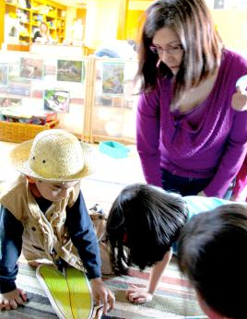
Review: Engaging your child in conversations involves…
TALKING WITH YOUR CHILD
Actively listening to what your child says.
Matching the tone and feelings of the conversation to your child’s emotions.
Building on your child’s experiences and interests.
Promoting many back-and-forth verbal exchanges between partners in the conversation.
Source: Thick and Thin Conversations | HeadStart.gov

Slide 30
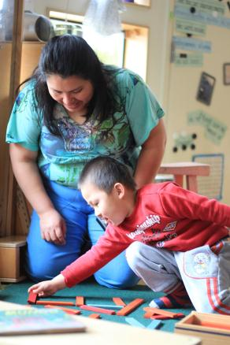
Review: Thick conversations with your child involve…
TALKING WITH YOUR CHILD
Encouraging multiple back and forth exchanges.
Providing opportunities to extend your child’s language.
Responding to your child’s interests and ideas.
Encouraging your child to engage in higher level thinking.
Source: Thick and Thin Conversations | HeadStart.gov

Slide 31
Supporting Reading Skills Across Different Ages
Talking with your child
Helping your child with speech sounds and letters
Reading with your child
Talking about books with your child
Asking questions when talking about or reading books
Image source: Supporting Your Child's Emergent Literacy at Home IES Guide.pdf
Notes:
Next, we’re going to talk about how families can support children as they learn speech sounds and letters. These early skills are the building blocks of reading. When children learn to hear the sounds in words and connect those sounds to letters, they begin to understand how reading works.
You don’t need special materials to help with this. Simple activities—like playing with rhyming words, noticing beginning sounds, or pointing out letters in everyday places—make a big difference. These small moments help children become more confident with sounds and letters, and they set the stage for strong reading development.
Let’s look at some easy ways you can support these skills at home.

Slide 32
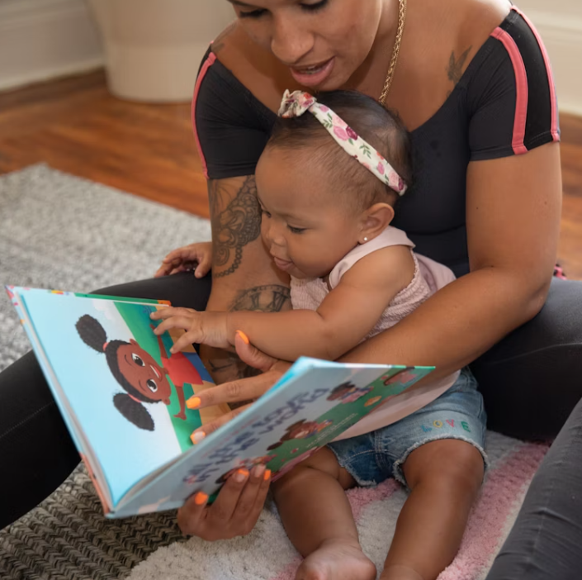
HELPING YOUR CHILD WITH SPEECH SOUNDS AND LETTERS
Helps your child:
Hear how language works
Learn that letters relate to spoken sounds
Link letters to their sounds
Read words later
Notes:
Note: This slide explains why the topic is important/the session big ideas for preschool children.​
​
Helping your child with speech sounds and letters helps your child hear how language works, learn that letters relate to spoken sounds, link letters to their sounds, and read works later. Be sure to check with your child’s early childhood provider to see what skills your child is learning so you can practice at home.​
​
Resource: Distribute, review, and discuss Route to Reading: Help Your Child Fuel Up with participants. Tell participants they can use this bookmark when reading together with their child to help him or her with speech sounds.​
Resource Link: Route to Reading Help Your Child Fuel Up https://vapta.org/~documents/route%3A/download/2759/
​​

Slide 33
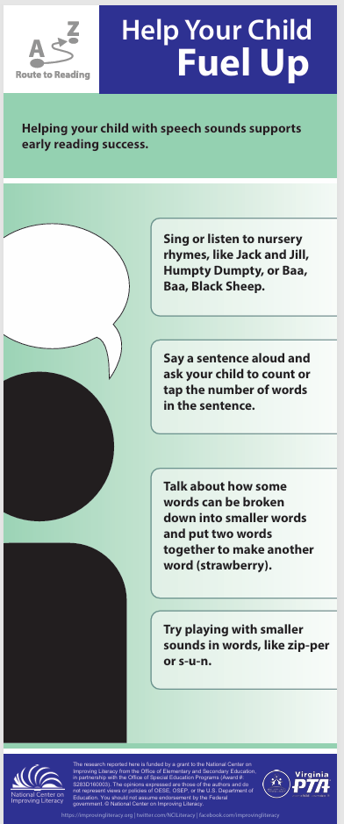



HELPING YOUR CHILD WITH SPEECH SOUNDS AND LETTERS
Noticing rhymes shows how language works.
Rhyming words have the same or similar end sounds.
Sing or listen to nursery rhymes.
See it in Action.
Read rhyming books.
Get Started.
Play rhyming games.
Try It Out
Notes:
Noticing rhymes show how language works. Rhymes are words that sound the same when spoken. Rhyme is found in poetry, songs, and many children's books and games. You can sing or listen to nursery rhymes, like Jack and Jill, Humpty Dumpty, or Baa, Baa, Black Sheep.
Click the link or use to the QR Code to hear one.
Link: https://youtu.be/MJkkGFg3Z0Y?si=sQchunjOrfiy-2nK
You can read rhyming books. Many books for young children have rhyming patterns in them. Check with your local librarian for help finding books with rhyming words.
Click the link or use to the QR Code to hear one.
Link: https://youtu.be/3RTJGCLwIGE?si=LnQjl3EsPR4iFBZb
Or, you can play rhyming games. You can match pictures of things that rhyme, find objects around the house that rhyme with one another, or just say a real word and make up a silly rhyme for it.
Click the link or use to the QR Code to hear one.
​Link: https://youtu.be/B5-y__faQrY?si=AwFwJSqcxviRzISD
Route to Reading Help Your Child Fuel Up
https://vapta.org/~documents/route%3A/download/2759/​
​
​

Slide 34



HELPING YOUR CHILD WITH SPEECH SOUNDS AND LETTERS
Learning letters and letter sounds supports early reading success.
Use alphabet toys to make letter and letter sound learning exciting.
Try It Out.
Sing songs like “Bingo” or play games like “I Spy” to make letter and letter sound learning fun.
See It in Action.
Encourage your child’s interest in letters and their sounds.
Notes:
Learning letters and letter sounds support early reading success. You can use alphabet toys to make letter and letter sound learning exciting. Try letter blocks, magnetic letters, alphabet puzzles, and letter stamps. Make letter shapes with playdough, bath bubbles, chalk, or paper.
You can sing songs like Bingo or play games like I Spy to make letter and letter sound learning fun. For example, “I spy something that starts with the letter F. Remember what sound F makes? /f/, /f/, can you guess what I see?” “There’s a farmer who had a dog, And Bingo was his name-o. B-I-N-G-O, B-I-N-G-O, B-I-N-G-O and Bingo was his name-o. Repeat and each time replace a clap for the next letter. Try using names of family members and friends.
Finally, encourage your child’s interest in letters and their sounds. Let your child tell you the letters in his name, name other familiar letters, or say letter sounds. Show how letters are matched with sounds. Keep it playful. ​
​
Resource: Distribute, review, and discuss the Try It Out resource (ABC card deck) with participants. Provide time for participants to cut apart the alphabet cards to create a deck of cards for playing letter and sounds games with their child at home.​
Printable flashcards link: Free Printable Alphabet Flashcards - ESL Flashcards
https://www.eslflashcards.com/sets/alphabet/
NOTE: This is the end of session 1

Slide 35
Supporting Reading Skills Across Different Ages
Talking with your child
Helping your child with speech sounds and letters
Reading with your child
Talking about books with your child
Asking questions when talking about or reading books
Image source: Supporting Your Child's Emergent Literacy at Home IES Guide.pdf
Notes:
Today we’re going to talk about one of the most powerful things you can do to support your child’s learning—reading together. Reading with your child, even for just a few minutes a day, helps build their language, their curiosity, and their confidence as a reader.
You don’t need special materials or long lessons. What matters most is the time you spend together—looking at pictures, talking about the story, asking questions, and enjoying the moment. These small routines help your child develop the early skills they need for reading success, and they make reading feel warm, fun, and connected.
Let’s explore some simple ways to make reading with your child a meaningful part of everyday life.

Slide 36

READING WITH YOUR CHILD
Helps your child:
Learn new sounds, words, and ideas
Link letters to their sounds
Learn how books work
Develop an interest in reading
Notes:
Note: This slide explains why the topic is important/the session big ideas.​
​
Reading with your child helps your child learn new sounds, words, and ideas; link letters to their sounds; learn how books work; and develop an interest in reading.​
​
​
​
​

Slide 37

READING WITH YOUR CHILD
Get Ready to Read
Find a quiet, cozy spot so you both can listen and talk.
Let your child pick a book or choose one that matches their
interests. Young children love to re-read the same
book, and that is great!
Follow your child's lead and keep it fun.
Notes:
You can get ready to read by finding a quiet, cozy spot so you both can listen and talk, let your child pick a book or choose one that matches her interests. Young children love to re-read the same book and that is great! Finally, follow your child’s lead and keep it fun.
Guiding Question:
What might be a good spot in your home for reading with your child? If you already have one, what makes it so?
​
​
​
​

Slide 38


READING WITH YOUR CHILD
Watch Video
Video provided by:
Notes:
Let’s watch a video to hear Dr. Maryanne Wolf discuss the importance of reading books with your child. ​
​
IF THE VIDEO LINK DOES NOT WORK, USE THE EMBEDDED VIDEO ON THE NEXT SLIDE.
Video: Play https://youtu.be/2JZSzvOI1EM?si=WuMM8GCHHNIpk8H1
Transcript: Reading out loud to young children is hugely beneficial. Primarily we talk a lot about early on that important bond that happens between parent and child. Children learn best through those warm engaging interactions with those closest to them-like mom, dad, grandma, sibling, so you can follow their cues. You can encourage their interests. You can encourage their development, and as far as long-term effects, it certainly follows them into school readiness, language development, thinking skills, problem-solving. It increases your vocabulary, and vocabulary in itself for a child who goes into first grade is one of the best predictors of how they're going to do when they're in fourth grade as far as reading comprehension, so it's all connected. It also helps increase their imagination, a little bit of empathy because they're putting themselves into the characters they're reading about, decreased disruptive behaviors in school, increased attention span. It helps bring families together, even for busy people. this is the time they get together and bond, and you might have kids of different ages, and we can all still sit together and read different books. There is no time too soon to start. We often encourage families who are expecting a new baby to start that routine then. Baby hears you while they're in the wombs, and certainly at birth it becomes much more exciting- holding them close. They are not necessarily going to be attentive to the words in the book, but it's them hearing the language and hearing the sounds and the rhythm of the language is really setting the tone for what will take place later when they begin to speak. It's all precursor to school readiness and success in school and even further in life. The books that you read to your kids, it definitely depends on the age of the child, the child's interests, and their maturity, how developed they are. So early on birth to say 6 to 12 months, a lot of the books are going to be very basic-limited in the text and pictures, which is what you want. You want to really just be spending that time holding baby, making eye contact, maybe pointing some things out. Books with different textures, so they can touch and feel, and as they get a little older, you know, you can start reading small storybooks. Pop out books are a lot of fun, and then maybe you want ask questions to the child. 'What do you think's going to happen in the next page?' or 'Where's the cow?' so that kind of helps with the child learning. Choosing books that are interesting to them, if they like trucks or they like animals, they'll be lighting up and participating, pointing to pictures, looking for things that are familiar to them. I usually try to tell parents try to read every night because then that's a routine for you. Your child knows that 'Hey, before bedtime when I'm relaxed and quiet this is what we do. We brush our teeth and then we read a book.' They'll look forward to that built-in part of their routine and bring books to the experience and almost maybe look forward to that bedtime. It might start with just a few minutes to begin with, and as kids get older of course they might start reading to you, which is also great because then you can kind of regulate how is their vocabulary? How was their pronunciation? The libraries can help you find the perfect book, and there's a myriad of different topics available for young children. Early Child Alliance is thrilled to be partnered with Parkview in many different ways. We certainly are proud to have at a couple of different pediatric sites through Parkview our Books and Docs Program, which is where families are able to receive books at the well-child checks. This gives the nurses and doctors an opportunity to have that tool to share with families that they take home while they're giving them important messages about reading aloud and the big impact that it can have on their life.

Slide 39
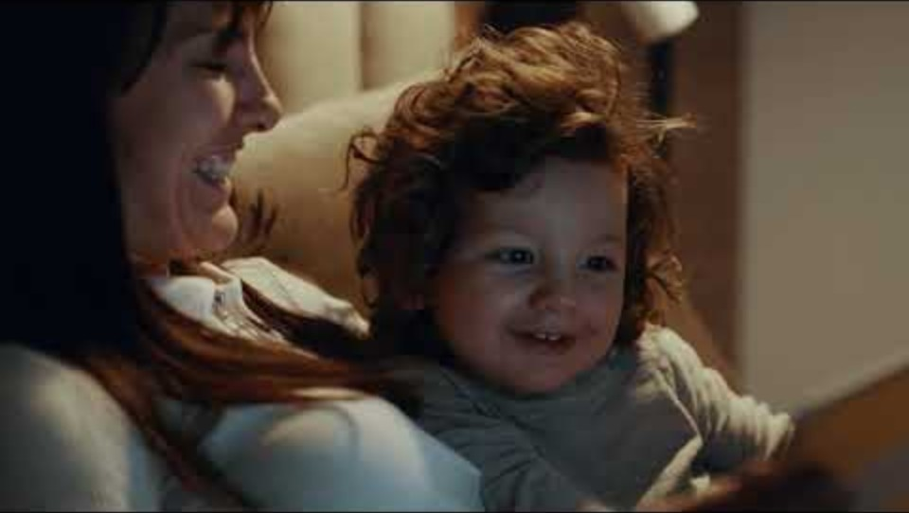



READING WITH YOUR CHILD
Video provided by:
Parkview Health
Notes:
Let’s watch a video that discusses the importance of reading books with your child. ​
​
Video: Play https://youtu.be/2JZSzvOI1EM?si=WuMM8GCHHNIpk8H1
​
​0:00
Reading out loud to young children is hugely beneficial. Primarily we talk a
0:04
lot about early on that important bond that happens between parent and child.
0:07
Children learn best through those warm engaging interactions with those closest
0:12
to them-like mom, dad, grandma, sibling, so you can follow their cues. You can
0:16
encourage their interests. You can encourage their development, and as far
0:20
as long-term effects, it certainly follows them into school
0:23
readiness, language development, thinking skills, problem-solving. It increases your
Benefits of reading
0:28
vocabulary, and vocabulary in itself for a child who goes into first grade is one
0:34
of the best predictors of how they're going to do when they're in fourth grade as
0:37
far as reading comprehension, so it's all connected.
0:40
It also helps increase their imagination, a little bit of empathy because they're
0:44
putting themselves into the characters they're reading about, decreased
0:47
disruptive behaviors in school, increased attention span. It helps bring families
0:52
together, even for busy people. this is the time they get together and bond,
0:56
and you might have kids of different ages, and we can all still sit together and
1:00
read different books. There is no time too soon to start. We often encourage
1:03
families who are expecting a new baby to start that routine then. Baby hears you
1:08
while they're in the wombs, and certainly at birth it becomes much more exciting-
1:11
holding them close. They are not necessarily going to be attentive to the
When to start
1:14
words in the book, but it's them hearing the language and hearing the sounds and
1:18
the rhythm of the language is really setting the tone for what will take
1:22
place later when they begin to speak. It's all precursor to school readiness
1:26
and success in school and even further in life. The books that you read to your
1:30
kids, it definitely depends on the age of the child, the child's interests, and
1:34
their maturity, how developed they are. So early on birth to say 6 to 12
1:39
months, a lot of the books are going to be very basic-limited in the text and
1:43
pictures, which is what you want. You want to really just be spending that time
1:46
holding baby, making eye contact, maybe pointing some things out. Books with
1:51
different textures, so they can touch and feel, and as they get a little older, you
1:55
know, you can start reading small storybooks. Pop out books are a lot of
1:59
fun, and then maybe you want ask questions to the child. 'What do you think's going
2:02
to happen in the next page?' or 'Where's the cow?' so that kind of helps with the
2:05
child learning. Choosing books that are interesting to them, if they like trucks
When to read
2:09
or they like animals, they'll be lighting up and participating,
2:12
pointing to pictures, looking for things that are familiar to them. I usually try
2:18
to tell parents try to read every night because then that's a routine for you.
2:21
Your child knows that 'Hey, before bedtime when I'm relaxed and quiet this is
2:25
what we do. We brush our teeth and then we read a book.'
2:28
They'll look forward to that built-in part of their routine and bring books to
2:31
the experience and almost maybe look forward to that bedtime. It might start
2:35
with just a few minutes to begin with, and as kids get older of course they
2:38
might start reading to you, which is also great because then you can kind of
2:41
regulate how is their vocabulary? How was their pronunciation?
2:45
The libraries can help you find the perfect book, and there's a myriad of
2:49
different topics available for young children. Early Child Alliance is
2:52
thrilled to be partnered with Parkview in many different ways. We certainly are
2:56
proud to have at a couple of different pediatric sites through Parkview our
2:59
Books and Docs Program, which is where families are able to receive books at
3:03
the well-child checks. This gives the nurses and doctors an
3:06
opportunity to have that tool to share with families that they take home while
3:09
they're giving them important messages about reading aloud and the big impact
3:13
that it can have on their life.
All
For you
Recently uploaded

Slide 40

READING WITH YOUR CHILD
Tips to use when reading with your child
Make it fun! You and your child read and talk about the book together. It is interactive.
Read pictures, words, or use audio books. Label objects around the house and read them too.
Read and talk about the story in the language your child and you feel most comfortable.
Notes:
Let’s learn more about reading with your child. ​
1. Reading with your child means you and your child read and talk about the book together. It is interactive. This interactive conversation is a fun, purposeful way to share ideas.
2. Read pictures, words, or use audiobooks. Label objects around the house and read them too.
3. ​Read and talk in the language you and your child feel most comfortable.
​
Note: Click each title so participants can hear more. (see tips on next 3 slides)
​
​
​
​

Slide 41

READING WITH YOUR CHILD
When reading with your child, make it interactive. Interactive reading engages your child by having them discuss the story or narrative.
Video provided by:
Watch the video
Talking While You Read: Bear Says Thanks
Watch Video
Notes:
During interactive reading, an adult reader uses a variety of techniques to engage a child or group of children in the text. Interactive reading engages children in a story by having them discuss the narrative and images in the book. The reader might ask children to: point to the title, point to the words and pictures in the story; make predictions about what might happen in the book based on the cover or story so far; or retell the story in their own words. Interactive strategies get children talking and engaged in the story. Follow-up questions encourage students to expand their responses and express their ideas.
When reading with your child, make it interactive. Interactive reading engages your child by having her discuss the story or narrative. Let’s watch a video to learn more. Then, we’ll see how to do it yourself.
Video Link: 1 1 Talking While You Read Bear Says Thanks (4:44)
Transcript: The title of this book is there's two as thanks, thanks, thanks there you go I love these three books all alone in this cave there listen to the wind . he is bored, bored, bored and he misses his friends it's a meteor when you're bored he's like you have another kid yeah I think of anything to do just sitting there you're right I could make a big dinner a feast I could share but he looks through his cupboard and the cupboard is bare so I know so this bear doesn't mean that like the animal and this bear means others are empty okay so when he looked in his cupboards they or what damn and it's another word for empty bear then mouse stops by with the huckleberry pie and the bear says thanks bear says goodness meet a delectable pie but I have made nothing he answered the side delectable it's a big word so you delectable yes you know what that means there's something delectable it might not really, really in this case delicious tastes really good what did that one another time later okay but I have me a melon what's selectable and remember they need you really, really good really early in this case the pie is delicious and please tell me sure he's got even more what's badger burning thanks that's right Badgers bringing the dish stutters anywhere’s a big frown he's sighs and he moans and he plots himself down you have brought yummy treats you're so nice to share but me I have nothing my colors are bare ma'am Mammon why does the bear feel sad that's right you feel sad because his friends are bringing out his food and his cupboards are bare mouse squeaks don't fret there's enough dear bear you don't need any food you have stories to share his friends hug them tight it'll be all right and the bear says hey thanks that's right so what's Bear going to share what's that they should oh my goodness so what is bear going to share since he doesn't any food in those cupboards the TV instead of food my squeaks don't fret there's enough dear bear you don't need any food you have stories to share oh yeah he's going to share stories they pass around platters they tweet and they chatter that's a platter pass by a platter yeah but the plate that the food sits on is a platter if you have a big plate and you go through that the plate is the platter so they pass around platter if you're tweeting and chatter and they all say which one's your favorite character in this book you guys ready then say my favorite characters Raven I can't kill his waving white flag in the Griffon Heath block and you can fly you can fly I bet you'd like to fly how do you practice it
Resource link: Microsoft Word - Dialogic Reading Handout.doc
https://bookem-kids.org/wp-content/uploads/2025/10/Dialogic-Reading-Handout.pdf
Resource: Distribute, review, and discuss the Try It Out resource (Dialogic reading) with participants. Then use a picture book to model how you would apply the PEER sequence in a picture book. Have pairs use sticky notes to mark the places in the book where they would apply part of the sequence, noting which part and what they would ask. Have participants share out. Note that application of CROWD prompts will be discussed in a later session.
Note: This completes Session 2: Talking About Books and Reading with Your Child.
When reading with your child, make it interactive. Interactive reading engages your child by having her discuss the story or narrative. Let’s watch a video to learn more. Then, we’ll see how to do it yourself.

Slide 42
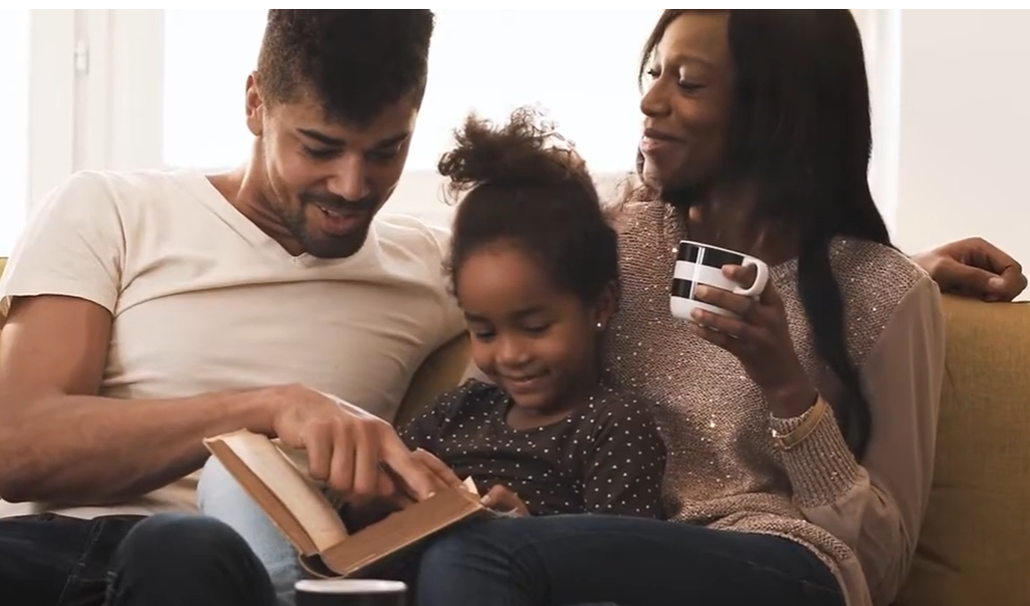
Video Review
READING WITH YOUR CHILD
Did the adult make it fun? Did they read and talk about the book together? Was it interactive?
As they were reading did they look at and talk about pictures and read the words?
Were they using language they were comfortable with while reading and talking about the story?
Notes:
Have participants share out their responses

Slide 43
Supporting Reading Skills Across Different Ages
Talking with your child
Helping your child with speech sounds and letters
Reading with your child
Talking about books with your child
Asking questions when talking about or reading books
Image source: Supporting Your Child's Emergent Literacy at Home IES Guide.pdf
Notes:
So now were ready to move into the topic of "Talking about books with your child." Talking about books with your child builds the foundation for early reading. These everyday conversations help children:
Understand how books work
Learn how print and pictures carry meaning
Hear and use new words
Develop new ways to express their ideas
Build early skills that support future reading success

Slide 44

TALKING ABOUT BOOKS WITH YOUR CHILD
Helps your child:
Learn how to hold a book and the parts of a book
Understand that words are read from left to right
See that pictures stand for real things
Learn that print tells a story
Find new ways to say things
Learn new words
Notes:
On this slide, we’re highlighting some of the powerful ways that simply talking about books supports your child’s early reading development. These are small moments that make a big difference.
First, children learn how to hold a book and understand its parts. When we show them the front cover, the title, the pictures, and how to turn pages, they begin to understand how books work.
They also learn that we read words from left to right. Even before they can read on their own, watching you point to words and move across the page helps them understand the direction of print.
Talking about books also helps children see that pictures stand for real things. When you point to a picture and name it—‘That’s a butterfly’ or ‘Look at the tall tree’—children connect the image to the real world.
They begin to understand that print tells a story. As you read and talk about what’s happening, children learn that the words on the page carry meaning.
These conversations also help children find new ways to say things. When you model richer or more precise language—like saying ‘gigantic’ instead of ‘big’—children hear new ways to express their ideas.
And finally, talking about books helps children learn new words. Every book introduces vocabulary they might not hear in everyday routines, which builds their language and supports later reading comprehension.
All of these skills grow naturally when families talk about books together, even for just a few minutes a day.”
​Note: This slide explains why the topic is important/the session big ideas.

Slide 45
TALKING ABOUT BOOKS WITH YOUR CHILD
What does it mean to talk about a book?
Looking at picture books together creates natural moments for talking and learning.
Even toddlers learn a lot from simple conversations about pictures.
Children learn that pictures and words stand for real things and can tell a story.
Talking about books builds vocabulary and helps children express themselves.
Focus on the pictures—ask questions, comment, and encourage your child to talk.
The goal is conversation, not reading every word on the page.
You help your child learn new words and clearer ways to communicate.
Everyday book talk builds strong early language skills.
Notes:
What does it mean to talk about a book?
Read through each box
Guiding question to Check for Understanding: How is talking about a book different than reading a book with your child?

Slide 46
TALKING ABOUT BOOKS WITH YOUR CHILD
Strategies to engage your child with the text.
Tip 1
Tip 2
Talk about what you both see in the pictures. Name colors, shapes, and objects.
Talk about what is happening in the story.
Tip 3
Guess what might happen next in the story.
Tip 4
Make connections between the book and your life or what you know.
Notes:
Here are some strategies for talking about books with your child. ​
​
Tip 1 — Talk about what you both see in the pictures. Name colors, shapes, and objects. For example: “Look at that big red truck! I see a circle wheel and a square window. What do you see?”
Tip 2 — Talk about what is happening in the story. An example migh be: “Oh, the puppy is running after the ball. It looks like he really wants to catch it!”
Tip 3 — Guess what might happen next in the story. For instance: “The girl is climbing the ladder. What do you think she’s going to do next? Maybe she’ll slide down!”
Tip 4 — Make connections between the book and your life or what you know. Such as: “They’re having a picnic in the park. Remember when we had a picnic last summer? What did we bring?”

Slide 47

TALKING ABOUT BOOKS WITH YOUR CHILD
Unsure of how to go about talking about books with your child?
Expand
Repeat
Caution
Support
Expand on your child’s response by adding a few more words.
For example, “Yes, it’s a big, red firetruck."
Ask your child to repeat what you said.
For example, “Yes, it’s a big
red firetruck. Can you say big red firetruck?”
Do not point out errors when you expand and repeat. Instead, repeat what your child said using correct pronunciation.
For example, if your child says “burn” instead of “brown,” you could say: “That’s right, a brown cocoon.”
Say all the sounds in the word slowly and clearly for your child. This focuses their attention on the sounds and the way your mouth looks when making them.
For example, /b-r-o-w-n/.
Notes:
Unsure of how to go about talking about books with your child? Here are a few strategies
Expand - Expand on your child’s response by adding a few more words. For example, Yes, it’s a big, red, fire truck. ​
​
Repeat - Ask your child to repeat what you said. For example, Yes, it’s a big, red, fire truck. Can you say that? ​
​
Caution - Do not point out errors when you expand and repeat. Instead, repeat what your child said using correct pronunciation. For example, if your child says burn instead of brown, you can say that’s right, a brown cocoon. ​
​
Support - Say all the sounds in the word slowly and clearly for your child. This focuses his attention on the sounds and the way your mouth looks when making them /b - r ow - n/.​
​

Slide 48
Supporting Reading Skills Across Different Ages
Talking with your child
Helping your child with speech sounds and letters
Reading with your child
Talking about books with your child
Asking questions when talking about or reading books
Image source: Supporting Your Child's Emergent Literacy at Home IES Guide.pdf
Notes:
One powerful habit that makes a big difference in your child’s literacy development is asking questions while you talk about or read books together.
When we ask children questions, we invite them to think more deeply, use new words, explain their ideas, and make sense of the letters and sounds they see on the page. These small conversations help children become active thinkers rather than just listeners.
Asking questions turns reading into a back‑and‑forth experience, and that back‑and‑forth is what builds strong language and early reading skills. Even simple questions can open the door to big learning moments.

Slide 49

ASKING QUESTIONS WHEN TALKING ABOUT OR READING BOOKS
Helps your child:
Think in new ways
Consider new words and ideas
Explain their thinking
Make sense of letters, sounds, and words
Notes:
When we ask children questions while we read or look at books together, we’re doing much more than checking if they’re paying attention. Questions actually help children grow as thinkers and readers.
First, asking questions helps children think in new ways. When we say things like, ‘Why do you think the character did that?’ or ‘How else could they solve this problem?’ we’re encouraging children to look beyond the surface and explore different possibilities.
Questions also help children consider new words and ideas. When we pause to ask, ‘What do you think this word means?’ or ‘Have you ever heard that word before?’ we’re helping them build vocabulary and connect new ideas to what they already know.
Another benefit is that questions encourage children to explain their thinking. When we ask, ‘How did you figure that out?’ or ‘What made you think that?’ children learn to put their thoughts into words, which strengthens both language and comprehension.
And finally, asking questions helps children make sense of letters, sounds, and words. Simple prompts like, ‘What sound does this letter make?’ or ‘Do you see any words you know on this page?’ help children notice the building blocks of reading.
These small, everyday questions turn book time into a powerful learning moment—and they help children become confident, curious readers.
​​
​
​

Slide 50


ASKING QUESTIONS WHEN TALKING ABOUT OR READING BOOKS
Asking questions helps to make talking about or reading books interactive.
Video provided by:
Watch the video to learn more.
Watch Video
Watch on YouTube
Notes:
Asking questions helps to make talking about or reading books interactive. For preschoolers, ask questions that start with “why.” Or, “where.” Or, “I wonder.” Questions that don't have a yes or no answer. If possible, personalize stories by relating them to situations in your child’s life. Let’s watch a video to learn more.
Video: Questions to Ask When Reading to Children (3:54)
Video link: https://youtu.be/j9j5c3sj-60?si=pod0CqdZrbxTSssO
Transcript: So today we're going to read Izzy's Unicorn Adventure there's Michael he's got the same name was you where's your name show me what your name there you go what do you think this book's going to be about adventures yes do you like her hair it's very cool there once was a beautiful unicorn with a beautiful name the unicorn was called easy and easy love to play games you like to play games you do yeah look at her friends I like that one do you like that one that one the gold one pretty what does that say easy and the flowers how cool is that off is he trotted to find another place to play I'm lucky to have an adventure on such a beautiful day what do you think unicorns do in their spare time do you think they watch telly yeah do you think they play on their iPads what do you think they like to eat if it ain't grass cotton candy that is a really good answer the clouds were made of marshmallow fluff and the trees were lollipops so you were close with cotton candy but these are marshmallows but soon all this sugar gave is a tooth ache that's why we have to brush our teeth isn't it every night yeah next is he galloped into a magical wood is he said aloud this enchanted forest looks good look at that what's that yeah and who's made that the fairy look she's made your name with all their magic lights whoa what's happened in the forest now do you think it looks a bit scary now looks a bit spooky what's that a bat and what's that wow what noise does they all make I don't know what noise a bat makes oh it's good knowledge look all the snow on the trees who lives places like this where it's all snowy Chris father Christmas yeah is he decided with a flick of a tail to jump in a boat and soon easy set sail what's that see oh really she's a funny fellow yes what's happened her hooves the gold what does that mean she's warm easy do you think that's her home do you think that's where she should be she thinks she's gonna find her friends there I hope so she looks a little bit sad again doesn't she so Izzy's adventure so where did she go where did we start we started in there in the field in the meadow with all the flowers and then where did she go candy candy land that's right what were the clouds made of can you remember marshmallow well done she was bored she went to her friend's back and she wanted the castor that's fine she got to the castle and then when she was happy wasn't she because her friends were there that's you how did they put a picture of you in the book maybe it's unicorn magic

Slide 51
ASKING QUESTIONS WHEN TALKING ABOUT OR READING BOOKS
CROWD helps you remember different kinds of questions to ask.
Completion
Ask your child to fill in the blank using words from the story after it is repeated several times or once it is very familiar.
Recall
Ask your child to tell you what happened in the story.
Open-Ended
Ask your child what is happening in a picture or story to get her talking.
“Wh” Prompts
Ask your child who, what, when, where, and why questions.
Distancing
For example:
For example:
For example:
"Can you describe the caterpillar?"
"Why do you think the caterpillar was so hungry?
For example:
"What other foods might a caterpillar eat?"
"Where does a caterpillar turn into a butterfly?"
"And the caterpillar turned into a beautiful __________."
"Can you tell me two foods the caterpillar ate?"
Ask your child to connect to something in their own life.
For example:
"What do you think would happen if you ate that much?"
Notes:
The word Crowd can help you remember different kinds of questions to ask. C stands for completion, r for recall, o for open-ended, w for wh prompts, and d for distancing.
​
​Here are a few simple ways we can ask questions while reading that help children think, talk, and understand stories more deeply. These strategies work with any book, and they’re easy to use during everyday reading time.
1. Completion Prompts - Completion prompts encourage your child to listen closely and use words from the story. Once a book becomes familiar, you can pause and let them fill in the missing word. For example, you might say: ‘And the caterpillar turned into a beautiful ________.’ Children love finishing the sentence, and it helps them remember key vocabulary.
2. Recall Prompts - Recall prompts help children remember what happened in the story. This builds comprehension and sequencing skills. You might ask: ‘Can you tell me two foods the caterpillar ate?’ These questions help children practice retelling in their own words.
3. Open‑Ended Prompts - Open‑ended questions invite children to talk more and think more. There’s no right or wrong answer—they just get to share their ideas. For example: ‘Can you describe the caterpillar?’ ‘Why do you think the caterpillar was so hungry?’ These questions encourage conversation and deeper thinking.
4. “Wh” Prompts - These are the classic who, what, when, where, and why questions. They help children understand details and make sense of the story. For example: ‘What other foods might a caterpillar eat?’ ‘Where does a caterpillar turn into a butterfly?’
5. Distancing Prompts - Distancing prompts help children connect the story to their own life. This builds understanding and makes reading more meaningful. For example: ‘What do you think would happen if you ate that much?’ These questions help children relate the book to their own experiences.
Using these different types of questions turns reading time into a rich conversation—and helps children grow as thinkers, talkers, and readers.
​

Slide 52

ASKING QUESTIONS WHEN TALKING ABOUT OR READING BOOKS
Engage your child by asking questions . . .
Before Reading
During Reading
After Reading
ThePhoto by PhotoAuthor is licensed under CCYYSA.
Notes:
To help build vocabulary and comprehension, engage your child by asking questions before, during, and after reading.
​
​

Slide 53
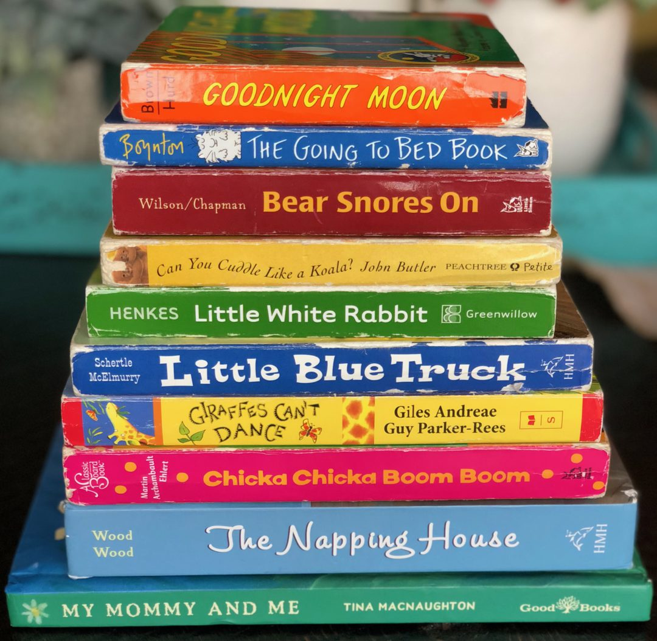
ASKING QUESTIONS WHEN TALKING ABOUT OR READING BOOKS
BEFORE READING
Look at the cover and talk about what the story might be about.
For example:
"Let's read the title and look at the picture. What do you think this story is about?"
Notes:
Before reading, look at the cover and talk about what the story might be about. For example, let’s read the title and look at the picture. What do you think this story might be about?
​
​
​
​

Slide 54
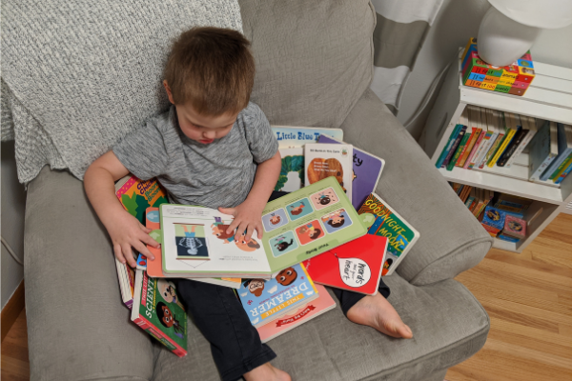
ASKING QUESTIONS WHEN TALKING ABOUT OR READING BOOKS
DURING READING
Ask your child about letters, sounds, words, or ideas.
For example:
"Can you say the word that sounds like 'cave'?"
"What games can you play at the beach?"
"Why is the girl sad?"
Notes:
During reading, ask your child about letters, sounds, words, or ideas. For example, can you say a word that sounds like 'cave'? What games can you play at the beach? Why is the girl sad?
​
​
​
​

Slide 55
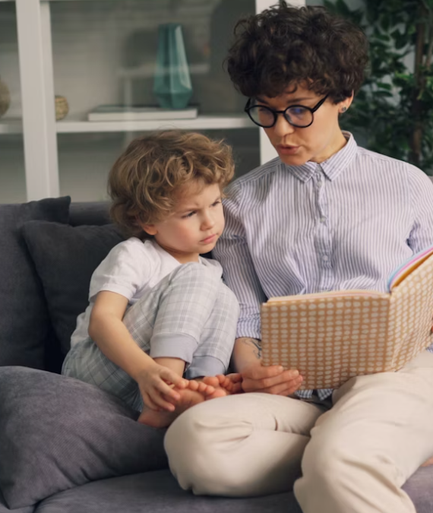
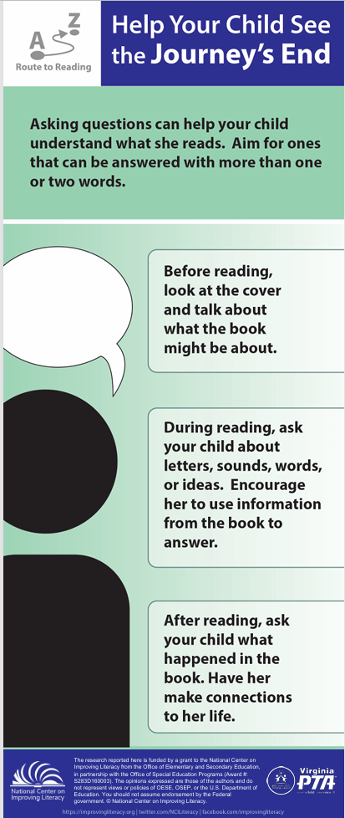

ASKING QUESTIONS WHEN TALKING ABOUT OR READING BOOKS
AFTER READING
Ask your child what happened in the story. Help them make connections.
For example:
"What was the story about?"
"What does this story remind you of?"
"What did you like about the story?"
Notes:
After reading, ask your child what happened in the story. Have her make connections. For example, what was the story about? What does this story remind you of? What did you like about the story?
Resource: Distribute, review, and discuss Route to Reading: Help Your Child See the Journey’s End with participants. Tell participants they can use bookmark when reading together with their child to support his or her understanding.
​
Resource ​Link: https://vapta.org/~documents/programs/readingnight/route-reading-child-see-journey-end/?layout=file
​

Slide 56
Closing

Slide 57




Ways to Support Your Child’s Literacy Development Across Stages
Review
Listen: Note which sounds, letters, words, or ideas seem hard for your child when reading aloud or talking.
Look: Watch for the skills or tasks that appear difficult for your child. See if they improve with practice.
Help: Pause and give your child a chance to correct a mistake. Then try giving them a hint or prompt to figure it out.
Encourage: Talk with your child about the book or activity. Offer praise when successful and reassure them when difficulties arise.
Notes:
Regardless of what stage of literacy development your child is in, families and caregivers play an important role in supporting their literacy development. Today we talked about ways to support your child’s literacy development by taking a deep dive into ways families can help children become proficient readers.
When you are working with your child at home, you can support your child in four key ways - by listening, looking, helping, and encouraging. As you work with your child, a few areas you can focus on that we will talk about during this workshop include:
● Listening and noting which sounds, letters, words, or ideas seem hard for your child when reading aloud or talking.
● Looking and watching for the skills or tasks that appear difficult for your child. See if they improve with practice.
● Helping by pausing and giving your child a chance to correct a mistake. Then try giving them a hint or prompt to figure it out.
● Encouraging them by talking about the book or activity, offering praise when successful and reassuring them when difficulties arise.
We talked about:
● Listening and noting which sounds, letters, words, or ideas seem hard for your child when reading aloud or talking.
● Looking for the skills or tasks that appear difficult for your child. See if they improve with practice.
● Helping your child by pausing and giving them a chance to correct a mistake.
● Encouraging your child by talking about the book and offering praise when they’re successful and reassuring them when difficulties arise.
And if you have concerns, don’t hesitate to talk with your child’s early childhood provider or pediatrician to be sure that you’re supporting your child in skills that are developmentally appropriate.

Slide 58
Review
Supporting Reading at Home
Practice at home the same skills your child is learning at school
Children who find reading challenging make the most progress with frequent practice
Schools can help by sharing simple guidance on what to work on at home
Everyday activities that build literacy:
Talk with your child throughout the day and ask questions
Listen closely to their ideas and responses
Read together and enjoy books as a shared routine
Say the alphabet, play with sounds, and connect letters to their sounds
Explore your community and talk about what you see to build background knowledge
Notes:
Earlier in the workshop we talked about the overarching themes for today. When we review them our hope is that you see as families, it is important to provide literacy opportunities when children are young and reinforce skills taught in early childhood settings or school.
Families can help children grow as readers by practicing at home the same skills they’re learning at pre-school. Children who find reading challenging make the most progress when they get lots of chances to practice. Pre-schools can support families by sharing simple information about what to work on at home.
Everyday activities are powerful for building literacy. Talk with your child throughout the day, ask questions, and listen closely to their ideas. Read together, say the alphabet, play with sounds, and help connect letters to the sounds they make. Explore your neighborhood or community and talk about what you see—these conversations help children learn about the world and build important background knowledge.
Resource link: 10 Ways to Support Your Child’s Literacy at Home – National on Improving Literacy
https://improvingliteracy.org/resource/supporting-your-child-s-literacy-at-home/

Slide 59

Quiz Question
Andrew has a six-year-old child. They speak English and another language at home. What could Andrew do to support his child's literacy development?
Read and talk together, sing nursery rhymes, and tell stories.
Use whatever language is most comfortable when talking and reading.
Use daily activities as ways to build language and literacy skills.
Play with spoken words and sounds.
All of the above.
Notes:
Think about what you’ve learned about supporting your child’s literacy development at home to help Andrew. Andrew has a five-year-old child. They speak English and another language at home. What could Andrew do to support his child’s literacy development at home? Choose the answer that best fits. Read and talk together, sing nursery rhymes, and tell stories; use whatever language is comfortable when talking and reading; use daily activities as ways to build language and literacy skills; play with spoken words and sounds; or all of the above.
Note: Provide time for participants to review and discuss the scenario. Then, ask participants to discuss the correct answer with their tablemates. Poll participants on the answer and click Submit to see if correct.
Check for Understanding: What could Andrew do to support his child’s literacy development at home? Correct answer: All of the above

Slide 60
Quiz Question
Andrew has a six-year-old child. They speak English and another language at home. What could Andrew do to support his child's literacy development?
Read and talk together, sing nursery rhymes, and tell stories.
Use whatever language is most comfortable when talking and reading.
Use daily activities as ways to build language and literacy skills.
Play with spoken words and sounds.
All of the above.
Notes:
Think about what you’ve learned about supporting your child’s literacy development at home to help Andrew. Andrew has a five-year-old child. They speak English and another language at home. What could Andrew do to support his child’s literacy development at home? Choose the answer that best fits. Read and talk together, sing nursery rhymes, and tell stories; use whatever language is comfortable when talking and reading; use daily activities as ways to build language and literacy skills; play with spoken words and sounds; or all of the above.
Note: Provide time for participants to review and discuss the scenario. Then, ask participants to discuss the correct answer with their tablemates. Poll participants on the answer and click Submit to see if correct.
Check for Understanding: What could Andrew do to support his child’s literacy development at home? Correct answer: All of the above

Slide 61
Today we explored and talked about…
The Science of Reading and the critical skills needed for children to be successful readers.
Using simple, meaningful conversations to help children build strong language and early reading skills.
Trying fun activities to help children hear and play with speech sounds and begin connecting those sounds to letters.
Encouraging children’s excitement about books and reading to spark children’s interest in reading.
Supporting children’s understanding of stories and information by building background knowledge and talking together about what they hear and read.
Notes:
Read slide

Slide 62

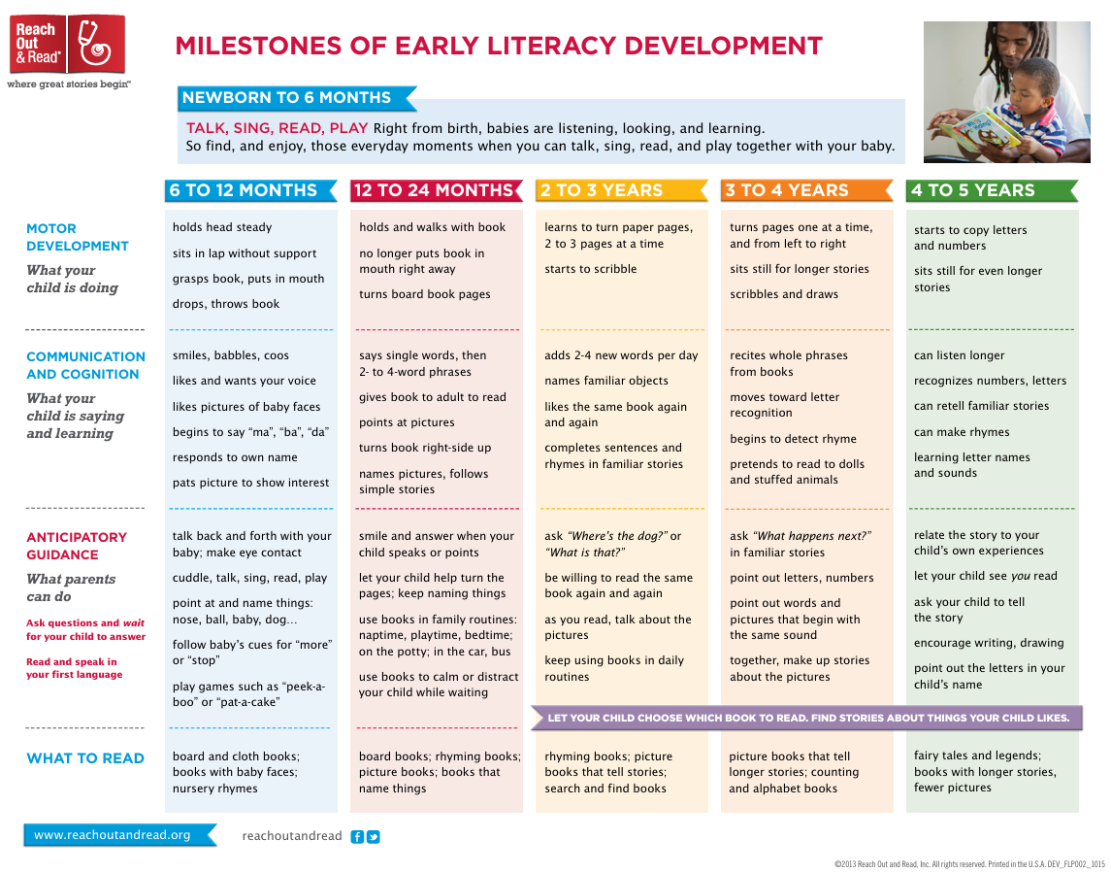
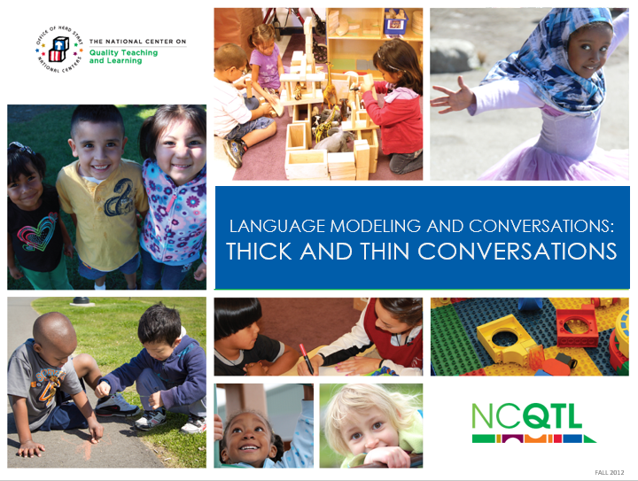


Additional Resources
10 Ways to Support Your Child’s Literacy Development at Home
Milestones of Early Literacy Development
Language Modeling and Conversations: Thick and Thin Conversations
Notes:
On this slide and the next are some additional resources for you to use as you support your child's literacy development.
10 Ways to Support Your Child’s Literacy at Home – National Center on Improving Literacy Link: https://improvingliteracy.org/resource/supporting-your-child-s-literacy-at-home/
ROR-Milestones-of-Early-Development-Chart.pdf - https://reachoutandread.org/wp-content/uploads/2023/04/ROR-Milestones-of-Early-Development-Chart.pdf
Language Modeling and Conversations: Thick and Thin Conversations link: https://headstart.gov/video/thick-thin-conversations

Slide 63
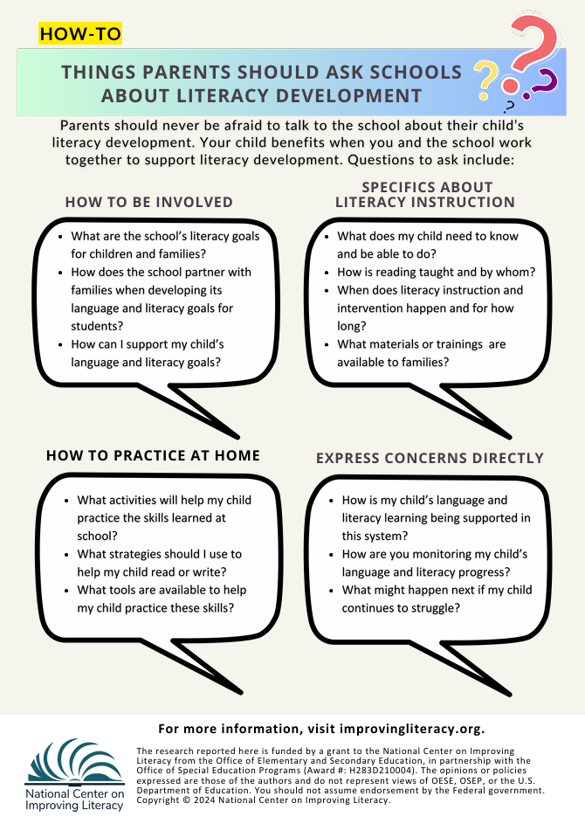
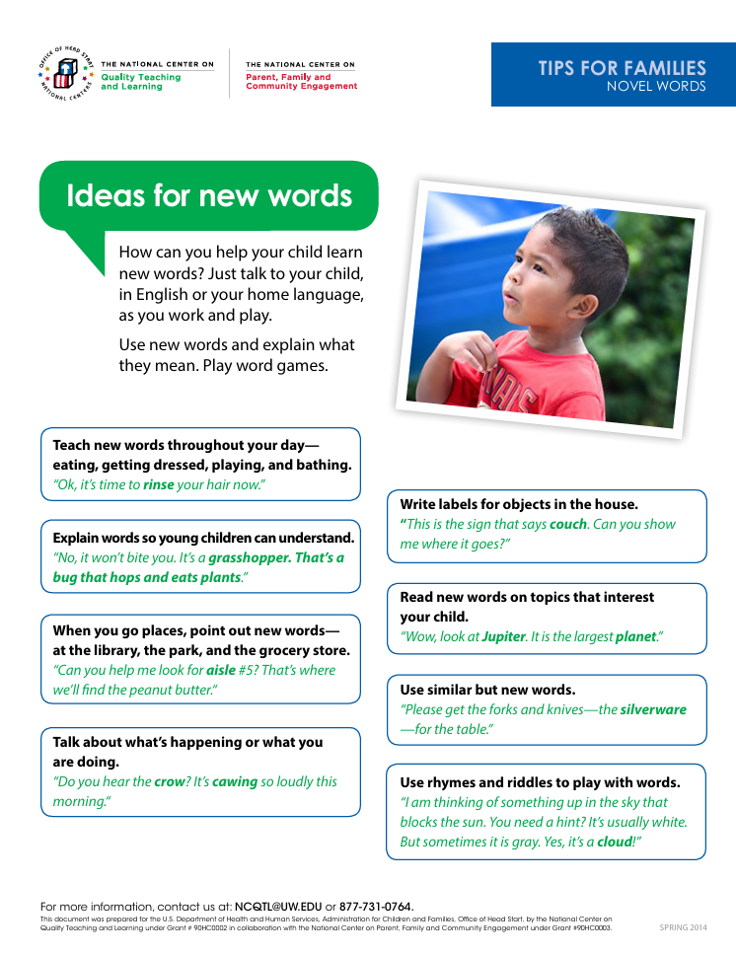


Additional Resources
Supporting Your Child’s Emergent Literacy Development at Home
Tips for Families: Novel Words
How Families Can Partner with Schools on Literacy Development
Notes:
Supporting Your Child’s Emergent Literacy Development at Home -. Supporting Your Child’s Emergent Literacy at Home
Resource Link Tips for Families: Novel Words: TIPS FOR FAMILIES: NOVEL WORDS
Resource Link: How Families Can Partner With Schools on Literacy Development – National Center on Improving Literacy

Slide 64
Questions ?
Notes:
Slide to use for soliciting questions from participants and discussing answers on session content and related information at the end of the workshop. Review the big ideas from all three sessions and clarify as needed.

Slide 65
Thank You!
[insert personal contact information]
Contact NCIL: https://improvingliteracy.org/contact-us/
Email: info@improvingliteracy.org
Notes:
Slide for inserting contact information so participants can communicate with you after the workshop.

