Slide 1
Supporting Your Child’s Literacy Development
Adolescent
[insert - Presenter Name]
[insert - Presenter Title]
If you have questions after the presentation, please contact: [insert contact name and email]
or
Contact | National Center on Improving Literacy at nciliteracy@gmail.com
Notes:
How to present this slide deck:
This slide deck is intended to be use and modified to meet the needs of your organization. The following information should be used to assist you, the presenter, as you modify the slides to meet the needs of your audience. At the bottom of the notes on this slide is the script to introduce this presentation.
Text coding:
Bold text = Presenter Script (what the presenter should say)
Italic text = Ideas for activity or interaction
Underlined text = specific contexts (e.g., zoom vs in-person)
Yellow highlighted text is for you to customize based on your state/grade for the presentation
Regular text = Presenter notes (reminders or instructions)
Regular text with bullet = specific instruction
Information in Notes:
* Asterisks indicate hints or ideas for customization
If there is a video, the link will be provided in the slide notes. The transcript for the video is provided so that you can decide if you want to show the video, or if you want to cover the topic through a discussion.
CLICK, directions for animated slides
Slides Information:
Hidden slides are optional and may be used at the presenter's discretion based on the needs of the audience.
The pink backpack on a slide indicates there are resources to either be distributed during the workshop, or to provide for participants to review later. You can click on the icon directly from the slide to access the online version. The URL is included in the speaker notes. If the training is in person, you may choose to print some out and distribute as handouts.
---
Greet participants and begin workshop with introductions as needed. Follow the facilitation procedure notes appropriate for the workshop session.
Welcome to the National Center on Improving Literacy’s workshop on learning about your child’s reading development. Children who struggle learning early literacy skills are at risk for reading and academic difficulties later. As a parent or caregiver, being informed about the parts of literacy, how your child learns to read, and why he or she might struggle can help you make better decisions about your child’s education. This workshop is part two of a four-part series on key roles that families can play for children’s literacy success.

Slide 2

Supporting Your Child's Literacy Development
Notes:
Note: Greet participants and begin workshop with introductions as needed. Follow the facilitation procedure notes appropriate for the workshop session.
For the traditional blended and virtual dissemination models, activate the tutorial link and start with the introduction slide and then continue to the next slide.
For the flipped blended dissemination model, ask participants in they have any questions about the purpose of NCIL’s tutorial on Supporting Your Child’s Literacy Development at Home.

Slide 3



The National Center on Improving Literacy (NCIL) is a partnership among literacy experts, university researchers, and technical assistance providers, with funding from the United States Department of Education.
Our mission is to increase access to, and use of, evidence-based approaches to screen, identify, and teach students with literacy-related disabilities, including dyslexia.
Notes:
Today’s workshop was created by the National Center on Improving Literacy. The National Center on Improving Literacy’s mission is to increase access to, and use of, evidence-based approaches to screen, identify, and teach pre-K to grade 12 students with literacy-related disabilities, including dyslexia.

Slide 4
Learn About Supporting Your Adolescent Child’s Literacy Development
This workshop is part of a series on the key roles families play in supporting children’s literacy success. It is designed for parents and caregivers of students in grades 6–12 who want to better understand how reading develops during adolescence and how to strengthen it at home. Families will learn the basics of the Science of Reading and the essential skills older students need to become confident, capable readers.
The research reported here is funded by a grant to NCIL from the Office of Elementary and Secondary Education, in partnership with the Office of Special Education Programs (Award 3: S283D160003). The opinions expressed are those of the authors and do not represent views or policies of OESE, OSEP, or the U.S. Department of Education. You should not assume endorsement by the Federal government.
Notes:
Reading is necessary to access knowledge and children who struggle learning literacy skills are at risk for reading and academic difficulties. This session supports parents and caregivers of students in grades 6–12 who want to better understand how reading develops and how to strengthen it at home. Families will learn the basics of the Science of Reading and the essential skills older students need to become confident readers. The session shares practical, evidence‑based ways to spark interest in reading, build listening and comprehension skills, reinforce speech‑sound and letter‑sound knowledge, and support word reading and oral reading fluency. Parents will also gain simple strategies for nurturing language and literacy through everyday interactions and for partnering effectively with schools to promote reading success. Being informed about the parts of literacy, how children learn to read, and why they might struggle can help you make better decisions about your child's education.

Slide 5
Learning Objectives
By the end of this session, participants will have learned:
Simple, evidence‑based ways to help students think deeply about what they read and build strong comprehension skills.
Practical, research‑supported ideas for creating everyday opportunities for students to read, write, and talk about their thinking.
Strategies and activities that encourage students to explore books, ask questions, and make sense of information.
How to interact with students in ways that support, guide, and keep track of their growing literacy skills.
Notes:
Read through objectives
Note: Participant learning objectives to display and communicate when the workshop begins.

Slide 6

Agenda
Science of Reading and the Simple View of Reading Overview
Engaging in Conversations
Building a Literacy-Rich Environment
Modeling Reading and Writing Behaviors
Being a Media Mentor
Motivating Your Child to Read
The Family-School Partnership
Notes:
Today we have a big agenda to support your adolescent reader. We will go over:
Science of Reading and the Simple View of Reading Overview
Engaging in Conversations
Building a Literacy-Rich Environment
Modeling Reading and Writing Behaviors
Being a Media Mentor
Motivating Your Child to Read
Reading with Your Child
The Family-School Partnership

Slide 7
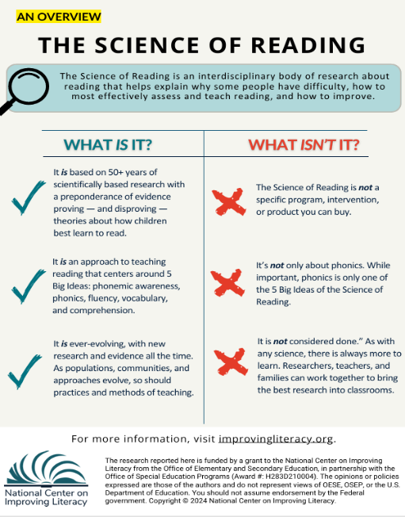
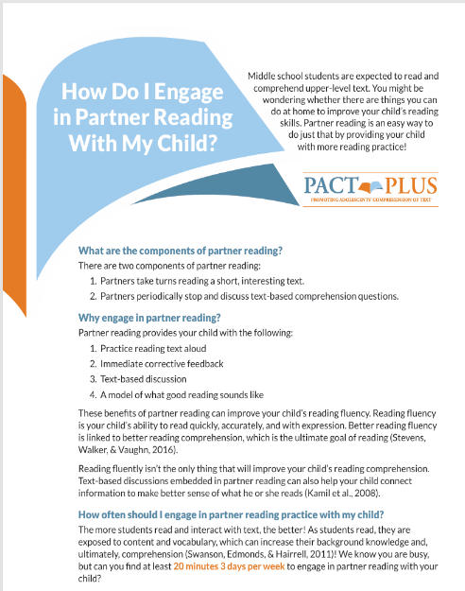
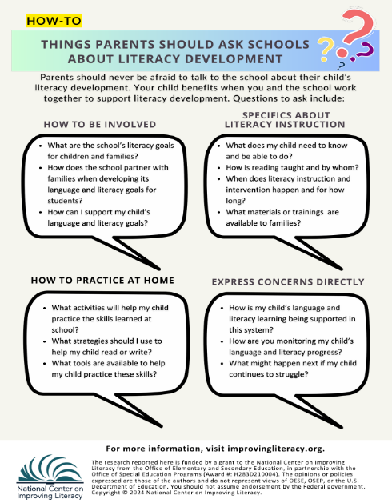
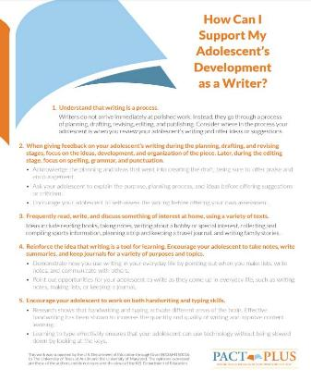





Workshop Materials
Science of Reading and the Simple View of Reading Overview
How Can I Support My Adolescent’s Development as a Writer?
How Do I Engage in Partner Reading With My Child?
The Family-School Partnership
Notes:
Today we have a big agenda to support your adolescent reader. We will go over:
Science of Reading and the Simple View of Reading Overview
How Can I Support My Adolescent’s Development as a Writer?
How Do I Engage in Partner Reading With My Child?
The Family-School Partnership

Slide 8
Science of Reading and the Simple View of Reading Overview

Slide 9
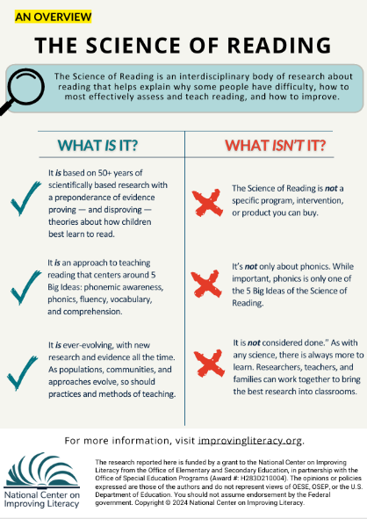

The Science of Reading:
What It Is and What It Isn’t
What It Is
Grounded in 50+ years of research on how children learn to read
Built on the 5 Big Ideas: phonemic awareness, phonics, fluency, vocabulary, comprehension
Continually evolving as communities, populations, and instructional methods change
What It Isn’t
Not a specific program, intervention, or product you can purchase
Not only about phonics—phonics is just one of the 5 Big Ideas
Not “finished”; like any science, it continues to grow as researchers, educators, and families contribute
Notes:
Handout link: The Science of Reading: An Overview – National Center on Improving Literacy
There are so many pieces to the Science of Reading that it can be difficult to know where to start. Here are a few highlights about what the Science of Reading is — and what it’s not. This knowledge will help you on your journey to teaching all children, including those with diverse needs and cultural backgrounds, to read.
The Science of Reading: What It Is and What It Isn’t
What It Is
Based on 50+ years of scientifically grounded research that confirms and disproves theories about how children learn to read
An instructional approach centered on the 5 Big Ideas: phonemic awareness, phonics, fluency, vocabulary, and comprehension
An evolving body of research that grows as communities, populations, and instructional methods change
What It Isn’t
Not a specific program, intervention, or product you can purchase
Not only about phonics—phonics is just one of the 5 Big Ideas
Not “finished”; like any science, it continues to grow as researchers, educators, and families contribute

Slide 10
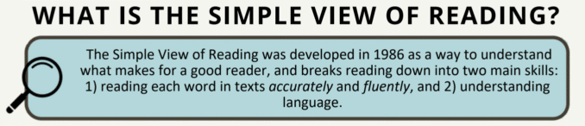
Learning to Read: The Simple View of Reading
Word Recognition
Language
Comprehension
Reading
Comprehension
Notes:
Read what is on the slide

Slide 11
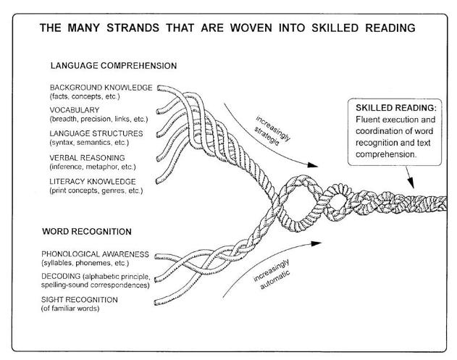
Reading involves two critical skills:
Language Comprehension:
Comprehending the meaning of the text
Students need strategies to read unfamiliar words
They must also recognize previously encountered words
Fluency supports better comprehension
Word Recognition:
Reading each word accurately and fluently
Understanding vocabulary and sentence structure is key
Requires strong language comprehension skills
Image Credit: The image, courtesy of the author, originally appeared in the following publication: Scarborough, H. S. (2001). Connecting early language and literacy to later reading (dis)abilities: Evidence, theory, and practice. In S. Neuman & D. Dickinson (Eds.), Handbook for research in early literacy (pp. 97–110). New York, NY: Guilford Press.
Notes:
Image link: https://institute.aimpa.org/resources/readingrope
Read skills from slide, then add this brief description of Scarborough’s rope:
These critical reading skills are also the strands that create what is know as Scarborough’s Reading Rope. Basically, Scarborough’s Reading Rope is a visual model showing that skilled reading develops when word recognition skills (like phonological awareness, decoding, and recognizing familiar words) are woven together with language comprehension skills (such as vocabulary, background knowledge, and understanding sentence structure). As each strand becomes stronger and more automatic, they intertwine to form a fluent, proficient reader.

Slide 12
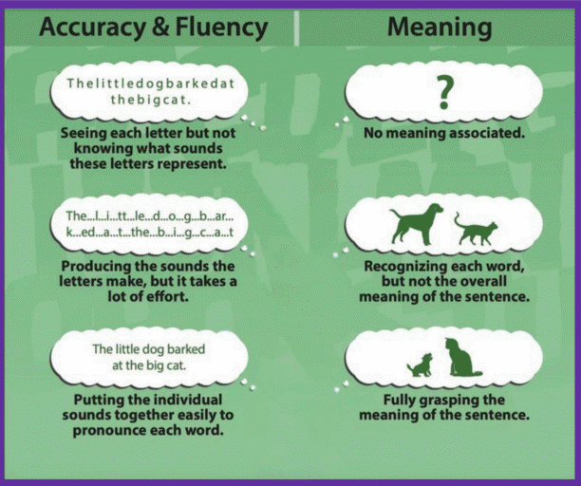
What do these skills look like in the classroom?
Word Recognition Skills
Language Comprehension Skills
Notes:
Read through the progression of building skills as presented on the slide.

Slide 13




Four Key Ways to Support Your Child’s Literacy Development
Note which sounds, letters, words, or ideas seem hard for your child when reading aloud or talking.
Watch for the skills or tasks that appear difficult for your child. See if they improve with practice.
Pause and give your child a chance to correct a mistake. Then try giving her a hint or prompt to figure it out.
Talk with your child about the book or activity. Offer praise when successful and reassure him when difficulties arise.
Listen:
Look:
Help:
Encourage:
Notes:
As we begin to dive into the content of today’s workshop let’s look at four keys to supporting your child’s literacy development. These four keys will be weaved throughout the content we go over.
It’s important to note that parents and caregivers play an important role in supporting children’s literacy development, especially when children are having difficulty. You can support your child in four key ways - by listening, looking, helping, and encouraging - while you and your child participate in activities together. As you try out the literacy tips and activities in this module with your child, you can:
Listen and note which sounds, letters, words, or ideas seem hard for your child when reading aloud or talking.
Look and watch for the skills or tasks that appear difficult for your child. See if they improve with practice.
Help by pausing and giving your child a chance to correct a mistake. Then try giving her a hint or prompt to figure it out.
Encourage by talking with your child about the book or activity. Offer praise when successful and reassure him when difficulties arise.
Talk with your child’s early childhood provider or pediatrician to be sure that you’re ● supporting your child in skills that are developmentally appropriate.
Handout: Distribute copies, review, and discuss the Supporting Your Child’s Literacy Development at Home literacy brief and infographic with participants. Tell participants that the session topic is related to the literacy brief.
Handout link: 10 Ways to Support Your Child's Literacy at Home - NCIL

Slide 14
Engaging in Conversations

Slide 15
Engaging in Conversations
Talk about school, friends, or current events
Ask questions about what they are reading
Discuss information read together
Notes:
When engaging in conversations with your child, talk about school, friends, or current events. For example, discuss everyday life at mealtimes, when traveling in the car, or before bed. Ask questions about what your child is reading and listen to his answers. Discuss information read together. Talk about the author’s message, issues raised, information learned, and his reactions to what was read.
Let’s read a tip for more information about developing conversation skills in your child.
Handout: Distribute, review, and discuss the Just Take 20: Parenting Tips for Teaching Older Kids Conversation Skills
Read Tip resource with participants about tips for teaching older kids conversation skills. Encourage participants to do the Parent Challenge and try these tips to engage their child in rich conversation during their next family dinner and report on how it went at the next session.
Handout link: https://www.fldoe.org/core/fileparse.php/16293/urlt/68TOKCS.pdf

Slide 16
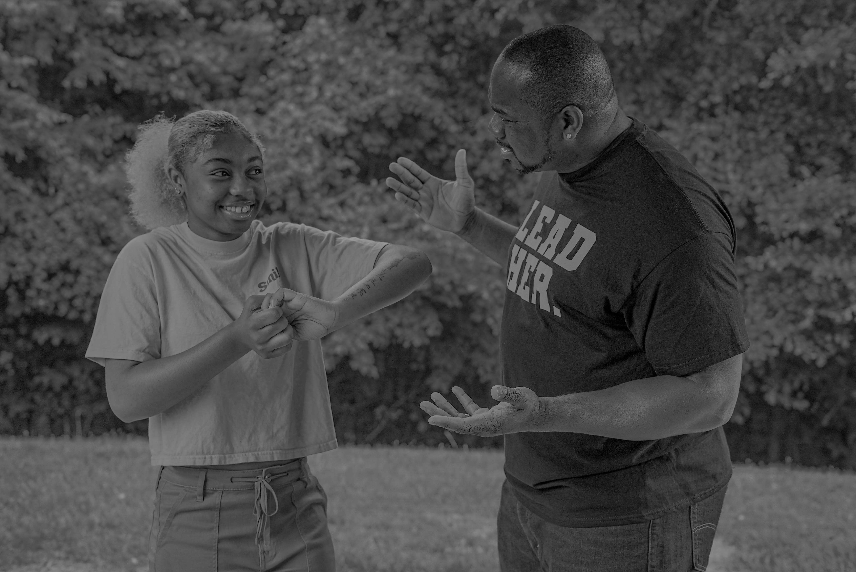



Engaging in Conversations
Does your teen have this key communication skill?
Watch the video to find out.
Watch Video
Video provided by:
Notes:
Being able to hold a meaningful conversation is an important skill for adolescents to have for school and life. Does your teen have this key communication skill? Let’s watch a video to find out.
Video link: https://www.youtube.com/watch?v=Wd-fP4puheo
Video: Play Can your teen hold their own in a discussion? (2:30)
Man: Sorry for starting the meeting late...Woman: I've been thinking about this a lot. I like the day of launch, but I really think for social media we need...Narrator: Ever been in a meeting like this? Man: Let's go over the start of the day. So, we're going to kick off around 8AM...2nd Man: I was thinking we could try that new place for lunch... Narrator: Chances are, your high schooler can do better. Presenter: More public schools than ever are adopting mandatory uniform policies for students. Narrator: Being able to participate effectively in a group discussion is a skill that doesn’t get a lot of attention, but we all know it's important. So what does a good discussion look like? Let's watch. Girl: My neighbor and one of my friends, they had to wear school uniforms, and a lot of people really didn't like it. Picking what you want to wear, it's kind of like expressing yourself. Boy 1: I wore uniforms from kindergarten through 8th grade, and personally, it like, kind of helped me out in the morning. Narrator: They listen actively to each other. This means they're paying attention, even when they're not the one talking. Boy 1: So, I guess it kind of helped me, because I thought I was like, equal with everybody else. Narrator: They ask questions. Girl: Did it surprise you that the studies show that the uniforms didn't make a difference? Boy 1: I was actually kind of surprised because I thought that one of the main reasons that people got picked on was what they wore; and saying that it's not that big of a difference, that surprised me. Narrator: They build on each other's thinking. Boy 2: It's like you said, I don't have to choose how to look good or whatever, but it removes each student's individuality. Narrator: But don't forget - kids are still developing these skills. Some kids will struggle a bit! Teacher: The other kind of area where students struggle in general is analysis, and so it shows in their speaking, when they're explaining their opinion and explaining why they believe in what they believe. Narrator: How can you help? Teacher: Really try to push them to explain, and bring in evidence, and explain how that evidence pushed them into believing that. Boy 1: The guy said that uniforms don't really make that big of a difference, in like, academics. So, I guess it'd just be better not to have uniforms. Narrator: So what to look for in a discussion with your high schooler? Are they... Listening actively? Asking and answering questions? Building on each other's thinking? If they are, then chances are, they're doing better than these guys. Woman: If we had this meeting again, because the morning of, if we build up the momentum, then on the morning of we'll have more to do...
Guiding Question to Check for Understanding: What is your experience having discussions with your child? What has worked and what is difficult?

Slide 17
Engaging in Conversations
Ask questions about what your child is reading to:
See if they can identify key ideas and the sentences from the book that support them
Figure out the meaning of unfamiliar words
Support them if reading gets difficult
Notes:
During conversations about what your child is reading, you can ask questions to make sure he is understanding what is read. See if he can identify key ideas and the sentences from the book that support them, figure out the meaning of unfamiliar words, and support him if reading gets difficult.

Slide 18

Engaging in Conversations
Video provided by:
Notes:
Let’s watch a video to learn about how to check if your teen is understanding what is read. Video on next slide
Video: Play How to know if your teen can understand what they read (2:44)
Video link: https://www.youtube.com/watch?v=b-LsZ7TKGgE
Video: Play How to know if your teen can understand what they read (2:44)
Narrator: Did you know that seventy percent of high school students need some form of reading help and remediation? You might be surprised as to why. Bobby Cupp: One common misconception about reading is that someone who can read the words in a text, also deeply understands those words. Student: After growing up poor in a mostly AfricanAmerican neighborhood of Cincinnati, the young adults have reached their early twenties. One by one their brains were scanned by an MRI...Narrator: Does your child really understand what she reads? Kids who don't really understand what they've read might hesitate, and have trouble answering questions about it. Teacher: What are these couple of paragraphs about? Student: I'm not sure. Narrator: But kids who do understand can show you they do. They can tell you the key ideas in a text, and point to the sentences in that text that support those ideas. Student: I feel like the main idea is talking about how lead has influenced the crime rates and skills in like, school and how you perform. It talks about it right here, after they introduced the lead and how it affects the people that grew up in Cincinnati. Narrator: And as the vocabulary gets harder, they can figure out the meaning of unfamiliar words. Student: It says "I've gotten off to a disastrous start." It means, like, the start is horribly wrong. Narrator: Because texts are more complex, even good readers won't understand everything they read. That's okay, but they need good strategies for sticking with it, to try to understand it. First, kids can reread the text. Teacher: If you're not sure what can you do?
Student: Go back and reread. Narrator: They can ask questions. Student: The main question I had was where the majority of the lead exposure was coming from? Narrator: And they can make notes and annotations. So how do you make sure your child is understanding what he reads? Bobby Cupp: Parents can encourage their students to take a challenging piece of text, paragraph by paragraph. Narrator: So take a few minutes and make sure your high schooler is really understanding when they read. Dad: What are you reading about? Son: I'm reading about how butterflies fly and navigate. Dad: What's the main idea? Son: The main idea is how, when it’s clear and sunny they navigate via the sun; and when it's a cloudy day they follow the magnetic poles of the earth. Narrator: So does your child understand what they read? If they can identify key ideas, and sentences that support those ideas figure out the meaning of unfamiliar vocabulary and stick with it when they don't understand, chances are they do.
Guiding Question to Check for Understanding: What are some ways that you can check your child’s understanding of what he or she reads? What does your child do or say when reading?

Slide 19
Engaging in Conversations
Ask questions that allow your child to think more about what they are reading.
These questions require more than a "yes/no" answer and often have your child explain their thinking.
For example:
"What is the author trying to say?"
"Why do you think the author used that phrase?"
Notes:
Read through slide

Slide 20




Engaging in Conversations
Question prompts for deeper thinking:
What questions would you ask if . . . ?
Do you think . . . ?
What was the problem with . . . ?
How would you . . . ?
Notes:
Different types of questions help your child process what he learned and grow his understanding. Here are some question prompts to promote deeper thinking about what your child is reading.
What questions would you ask if…? What was the problem with…? Do you think…? How would you…? Click read tip for more information about how to promote deeper, or higher-order thinking, in your child.
Guiding Questions to Check for Understanding: How does reading with your child help him or her read? How has what you’ve learned influenced your thinking about engaging your child in conversations?
Note: This completes Section 1: Reading with Your Child and Engaging in Conversations.

Slide 21
Building a Literacy-Rich Environment

Slide 22

Building a Literacy-Rich Environment
A literary-rich environment is a place that encourages reading and writing, such as listening to stories, reading together, and talking about ideas.
You can:
Have a variety of reading material at home
Build off your child's interests
Let your child choose what they read
Notes:
Note: This slide explains why the topic is important/the session big ideas.
A literacy-rich environment is a place that encourages reading and writing, such as listening to stories, reading together, and talking about ideas. To offer a literacy-rich environment, you can have a variety of reading material at home, like magazines, books, and instructional manuals. See what your child picks up as a clue to his interests. Look for reading material that builds on your child’s interests, like sports teams, hobbies, popular culture, or issues facing teens. Finally, let your child choose what he reads.

Slide 23
Building a Literacy-Rich Environment
Types of Reading Material
Books (fiction & informational)
Magazines
Newspapers
Comics
Articles
Blogs
Places to Find Reading Material
Public libraries
Book stores
Thrift stores
Dollar stores
Yard sales
Online
Borrowing from friends!
Notes:
Wondering what kinds of reading material to have at home? Try fiction and informational books, magazines, newspapers, comics, articles, and blog posts. You can find many of these and other reading material at your local public library; book, thrift, and dollar stores; and yard sales. Consider borrowing reading material from friends. Remember, different kinds of reading material can be found online too. Let’s read a tip for information on how to help your teen choose a book.

Slide 24
Modeling Reading and Writing Behaviors

Slide 25






Modeling Reading and Writing Behaviors
Model reading and writing behaviors for your child:
Read and write regularly yourself
Read and write together
Show how reading and writing are related to other activities
Read Tip
Try it Out
Notes:
Note: This slide explains why the topic is important/the session big ideas.
You can model reading and writing behaviors for your child by reading and writing yourself. For example, reading the newspaper, reading online or using an ereader, listening to audiobooks, or making to-do lists. Read and write together. For example, you can read the same book along with your child, try partner reading, or participate in a book club. Blogging and mobile storytelling are fun ways to engage in writing. Show how reading and writing is related to other activities, like planning a trip, adopting a pet, and learning a new skill. Click read tip to find out how to support your teen’s writing development and click try it out to learn how to read together.
Resource: Distribute, review, and discuss the Read Tip resource on How Can I Support My Adolescent’s Development as a Writer? with participants. Have participants review the tips is small groups. Come back together to discuss the phase and steps of and suggested feedback for the writing process and clarify as needed.
Handout link: How Can I Support My Adolescent’s Development as a Writer? - The Meadows Center https://meadowscenter.org/resource/how-can-i-support-my-adolescents-development-as-a-writer/
Resource: Distribute, review, and discuss the Try It Out resource on How Do I Engage in Partner Reading With My Child? with participants. Have participants pair up and give each pair a book. Have them take turns trying out the steps to prepare for partner reading and procedures for doing partner reading.
Handout link: https://meadowscenter.org/wp-content/uploads/2022/04/ParentFlyer_PartnerReading1.pdf
Guiding Questions to Check for Understanding: How does creating a literacy-rich environment help your child read and write? How has what you’ve learned influenced your thinking about modeling reading and writing behaviors?
Note: This completes Session 2: Offering a Literacy-rich Environment and Modeling Reading and Writing Behaviors.

Slide 26
Being a Media Mentor

Slide 27

Being a Media Mentor
Show and tell what you are doing online and why
Check the source of information together
Talk about quality and usefulness of the information
Notes:
Note: This slide explains why the topic is important/the session big ideas.
You can be a media mentor for your child by showing and telling what you are doing online and why. For example, describe how you are using an online mapping tool to find the closest movie theater or why you are using a video call to connect with someone. Help your child to be an educated consumer of information on the internet. Check the source of the information together. Emphasize the need to analyze and think critically about information and images on the internet. Talk about the quality and usefulness of information. Discuss how the source presents the information and why, how to check if the information is correct, and if the information is matched to your child’s purpose. These skills are important ones for researching a topic.

Slide 28

Being a Media Mentor
Does your teen have the skills needed to research a topic?
Watch this video to find out:
Video provided by:
Watch Video
Notes:
Does your teen have the skills needed to research a topic? Let’s watch a video to find out.
Video link: https://www.youtube.com/watch?v=WDNByiAV8tY
Video: Play Research skills your teen needs for college (2:59)
Dad: Hey man, what's up? What are you doing? Son: I'm researching about cars right now, and I believe our next family car should be a Tesla Model S. Dad: A Tesla? Yeah, right. Why? Son: Well, you see, according to safercar.gov, which is a government based site, it has a five-star rating on safety and out of all of the cars in its class, it has the most cargo space. I mean imagine how many groceries we could fit. Dad: All right, that's actually pretty decent research. How'd you learn how to do something like that? Narrator: By this time, your high schooler may or may not be researching the next family car, but they should be pretty comfortable doing research on their own to learn about a new topic. It's a skill that will serve them well in life. Learning starts with a topic and a question. Teacher: Could you read that research question? Student: Does sex trafficking exist in the United States today? I think what makes a good research question is that it's debatable but it's not too narrow, and it's not too broad. Narrator: Next, they look for sources, deciding between good sources, and bad sources. Student: First, I look at the URL, and then I look at the author. Narrator: Two big things to look for in a source: is it reliable, such as a university or major news organization, and is it relevant? This is where you can help. Teacher: Ask them: what are you looking for? What is your research question? Why did you click on this link and not on other links? The student should have an answer for that.
Narrator: And, of course, the big Internet age question: can you use Wikipedia? Student: You could still use Wikipedia as a reliable source, but you’re not going to want to use the information that is said in it because users have the ability to change it. So what you can do is find what you need and there will be a number next to some information and it'll take you to what source they cited. Narrator: As kids read through all the different information and perspectives they've collected, they should be developing a deeper understanding of the topic. Student: Each of the sources I used, they all had a different take on sex-trafficking. It was more helpful for me to get different perspectives on it. Narrator: Ultimately, kids can take their new body of knowledge and create something with it. Student: The final product was a video. I learned that the runaway youth are more prone to being involved in sex trafficking. That pretty much anyone could be a victim of sex trafficking. Narrator: So is your high schooler a research wiz? By the end of high school, students should be comfortable: Choosing a topic that answers the question or solves a problem; Identifying multiple, reliable sources and using all the information to develop a deeper understanding of the topic.
Guiding Questions to Check for Understanding: Does your child use the internet for research and what does it look like? What are the key research skills that you can help your child with?
​
​

Slide 29
Motivating Your Child to Read

Slide 30
MOTIVATING YOUR CHILD TO READ
What Helps Teens Want to Read More
Set clear goals - Help your child understand the purpose of the reading and what they’re working toward.
Offer choices - Let your child choose books, topics, or reading activities to boost interest and ownership.
Encourage reading with others - Partner reading, small‑group discussions, and shared reading build confidence and connection.
Keep Text Difficulty in Mind
Many teens are asked to read texts that feel overwhelming. Don’t be afraid to ask teachers to offer materials on the same topic at different difficulty levels to help your child stay engaged and successful.
Notes:
Helping teens stay motivated to read can be challenging, especially when reading feels hard for them. While there isn’t a huge amount of research on what boosts motivation for older students, experts agree on a few practices that make a real difference. These ideas come from studies summarized by researchers Guthrie and Humenick, and later highlighted by the Institute of Education Sciences.
What helps teens want to read more:
Set clear goals. Teens are more motivated when they know why they’re reading and what they’re working toward.
Offer choices. Allowing students to choose from different books, topics, or reading activities helps them feel more in control and more interested.
Use interesting, engaging texts. When the reading connects to their lives, interests, or curiosity, students are more willing to stick with it.
Encourage reading with others. Partner reading, small‑group discussions, and shared reading experiences help teens feel supported and connected.
Another important factor is the difficulty level of the text. Many middle and high school students are asked to read materials that are far above their reading level. This can feel overwhelming and discouraging. One helpful approach is to provide texts on the same topic at different levels of difficulty so all students can participate and build confidence.

Slide 31


MOTIVATING YOUR CHILD TO READ
Want to promote a love of reading in your teen?
Watch this video to learn how.
Video provided by:
Watch Video
Notes:
Let’s take a look at how families can promote a love of reading in this video.
Video link: https://www.youtube.com/watch?v=4qR3NcunD8g
Video: Play Promoting Love of Reading for Teens (3:36)
Welcome to this segment of our Raising Readers series, Promoting a Love of Reading for Teens. In this segment, I will be sharing some easy and effective ways that you can promote a joy of reading so that even your teens become lifelong readers. Students in middle and high school are often very busy with homework, after-school activities, sports, friends, and other responsibilities so they tend to read less than when they were younger. Therefore, it is very important for parents to encourage their teens to build a love of reading. It is never too late. Reading takes many forms. If your teens are more interested in reading online, or reading magazines, graphic novels, or video game manuals, take heart, they are still reading. Praise your teens for reading. Provide access to the types of things they like to read and encourage them to expand their reading interests. Teens are very social, and taking group outings as a family or with friends to the bookstore or library will connect that social interest to reading. Many bookstores and libraries have special events for teens such as book clubs, poetry slams, or author presentations. In addition, teens enjoy hanging out in the bookstore cafe with their friends reading and discussing books and magazines. Many popular book series for teens have been made into movies, such as Harry Potter, Lord of the Rings, and Twilight. Encourage your teen to read the book first and then to view the movie to consider which they liked better, as well as how the book and movie versions differed. Teens love their smartphones and there are many free reading apps available, such as Word of the Day, Dictionary.com, Words with Friends, Scrabble, eBooks, and Goodreads, which is a social networking site for book reviews and recommendations. Many teens spend a great deal of time playing video games. Encourage your family to play word games together, such as My Word Coach and WordJong Party, Puzzler Collection, and Puzzle Challenge for the Wii video game system. Teens are often interested in current events, sports news, and entertainment news. Make newspapers, either print or electronic, available to your teen to read about these interests. Some popular topics addressed in teen magazines include entertainment, fashion, sports, and video gaming. Consider giving your teen a subscription to a favorite magazine as a gift. Don't nag your teens about reading because doing so will make reading a negative experience for them. Stay positive and keep looking for interesting, appealing materials and opportunities for your teens to read.
Guiding Questions to Check for Understanding: In what ways have you promoted a love of reading in your child? What might motivate him or her?

Slide 32

MOTIVATING YOUR CHILD TO READ
Strategies to Motivate Your Child to Read
Follow your child's lead.
Separate reading for school and reading for fun.
Listen to podcasts and audiobooks in the car.
Try comics, graphic novels, or series.
Notes:
Note: This slide explains why the topic is important/the session big ideas.
You can motivate your child to read by following your child’s lead. Talk with them about their lack of interest in reading. Listen and acknowledge your child’s reasons. Adolescents are expected to read a lot of long and often difficult material for school. It is easy for them to get tired of reading, especially if your child only associates reading with school. Talk to your child about how reading can be enjoyable and even fun. Find a place to read for fun that is different from the place for school, one that is inviting and relaxing. Separate reading for school and reading for fun. Sometimes teens go through times where they might not be motivated to read or write. That’s okay. Continue to provide an environment that encourages your child to do so. Eventually, they will be interested again. Listen to podcasts and audiobooks in the car or have your child try comics, graphic novels, and series, which can be appealing to teens.

Slide 33



How Families Can Partner with Schools on Literacy Development
Communicate and Interact Often
Discuss Literacy Instruction and Intervention
Practice Literacy Skills at Home
Address Concerns Together
Families should ask the school how best to communicate and should feel comfortable to ask questions if more information is needed.
Families should know what literacy standards their child is working on, review whether those expectations are appropriate, and ask whether the instruction and interventions are evidence‑based and focused on the skills their child needs most.
Families should talk with the school about home literacy activities that match the child’s skill level.
Families should discuss with the school which activities or tasks the child has trouble with at home, and what helped. Learn about the school’s system of learning support.
Notes:
Resource Link: How Families Can Partner With Schools on Literacy Development – National Center on Improving Literacy
https://improvingliteracy.org/resource/how-families-can-partner-with-schools-on-literacy-development/
Families should collaborate with the school to make decisions about a child’s literacy education, promote faster development and catch trouble spots early. Here are four things families do to support their child's literacy development.
Communicate and Interact Often - Here are some ways families can share experiences and thoughts with the school: Help in the classroom, Go to meetings (school/teacher orientation, parent-teacher conferences), Join school groups (Parent-Teacher Association or Organization, Family Advisory Council), Ask questions such as: “What are the school’s literacy goals for children and families?” “How does the school partner with families when developing its language and literacy goals for students?” “How can I support my child’s language and literacy goals?”
Discuss Literacy Instruction and Intervention – Ask questions such as: “What does my child need to know and be able to do?” “How is reading taught and by whom?” “When does literacy instruction and intervention happen and for how long?” “How many other children join?” “What school materials or trainings about literacy are available to families?”
There may be a variety of tools to help a child read and write. A few examples are audio books, screen readers, special keyboards, and speech recognition software. Ad discussion with your child's school might assist in identifying what tools are available.
Practice Literacy Skills at Home – Begin by asking how you can support your child at home with questions like: “What activities will help her practice the skills learned at school?” “What strategies should I use to help my child read or write?” “What tools are available to help my child practice these skills?” At home, families can try out different activities and tools and share with the school what worked well and what did not. Let the school know if more information or support is needed, and discuss other ways to practice the skills learned at school, such as at the library or through literacy services in the community.
Address Concerns Together - Take time to understand the school’s position and openly communicate your view. Work together to find a solution to address your child’s learning needs that you both can support. If you and the school disagree, get advice from others on next steps. Ask questions: “How is my child’s language and literacy learning being supported in this system?” “How are you monitoring my child’s language and literacy progress?” “What might happen next if my child continues to struggle?”
How Families Can Partner With Schools on Literacy Development – National Center on Improving Literacy

Slide 34

Quiz Question
Jen has a daughter who reads slower than her peers. She reads to complete school assignments but does not read much otherwise. She'd rather play soccer and spend time with her friends. What can Jen do to support her child's literacy development at home?
Have a variety of reading material, like magazines, comics and articles.
Discuss information read together.
Build on her interests and let her choose what to read.
Separate reading for school and reading for fun.
All of the above.
Notes:
Think about what you’ve learned about supporting your child’s literacy development at home to help Jen. Jen has a daughter who reads slower than her peers. She reads to complete school assignments but does not read much otherwise. She’d rather play soccer and spend time with her friends. What could Jen do to support her child’s literacy development at home? Choose the answer that best fits. Have a variety of reading material, like magazines, comics, and articles available; discuss information read together; build off her interests and let her choose what to read; separate reading for school and reading for fun; or all of the above.
Note: Provide time for participants to review and discuss the scenario. Then, ask participants to discuss the correct answer with their tablemates. Poll participants on the answer and click Submit to see if correct. Check for Understanding: What could Jen do to support her child’s literacy development at home? Correct answer: All of the above

Slide 35
Quiz Question
Jen has a daughter who reads slower than her peers. She reads to complete school assignments but does not read much otherwise. She'd rather play soccer and spend time with her friends. What can Jen do to support her child's literacy development at home?
Have a variety of reading material, like magazines, comics and articles.
Discuss information read together.
Build on her interests and let her choose what to read.
Separate reading for school and reading for fun.
All of the above.
Notes:
Think about what you’ve learned about supporting your child’s literacy development at home to help Jen. Jen has a daughter who reads slower than her peers. She reads to complete school assignments but does not read much otherwise. She’d rather play soccer and spend time with her friends. What could Jen do to support her child’s literacy development at home? Choose the answer that best fits. Have a variety of reading material, like magazines, comics, and articles available; discuss information read together; build off her interests and let her choose what to read; separate reading for school and reading for fun; or all of the above.
Note: Provide time for participants to review and discuss the scenario. Then, ask participants to discuss the correct answer with their tablemates. Poll participants on the answer and click Submit to see if correct. Check for Understanding: What could Jen do to support her child’s literacy development at home? Correct answer: All of the above

Slide 36
Four Key Ways to Support Your Child’s Literacy Development
Note which sounds, letters, words, or ideas seem hard for your child when reading aloud or talking.
Watch for the skills or tasks that appear difficult for your child. See if they improve with practice.
Pause and give your child a chance to correct a mistake. Then try giving your child a hint or prompt to figure it out.
Talk with your child about the book or activity. Offer praise when successful and reassure them when difficulties arise.
Listen:
Look:
Help:
Encourage:
Notes:
As we wrap up let’s review some of the broad things you can do to support your child’s literacy development.
Parents and caregivers play an important role in supporting children’s literacy development, especially when children are having difficulty. You can support your child in four key ways - by listening, looking, helping, and encouraging - while you and your child participate in activities together. As you try out the literacy tips and activities in this module with your child, you can:
● Listen and note which sounds, letters, words, or ideas seem hard for your child when reading aloud or talking.
● Look and watch for the skills or tasks that appear difficult for your child. See if they improve with practice.
● Help by pausing and giving your child a chance to correct a mistake. Then try giving her a hint or prompt to figure it out.
● Encourage by talking with your child about the book or activity. Offer praise when successful and reassure him when difficulties arise.
Talk with your child’s early childhood provider or pediatrician to be sure that you’re supporting your child in skills that are developmentally appropriate.

Slide 37


Questions ?
Notes:
Note: Slide to use for soliciting questions from participants and discussing answers on session content and related information at the end of the workshop. Review the big ideas from all three sessions and clarify as needed.

Slide 38
Thank You!
[insert personal contact information]
Contact NCIL: https://improvingliteracy.org/contact-us/
Email: info@improvingliteracy.org
Notes:
Note: Slide for inserting contact information so participants can communicate with you after the workshop.

