Slide 1
Families and Schools Partnering for Children’s Literacy Success
School Track
[insert - Presenter Name]
[insert - Presenter Title]
If you have questions after the presentation, please contact: [insert contact name and email]
or
Contact | National Center on Improving Literacy at nciliteracy@gmail.com
Notes:
How to present this slide deck:
This slide deck is intended to be use and modified to meet the needs of your organization. The following information should be used to assist you, the presenter, as you modify the slides to meet the needs of your audience. At the bottom of the notes on this slide is the script to introduce this presentation.
Text coding:
Bold text = Presenter Script (what the presenter should say)
Italic text = Ideas for activity or interaction
Underlined text = specific contexts (e.g., zoom vs in-person)
Yellow highlighted text is for you to customize based on your state/grade for the presentation
Regular text = Presenter notes (reminders or instructions)
Regular text with bullet = specific instruction
Information in Notes:
* Asterisks indicate hints or ideas for customization
If there is a video, the link will be provided in the slide notes. The transcript for the video is provided so that you can decide if you want to show the video, or if you want to cover the topic through a discussion.
CLICK, directions for animated slides
Slides Information:
Hidden slides are optional and may be used at the presenter's discretion based on the needs of the audience.
The pink backpack on a slide indicates there are resources to either be distributed during the workshop, or to provide for participants to review later. You can click on the icon directly from the slide to access the online version. The URL is included in the speaker notes. If the training is in person, you may choose to print some out and distribute as handouts.
---
Greet participants and begin workshop with introductions as needed. Follow the facilitation procedure notes appropriate for the workshop session.
Welcome to the National Center on Improving Literacy’s workshop on learning about your child’s reading development. Children who struggle learning early literacy skills are at risk for reading and academic difficulties later. As a parent or caregiver, being informed about the parts of literacy, how your child learns to read, and why he or she might struggle can help you make better decisions about your child’s education. This workshop is part two of a four-part series on key roles that families can play for children’s literacy success.

Slide 2



The National Center on Improving Literacy (NCIL) is a partnership among literacy experts, university researchers, and technical assistance providers, with funding from the United States Department of Education.
Our mission is to increase access to, and use of, evidence-based approaches to screen, identify, and teach students with literacy-related disabilities, including dyslexia.
Notes:
Today’s workshop was created by the National Center on Improving Literacy. The National Center on Improving Literacy’s mission is to increase access to, and use of, evidence-based approaches to screen, identify, and teach pre-K to grade 12 students with literacy-related disabilities, including dyslexia.

Slide 3
Learn About Families and Schools Partnering for Children's Literacy Success
This workshop is part of a series on the key roles families play in supporting children’s literacy success. It is designed for parents and caregivers of students in grades Pre-K to 12 who want to better understand how to partner with schools to foster their child’s literacy success. Families will learn skills to collaborate with the school to make decisions about their child’s literacy education, promote faster development and catch trouble spots early.
The research reported here is funded by a grant to NCIL from the Office of Elementary and Secondary Education, in partnership with the Office of Special Education Programs (Award 3: S283D160003). The opinions expressed are those of the authors and do not represent views or policies of OESE, OSEP, or the U.S. Department of Education. You should not assume endorsement by the Federal government.
Notes:
Today we’re focusing on one of the most important parts of helping children grow as readers — the partnership between families and schools. This workshop is part of a larger series designed to support parents and caregivers with children in grades Pre‑K through 12. Our goal is to help you understand how to work with your child’s school so you can make informed decisions together, spot early signs of difficulty, and support strong literacy development at home. Everything we share is grounded in research funded through the National Center on Improving Literacy. By the end of this session, you’ll walk away with practical ways to collaborate with your child’s teachers and feel confident advocating for their literacy success.

Slide 4
Agenda
Workshop Overview
Session 1
  Family Engagement
  Communicate and Interact Often
Session 2
  Discuss Literacy Instruction and Intervention
Session 3
  Share Literacy Resources
Session 4
  Address Concerns Together

Slide 5
Learning Objectives
By the end of this workshop, participants will be able to:
Communicate and interact effectively with the school by knowing how to ask questions, seek clarification, and stay informed about their child’s literacy progress.
Discuss literacy instruction and intervention with confidence by understanding what their child is expected to learn and whether instruction and supports are evidence‑based and targeted to their needs.
Support literacy practice at home by identifying activities and strategies that match their child’s skill level and coordinating with the school to reinforce learning.
Address concerns collaboratively by sharing observations from home, understanding the school’s system of support, and working together to determine next steps when challenges arise.
Notes:
By the end of our time together, you’ll feel more confident partnering with your child’s school around literacy. We’ll talk about how to:
Communicate and interact effectively with the school by knowing how to ask questions, seek clarification, and stay informed about their child’s literacy progress.
Discuss literacy instruction and intervention with confidence by understanding what their child is expected to learn and whether instruction and supports are evidence‑based and targeted to their needs.
Support literacy practice at home by identifying activities and strategies that match their child’s skill level and coordinating with the school to reinforce learning.
Address concerns collaboratively by sharing observations from home, understanding the school’s system of support, and working together to determine next steps when challenges arise.

Slide 6
Workshop Materials
Session 1
Why Family Engagement Matters for School Success
Bridging Families Culture and School
Understanding Screening: Overall Screening and Assessment
6 Strategies for Partnering with Families
Creating Authentic Partnerships with Historically Marginalized Families and Other Stakeholders: Embracing an Equity Mindset
Reading Milestones
Session 2
What Do We Mean by Evidence-Based Literacy Resources?
10 Key Reading Practices for All Elementary Schools
10 Key Reading Practices for All Middle and High Schools
10 Key Writing Policies and Practices for All Schools
Evidence-based Teaching Practices
Tips for Administrators, Teachers, and Families: How to Share Data Effectively
Intensive Intervention: An Overview
Session 3
Tips for Teaching Your Child About Phonemes | Reading Rockets
What is Decoding
Improving Reading Comprehension in Kindergarten Through 3rd Grade
Session 4
Recognizing Reading Problems
Defining Dyslexia
Understanding Dyslexia: Myth vs. Facts
Neurological Considerations for Dyslexia
Understanding the New IDA Dyslexia Definition
Child Find Duty Quick Guide

Slide 7
Session 1:
- Family Engagement
- Communicate and Interact Often
Notes:
Learning to read can be joyful and fun, but it can also be upsetting and hard for many children. Some children may need extra help learning the skills needed to read and write well. This is common since learning to read is complicated. You and families can work together to support children’s academic and emotional well being to help him or her thrive.
Trust is the primary ingredient for strong home-school relationships. If you and families haven’t developed trust, you probably don’t communicate openly with one another. If you don’t communicate openly with one another, then it’s difficult to partner well. It can take time to build trust, but when space is given for all voices – including those of children - to be heard, acknowledged, and understood, it is a good start. Building trust over time can help break down assumptions and misunderstandings among you, children, and families and result in better relationships.

Slide 8

Session 1 Learning Objectives
To learn the characteristics of family engagement and the conditions that support effective home-school partnerships for literacy
To learn what family engagement may look like in a system of literacy support and services, like a Multi-tiered System of Support for Reading (MTSS-R)
Notes:
Participant learning objectives to display and communicate when the workshop begins.

Slide 9




What is Family Engagement?
It is a shared responsibility among families, schools, and communities for student learning and achievement
It is continuous from birth to young adulthood
It occurs across multiple settings where children learn
Learn More
The National Association for Family, School and Community Engagement
Watch Video
Try it Out
Video provided by:
ThePhoto by PhotoAuthor is licensed under CCYYSA.
http://bit.ly/4eJYJIW
Notes:
The first step in partnering with families for children’s literacy success is for you and families to have common agreement on what family engagement means. A shared understanding sets the stage for the type of partnership that will support children’s literacy learning.
What is family engagement? First, family engagement is a shared responsibility among families, schools, and communities for student learning and achievement. This means it relies on open communication, joint learning, and mutual decision-making among families, schools, and communities. When you pair your knowledge of children with that of families, children’s learning improves. Second, family engagement is continuous from birth to young adulthood; it is not just something that happens when children are very young. Third, family engagement occurs across multiple settings - like school, home, and community - where children learn. When you prioritize family engagement, students’ self-confidence, motivation, attendance, grades, and test scores improve.
Equitable family engagement focuses on meaningful engagement activities and systems between schools and families that do not characterize or treat specific parent groups as deficient in their level of engagement or approach to education. This includes specific practices or approaches that reflect the values of a general group of families, as well as systems that foster tailored supports, flexible engagement options, and coordination between families and schools.
Click Watch Video to hear Dr. Karen Mapp share tips for educators on partnering with families.
Click Learn More for six shifts needed for better family engagement.
Video: Play Watch Video Scholastic (2:03):
Video Link: Dr. Karen Mapp Shares Advice for Educators on Family and Community Engagement Strategies https://www.youtube.com/watch?v=6j-Hkl5vIS4
Transcript: So my three tips for educators would be one, that when you are trying to improve your practice when it comes to family engagement you have to really examine your core beliefs about your families - how you see the families in the community - do you look at them through a deficit lens that perhaps you don’t see them having strengths, or do you look at them as assets, people who have knowledge and skills that you really need to help you be an effective educator. The second tip would be to change the communication from being about negative news or bad news to positive news. And so I always say to teachers, especially make those first phone calls home especially at the beginning of the year about positive information or text things about what the child is doing that’s good. Families tell me that the only time they hear from schools is when it’s bad news. I think the third piece would be to really think about making those communications be about academics and not about discipline. So it sort of goes with number two, but more specifically when you’re talking to families, let them know what their children should know and be able to do. Families really want to know that information. They don’t want to just know that Johnny’s been a good boy or that Suzie is nice, because a lot of my families say that’s the kind of feedback we get; well, your child is nice. They want to know what their child should know and be able to do in October and in January and in June and they want to help you get there. So, those would be the three tidbits that I’d like to share with educators of how they can do something different with their families.
Guiding question to check for understanding: What tip resonates most with you and why?
Click Learn More - Display and review, and discuss Family Engagement and Student Success: What the research says with participants. Tell participants they can refer to this infographic for current research-based ideas on how to engage families as partners.
Link: https://www.understood.org/en/articles/family-engagement-and-student-success
Click Try it Out to engage in the activity – if time permits
Activity:
Display How to begin positive relationships with families: 8 tips to try
Link: https://www.understood.org/en/articles/eight-tips-to-build-a-positive-relationship-with-your-students-families
http://bit.ly/4eJYJIW
Have participants use either the QR code or the bit.ly link to access the "8 tips to try" site.
We’re going to take the next few minutes to explore a quick activity that helps us strengthen our relationships with families using a resource from Understood.org. Go ahead and open the article titled ‘Eight Tips to Build a Positive Relationship With Your Students’ Families.’
Step 1 — Skim & Spot (1 minute)
Ask teachers to open the article and skim the eight tips. Their task: Choose one tip that feels most doable for them in the next two weeks.
Prompt:
“As you skim, look for the tip that makes you think, ‘Yes, I could start this right away.’”
Step 2 — Name the Move (1 minute)
Teachers jot down (on a sticky note or chat box):
The tip they chose
One sentence describing why it stood out
One word that captures the impact it could have (e.g., trust, clarity, connection, calm)
Step 3 — Try It on Your Practice (2 minutes)
Teachers quickly plan a micro‑action they can take this week that aligns with their chosen tip.
Examples:
If they chose “Reach out early and often,” their micro‑action might be: Send a 2‑sentence welcome text to three families this week.
If they chose “Ask families what works for them,” their micro‑action might be: Add one question to my next family check‑in: “What helps your child feel confident at home?”
Think small. What is one action you can take in under 10 minutes that strengthens a family relationship? (pause for about 30 seconds)
Now jot down three quick things—this can be on a sticky note or in the chat if we’re virtual:
The tip you chose.
One sentence about why it stood out.
One word that captures the impact it could have—something like trust, clarity, connection, or calm.
Step 4 — Share & Lift (1 minute)
Invite teachers to share their micro‑action with a partner or in the chat.
Ask participants to share their response to:
What difference might this small action make for one student or family?

Slide 10



A System of Literacy Services and Supports
Literacy instruction
Assessment
Intervention
During the School Day
Outside the School Day
Literacy support
Practice at home
Practice in the community
Examples
Literacy activities
Extra practice activities
Learn More
Notes:
Since family engagement is a shared responsibility across multiple settings, then you and families have important roles in a system of literacy services and support for children’s literacy learning. A system of literacy services and support is the combination of activities that happen during and outside school. Importantly, these responsibilities are shared across both sides, especially in a remote learning situation. This system builds on the strengths of both school and home to help children succeed. When the focus is only on what happens in or out of school, instead of across the two, children may miss important learning opportunities.
A system of literacy services and support works best when in and out of school activities are coordinated and aligned. For example, you can provide families with home activities that reinforce literacy skills previously learned at school or extra practice opportunities for skills currently being learned. To do this, there must be regular occasions for you and families to communicate and interact. This involves the children too. Regular and positive communication and interaction between you and families make partnering to support children’s literacy learning possible. This is especially important in remote learning, which may not resemble a traditional school day.
Click Learn More for information to share with families on why family engagement matters for school success.
Resource: Distribute, review, and discuss Why Family Engagement Matters for School Success with participants
Link: family-engagement-matters.pdf https://www.pta.org/docs/default-source/files/cfe/family-engagement-matters.pdf
Focus on the 5 Ways Families, Teachers, Schools and Communities Can Work Together to Support Children’s Learning and School Success with participants. Tell participants they can use the document later to reflect on what they are doing now and what they might do in the future to promote student success in partnership for literacy with their child’s school. If time permits, see activity below.
Activity: Provide time for participants to use the document to discuss what they are doing now and what they could do in the future to promote student success in partnership for literacy with their families and community. Encourage participants from the same setting to discuss and record their reflections on the document and use it to engage others back at school.

Slide 11
A System of Literacy Services and Supports
Consider new strategies for the Approach and Action
It will not look the same for every family
Use communication practices that are sensitive to families' language and cultural backgrounds
Encourage engagement that sets the stage for literacy partnerships
During the School Day
Outside the School Day
Approach
Attitudes
Atmosphere
Action
Approach
Attitudes
Atmosphere
Action
Learn More
Notes:
How can regular and positive communication and interactions between you and families be strengthened? By focusing on four A’s:
Approach. Approach is the way you and families structure home-school interactions and relationships, like expectations for involvement and recognizing what each of you know about your children. For example, has a shared goal for children’s literacy success been set across home and school?
Attitudes. Attitudes are the values and views you and families hold about home-school relationships and the commitment to family engagement as a key way to improve literacy learning. For example, is there a willingness to share views of children’s literacy performance across home and school?
Atmosphere. Atmosphere is the climate for the interactions between you and families. Is it welcoming and respectful? Are there ways to communicate about children’s literacy learning? Is families and the school’s input used to shape children’s literacy learning?
Action. Action is the joint activities you and families take part in to support literacy learning and the strategies for building shared responsibility for children’s literacy progress and success. For example, are ways to partner with families to help children succeed in literacy provided schoolwide?
The approach, attitudes, and atmosphere usually need to be addressed first before taking action. This is so the home-school relationships can work smoothly to support children’s literacy development, especially if children are having difficulty reading. In remote learning, it is likely that you will need to consider new or refined strategies for the approach and action since remote learning will not look the same for every family. Because communication is innately tied to cultural backgrounds, using communication practices that are sensitive to families’ language and cultural backgrounds encourages engagement and set’s the stage for literacy partnerships.
Click “Learn More Communication.” For more information on tapping the strengths of families by building a cultural bridge,
Distribute and review Bridging Families Culture and School
Resource link: X-Bridging-Families-Culture-and-School.pdf
https://ride.ri.gov/sites/g/files/xkgbur806/files/Portals/0/Uploads/Documents/OSCAS/English-Learner-Pages/EL-Toolkit/X-Bridging-Families-Culture-and-School.pdf
Activity: Have participants share their perspectives on the approach, attitudes, atmosphere, and actions of their school as it related to families.

Slide 12
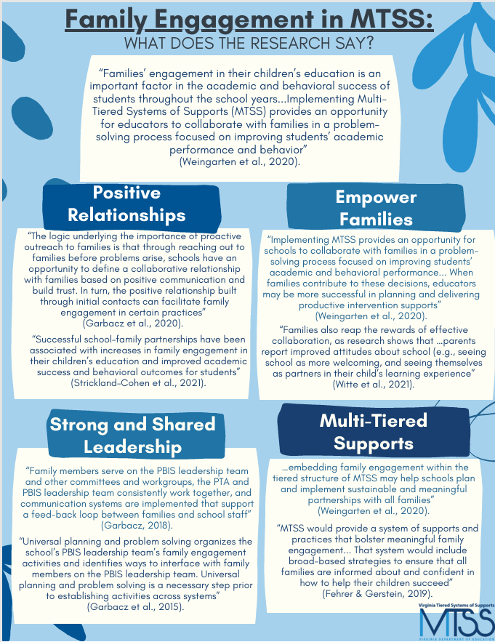
Family Engagement in a System of Literacy Support and Services: Multi-tiered System of Support for Reading (MTSS-R)
A Multi-tiered System of Support for Reading
MTSS-R provides opportunities for families and schools to:
Build positive relationships
Empower families
Provide a system of supports and practices
Engage in a problem-solving process
Support multidirectional communication
Promote a focus on team and data-based decision making
The goal of MTSS is to work WITH families to build systems of support for two-way collaboration
Learn More
Notes:
Families’ engagement in their children’s education is an important factor in the academic and behavioral success of students throughout the school years...Implementing Multi Tiered Systems of Supports (MTSS) provides an opportunity for educators to collaborate with families in a problem solving process focused on improving students’ academic performance and behavior (Weingarten et al., 2020). MTSS-R provides opportunities for families and schools to:
Build positive relationships
Empower families
Provide a system of supports and practices
Engage in a problem-solving process
Support multidirectional communication
Promote a focus on team and data-based decision making
Click for animation box to appear
Click learn more to review the resource Family Engagement in MTSS: What does the Research Say? with participants
Resource Link: Family Engagement in MTSS Copy of Fam Eng in MTSS What Research Says FINAL
https://vtss-resources.vcu.edu/media/resources-vtss-ric/implementation-resources/student-family-community/FamilyEngagementinMTSS,WhatResearchSays11_2024.pdf

Slide 13


A Multi-tiered System of Support for Reading
MTSS-R
A schoolwide framework for instruction and intervention so all children meet literacy goals
Specialized Small Group Instruction
During the School Day
Skill-Focused Small Group Instruction
Learn More
High-Quality Classroom Instruction
Notes:
During the school day, the system of services and support for children’s literacy development is often called a multi-tiered systems of support for reading or MTSS-R. MTSS-R is a school-wide framework for instruction and intervention so all children meet essential literacy goals. In MTSS—R, multiple tiers of instruction and intervention are linked together and get increasingly more intensive so all children get the knowledge and skills they need to reach grade-level literacy goals. Assessments and data are used at all tiers to guide decisions about children’s response to instruction and intervention.
In MTSS-R, schools first identify what children need to know and do to succeed in each grade. Then, schools often screen all children to identify who may be at risk for reading difficulties. Next, schools teach and assess children so they meet literacy goals. Tier one is high-quality classroom literacy instruction for all children in each grade. Children who need only this support read and write well and are on track to meet grade level literacy goals. Tier two is additional small group instruction for some children in each grade. These children need a boost with extra instruction in targeted skills to be on track to meet grade level literacy goals. Tier three is specialized small group instruction for fewer children in each grade. These children need intensive, individualized instruction or intervention to be on track to meet grade level literacy goals.
Click Learn More for information to share with families on screening and assessment.
Resource: Distribute, review, and discuss Understanding Screening: Overall Screening and Assessment with participants. Have participants share how they would use this resource with families and what they would say.
Link: Understanding Screening: Overall Screening and Assessment - NCIL https://improvingliteracy.org/resource/understanding-screening-overall-screening-and-assessment/

Slide 14
A Multi-tiered System of Support for Reading
How can families help?
Participate in school improvement teams, committees, or in other groups
Help develop home literacy lending kits
Family Engagement at each level
Help with after-school literacy programs
Link families to community resources
Notes:
Be sure to provide ways for families to learn about your school’s MTSS–R, why it is being used, and how their children are being supported within the system. When doing so, carefully explain academic or technical jargon or limit its use. Families are important to the MTSS-R problem-solving process. Together with families, review data and make data-based decisions for children’s literacy learning. If your school does not have a MTSS-R, then explain to families your process to identify and provide support for children off-track for meeting grade-level literacy goals. Offer regular occasions for families to share their interests or needs with you so opportunities can be better matched to the learning wishes of families.
There are many ways that families can participate in MTSS-R to support their children in all tiers. The key is for families to have opportunities to do so. For example, families can help the school understand their background, culture, and goals for their children. They can also provide you with information to address the needs and interests of other families like theirs. Perhaps families are seeking information or training offered by the school on specific literacy topics or want to know how to best support their children’s literacy development at home. Or, maybe families are interested in volunteering at the school or organizing help and support from other families. Families can help make school literacy decisions that benefit all children by participating on school improvement teams, committees, or in other groups. Or, perhaps they want help develop home literacy lending kits, afterschool literacy programs, or link families to community resources to support literacy learning. Families are key decision-makers in their children’s literacy learning. Think about the various ways families can give feedback on their children’s literacy goals, instruction, and support.
Activity: Provide time for participants to think about the various ways families can give feedback on their children’s literacy goals, instruction, and support in their setting. Ask for a few volunteers to share their ideas with all.

Slide 15
A Multi-tiered System of Support for Reading
Learn More
Information, materials, and training matched to the literacy needs and goals of individual children and ways to intensify support at home.
Specialized Small Group Instruction
Information, materials, and events matched to the literacy needs of children from specific families and ways to support literacy needs at home.
Intensity
Additional Small Group Instruction
Information, materials and events about literacy teaching and learning, curriculum, goals, and ways to support literacy development at home.
High Quality Classroom Instruction
Notes:
What might family engagement look like in each tier of MTSS-R? It will likely depend on the setting within your school and the needs of families. Since each tier involves a greater intensity of services and support for children, a greater intensity of communication and collaboration is also needed between families and schools. For example:
In tier 1, families may receive information, materials, and announcements about events that focus on your approach to literacy teaching and learning, literacy curricula, literacy goals, screening data, and ways that families can support their children’s literacy development at home. For instance, family literacy nights, group literacy discussions, and guest speakers on family requested literacy topics.
In tier 2, families may receive information, materials, progress monitoring data, and announcements about events matched to the literacy needs of their children and ways for families to specifically support literacy needs at home. Engagement at this tier is meant to prevent further literacy difficulties by coordinating and aligning activities between home and school.
In tier 3, families may receive information, materials, progress monitoring data, and training matched to the individual literacy needs of their children, including ways to intensify support of their children’s literacy needs at home. You can help families learn intervention strategies and activities that they can do and practice at home that are linked to their child’s literacy goals. Click Learn More for strategizes on how you can partner with families of English language learners.
Resource: Distribute, review, and discuss 6 Strategies for Partnering with Families of English Language Learners with participants. Have participants share other strategies they’ve used that have been successful.

Slide 16


Equitable and Meaningful Family Engagement
Equitable family engagement practices in MTSS-R include:
Considering the features of MTSS-R that may have cultural implications.
Consulting with cultural stakeholders in the community.
Facilitating family access to information about the MTSS-R.
Having representation on the MTSS-R/leadership team that reflects the diversity of experiences and perspectives in the school community.
Making materials available in all languages represented within the school community.
Providing staff training in culturally appropriate practices.
Disaggregating data to assess disproportionality.
Notes:
Schools can create meaningful family engagement when they take time to get to know their families so they can be culturally responsive to student and family needs. Equitable family engagement practices in MTSS-R include:
Considering the features of MTSS-R that may have cultural implications;
Consulting with cultural stakeholders in the community;
Facilitating family access to information about the MTSS-R;
Having representation on the MTSS-R or leadership team that reflects the diversity of experiences and perspectives in the school community;
Making materials available in all languages represented within the school community;
Providing staff training in culturally appropriate practices; and
Disaggregating data to assess disproportionality to see if certain student populations are being overidentified for reading disabilities.
Activity: Distribute Creating Authentic Partnerships with Historically Marginalized Families and Other Stakeholders: Embracing an Equity Mindset to participants. Have participants discuss and use this continuum to assess the cultural norms that currently exist and to think about what changes are needed to create authentic opportunities for partnership.
Resource link: Creating Authentic Partnerships with Historically Marginalized Families and Other Stakeholders: Embracing an Equity Mindset

Slide 17





Think About and Respond
What are your language and literacy goals for children and families?
Ask families what their goals are and guide goal setting if needed.
What are the ways families can share information with you about their children's language and literacy learning?
How do you partner with families when developing language and literacy goals for children?
Share objective data about progress.
How can families support children's language and literacy goals?
How do families learn about what children need to know and be able to do in language and literacy?
Notes:
To start talking and interacting often with families, think about and prepare responses to these questions:
What are your language and literacy goals for children and families?
What are the ways families can share information with you about their children’s language and literacy learning?
How do you partner with families when developing language and literacy goals for students?
How can families support children’s language and literacy goals?
How do families learn about what children need to know and be able to do in language and literacy ?
Be sure to ask families what their language and literacy goals are for their children. Guide families in goal setting if needed. Families often wonder first how their individual child is doing. When answering, think about the objective data you can share with families about how their child is progressing. Responses should build common understanding and promote joint action between home and school.
Resource: Distribute, review, and discuss Reading Milestones with participants. Tell participants they can use the information back at their school to think about and prepare responses to the questions and prepare for goal-setting. If time permits, see activity below.
Resource link: https://kidshealth.org/en/parents/milestones.html?view=ptr&WT.ac=p-ptr
Activity: Provide time for participants to use the infographic to think about and prepare responses to the questions. Encourage participants from the same setting to discuss and record their responses and use them to confer and reach consensus with others back at school.

Slide 18
Communicate and Interact Often
Communicate and Interact Often
Families and schools work best when they stay connected
Foster Strong Communication
Ask parents how they want the school to communicate with them
Find out how you will receive communication from home
Feel confident asking questions anytime you need more information
Get Families Involved
Encourage families to help in the classroom when appropriate
Make families aware of school events and meetings (orientation, parent‑teacher conferences)
Ask Questions and Make Suggestions
Ask thoughtful questions to understand how home activities support literacy and offer suggestions to build trust and ensure everyone is working toward the same goals
Notes:
Families and schools work best when we stay connected, and this slide highlights three simple ways to build that partnership. First, strong communication matters—ask how your child’s school prefers to share updates and feel confident reaching out with questions. Next, stay involved in ways that work for your schedule, whether that’s helping in the classroom or attending events. And finally, ask meaningful questions about how the school supports your child’s literacy. These conversations build trust and keep everyone working toward the same goals.
Staying connected is one of the most powerful ways families and schools can support a child’s learning. Strong communication helps everyone understand how your child is doing and what they need. Ask your school how they prefer to share updates, and never hesitate to reach out with questions. You can also stay involved by helping in the classroom, attending meetings, joining school groups, or sharing what you notice at home. Every interaction strengthens the partnership around your child.

Slide 19

Communicate and Interact Often
Families and schools work best when they stay connected
Share Experiences & Build Partnerships
Families bring valuable insights about their child’s strengths, challenges, and learning habits. Sharing these experiences helps the school tailor support and strengthens the home‑school connection.
Ways to Share Your Perspective
Ask families what works well at home
Describe activities or tasks their child finds challenging at school
Ask for clarification when something is unclear
Offer ideas or examples that might help parents work with their child at home
Notes:
One of the most meaningful ways to strengthen that connection is by sharing what you see in the classroom and asking families to share their experiences from home. Families know their child best—what motivates them, what challenges them, and what helps them thrive. When you share what works well, what’s difficult, or when you ask for clarification, it helps teachers tailor support and better understand their child and helps families support their child at home. These conversations build a true partnership centered on your child’s success.

Slide 20

Questions ?
Notes:
Slide to use for soliciting questions from participants and discussing answers on session content and related information at the end of the workshop. Review the big ideas from all three sessions and clarify as needed.

Slide 21
Communicate and Interact Often
The big ideas...
Family engagement for children’s literacy learning and achievement is a shared responsibility among families, schools, and communities. ​​
Trust is the primary ingredient for strong home-school relationships for children’s literacy learning and achievement. Strong home-school relationships rely on open, two-way communication.​​
An effective system of support and services for children’s literacy learning involves home and school partnering together.​​
Notes:
The big ideas from this section include:​
• Family engagement for children’s literacy learning and achievement is a shared responsibility among families, schools, and communities. ​
• Trust is the primary ingredient for strong home-school relationships for children’s literacy learning and achievement. Strong home-school relationships rely on open, two-way communication.​
• An effective system of support and services for children’s literacy learning involves home and school partnering together.​
​
We have now completed the section on talking and interacting often.
​
Note: This completes Session 1: Talk and Interact Often.

Slide 22
Session 2:
- Discuss Literacy Instruction and Intervention
Notes:
You and families can talk about how to partner to help children and others get high quality and effective literacy instruction.

Slide 23
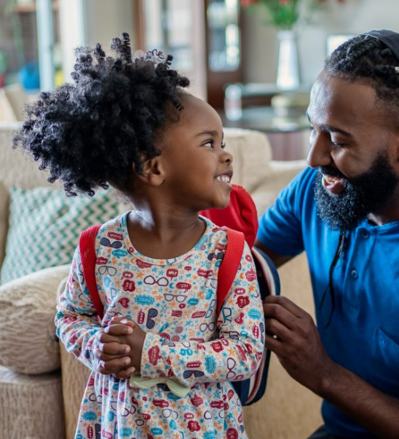
Session 2 Learning Objectives
Discuss Literacy Instruction and Intervention
To learn how families and schools can partner to help children get evidence-based literacy instruction and intervention
To learn what to talk about when discussing literacy instruction and intervention
Notes:
Note: Participant learning objectives to display and communicate when the workshop begins.

Slide 24

Discuss Literacy Instruction and Intervention
Talk about literacy standards, curriculum, and instruction.
Share key instructional materials, concepts or projects to learn how children are learning literacy content/skills.
Use different ways to convey literacy information.
Talk about activities related to literacy goals.
Try it Out Kindergarten
Try it Out 1st Grade
Notes:
You can begin by talking with families about the grade-level literacy standards, how the literacy curriculum and instruction helps children meet the standards, and children’s current literacy data and what it means. It is then important for each of you to continue to discuss the specific literacy goals for children, as they usually change over time. Also, they may differ between home and school. The information shared helps inform children’s literacy profile so you can best match services and support to children’s needs.
It is important to share key instructional materials, concepts, projects, and assessments with families to help them understand how children are learning literacy skills or content, including sharing material in families’ preferred language. Think about the different ways you can convey literacy information to families, like developing a visual display at open houses and back-to-school nights; inviting families’ reactions to the information during school gatherings; posting information on your web site and through other virtual means; and emailing, texting, or using communication apps.
Also, talk about activities related to children’s specific literacy goals. Discuss strategies and tips that families can use with children at home to practice skills. Start by focusing on one, well-understood activity. Provide a demonstration or example. Consider creating literacy learning kits to lend to families for home use. These kits should contain clear directions for use and be tied to key literacy skills or content children are learning. Ask families to let you know how the activity went and where they or their children need extra support. Invite families to participate in literacy activities at events throughout the year where you and families can learn from each another. The activities should be connected to classroom literacy instruction and include an explanation of why they are important.
Click Try It Out Kindergarten for A Kindergarten Teacher’s Guide to Supporting Family Involvement in Foundational Reading Skills.
Link: A Kindergarten Teacher's Guide to Supporting Family Involvment in Foundational Reading Skills https://ies.ed.gov/rel-southeast/2025/01/kindergarten-teachers-guide-supporting-family-involvement-foundational-reading-skills-0
Click Try it Out 1st grade for A First Grade Teacher’s Guide to Supporting Family Involvement in Foundational Reading Skills.
Link: A First Grade Teacher’s Guide to Supporting Family Involvement in Foundational Reading Skills https://ies.ed.gov/ies/2025/01/first-grade-teachers-guide-supporting-family-involvement-foundational-reading-skills
Note: Click each Try It Out to show participants the guides, reviewing the main table of contents areas, and recommend that they review it back at school with the appropriate grade level team. Tell participants that second and third grade versions of the guides are available too.

Slide 25
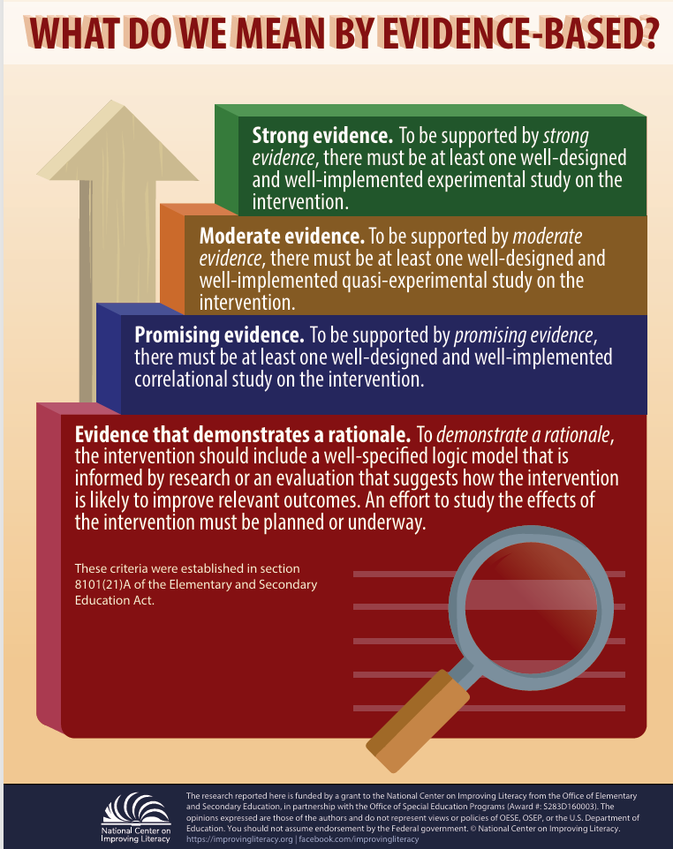

Key Discussion Topics: Evidence-Based Instruction
Discuss Literacy Instruction and Intervention
Learn More
Is the literacy approach, strategy, or program evidence-based?
1
Evidence‑based instruction refers to a teaching strategy or program supported by research showing there is credible evidence that it leads to improved academic outcomes.
Watch Video
Video provided by
Notes:
There are a few key topics to raise when you and your child’s teacher are discussing literacy instruction and intervention. First, find out if the literacy approach, strategy, or program being used with your child is evidence-based. Evidence-based instruction is a teaching strategy or program that research shows there is reasonable evidence that the teaching strategy or program will result in academic gains.
Click "Learn More" to access the infographic "What Do We Mean by Evidence-Based Literacy Resources?" Review the information on what evidence-based means with participants.
Link: https://improvingliteracy.org/sites/improvingliteracy2.uoregon.edu/files/briefs/what-do-we-mean-by-evidence-based.pdf
Knowing what scientific research says about how kids learn to read can help you determine if the literacy approach, strategy, or program being used with your child is evidence-based. What does science say about how kids learn to read?
Click Watch Video to learn more. For more information on how children learn to read, see NCIL’s Learning About Your Child’s Reading Development tutorial.
Video: Play Watch Video What the Science Says About How Kids Learn to Read Education Week (3.55)
Video link: https://www.edweek.org/teaching-learning/video-what-the-science-says-about-how-kids-learn-to-read/2019/12
Transcript: For over a century, researchers have argued about how do children learn to read? But for the last few decades, the research has actually been pretty clear. Written language is a code. Certain combinations of letters predictably represent certain sounds. Teaching young children how to crack the code is the most reliable way to make sure that they learn how to read words. This kind of instruction is called systematic phonics. Connecting printed letters on a page to written sounds isn’t intuitive. While some young children may make those connections on their own, most don’t. The research shows that explicit phonics instruction benefits early readers but particularly those who struggle to read. That’s because small strengthens or deficits at the start of reading compound over time. Of course, there is more to reading than seeing the words on a page and pronouncing it out loud. Children need to make meaning out of the words they read. That means they need deep background and vocabulary knowledge and eventually, they need to be able to recognize most words automatically and read connected text fluently. But knowing how to decode is an essential step in becoming a reader. If children can’t decipher the precise words on a page, they’ll never become fluent readers. In a systematic phonics program, teachers don’t just address the letter-sound connections that students stumble over. They teach all of them in a sequence and teachers explicitly tell students which sounds correspond to which letter patterns rather than ask students to figure it out. Two decades ago, the U.S. government brought together a panel to evaluate reading research. The panel’s report found that among students in kindergarten and first grade, phonics instruction led to improvements in decoding ability and reading comprehension across the board. Children at risk of developing future reading problems, children with disabilities, and children from all socioeconomic backgrounds all benefited. Neuroscience research has since confirmed that explicitly teaching these skills helps people learn how to read new languages more quickly. Of course, phonics instruction, like all teaching, can and should be differentiated to meet the needs of individual students. Once a student knows or learns a phonics skill, he should move on. Many early reading classrooms teach students strategies to identify a word by guessing using context clues and pictures. Neuroscience studies have found that guessing is a much less efficient way to identify a new word. It’s what struggling readers do, not proficient ones. Phonics is essential, but understanding the alphabetic code doesn’t automatically make students good readers. There are five components of reading: phonemic awareness, phonics, fluency, vocabulary, and comprehension. A framework called the simple view of reading explains how comprehension works. It says that reading comprehension is the product of decoding ability and language comprehension. A student needs both good decoding and good language skills to understand what’s on the page. If either one of those is low, then comprehension will be low as well. Many people point out that research show that children who read more are better readers. That’s true, but it’s important to remember that those studies are correlational. It’s unclear if students become better readers because they read more or whether good readers are just more likely to pick up books.
Guiding question to check for understanding: What did you learn about the process of learning to read? What kind of instruction works best?

Slide 26




Discuss Literacy Instruction and Intervention
Key Discussion Topics: Literacy Practices
2
Are the literacy practices appropriate for my child's grade level?
10 Key Reading Practices
K-5
10 Key Reading Practices
6-12
10 Key Writing Policies and Practices
for K-12
Are there missing practices?
Notes:
Second, it is important to identify if the evidence-based literacy practices are appropriate for your child’s grade-level or if any key practices are missing. To better understand what children need to know and be able to do to be successful readers and writers – and the evidence-based practices that can help them get there, let's look at some information from the Meadows Center to help us.
Click 10 Key Reading Practices – K-5.
Click 10 Key Reading Practices – 6-12.
Click 10 Key Writing policies and practices for K-12.
Use these materials as conversation starters with your child’s teacher to discuss the ways in which the school’s literacy curriculum addresses these practices and the progress your child is making in these grade-level skills. Know that you are not expected to take the place of teachers, especially when learning remotely. Instead, help your child practice learned skills and using them in new ways.
Resource: Distribute, review, and discuss the three documents with participants. Tell participants they can use the documents to reflect on the ways in which their child’s school literacy curriculum addresses these practices and how they would use this resource with school staff. If time permits, see activity below.
Activity: Provide time for participants to select one of the documents to reflect on the ways in which their child’s school’s literacy curriculum addresses these practices, noting any gaps. Encourage participants to discuss how they would use this resource with school staff and what they would say (see resource below to use with this activity). Encourage participants to use it to engage others in the community.
Resource: Distribute, review, and discuss Conversation Starters to Use with Your Child’s Teacher with participants. Tell participants they can use the document to prepare for conversations with school staff.
10 Key Reading Practices for All Elementary Schools - https://meadowscenter.org/resource/10-key-reading-practices-for-all-elementary-schools-with-strong-evidence-of-effectiveness-from-high-quality-research/
10 Key Reading Practices for All Middle and High Schools - https://meadowscenter.org/resource/10-key-reading-practices-for-all-middle-and-high-schools-with-strong-evidence-of-effectiveness-from-high-quality-research/
10 Key Writing Policies and Practices for All Schools - https://meadowscenter.org/resource/10-key-writing-policies-and-practices-for-all-schools-with-strong-evidence-of-effectiveness-from-high-quality-research/

Slide 27
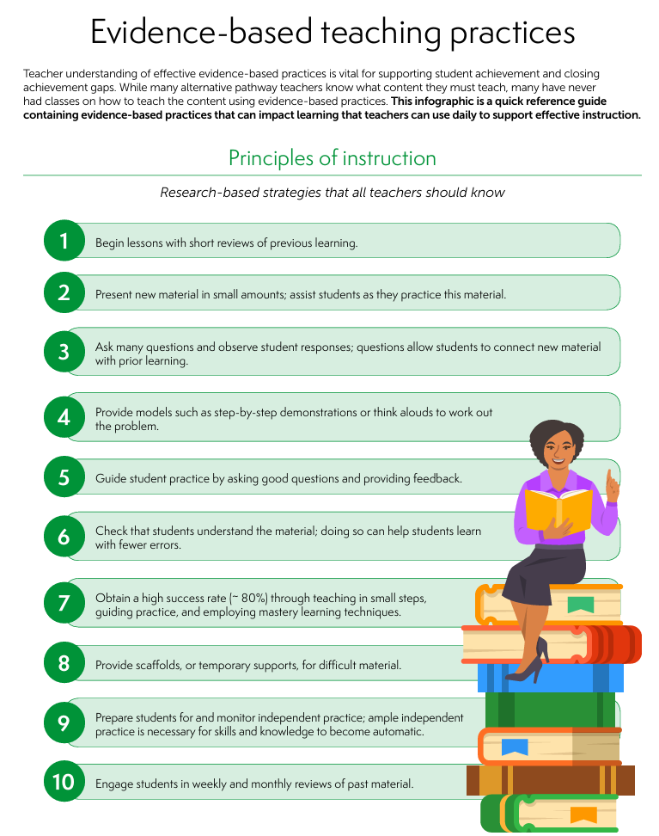

Discuss Literacy Instruction and Intervention
Key Discussion Topics: Instruction Delivery
Is instruction designed and delivered effectively?
3
Different ways to get materials
Flexibility
Accessible and understandable
Find out about additional support
Watch Video
Video provided by
Learn More
Notes:
Third, it is important to find out if the literacy approach, strategy, or program being used with your child is designed and delivered effectively. As we look at instruction delivery, our core question is simple: Is instruction designed and delivered effectively? That means students can access materials in different ways, there’s flexibility built into lessons, and families know how to find additional support when they need it. Remember, effective literacy instruction should be explicit and systematic. Explicit means teaching that is direct and step-by-step, including explaining and showing how to do something and systematic means teaching that has a carefully planned sequence, including building from easier to more difficult tasks and breaking down harder skills into smaller parts. Let's watch a short video explaining explicit instruction.
Click Watch Video to hear what effective literacy instruction should look like.
Video: Explicit Instruction for Struggling Readers Explained
Video link: Explicit Instruction for Struggling Readers Explained - YouTube https://www.youtube.com/watch?v=ZO5tsmIp138&t=14s
Video: Play Watch Video NCIL (4:14)
Effective instruction for students who struggle with reading should be systematic. It should be systematic in that it follows a scope and sequence that builds in level of difficulty and complexity while also building in time for review for students to practice skills they have already learned. It should also be explicit. Explicit instruction that is teacher directed has been proven to be more effective through research than less teacher directed, less explicit instruction. Explicit instruction involves several components. The first is the teacher explanation. The teacher explanation should be short and concise. It should provide an objective or a target area of learning for that part of the lesson, and the quicker the teacher explanation is, the more time there is for students to respond to instruction. So, quick and concise is key with a teacher explanation. The next component of explicit instruction is a teacher model. The teacher model should show students exactly what is expected for a response. Once students know what is expected the model can be dropped to provide additional practice opportunities for students within the lesson. The signal is an important part of explicit instruction as well. The signal includes four parts. It's the focus, the cue, think time, and then a signal for response. A focus shows students exactly what they are working on in the task at hand. A cue is a quick reminder of what they are being asked to do, such as "sound" if they're working on sounds practice. Think time is a crucial component of the signal. The think time allows all students to think about and formulate their response before students give the response in unison as a group. And then the signal to respond shows that all students are ready to respond and all students take part in the practice opportunity. Another component of explicit instruction is multiple opportunities to respond. Which the signal that we just mentioned helps with that. Multiple opportunities to respond could be through the use of whiteboards, or response cards for students. You could also have students work in small groups or work with pairs in a think-pair-share model, where students think about their answers, share them with a partner, before sharing out as a whole group. The big part with multiple opportunities to respond are that all students are practicing and all students are engaged in the lesson. Choral responding is another way that you could have students engage, where all students are responding to the response, in a quick and concise way when answers are the same and short. The pacing of your lesson should be quick and perky to allow all students the opportunity to respond to your instruction and it keeps them engaged as your lesson moves along. One part of your pacing is to remember to add in that think time for each component students are working on. So, embed that into your pacing for all students to have time to think and practice as part of your lesson. Another component of explicit instruction is immediate error correction. Errors should be corrected immediately, in a non-punitive tone, and it consists of two parts for your error correction. The first part is the actual error correction. The teacher models the correct answer and students practice that correct answer. The second component of error correction is part firming. So, students move on from the item that they missed and then loop back later in instruction to make sure that the efficient error correction was effective. Checks for understanding should be frequently embedded throughout your explicit instruction lesson. Frequent checks for understanding can be used to ensure that students are mastering the content that you are teaching or it can identify areas where students need additional practice throughout the lesson. Two to three individual turns is sufficient for each component of your lesson. If all students are given individual turns for each component of the lesson it takes away from student practice opportunities for everyone as you're teaching. Through systematic explicit instruction students are given multiple opportunities to practice and they are given the supports they need to promote literacy development.
Click "Learn More" to access the IES infographic "Evidence-based Teaching Practices" Review the characteristics of effective instruction with participants.
Link: Evidence-based teaching practices
https://ies.ed.gov/rel-southeast/2025/01/infographic-21
Resource: Distribute, review, and discuss Evidence-based Teaching Practices with participants. Tell participants they can use the infographic and information in the video to discuss the ways in which the key reading and writing practices are taught in their child’s school and to request home literacy tips, activities, and homework matched to effective, evidence-based literacy instruction.
Guiding question to check for understanding: What makes instruction systematic and explicit?
Use these materials as conversation starters with school staff to discuss the ways in which the key reading and writing practices are taught in the school. You can also use them to see if home literacy tips, activities, and homework from the school reflect effective, evidence-based literacy instruction. Click Learn More for information on how to judge if activities or strategies sent home from school are appropriate.

Slide 28
Discuss Literacy Instruction and Intervention
  Talk About:
  Literacy Assessment and Data
Talk About:
Literacy Intensive Intervention
Share key assessment tools, rubrics, grading criteria, or strategies to help determine if children are successful in learning literacy content/skills or completing an assignment.
Explain how instruction can be more explicit, comprehensive, intensive, and supportive to target needed skills and knowledge.
Use different ways to convey literacy assessment results and data.
Problem-solve using an ongoing and collaborative process.
Learn More
Learn More
Notes:
When discussing literacy instruction, you can also share information about literacy assessments and data. Sharing key assessment tools, rubrics, grading criteria, or strategies can help families determine if their children are successful in learning literacy content, skills, or completing an assignment. It is important to understand families’ reasons for wanting data on their children’s literacy learning so you can decide the range of data to share and what to prioritize. When families share information about their children - like interests, behaviors, and challenges - it helps you to support children’s learning by making curriculum and instruction more relatable, motivating, and targeted to children. Ensure that assessment results and data are accurate and timely and presented to families in accessible and meaningful ways. There are many paths available for sharing data but also challenges to communicating data well.
Click Learn More – Go to pages 5-6 for how to engage families in data conversations.
Tips for Administrators, Teachers, and Families: How to Share Data Effectively https://ceedar.education.ufl.edu/wp-content/uploads/2022/08/Tips_Sharing-Data-with-Families-HarvardFamilyResearchProject.pdf
When discussing intensive intervention, convey that children with or at risk for reading difficulties usually gain certain reading skills and knowledge more slowly than typical readers. That is why they need much more intensive instruction to keep typical growth patterns in reading. Intensive intervention is an ongoing process that often requires school teams to make a number of changes before children’s performance improves. Intervention may look different over time for children. Try to engage families in the process right from the start. When appropriate, conversations about literacy instruction, intervention, and assessment should also include children. Children who receive intervention are likely to be more invested when they understand the what and why of intervention and may be less likely to feel embarrassed or confused when participating. It is important to imprint early that reading difficulties are nothing to be ashamed of.
Let's learn more about intensive intervention by reviewing an infographic.
Resource: Distribute, review, and discuss Click Learn More for to view and discuss the infographic "Intensive Intervention: An Overview for Parents and Families". Tell participant they can use the infographic to learn more about intensive interventions.
https://intensiveintervention.org/sites/default/files/17-3324_NCII-Family-Overview-508.pdf

Slide 29



Discuss Literacy Instruction and Intervention
Intensive Intervention
Explicit
Watch Video
Comprehensive
Supportive
Video provided by:
Notes:
The instruction in intensive intervention is usually more explicit, comprehensive, and supportive then what is provided to most children and targets the specific types of skills and knowledge that are interfering with children’s reading growth.
As you watch, think about the ways in which the instruction in the video is the same or different from the instruction children might be getting in intervention. Discuss what you saw in the video with your colleagues. Engage and communicate with families about intensive intervention so they understand the expectations, outcomes, and the families’ and school’s role.
Click Watch Video to hear more about what effective reading interventions should look like.
Video: MTSS Alignment: The Key to Effective Reading Intervention (5:10)
Video Link: MTSS Alignment: The Key to Effective Reading Intervention
https://youtu.be/K05Rk0Q99oU?si=cvQdTP943Z1ybME3
Guiding question to check for understanding: What makes a reading intervention different than regular classroom instruction?
Activity – Review, and discuss the handout from the previous slide: Intensive Intervention: An Overview for Parents and Families with participants. Have participants share how they could connect the information from the video and use this resource with families. Have them provide examples of what they would say.

Slide 30





Discuss Literacy Instruction and Intervention
Literacy Discussions: Think About and Respond
What reading skills are taught, how, and by whom?
When does literacy instruction and intervention happen and for how long?
How many other children join?
How does the instruction/intervention align with children's specific language and literacy needs?
What materials or trainings about language and literacy are available to families?
Notes:
To start discussing literacy instruction and intervention with families, think about and prepare responses to these questions:
What reading skills are taught, how, and by whom?
When does literacy instruction and intervention happen and for how long?
How many other children join?
How does the instruction/intervention align with children’s specific language and literacy needs?
What materials or trainings about language and literacy are available to families?
Responses should build common understanding and promote joint action between home and school.

Slide 31





Discuss Literacy Instruction and Intervention
Literacy Discussions: Think About and Respond
What screening practices for language and literacy does the school use and when?
What information does the school collect on my child’s language and literacy progress?
​How is the information used to make decisions about my child’s language and literacy needs?
How are you monitoring my child’s language and literacy progress?
​How are children with reading difficulties identified?
Notes:
To start discussing literacy assessments and data with families, think about and prepare responses to these questions:
What screening practices for language and literacy does your school use and when?
What information does your school collect on children’s language and literacy progress?
How is the information used to make decisions about children’s language and literacy needs?
How are you monitoring children’s language and literacy progress?
How are children with reading difficulties identified?
Responses should build common understanding and promote joint action between home and school.
Activity: Provide time for participants to think about and prepare responses to the questions. Encourage participants from the same setting to discuss and record their responses and use them to confer and reach consensus with others back at school.

Slide 32
Questions ?
Notes:
Slide to use for soliciting questions from participants and discussing answers on session content and related information at the end of the workshop. Review the big ideas from all three sessions and clarify as needed.
Activity: Distribute to participants the Families & Schools Partnering for Children’s Literacy Success Checklist and have them reflect on the item statements related to the session learning objectives, including identifying a next step they will take after the workshop to further action on the item.

Slide 33
Discuss Literacy Instruction and Intervention
The big ideas...
Knowing what scientific research says about how kids learn to read can help you determine if the literacy approach, strategy, or program being used with your child is evidence-based.
It is important to identify if the evidence-based literacy practices are appropriate for your child’s grade level or if any key practices are missing.
Discussing literacy instruction and intervention can help you determine if the literacy approach, strategy, or program being used with your child is designed and delivered effectively.
Notes:
Summarize the big ideas for participants:
• Knowing what scientific research says about how kids learn to read can help you determine if the literacy approach, strategy, or program being used with your child is evidence-based.
• It is important to identify if the evidence-based literacy practices are appropriate for your child’s grade-level or if any key practices are missing.
• Discussing literacy instruction and intervention can help you determine if the literacy approach, strategy, or program being used with your child is designed and delivered effectively.
You have now completed the section on discussing literacy instruction and intervention. Click on the bar to continue.
Note: This completes Session 2: Discuss Literacy Instruction and Intervention.

Slide 34
Session 3:
- Share Literacy Resources
Notes:
When discussing literacy instruction and intervention with families, you both can share literacy resources with one another to better understand and support children’s literacy development and that of others.

Slide 35

Session 3 Learning Objectives
Share Literacy Resources
To learn what literacy resources are important for you and families to share with one another to better understand and support children’s literacy development
To learn how our language system works to listen, speak, read, and write well
Notes:
Note: Participant learning objectives to display and communicate when the workshop begins.

Slide 36
Foundational Skills in Early Reading Instruction
Share Literacy Resources
Phonemic Awareness
The ability to identify and play with individual sounds in spoken words
Phonemes are the smallest unit of sound in spoken language, like /c/ in "cat."
Phonics
Reading instruction on understanding how letters and groups of letters link to sounds to form letter-sound relationships and spelling patterns
Decoding is using your knowledge of letter-sound relationships to sound out words.
Watch Video
Learn More Phonemes
Watch Video
Learn More Decoding
Video provided by
Video provided by
Notes:
When sharing literacy resources, it is important to first understand how our language system works in order to listen, speak, read, and write well. Two important foundational skills in early reading instruction are phonemic awareness and phonics. These two ideas can be easily confused by both teachers and families.
Phonemic awareness is the ability to identify and play with individual sounds in spoken words.
Phonemes are the smallest sound part in spoken language, like /c/ in "cat".
Phonics is reading instruction in understanding how letters and groups of letters link to sounds to form letter-sound relationships and spelling patterns. Decoding is using your knowledge of letter-sound relationships to sound out words. These skills are important building blocks for understanding what you read.
Click Wach Video
Video: Phonemic Awareness: Big 5 in Under 5 (4:52)
Video Link: https://www.youtube.com/watch?t=22&v=TLsCodzmJ6U
Video transcript:
What is Phonemic Awareness? It is the ability to identify and manipulate individual sounds in spoken words. It is essential for learning to read in an alphabetic writing system and a strong predictor of children who experience early reading success – so in other words, if a child can do phonemic awareness tasks, they will most likely be a good reader. To understand phonemic awareness, it’s important to understand that it is the most advanced skill of Phonological Awareness. Phonological Awareness is the ability to recognize that spoken words are made up of individual sound parts. It is like an umbrella under which Phonemic Awareness exists with other levels of phonological awareness. These levels progress from larger sound units to the smallest sound unit, and includes the ability to distinguish sounds at a word-, syllable-, onset-rime-, and phoneme-level. So, phonemic awareness is a skill within phonological awareness that emphasizes an ability to play with words at the smallest unit of sound by identifying, categorizing, isolating, blending, segmenting, adding, deleting, and substituting individual phonemes in words. So, what does Phonemic Awareness look like? For starters, it is an auditory skill. It is the task of being able to pull apart words into their individual phonemes, the smallest unit of language, when heard. Purposeful phonemic awareness instruction includes: Identifying: recognizing a first sound in a word. What is the first sound you hear in cat? /k/ Matching: Taking a beginning sound and noticing it is the same as other beginning sounds. Choose a picture that matches the first sound /d/. Dog and Door. Categorizing: Grouping beginning sounds together that are the same. Is the /k/ in cat the same as the /m/ in map? Is it the same as the /k/ in cap? Is the /k/ in cat the same as the /k/ in can? Cat, cap, and can start with the same sound. Blending: Putting phonemes together to say a word. What word is made up of the sounds /k/ /ă/ /t/? "cat" Segmenting: Saying each phoneme in a word. What are all the sounds you hear in cat? /k/ /ă/ /t/ Deleting: Removing a phoneme to change a word. What is “Cat” without the /k/ sound? “at.” Substituting: Changing a phoneme to make a new word. What word would you have if you changed the /t/ in cat to an /n/? “can” and Adding: which is Adding a phoneme to make a new word. Add /k/ to rash. What is the new word? /k/ rash=crash. How do we teach phonemic awareness? Keep lessons short. Less than 15 minutes. Focus on only 1 or 2 phonemic manipulation activities in a lesson. Use materials that reduce memory load and help represent sounds. For example, using pictures to help children remember the words and to focus their attention or using a 3-square strip or blocks to represent sounds in a word. Tie it to your instruction in reading and writing. So, present an auditory task focused on phonemic awareness, then include the same target sounds in words that students will practice reading or spelling. Once children can blend and segment sounds easily, use letters during lessons as a transition to phonics. Seeing the letters help children associate which sounds go with which letters. Finally, why is phonemic awareness important? It helps children get ready for reading and writing, understand that words are made of smaller sounds and helps them sound out words as they read and write. One of the common differences between readers who struggle and those who don’t, is strong phonemic awareness. First graders who cannot blend sounds into words, or segment words into sounds are likely in need of phonemic awareness intervention. Some students will also need word-level and spelling instruction to explicitly link sounds to print. Thanks for watching the Big 5 in Under 5: Phonemic Awareness.
Click Wach Video
Video: Phonics: Big 5 in Under 5 (4:52)
Video Link: Phonics: Big 5 in Under 5 https://www.youtube.com/watch?v=zHQSSu6BNe0&t=25s
Video transcript:
What is Phonics? Phonics is reading instruction on understanding how letters and groups of letters link to sounds to form letter-sound relationships and spelling patterns. When children know the letter B says /b/ and t-i-o-n says /shun/, they’re using phonics. The ability to apply these predictable relationships to familiar and unfamiliar words is crucial to reading success. Phonics is not a particular reading program. It is an important part of explicit and systematic instruction for beginning readers. Systematic Phonics What does phonics look like? Systematic phonics instruction begins with teaching basic letter-sound correspondence - the relationship of the letters in the alphabet to the sounds they represent - and progresses to more complex letter-sound relationships so that students can decode regular and irregular words. Phonics instruction should be targeted. It should be evidence-based, engaging, systematic, and explicit. Letter Sound Relationships So, how do we teach phonics? While there isn’t a specific, agreed upon instructional sequence for introducing letter-sound relationships, it’s good to begin with the sounds that will enable students to begin reading words as quickly as possible. Start with letter-sounds of high utility such as m, a, and s so students can begin working with words as soon as possible. Work with just a few sounds at a time by teaching each letter of the alphabet and its most common corresponding sound. Instruction should include naming the letter or letters that represent the sound. Separate and stagger letter-sound relationships that are auditorily confusing (b and v) or visually similar (b and d) to promote mastery of one before introducing the other that may create confusion. When introducing each letter-sound relationship in isolation (versus when reading connected text), associate a word beginning with that letter-sound and follow up by introducing an object or picture of that word. Visually representing a word containing the letter-sound being taught can help a student remember the relationship between the letter and the sound. Use that word to create a short sentence or story, read the sentence aloud and then introduce the object or picture. By reinforcing the letter-sound with both the letter in print and the object, this helps the student recall the sound when they encounter the letter later. It’s important to note that pictures as part of phonics instruction are used to associate the sound to the letter and help with memory of that letter and it's sound. The pictures are not used to predict or decode words. Letters should be introduced in uppercase and lowercase when teaching the relationships between letters and sounds. Provide multiple opportunities for students to practice with letter-sound relationships. Once students have a good grasp of the letter-sound relationship you are targeting and are moving on to connected text, focus solely on the letters and sounds in the words . Pictures are not part of the continued building of phonics skills. Why is Phonics Important Finally, why is phonics important? Phonics helps crack the code of written language. Knowing the sounds of letters will help children read - decoding. And helps children know which letters to use when writing – encoding. It’s important to note that phonics is what connects instruction in phonemic awareness, the ability to identify and play with individual sounds in spoken words, to actual print. Phonics has a profound impact on fluency: The ability to read words, phrases, sentences, and stories correctly, with enough speed, and expression. and reading comprehension: the ability to understand what you are reading. Correctly and quickly decoding, or sounding out words, allows children to focus their attention and energy on understanding what they read. Which is what we want all children to be able to do. Thanks for watching the Big 5 in Under 5: Phonics.
For children who struggle to read, working with phonemes and decoding words can be especially difficult. You can share and discuss resources that aid families in helping their children practice these skills at home.
Click Learn More Phonemes for tips on phonemes to share with families. Tips for Teaching Your Child About Phonemes | Reading Rockets
Resource: Distribute, review, and discuss Tips for Teaching Your Child About Phonemes and What is Decoding? with participants. Have participants share how they would use these resources with families and what they would say.
Tips for Teaching Your Child About Phonemes Link: Tips for Teaching Your Child About Phonemes | Reading Rockets
What is Decoding? Link: https://www.understood.org/en/articles/decoding-what-it-is-and-how-it-works

Slide 37

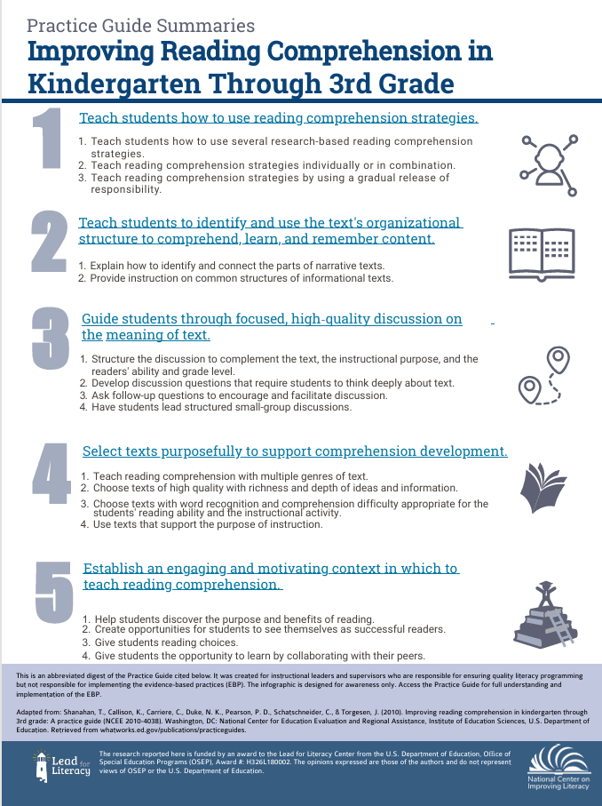


Oral Language | Fluency | Reading Comprehension
Share Literacy Resources
Oral Language
The way you communicate with others through speaking and listening.
Learn More: Comprehension
Fluency
The ability to read words, phrases, sentences and stories correctly, with enough speed and expression.
Reading Comprehension
The ability to understand what you're reading.
Watch Video
Video provided by:
Notes:
Learning to listen, speak, read, and write well also includes developing oral language skills and reading fluently and with meaning. Oral language is the way you communicate with others through speaking and listening. Fluency is the ability to read words, phrases, sentences, and stories correctly, with enough speed, and expression. Reading comprehension is the ability to understand what you’re reading. This is the goal of reading. To understand the meaning of what is being read, child must have strong language comprehension skills.
Resource: Distribute, review, and discuss Improving Reading Comprehension in K – 3 Click Learn More Comprehension for information to share with families on how to help improve children’s reading comprehension.
Link: Improving Reading Comprehension in Kindergarten Through 3rd Grade - NCIL
Click Watch Video to see how to help families choose books for kids who struggle with reading. : Books for Kids | How to Choose a Book https://www.youtube.com/watch?v=TG7Tyco2j1s&t=14s
You may find it difficult to share literacy resources that support all families and communicate them well to families. It can help to consider integrating different modes of dissemination, such as through an learning management system, website, email, texting, social media, public television, or in print. Then, imagine what information families need to access and understand the resources so they can facilitate their children’s learning. Be sure to incorporate explicit yet simple and easy to follow explanations on the purpose and use of the resources to address this.
Video: Play Watch Video Understood (2:56)
Video link: Books for Kids | How to Choose a Book https://www.youtube.com/watch?v=TG7Tyco2j1s&t=14s
Transcript: If your child struggles with reading, finding the right book can be a challenge. Many kids with learning issues have already decided they don’t like to read. So how can we keep them engaged with reading at home? Here are a few ideas. Choose topics your child already likes. Start with topics your child already likes. If she only wants to read about soccer or superheroes, that’s OK. The most important thing is to keep children reading. And as their confidence grows, they might be open to exploring a broader range of topics. Find a book at the right reading level. Try to find a book at the right reading level. Kids get discouraged if a book is too hard. That’s especially true for children who are already struggling at school. One good way to pick a book is to use the “Five Finger Test.” Ask your child to pick a page in the middle of a book and read it aloud. Ask her to hold up a finger for each word she can’t read or doesn’t know. If it’s just two or three words on a page, that’s fine. But if there’s five or more words on a single page, that are too hard, that’s a formula for frustration. It’s probably time to look for a simpler book so your child can read without getting stuck too often. Maybe that harder book is one that you can read together. Choose books that boost your child’s confidence. Don’t worry if your child picks a book that seems too easy. Or, if she wants to read the same book again and again. Reading simpler books at home gives children a chance to develop their fluency as readers and boost their confidence. That’s especially important for kids with dyslexia. As parents, we can use the books our kids love to suggest a related books that’s more challenging. You can say, “Sure, you can read that ‘Elephant and Piggy’ book again. But as soon as you’re done, let’s try this other funny book that I think you might like.” That can be a win/win. Your child gets to read the book she picked out and then hopefully, she’ll try a book that’s a little more difficult and that might expose her to new vocabulary and new ideas. And remember, finding books that your child is interested in is really important. You can find lists of great books for reluctant readers and lots of other helpful resources on Understood.org.
Guiding question to check for understanding: What three tips were shared for finding the right books?
Activity: Have participants share how they would use the resource and information from the video with families and what they would say.

Slide 38
Questions ?
Share Literacy Resources
Notes:
Slide to use for soliciting questions from participants and discussing answers on session content and related information at the end of the workshop. Review the big ideas from all three sessions and clarify as needed.
Activity: Distribute to participants the Families & Schools Partnering for Children’s Literacy Success Checklist and have them reflect on the item statements related to the session learning objectives, including identifying a next step they will take after the workshop to further action on the item.

Slide 39
Share Literacy Resources
The big ideas...
Two important foundational skills in early reading instruction are phonemic awareness and phonics.
For children who struggle to read, working with phonemes and decoding words can be especially difficult.
Learning to listen, speak, read, and write well also includes developing oral language skills and reading fluently and with meaning.
Notes:
Summarize the big ideas for participants:
• Two important foundational skills in early reading instruction are phonemic awareness and phonics.
• For children who struggle to read, working with phonemes and decoding words can be especially difficult.
• Learning to listen, speak, read, and write well also includes developing oral language skills and reading fluently and with meaning.
Note: This completes Session 3: Share Literacy Resources

Slide 40
Session 4:
- Address Concerns Together
Notes:
You and families can discuss what their children have learned and what skills they are still working on. You can encourage families to share their understanding of their child’s learning needs and tell you what activities or tasks are giving their child trouble at home and how they’ve helped.

Slide 41

Session 4 Learning Objectives
Address Concerns Together
To learn what makes reading a complex and unnatural process
To learn how to appropriately address children’s literacy needs early
To learn about reading disabilities, including dyslexia
Notes:
During this session, we’re going to dig into what actually makes reading such a complex and unnatural process for children. We’ll look at how we can recognize and support literacy needs early—before small challenges become bigger ones. And we’ll spend time understanding reading disabilities, including dyslexia, so every child gets the right support at the right time. Our goal is to build shared clarity and confidence as we address concerns together.

Slide 42
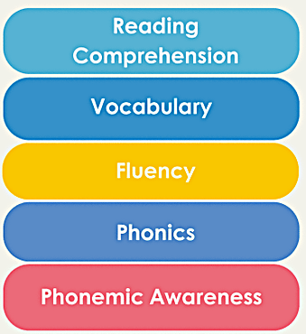

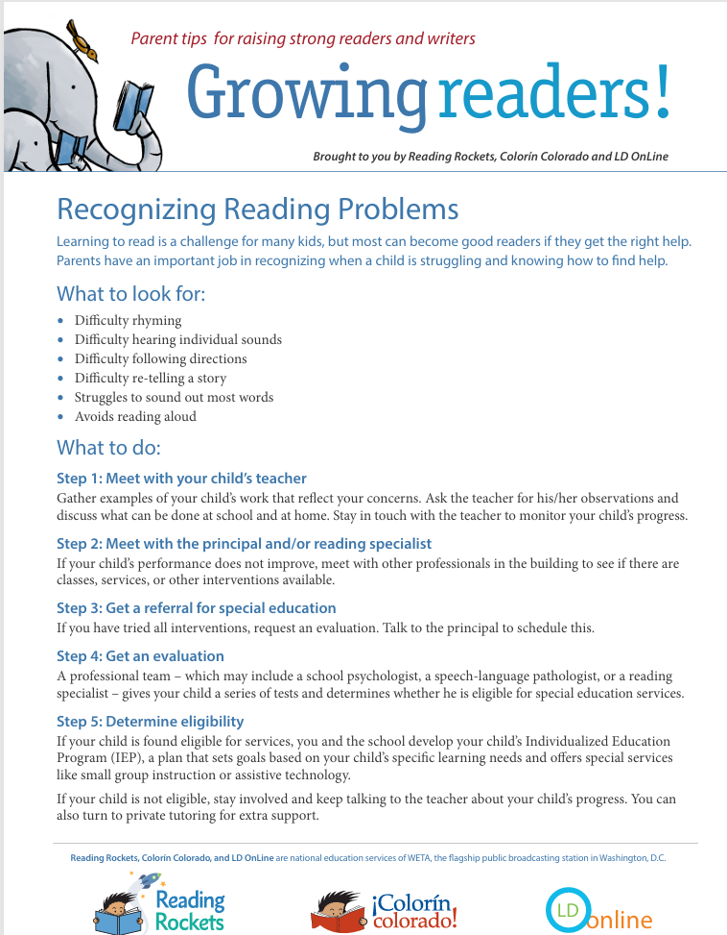

A Complex and Unnatural Process
Address Concerns Together
Watch Video
Video provided by:
Explicit and Systematic Reading Instruction
Learn More
Notes:
Learning to read is a complex and unnatural process. This may explain why so many children do not learn to read through exposure to books and language alone. All children benefit from explicit, systematic reading instruction in phonemic awareness, phonics, fluency, vocabulary, and comprehension. Yet, some children continue to struggle with reading even with high-quality classroom instruction. By appropriately addressing children’s literacy needs early, children can learn to read.
Click Watch Video to see Linda Farrell discuss why every child can become a better reader.
Video link: Reading expert Linda Farrell: Every student can become a better reader
Video: Play Watch Video Reading Rockets (0:35)
I go to some schools and students really aren’t scoring well on their tests. And there are a number of reasons for that. And what is so satisfying is when teachers say, “I know they’re not scoring well on their tests but they can, they can.” We know how to do this. Help us do even more. And that is fabulous because every student can learn more. Every student can learn more. And, I have yet to find a student who cannot learn to decode.
Guiding question to check for understanding: What is your key takeaway from the video?
Click Learn More for information to share with families on how to recognize if their children might have reading problems.
Resource: Distribute, review, and discuss Recognizing Reading Problems with participants. Have participants share how they would use this resource with families and what they would say. Resource Link: Recognizing Reading Problems | Reading Rockets

Slide 43
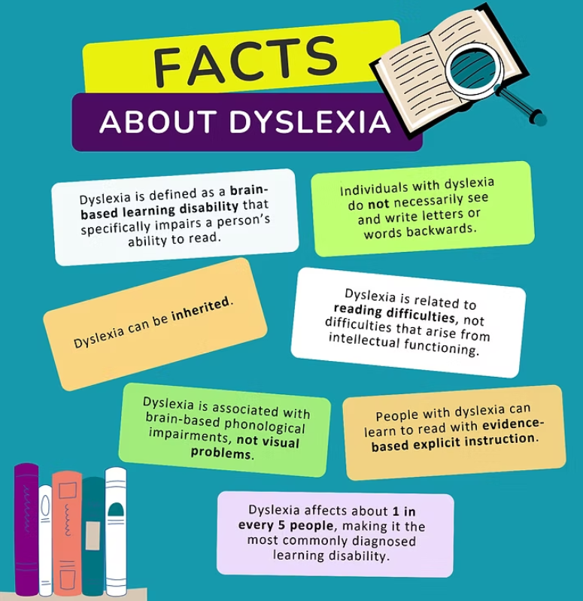
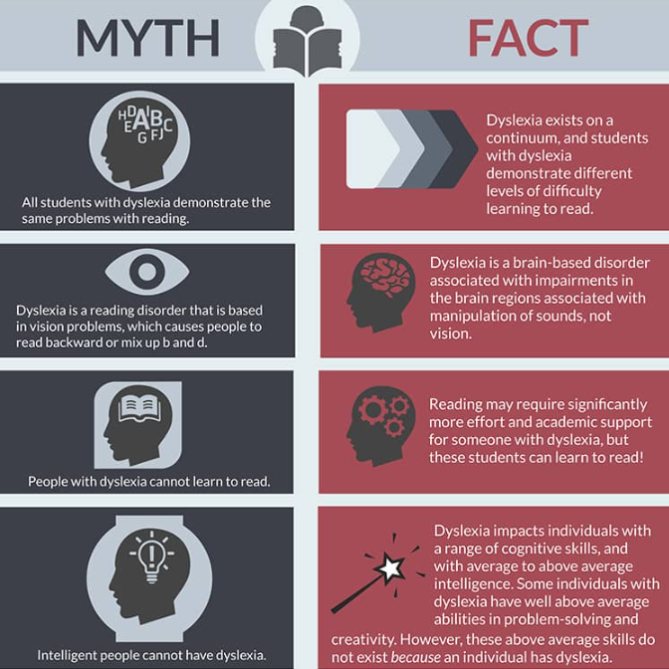


Address Concerns Together
What is Dyslexia?
Dyslexia Myths vs. Facts
Learn More
Learn More
Notes:
Dyslexia affects about one in every five individuals, making it the most commonly diagnosed learning disability. It is a brain-based learning disability that specifically impairs a person’s ability to read. It is brain-based, meaning that specific portions of the brain associated with important reading processes may develop or function differently than those without dyslexia. Individuals with dyslexia may have difficulty decoding letters into blended sounds to form words, spelling, and/or quickly verbalizing printed letters and words.
Dyslexia is related to reading difficulties, not difficulties that arise from intellectual functioning. Individuals with dyslexia have otherwise typical intellectual functioning, meaning that other portions of the brain function similarly to other children.
There are many myths about dyslexia exist. For example, many people think that all individuals with dyslexia demonstrate the same problems with reading. The truth is that dyslexia exists on a continuum, meaning that individuals with dyslexia may have different levels of difficulty with learning to read.
Resources: Distribute, review, and discuss the Defining Dyslexia infographic with participants. Use the literacy brief portion of the resource to expand upon information in the infographic when reviewing with participants. Clarify information and answer questions as needed. Distribute, review, and discuss the Understanding Dyslexia: Myths vs. Facts infographic with participants.
Handout Links:
Defining Dyslexia – NCIL https://improvingliteracy.org/resource/defining-dyslexia/
Understanding Dyslexia: Myth vs. Facts – NCIL https://improvingliteracy.org/resource/understanding-dyslexia-myth-vs-facts/
Note: Click Learn More to show the landing page for NCIL’s Understanding Dyslexia Toolkit for more information on the underlying causes and effects of dyslexia.

Slide 44

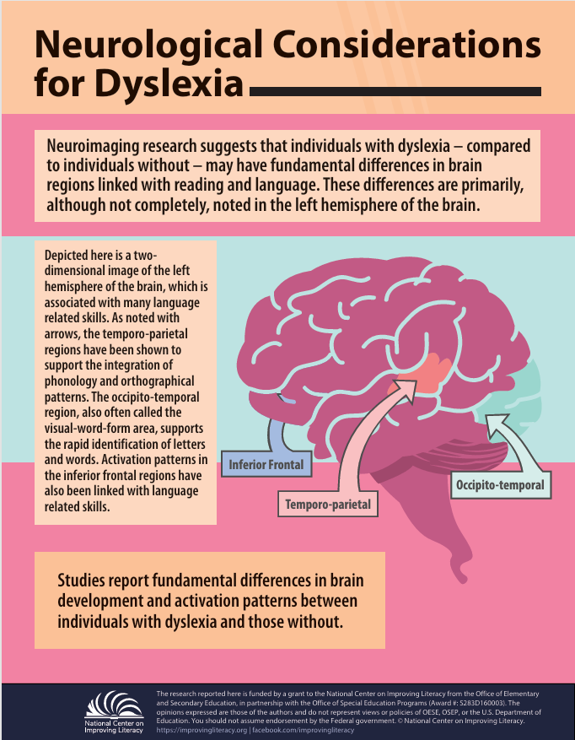

Neurological Considerations for Dyslexia
Address Concerns Together
Learn More
Notes:
If families or you are concerned that a child’s reading difficulties are unexpected and unusual, seek further information from your school supports and others about next steps. One type of learning disability in reading is dyslexia. As we know, reading is not just something children learn; it is something the brain learns to do. When a child begins to read, the brain must connect sounds, letters, and meaning in a fast and smooth way. For many students, this process develops with practice and strong instruction. But for some children, especially those with dyslexia, the brain processes reading in a different way. Understanding this difference can help schools provide better support and improve reading success. Let's take a minute to look at the Neurological Considerations for Dyslexia.
Click Learn More
Resource: Distribute, review, and discuss Neurological Considerations for Dyslexia
Link: Understanding the Brain Basis of Dyslexia - NCIL https;//improvingliteracy.org/resource/understanding-the-brain-basis-of-dyslexia/
Activity
Step 1 — Silent Scan & Sticky Insight (30 seconds)
Ask participants to look at the infographic and silently note:
“What is one thing here that reinforces or challenges what you already believed about dyslexia?”
They jot one phrase on a sticky note (physical or digital).
Step 2 — Three Regions, Three Implications (1 minute)
Say: “This image highlights three major reading-related regions. As I name each one, think about the instructional implication.”
Name each region and prompt a rapid call‑out:
Temporo‑parietal — “What does this suggest about the importance of explicit phonics and phonological work?”
Occipito‑temporal — “What does this tell us about why automatic word recognition must be built, not assumed?”
Inferior frontal — “How does this reinforce the need for structured language instruction that supports meaning-making?”
Keep responses to 1–2 sentences each.
Step 3 — Leadership Lens Quick Turn (45 seconds)
Turn to someone near you and complete this sentence: ‘If dyslexia involves differences in these reading circuits, then leaders must…’
Examples you might hear:
ensure systematic phonics instruction
protect intervention time
avoid guessing‑strategy prompts
invest in teacher training on the reading brain
Step 4 — Collective Takeaway (15 seconds)
Dyslexia is neurological, not motivational. Our leadership decisions either align with how the reading brain develops or work against it. Today’s work is about choosing alignment.

Slide 45

Address Concerns Together
Understanding Dyslexia: What Families Should Know (IDA Definition 2025)
What it means: Dyslexia is a learning difference that makes reading and spelling harder.
It looks different for every child: Challenges can vary depending on the language and writing system.
It’s not about effort: Dyslexia happens because of a mix of brain, genetic, and environmental factors.
Common signs: Trouble with sounds in words (phonological) or word parts (morphological).
Possible effects: Reading may be slow or tiring, and this can affect confidence and school success.
The good news: With the right support and instruction, children with dyslexia can become strong, joyful readers at any age.
Watch Video
Video provided by:
Notes:
Families often ask, ‘What exactly is dyslexia?’ The updated IDA definition helps us see it clearly. Dyslexia isn’t about how hard a child tries—it’s about how their brain processes language. It can look different for every child, depending on the language they’re learning and the kinds of words they see. What’s most important is that early, targeted support makes a big difference. When families and schools work together—sharing strategies, celebrating progress, and keeping communication open—children with dyslexia can thrive. Every child deserves to feel confident and capable as a reader.
In 2025, the International Dyslexia Association updated its definition of dyslexia. I'll give you about a minute to quickly look over this handout on the new definition.
Resource: Distribute, review, and discuss Understanding the New IDA Dyslexia Definition (NCIL). Understanding the New IDA Dyslexia Definition - NCIL
Give participants a few moment to review the infographic. Then move on to showing them the video.
Let’s watch a short video to get the highlights.
Watch Video What's New in the IDA's Definition of Dyslexia
Link: https://youtu.be/dRq5-Bcg93A?si=M8j0h3fsbWASIzot
Transcript:
The International Dyslexia Association updated in definition of Dyslexia for the first time in over 20 years. Both definitions focus on reading a spelling difficulties. But the new one goes further. Dyslexia is not recognized as varying in severity. Every child's experience, and path forward, may look different. Additionally, the new definition extends to life beyond the classroom. It recognizes the impact dyslexia can have on confidence, well-being, and future opportunities. Early support is essential. The new definition says it clearly: The sooner your child gets help, the better the outcome. Is a child in your life struggling with reading? Don't wait. Ask what support is available, at home and at school. For free literacy resources for families, educators, and anyone who supports a child's reading journey, visit improvingliteracy.org.
To review, this slide gives you a clear, updated understanding of what dyslexia means and what to look for. Dyslexia is described as a learning difference that makes reading and spelling more challenging—not a reflection of effort or intelligence. It also looks different for every child, especially depending on the language they’re learning and the writing system they use.
We now know dyslexia has multiple causes, including brain development, genetics, and environmental factors. Some common signs include difficulty working with sounds in words or with meaningful word parts. These challenges can make reading slow or tiring, which can affect confidence and school success.
The most important message is the good news: with the right support and effective instruction, children with dyslexia can grow into strong, confident, joyful readers at any age. Families play a key role in helping make that happen. So what can you do to work with families to address concerns together? Let's see...

Slide 46
Address Concerns Together
Looking at the Full Picture
Reading difficulties can sometimes be linked to limited instruction or lack of opportunity
Schools consider all factors to make fair, informed decisions
The goal is to understand each child’s learning needs—not just label a problem
The Role of Families
Families are essential partners in understanding and supporting reading development
Clear communication about progress and instruction helps families support learning at home
Strong school–family partnerships create consistent support for the child
The Goal
Identifying reading difficulties is about understanding how a student learns
Schools focus on how students respond to instruction and what supports help them grow
With strong systems and the right support, every child can build the skills needed for reading success
What are the next steps if progress is not being made?
Notes:
When we talk about identifying reading difficulties, it’s important to remember to look at much more than a single score or one moment in time. We look at the full picture of a child’s learning. Sometimes reading difficulties can be connected to things like limited instruction or a lack of opportunity to practice certain skills. So before making any decisions, schools consider all of these factors to make sure we’re being fair and fully informed. The goal isn’t to label a problem—it’s to understand what each child needs to grow as a reader.
Families play a huge role in this process. You know your child best, and your insights help us understand how they learn, what motivates them, and what challenges they face. When schools share clear information about progress and instruction, families can better support learning at home. And when families share what they’re seeing at home, teachers can adjust instruction at school. That partnership creates consistent support for the child, which is one of the most powerful tools we have.
Ultimately, identifying reading difficulties is about understanding how a student learns and how they respond to instruction. Schools focus on what supports help a child make progress, and we adjust as we learn more. With strong systems, good communication, and the right support in place, every child can build the skills they need for reading success.
Click for animated box to appear

Slide 47
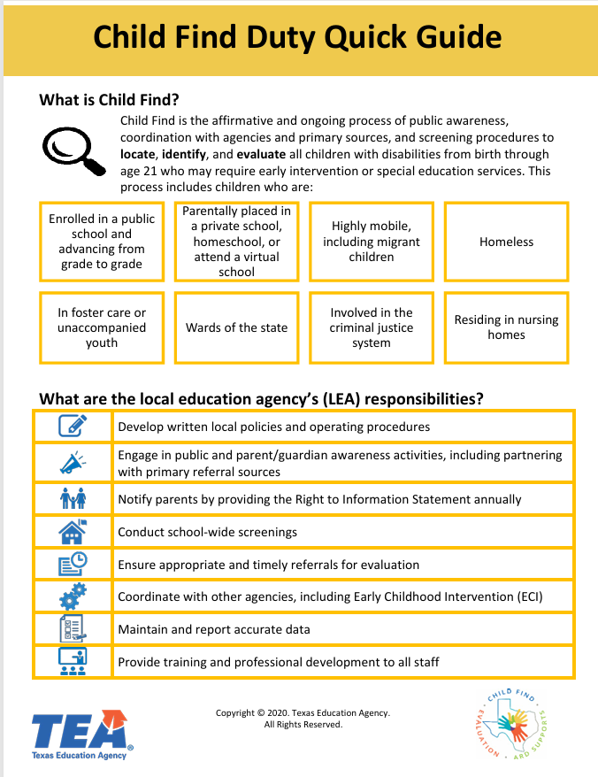

Address Concerns Together
Child Find
Learn More
Child Find: Key Points
Federal IDEA mandate: districts must identify, locate, and evaluate all children who may have disabilities.
District responsibility: cannot wait for parent requests; obligation is proactive.
Applies to all children—any severity, any setting (public, private, homeschool).
States must maintain a practical method to ensure children with disabilities are identified (20 U.S.C. § 1412(a)(3)).
Referral triggers at suspicion, not after interventions are exhausted.
Knowing the process helps leaders spot delays, missteps, or stalled evaluations.
Families may use IDEA procedural safeguards when districts fail to act promptly.
Notes:
Other learning disabilities in reading may be related to challenges in comprehension or a combination of skills. Families can request that the school evaluate their children for a reading disability if they suspect one.
Click Child Find and read the first paragraph aloud to participants.
Link: ECTA Center: Child Find for Young Children with Disabilities
Here are the Key Points to Child Find
In the Individuals with Disabilities Education Act (IDEA), the federal special education law, a child with characteristics of dyslexia or other literacy-related disabilities may qualify for IDEA services under the category of a specific learning disability. Child Find is one of the most important—and sometimes misunderstood—requirements in IDEA. It places a clear, proactive obligation on school districts to identify, locate, and evaluate any child who may have a disability. This responsibility belongs to the district, not the family. That means we cannot wait for a parent to ask for help, and we cannot delay an evaluation because a child is receiving interventions or isn’t yet failing. Child Find applies to all children, regardless of the severity of their disability or where they are educated. Federal law requires every state to have a practical method for ensuring that children with disabilities are actually identified and served. For leaders and educators, understanding how referrals, evaluations, and eligibility decisions work is essential. It helps us recognize when the process is slowing down, being misapplied, or stalling altogether. And when that happens, families have procedural safeguards under IDEA that allow them to push back. Ultimately, Child Find is about ensuring that no child who needs support is overlooked—and that our systems respond as soon as a disability is suspected.
Clink Learn More and distribute and review the Child Find Duty Quick Check. Quickly. Provide 1 –2 minutes for participants to review the resource on their own.
Link: Child Find Duty Quick Guide https://d16k74nzx9emoe.cloudfront.net/d9f07894-9745-4a82-a9fb-28184ccbf835/APPROVED%20and%20508%20Child%20Find%20Duty%20Quick%20Guide.pdf

Slide 48






Think About and Respond
Address Concerns Together
Learn More
Resource: Preparing for Challenging Conversations with Families
How are all children's language and literacy learning being supported in your school's system of literacy services and support?
What types of support can be offered to children if they are struggling to read or write?
What accommodations does your school provide to help children read or write?
What might happen next if children continue to struggle?
https://bit.ly/4bgzGvS
Notes:
To start addressing concerns about children’s literacy development with families, think about and prepare responses to these questions:
How are all children’s language and literacy learning being supported in your school’s system of literacy services and support?
What types of support can be offered to children if they are struggling to read or write?
What accommodations does your school provide to help children read or write?
What might happen next if children continue to struggle?
Responses should build common understanding and promote joint action between home and school.
Activity: Provide time for participants to think about and prepare responses to the slide questions. Encourage participants from the same setting to discuss and record their responses and use them to confer and reach consensus with others back at school.
Click Learn More to display the Preparing for Challenging Conversations with Families Resource. Have participants use the QR code or bit.ly url to access the resource to use for the activity below and back at their school.
Resource: Display, review, and discuss Preparing for Challenging Conversations with Families with participants. Resource link: Preparing for Challenging Conversations With Families https://www.brazeltontouchpoints.org/wp-content/uploads/2021/06/preparing-for-challenging-conversations-with-families.pdf
https://bit.ly/4bgzGvS
Tell participants they can use the document back at their school to practice having these conversations with families. If time permits, see activity below.
Activity: Provide time for participants to pair up and use the guide to articulate and practice having these conversations with families. Encourage pairs to script the conversations using information from the guide, with one participant taking the role of teacher and the other of a family member.

Slide 49
Address Concerns Together
The big ideas...
All children benefit from explicit, systematic reading instruction in phonemic awareness, phonics, fluency, vocabulary, and comprehension.
Some children continue to struggle with reading even with evidence-based classroom reading instruction.
If you or a family member is concerned that a child’s reading difficulties are unexpected or unusual, seek further information from the school and others about next steps.
Notes:
Summarize the big ideas for participants:
• All children benefit from explicit, systematic reading instruction in phonemic awareness, phonics, fluency, vocabulary, and comprehension.
• Some children continue to struggle with reading even with evidence-based classroom reading instruction.
• If you or a family member is concerned that a child’s reading difficulties are unexpected or unusual, seek further information from the school and others about next steps.
Note: This completes Session 4: Address Concerns Together.

Slide 50

Check for Understanding
What can I say or do to find out more about my child's literacy supports and services at school?
Think about what you've learned about partnering with families to help Dave. He is interested in learning about his child's school system of literacy support and services and how his child is being supported within that system. What can Dave say or do to find out more? Choose the answer that best fits.
Find out what opportunities are provided to help with literacy learning at the school.
Discuss what literacy skills his child has learned and what they are still working on.
Ask for literacy activities matched to his child's skill level and share what worked well and what did not.
Request information on his child's literacy progress and talk about what happens if he has concerns about the progress being made.
All of the above.
Notes:
Think about what you’ve learned about partnering with families to help Dave. Dave is interested in learning about his child’s school system of literacy support and services and how his child is being supported within that system. What can Dave say or do to find out more? Choose the answer that best fits. Find out what opportunities are provided to help with literacy learning at the school; discuss what literacy skills his child has learned and what he or she is still working on; ask for literacy activities matched to his child’s skill level and share what worked well and what did not; request information on his child’s literacy progress and talk about what happens if he has concerns about the progress being made; or all of the above.
Click to show participants correct answer
Note: Provide time for participants to review and discuss the scenario. Then, ask participants to discuss the correct answer with their tablemates. Poll participants on the answer and click Submit to see if correct.

Slide 51

How Can I Learn More?
National Center on Improving Literacy
The research reported here is funded by a grant to NCIL from the Office of Elementary and Secondary Education, in partnership with the Office of Special Education Programs (Award 3: S283D160003). The opinions expressed are those of the authors and do not represent views or policies of OESE, OSEP, or the U.S. Department of Education. You should not assume endorsement by the Federal government.
Notes:
Want to learn more? Search the NCIL Resource Repository for literacy resources and activities you use in your classroom, share with parent to do with their child at home or in your community. Resources can be sorted by audience, topic area, and resource type to find resources matched to skills in this tutorial.
Click the icon to take you there.

Slide 52
Questions ?
Notes:
Slide to use for soliciting questions from participants and discussing answers on session content and related information at the end of the workshop. Review the big ideas from all three sessions and clarify as needed.

Slide 53
Thank You!
[insert contact information]
Notes:
Slide for inserting contact information so participants can communicate with you after the workshop.

