Slide 1
Families and Schools Partnering for Children’s Literacy Success
Family Track
[insert - Presenter Name]
[insert - Presenter Title]
If you have questions after the presentation, please contact: [insert contact name and email]
or
Contact | National Center on Improving Literacy at nciliteracy@gmail.com
Notes:
How to present this slide deck:
This slide deck is intended to be use and modified to meet the needs of your organization. The following information should be used to assist you, the presenter, as you modify the slides to meet the needs of your audience. At the bottom of the notes on this slide is the script to introduce this presentation.
Text coding:
Bold text = Presenter Script (what the presenter should say)
Italic text = Ideas for activity or interaction
Underlined text = specific contexts (e.g., zoom vs in-person)
Yellow highlighted text is for you to customize based on your state/grade for the presentation
Regular text = Presenter notes (reminders or instructions)
Regular text with bullet = specific instruction
Information in Notes:
* Asterisks indicate hints or ideas for customization
If there is a video, the link will be provided in the slide notes. The transcript for the video is provided so that you can decide if you want to show the video, or if you want to cover the topic through a discussion.
CLICK, directions for animated slides
Slides Information:
Hidden slides are optional and may be used at the presenter's discretion based on the needs of the audience.
The pink backpack on a slide indicates there are resources to either be distributed during the workshop, or to provide for participants to review later. You can click on the icon directly from the slide to access the online version. The URL is included in the speaker notes. If the training is in person, you may choose to print some out and distribute as handouts.
---
Greet participants and begin workshop with introductions as needed. Follow the facilitation procedure notes appropriate for the workshop session.
Welcome to the National Center on Improving Literacy’s workshop on learning about your child’s reading development. Children who struggle learning early literacy skills are at risk for reading and academic difficulties later. As a parent or caregiver, being informed about the parts of literacy, how your child learns to read, and why he or she might struggle can help you make better decisions about your child’s education. This workshop is part two of a four-part series on key roles that families can play for children’s literacy success.

Slide 2



The National Center on Improving Literacy (NCIL) is a partnership among literacy experts, university researchers, and technical assistance providers, with funding from the United States Department of Education.
Our mission is to increase access to, and use of, evidence-based approaches to screen, identify, and teach students with literacy-related disabilities, including dyslexia.
Notes:
Today’s workshop was created by the National Center on Improving Literacy. The National Center on Improving Literacy’s mission is to increase access to, and use of, evidence-based approaches to screen, identify, and teach pre-K to grade 12 students with literacy-related disabilities, including dyslexia.

Slide 3
Learn About Families and Schools Partnering for Children's Literacy Success
This workshop is part of a series on the key roles families play in supporting children’s literacy success. It is designed for parents and caregivers of students in grades Pre-K to 12 who want to better understand how to partner with schools to foster their child’s literacy success. Families will learn skills to collaborate with the school to make decisions about their child’s literacy education, promote faster development and catch trouble spots early.
The research reported here is funded by a grant to NCIL from the Office of Elementary and Secondary Education, in partnership with the Office of Special Education Programs (Award 3: S283D160003). The opinions expressed are those of the authors and do not represent views or policies of OESE, OSEP, or the U.S. Department of Education. You should not assume endorsement by the Federal government.
Notes:
Today we’re focusing on one of the most important parts of helping children grow as readers — the partnership between families and schools. This workshop is part of a larger series designed to support parents and caregivers with children in grades Pre‑K through 12. Our goal is to help you understand how to work with your child’s school so you can make informed decisions together, spot early signs of difficulty, and support strong literacy development at home. Everything we share is grounded in research funded through the National Center on Improving Literacy. By the end of this session, you’ll walk away with practical ways to collaborate with your child’s teachers and feel confident advocating for their literacy success.

Slide 4
Agenda
Workshop Overview
Session 1
  Family Engagement
  Communicate and Interact Often
Session 2
  Discuss Literacy Instruction and Intervention
Session 3
  Practice Literacy Skills at Home
Session 4
  Address Concerns Together

Slide 5
Learning Objectives
By the end of this session, participants will be able to:
Communicate and interact effectively with the school by knowing how to ask questions, seek clarification, and stay informed about their child’s literacy progress.
Discuss literacy instruction and intervention with confidence by understanding what their child is expected to learn and whether instruction and supports are evidence‑based and targeted to their needs.
Support literacy practice at home by identifying activities and strategies that match their child’s skill level and coordinating with the school to reinforce learning.
Address concerns collaboratively by sharing observations from home, understanding the school’s system of support, and working together to determine next steps when challenges arise.
Notes:
By the end of our time together, you’ll feel more confident partnering with your child’s school around literacy. We’ll talk about how to:
Communicate and interact effectively with the school by knowing how to ask questions, seek clarification, and stay informed about their child’s literacy progress.
Discuss literacy instruction and intervention with confidence by understanding what their child is expected to learn and whether instruction and supports are evidence‑based and targeted to their needs.
Support literacy practice at home by identifying activities and strategies that match their child’s skill level and coordinating with the school to reinforce learning.
Address concerns collaboratively by sharing observations from home, understanding the school’s system of support, and working together to determine next steps when challenges arise.

Slide 6
Workshop Materials
Session 1
Family Engagement and Student Success: What the Research Says
Why Family Engagement Matters for Student and School Success
Family Engagement in MTSS
Understanding Screening: Overall Screening and Assessment
Questions to Ask Your Child’s School About RTI
Talk with Your Child’s Teacher
Talk with Your Child’s Teacher - Hablar con los maestros de su hijo
Reading Milestones
How Families Can Partner with Schools on Literacy Development
Session 2
10 Key Reading Practices for All Elementary Schools
10 Key Reading Practices for All Middle and High Schools
10 Key Writing Policies and Practices for All Schools
Evidence-based Teaching Practices
Intensive Intervention: An Overview for Parents and Families
Session 3
None
Session 4
Recognizing Reading Problems
Child Find: What it is and how it works
Notes:
Resource Link: How Families Can Partner With Schools on Literacy Development – National Center on Improving Literacy
How Families Can Partner With Schools on Literacy Development - NCIL

Slide 7
Session 1:
- Family Engagement
- Communicate and Interact Often

Slide 8
Family Engagement

Slide 9
What is Family Engagement?
Family engagement is one of the strongest predictors of student success. When schools and families work together, students benefit through improved grades, stronger attendance, greater persistence, and increased motivation.
Notes:
Family engagement is one of the strongest predictors of student success. When schools and families partner effectively, students benefit through improved grades, stronger attendance, greater persistence, and increased motivation. Research shows these positive effects hold true for families of all races and income levels.

Slide 10


What is Family Engagement?
Characteristics of Family Engagement
Family engagement is a shared responsibility, with schools, community organizations, and families all committed to supporting children’s learning and development.
Family engagement is continuous across a child’s life, with parents’ roles evolving as children grow into young adulthood.
Effective family engagement reinforces learning across all settings—at home, in early childhood programs, in school, in after‑school and faith‑based programs, and throughout the community.
Learn More
The National Association for Family, School and Community Engagement
Notes:
The first step in partnering with your child’s school is for you and school staff to have common agreement on what family engagement means. This shared understanding sets the stage for the type of partnership that will support your child’s literacy learning.​
​
What is family engagement? First, family engagement is a shared responsibility among families, schools, and communities for student learning and achievement. Shared responsibility relies on open communication and joint learning and decision-making among families, schools, and communities. When schools pair their knowledge of a child with that of families, children’s learning improves. Second, family engagement is continuous from birth to young adulthood. It is not just something that happens when children are very young. Third, family engagement occurs across multiple settings -like school, home, and your community - where children learn.​
​
If your child’s school does not view family engagement as a shared responsibility, you may want to discuss with staff the many benefits of engaging with families. When families are involved at home and school, children do better in school and the schools get better. Click Learn More for the benefits to partnering with families that may help you prepare for this conversation with school staff.​
​
Resource: Distribute, review, and discuss Family Engagement and Student Success: What the Research Says with participants.
Family engagement and student success: What the research says
https://www.understood.org/en/articles/family-engagement-and-student-success
Have participants share how they would use this resource in preparation for a conversation with school staff and what they would say.

Slide 11


A System of Literacy Services and Supports
How School + Home Work Together to Support Your Child’s Literacy
Literacy instruction
Assessment
Intervention
Literacy support
  Practice at home
  Practice in the community
During the School Day
Outside the School Day
Learn More
Notes:
Since family engagement is a shared responsibility across multiple settings, then you have an important role in a system of literacy services and support for your child’s literacy learning. A system of literacy services and support is the combination of activities that happen during and outside school. These responsibilities are shared equally across both sides, especially in a remote learning situation. This system builds on the strengths of both school and home to help your child succeed. When the focus is only on what happens in or out of school, instead of across the two, your child may miss important learning opportunities.
​
A system of literacy services and support works best when in and out of school activities are coordinated and aligned. For example, schools can provide you with home activities to do with your child that reinforce literacy skills he or she previously learned or provide extra practice opportunities for skills your child is currently learning. To do this, there must be regular occasions for you to communicate and interact with staff in your child’s school. This involves your child too when appropriate. Regular and positive communication and interaction between you and school staff makes partnering to support your child’s literacy learning possible. This is especially important in remote learning, which may not resemble a traditional school day.
Resource: Distribute, review, and discuss Why Family Engagement Matters for School Success with participants
Link: family-engagement-matters.pdf https://www.pta.org/docs/default-source/files/cfe/family-engagement-matters.pdf
Focus on the 5 Ways Families, Teachers, Schools and Communities Can Work Together to Support Children’s Learning and School Success with participants. Tell participants they can use the document later to reflect on what they are doing now and what they might do in the future to promote student success in partnership for literacy with their child’s school. If time permits, see activity below.​
​
Activity: Provide time for participants to use the document to reflect on what they are doing now and what they might do in the future to promote student success in partnership for literacy with their child’s school. Encourage participants to discuss and record their reflections on the document and use it to engage others in their community.

Slide 12
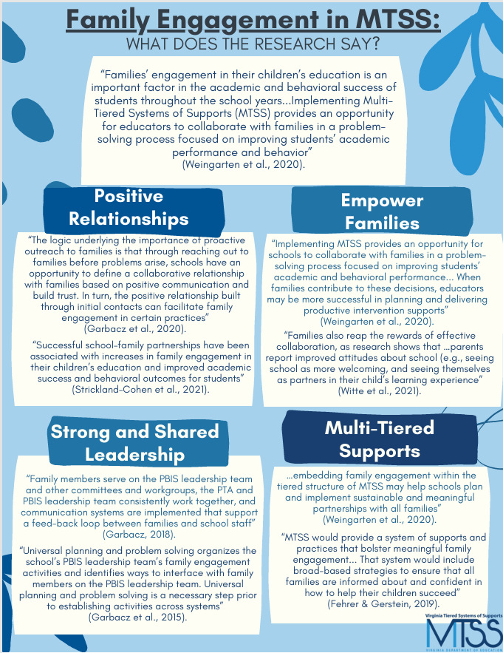
Family Engagement in a System of Literacy Support and Services: Multi-tiered System of Support for Reading (MTSS-R)
A Multi-tiered System of Support for Reading
MTSS-R provides opportunities for families and schools to:
Build positive relationships
Empower families
Provide a system of supports and practices
Engage in a problem-solving process
Support multidirectional communication
Promote a focus on team and data-based decision making
The goal of MTSS is to work WITH families to build systems of support for two-way collaboration
Learn More
Notes:
Families’ engagement in their children’s education is an important factor in the academic and behavioral success of students throughout the school years...Implementing Multi Tiered Systems of Supports (MTSS) provides an opportunity for educators to collaborate with families in a problem solving process focused on improving students’ academic performance and behavior (Weingarten et al., 2020). MTSS-R provides opportunities for families and schools to:
Build positive relationships
Empower families
Provide a system of supports and practices
Engage in a problem-solving process
Support multidirectional communication
Promote a focus on team and data-based decision making
Click for animation box to appear
Click learn more to review the resource Family Engagement in MTSS: What does the Research Say? with participants
Resource Link: Family Engagement in MTSS Copy of Fam Eng in MTSS What Research Says FINAL
https://vtss-resources.vcu.edu/media/resources-vtss-ric/implementation-resources/student-family-community/FamilyEngagementinMTSS,WhatResearchSays11_2024.pdf

Slide 13



A Multi-tiered System of Support for Reading
MTSS-R
A schoolwide framework for instruction and intervention so all children meet literacy goals
Learn More
Specialized Small Group Instruction
During the School Day
Additional Small Group Instruction
High-Quality Classroom Instruction
Watch Video
Videos provided by:
Notes:
During the school day, the system of services and support for your child’s literacy development is often called a multi-tiered systems of support for reading or MTSS-R. MTSS-R is a school-wide framework for instruction and intervention so all children meet essential literacy goals. Intervention is a team-based process that uses student data to help teachers figure out when and how to change instruction to help students be more successful. In MTSS—R, multiple tiers of instruction and intervention are linked together and get increasingly more intensive so all children get the knowledge and skills they need to reach grade-level literacy goals. Assessments and data are used at all tiers to track progress and guide decisions about children’s response to instruction and intervention.​
​
In MTSS-R, schools first identify what children need to know and do to succeed in each grade. Then, schools often screen all children to identify who may be at risk for reading difficulties. Screening is an assessment process that helps teachers identify students who are at risk for not meeting grade-level learning goals. Next, schools teach and assess children so they meet literacy goals. Tier one is high-quality classroom literacy instruction for all children in each grade. Children who need only this support read and write well and are on track to meet grade level literacy goals. Tier two is additional small group instruction for some children in each grade. These children need a boost with extra instruction in targeted skills to be on track to meet grade level literacy goals. Tier three is specialized small group instruction for fewer children in each grade. These children need intensive, individualized instruction or intervention to be on track to meet grade level literacy goals.
Click Learn More for information on assessment and screening. ​
Resource: Distribute, review, and discuss Understanding Screening: Overall Screening and Assessment with participants. Have participants share if they know whether their child’s school does universal screening. If so, do they know what screening tool the school uses? Do they get the results and do they make sense? ​
​Link: Understanding Screening: Overall Screening and Assessment - NCIL https://improvingliteracy.org/resource/understanding-screening-overall-screening-and-assessment/
We're going to watch a short video on how teachers use data to inform instruction. Before we watch however, I want you to know this video is from the Job Success Network and provides information for education professionals preparing for teacher interviews, however, the information is relative to what we are talking about today.
Click Watch Video to hear about how data is used to inform instruction.
Video: Play Watch Video The 74 (1:32)​
Video link: How Do You Use Data To Inform Instruction? - Job Success Network
Guiding question to check for understanding: What are some types of formative assessments and how are they used? ​
(Formative assessments: Taking notes, asking questions in individual conferences, listening to students read, administering a more formal assessment)​
(How they’re used: look at data and analyze patterns, identify strengthens and needs, make informed decisions to address needs, creating an instructional plan)

Slide 14
A Multi-tiered System of Support for Reading (MTSS-R)
How can you help?
Participate in school improvement teams, committees, or in other groups
Help develop home literacy lending kits
Family Engagement at each level
Help with after-school literacy programs
Link families to community resources
Try it Out
Learn More
Notes:
You may want to ask your child’s school how you can learn about its MTSS–R, why it is being used, and how your child is being supported within the system. Ask questions if something is unclear. You are important to the MTSS-R problem-solving process. Together with the school, you can review your child’s data and make data-based decisions for your child’s literacy learning. Your child’s school may use the term “progress monitoring”. If screening showed your child was at risk for reading difficulties, progress monitoring is often used to see if your child has made expected growth in literacy skills and is benefiting from the instruction. If the school does not appear to have a MTSS-R, then ask what its process is to identify and provide support for children off-track for meeting grade-level literacy goals. ​
​
There are many ways that you can participate in MTSS-R to support your child in all tiers. The key is to find the way that is comfortable for you. For example, you can help the school understand your family’s background, culture, and goals for your child. You can also provide the school with information to address the needs and interests of other families like yours. Perhaps you’re seeking information or training offered by the school on specific literacy topics or want to know how to best support your child’s literacy development at home. Or, maybe you’re interested in volunteering at the school or organizing help and support from other families. You may want to help make school literacy decisions that benefit all children by participating on school improvement teams, committees, or in other groups. Or, perhaps you want help develop home literacy lending kits, afterschool literacy programs, or link families to community resources to support literacy learning. If the opportunities offered by the school to participate do not match your interests or needs, share it with the school and others. ​
​You are a key decision-maker in your child’s literacy learning. Look for ways in the school to provide feedback on your child’s literacy goals, instruction, and support.
Resource: Distribute, review, and discuss Questions to Ask Your Child’s School About RTI with participants. Have participants identify which questions they know the answers to and which ones they may need to ask or have clarified.Click Try It Out for questions to ask your child’s school about Response to Intervention (RTI) and MTSS-R.
https://cpacinc.org/docs/LDorg_RTIquestions.pdf
Display Talk With Your Child’s Teacher link and review and discuss for families of English language learners, as needed.
Click Learn More for information on talking with your child’s teacher. ​
​link: https://www.colorincolorado.org/article/talk-your-childs-teacher

Slide 15
A Multi-tiered System of Support for Reading
Information, materials, and training matched to the literacy needs and goals of individual children and ways to intensify support at home.
Specialized Small Group Instruction
More Services & Supports
Information, materials, and events matched to the literacy needs of children from specific families and ways to support literacy needs at home.
More Communication & Collaboration
Additional Small Group Instruction
Information, materials and events about literacy teaching and learning, curriculum, goals, and ways to support literacy development at home.
High Quality Classroom Instruction
Notes:
What might family engagement look like in each tier of MTSS-R? It will likely depend on the setting within your child’s school and the needs of families. Since each tier involves a greater level of services and support for children, a greater level of communication and collaboration is also needed between families and schools. For example,​
​
In tier 1, you may receive information, materials, and announcements about events that focus on the school’s approach to literacy teaching and learning, literacy curricula, literacy goals, screening data, and ways that you can support your child’s literacy development at home. For instance, family literacy nights, group literacy discussions, and guest speakers on family requested literacy topics. ​
​
In tier 2, you may receive information, materials, progress monitoring data, and announcements about events matched to the literacy needs of your child and that of others with similar needs, along with ways to support your child’s literacy needs at home. Engagement at this tier is meant to prevent further literacy difficulties by coordinating and aligning activities between home and school.​
​
In tier 3, you may receive information, materials, progressing monitoring data, and training matched to the individual literacy needs of your child, including ways to deepen support of your child’s literacy needs at home. The school should help you learn intervention strategies and activities that you can do and practice at home that are linked to your child’s literacy goals.

Slide 16






Ask the Question
What are your language and literacy goals for my child and family?
How is my child doing in language and literacy development?
What are the ways I can share information with you about my child’s language and literacy learning?
How can I partner with you to develop language and literacy goals for children?
How can I support my child’s language and literacy goals?
What does my child need to know and be able to do?
Notes:
To start talking and interacting often with your child’s school, think about what your literacy goals might be for your child. If you’re unsure, Click Learn More for typical milestones in reading. Then ask the school:​
What are your language and literacy goals for my child and family?​
How is my child doing in language and literacy development?​
What are the ways I can share information with you about my child’s language and literacy learning?​
How can I partner with you to develop language and literacy goals for children?​
How can I support my child’s language and literacy goals?​
What does my child need to know and be able to do?​
​
The idea is to build common understanding and promote joint action between home and school.​
​
Resource: Distribute, review, and discuss Reading Milestones with participants. Tell participants they can use the milestones to think about their child’s literacy development and prepare for goal-setting conversations.​
Resource link: https://kidshealth.org/en/parents/milestones.html?view=ptr&WT.ac=p-ptr
​​
​

Slide 17
How Families Can Partner With Schools on Literacy Development
Communicate and Interact Often
Discuss Literacy Instruction and Intervention
Practice Literacy Skills at Home
Address Concerns Together
Families should ask the school how best to communicate with each other, and should feel comfortable asking questions if more information is needed.
Families should know what literacy standards their child is working on, review whether those expectations are appropriate, and ask whether the instruction and interventions are evidence‑based and focused on the skills their child needs most.
Families should talk with the school about home literacy activities that match the child’s skill level.
Families should discuss with the school which activities or tasks the child has trouble with at home, and how you helped. Learn about the school’s system of learning support.
Notes:
So now that you're familiar with family engagement, we're going to explore four things families do to partner with their child's school on literacy development.
Distribute resource: How Families can Partner with Schools on Literacy Development
Click for animated box to appear.
Communicate and Interact Often – we'll look at some ways families can share experiences and thoughts with the school.
Click for animated box to appear.
Next we will explore Discussing Literacy Instruction and Intervention by looking at what you need to know such as literacy standards to support your child.
Click for animated box to appear.
Then we'll examine how to Practice Literacy Skills at Home
Click for animated box to appear.
Finally, we will examine how to Address Concerns Together – learning how to understand the school’s position and openly communicate your view.

Slide 18
Communicate and Interact Often
Notes:
Learning to read can be joyful and fun, but it can also be upsetting and hard for your child and you. You and your child’ school can work together to support your child’s reading success and it begins with forming a good relationship.
Trust is the foundation of strong home–school relationships. When families and schools trust one another, communication feels open, respectful, and supportive. And when communication is strong, it becomes much easier to work together in ways that help children thrive.
As trust builds, so does the sense that you’re all on the same team, working toward the same goal: your child’s success and well‑being.

Slide 19
How Families Can Partner With Schools on Literacy Development
Communicate and Interact Often
Discuss Literacy Instruction and Intervention
Practice Literacy Skills at Home
Address Concerns Together
Families should ask the school how best to communicate with each other, and should feel comfortable asking questions if more information is needed.
Families should know what literacy standards their child is working on, review whether those expectations are appropriate, and ask whether the instruction and interventions are evidence‑based and focused on the skills their child needs most.
Families should talk with the school about home literacy activities that match the child’s skill level.
Families should discuss with the school which activities or tasks the child has trouble with at home, and how you helped. Learn about the school’s system of learning support.
Notes:
The first way families can partner with schools on their child's literacy development is by Communicating and Interacting Often. In this session, we will explore the characteristics of family engagement and the conditions that support effective home-school partnerships for literacy as well as what family engagement may look like in a system of literacy support and services, like a Multi-tiered System of Support for Reading (MTSS-R).

Slide 20
Families and schools work best when they stay connected
Communicate and Interact Often
Foster Strong Communication
Ask how the school prefers to communicate
Find out how you will receive communication from the school
Feel confident asking questions anytime you need more information
Get and Stay Involved
Help in the classroom
Attend school events and meetings (orientation, parent‑teacher conferences)
Join school groups
Ask Meaningful Questions
Asking thoughtful questions to understand how the school supports literacy to build trust and ensure everyone is working toward the same goals
Notes:
Families and schools work best when we stay connected, and this slide highlights three simple ways to build that partnership. First, strong communication matters—ask how your child’s school prefers to share updates and feel confident reaching out with questions. Next, stay involved in ways that work for your schedule, whether that’s helping in the classroom or attending events. And finally, ask meaningful questions about how the school supports your child’s literacy. These conversations build trust and keep everyone working toward the same goals.
Staying connected is one of the most powerful ways families and schools can support a child’s learning. Strong communication helps everyone understand how your child is doing and what they need. Ask your school how they prefer to share updates, and never hesitate to reach out with questions. You can also stay involved by helping in the classroom, attending meetings, joining school groups, or sharing what you notice at home. Every interaction strengthens the partnership around your child.

Slide 21
Families and schools work best when they stay connected
Communicate and Interact Often
Ask Questions That Matter
Asking thoughtful questions helps families understand how the school supports literacy and how they can be part of the process. These conversations build trust and ensure everyone is working toward the same goals.
Helpful Questions to Ask
“What are the school’s literacy goals for children and families?”
“How does the school partner with families when developing literacy goals?”
“How can I support my child’s language and literacy goals at home?”
Notes:
Families and schools work best when they stay connected, and one of the most powerful ways to do that is by asking questions that matter. Thoughtful questions help you understand how the school supports your child’s literacy and how you can be part of that process. Asking about literacy goals, how the school partners with families, or what you can do at home builds trust and keeps everyone working toward the same goals for your child.

Slide 22

Families and schools work best when they stay connected
Communicate and Interact Often
Share Experiences & Build Partnerships
Families bring valuable insights about their child’s strengths, challenges, and learning habits. Sharing these experiences helps the school tailor support and strengthens the home‑school connection.
Ways to Share Your Perspective
Tell teachers what works well at home
Describe activities or tasks your child finds challenging
Ask for clarification when something is unclear
Offer ideas or examples that might help teachers understand your child better
Notes:
One of the most meaningful ways to strengthen that connection is by sharing your experiences from home. You know your child best—what motivates them, what challenges them, and what helps them thrive. When you share what works well, what’s difficult, or when you ask for clarification, it helps teachers tailor support and better understand your child. These conversations build a true partnership centered on your child’s success.

Slide 23
Questions ?
Communicate and Interact Often
Notes:
Before we wrap up this session, are there any questions?

Slide 24
Communicate and Interact Often
The big ideas...
Family engagement for children’s literacy learning and achievement is a shared responsibility among families, schools, and communities. ​​
Trust is the primary ingredient for strong home-school relationships for children’s literacy learning and achievement. Strong home-school relationships rely on open, two-way communication.​​
An effective system of support and services for children’s literacy learning involves home and school partnering together.​​
Notes:
The big ideas from this section include:​
• Family engagement for children’s literacy learning and achievement is a shared responsibility among families, schools, and communities. ​
• Trust is the primary ingredient for strong home-school relationships for children’s literacy learning and achievement. Strong home-school relationships rely on open, two-way communication.​
• An effective system of support and services for children’s literacy learning involves home and school partnering together.​
​
We have now completed the section on talking and interacting often.
​
Note: This completes Session 1: Talk and Interact Often.

Slide 25
Session 2:
- Discuss Literacy Instruction and Intervention

Slide 26
How Families Can Partner With Schools on Literacy Development
Communicate and Interact Often
Discuss Literacy Instruction and Intervention
Practice Literacy Skills at Home
Address Concerns Together
Families should ask the school how best to communicate with each other, and should feel comfortable asking questions if more information is needed.
Families should know what literacy standards their child is working on, review whether those expectations are appropriate, and ask whether the instruction and interventions are evidence‑based and focused on the skills their child needs most.
Families should talk with the school about home literacy activities that match the child’s skill level.
Families should discuss with the school which activities or tasks the child has trouble with at home, and how you helped. Learn about the school’s system of learning support.
Notes:
In this next session, we will explore Discuss Literacy Instruction and Intervention. We will focus on how families and schools can partner to help children get evidence-based literacy instruction and intervention and learn what to talk about when discussing literacy instruction and intervention.

Slide 27

Literacy Discussions: Curriculum & Instruction
Discuss Literacy Instruction and Intervention
Talk about literacy standards, curriculum, and instruction
Ask about the instructional materials that will be used and the learning expectation for the year
Talk about activities related to literacy goals
Request examples, activities, and strategies to use at home to connect with your child's reading goals
Learn More
Notes:
You and the school can start by talking about what your child is expected to learn in reading this year, how the school’s literacy program supports those skills, and what your child’s current reading data means. It helps to keep checking in about your child’s literacy goals, since they often change over time. If you’d like help setting goals, let the school know—they can guide you. Sharing this information builds a clear picture of your child as a reader so the right supports can be put in place.
Schools can also help families understand how children are learning by sharing important materials, projects, and assessments in different ways—at open houses, during school events, on the website, or through email, text, or communication apps.
You can ask the school for simple activities and strategies to use at home that connect to your child’s reading goals. Start with one easy activity and ask for an example if you need it. Some schools offer literacy kits for families to borrow, with clear directions and materials tied to classroom learning. After trying an activity, you can share how it went so the school can offer more support. Throughout the year, families may also be invited to join literacy activities at school events, giving everyone a chance to learn together.
Click Learn More to see Supporting Your Child’s Reading at Home. Show the website to participants, selecting one grade level to highlight. Review the four recommendations in the left side introduction column and select one as an example.
Resource Link: Supporting Your Child's Reading at Home | IES
https://ies.ed.gov/use-work/resource-library/resource/other-resource/supporting-your-childs-reading-home#third-grade

Slide 28
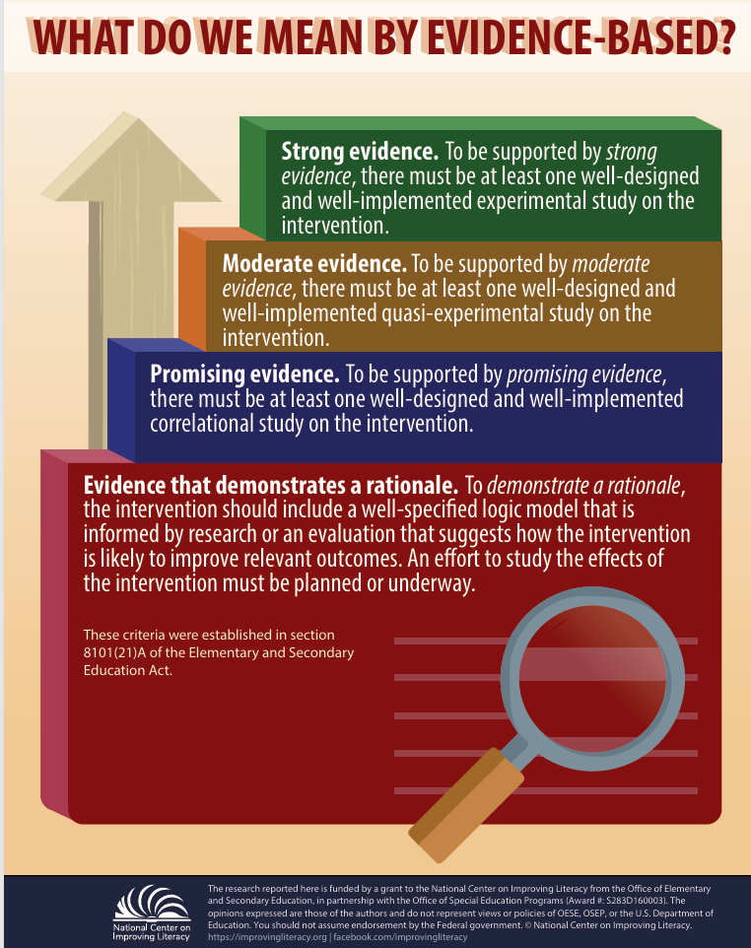

Key Discussion Topics: Evidence-Based Instruction
Discuss Literacy Instruction and Intervention
Learn More
Is the literacy approach, strategy, or program evidence-based?
1
Evidence‑based instruction refers to a teaching strategy or program supported by research showing there is credible evidence that it leads to improved academic outcomes.
Watch Video
Video provided by
Notes:
There are a few key topics to raise when you and your child’s teacher are discussing literacy instruction and intervention. First, find out if the literacy approach, strategy, or program being used with your child is evidence-based. Evidence-based instruction is a teaching strategy or program that research shows there is reasonable evidence that the teaching strategy or program will result in academic gains.
Click "Learn More" to access the infographic "What Do We Mean by Evidence-Based Literacy Resources?" Review the information on what evidence-based means with participants.
Link: https://improvingliteracy.org/sites/improvingliteracy2.uoregon.edu/files/briefs/what-do-we-mean-by-evidence-based.pdf
Knowing what scientific research says about how kids learn to read can help you determine if the literacy approach, strategy, or program being used with your child is evidence-based. What does science say about how kids learn to read?
Click Watch Video What the Science Says About How Kids Learn to Read to learn more. For more information on how children learn to read, see NCIL’s Learning About Your Child’s Reading Development tutorial.
Video: Play Watch Video Education Week (3.55)
Video link: https://www.edweek.org/teaching-learning/video-what-the-science-says-about-how-kids-learn-to-read/2019/12
Transcript: For over a century, researchers have argued about how do children learn to read? But for the last few decades, the research has actually been pretty clear. Written language is a code. Certain combinations of letters predictably represent certain sounds. Teaching young children how to crack the code is the most reliable way to make sure that they learn how to read words. This kind of instruction is called systematic phonics. Connecting printed letters on a page to written sounds isn’t intuitive. While some young children may make those connections on their own, most don’t. The research shows that explicit phonics instruction benefits early readers but particularly those who struggle to read. That’s because small strengthens or deficits at the start of reading compound over time. Of course, there is more to reading than seeing the words on a page and pronouncing it out loud. Children need to make meaning out of the words they read. That means they need deep background and vocabulary knowledge and eventually, they need to be able to recognize most words automatically and read connected text fluently. But knowing how to decode is an essential step in becoming a reader. If children can’t decipher the precise words on a page, they’ll never become fluent readers. In a systematic phonics program, teachers don’t just address the letter-sound connections that students stumble over. They teach all of them in a sequence and teachers explicitly tell students which sounds correspond to which letter patterns rather than ask students to figure it out. Two decades ago, the U.S. government brought together a panel to evaluate reading research. The panel’s report found that among students in kindergarten and first grade, phonics instruction led to improvements in decoding ability and reading comprehension across the board. Children at risk of developing future reading problems, children with disabilities, and children from all socioeconomic backgrounds all benefited. Neuroscience research has since confirmed that explicitly teaching these skills helps people learn how to read new languages more quickly. Of course, phonics instruction, like all teaching, can and should be differentiated to meet the needs of individual students. Once a student knows or learns a phonics skill, he should move on. Many early reading classrooms teach students strategies to identify a word by guessing using context clues and pictures. Neuroscience studies have found that guessing is a much less efficient way to identify a new word. It’s what struggling readers do, not proficient ones. Phonics is essential, but understanding the alphabetic code doesn’t automatically make students good readers. There are five components of reading: phonemic awareness, phonics, fluency, vocabulary, and comprehension. A framework called the simple view of reading explains how comprehension works. It says that reading comprehension is the product of decoding ability and language comprehension. A student needs both good decoding and good language skills to understand what’s on the page. If either one of those is low, then comprehension will be low as well. Many people point out that research show that children who read more are better readers. That’s true, but it’s important to remember that those studies are correlational. It’s unclear if students become better readers because they read more or whether good readers are just more likely to pick up books.
Guiding question to check for understanding: What did you learn about the process of learning to read? What kind of instruction works best?

Slide 29




Discuss Literacy Instruction and Intervention
Key Discussion Topics: Literacy Practices
2
Are the literacy practices appropriate for my child's grade level?
10 Key Reading Practices
K-5
10 Key Reading Practices
6-12
10 Key Writing Policies and Practices
for K-12
Are there missing practices?
Notes:
Second, it is important to identify if the evidence-based literacy practices are appropriate for your child’s grade-level or if any key practices are missing. To better understand what children need to know and be able to do to be successful readers and writers – and the evidence-based practices that can help them get there, let's look at some information from the Meadows Center to help us.
Click 10 Key Reading Practices – K-5.
Click 10 Key Reading Practices – 6-12.
Click 10 Key Writing policies and practices for K-12.
Use these materials as conversation starters with your child’s teacher to discuss the ways in which the school’s literacy curriculum addresses these practices and the progress your child is making in these grade-level skills. Know that you are not expected to take the place of teachers, especially when learning remotely. Instead, help your child practice learned skills and using them in new ways.
Resource: Distribute, review, and discuss the three documents with participants. Tell participants they can use the documents to reflect on the ways in which their child’s school literacy curriculum addresses these practices and how they would use this resource with school staff. If time permits, see activity below.
Activity: Provide time for participants to select one of the documents to reflect on the ways in which their child’s school’s literacy curriculum addresses these practices, noting any gaps. Encourage participants to discuss how they would use this resource with school staff and what they would say (see resource below to use with this activity). Encourage participants to use it to engage others in the community.
Resource: Distribute, review, and discuss Conversation Starters to Use with Your Child’s Teacher with participants. Tell participants they can use the document to prepare for conversations with school staff.
10 Key Reading Practices for All Elementary Schools - https://meadowscenter.org/resource/10-key-reading-practices-for-all-elementary-schools-with-strong-evidence-of-effectiveness-from-high-quality-research/
10 Key Reading Practices for All Middle and High Schools - https://meadowscenter.org/resource/10-key-reading-practices-for-all-middle-and-high-schools-with-strong-evidence-of-effectiveness-from-high-quality-research/
10 Key Writing Policies and Practices for All Schools - https://meadowscenter.org/resource/10-key-writing-policies-and-practices-for-all-schools-with-strong-evidence-of-effectiveness-from-high-quality-research/

Slide 30
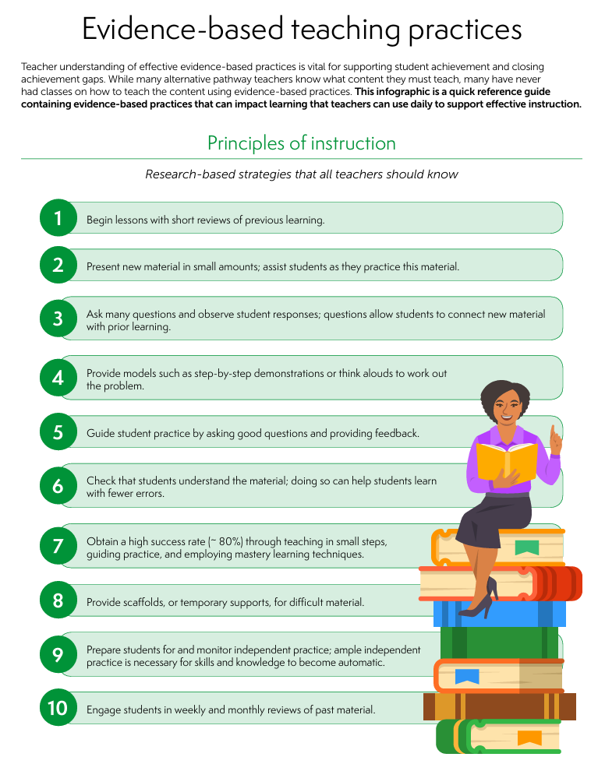

Discuss Literacy Instruction and Intervention
Key Discussion Topics: Instruction Delivery
Is instruction designed and delivered effectively?
3
Different ways to get materials
Flexibility
Accessible and understandable
Find out about additional support
Watch Video
Video provided by
Learn More
Notes:
Third, it is important to find out if the literacy approach, strategy, or program being used with your child is designed and delivered effectively. As we look at instruction delivery, our core question is simple: Is instruction designed and delivered effectively? That means students can access materials in different ways, there’s flexibility built into lessons, and families know how to find additional support when they need it. Remember, effective literacy instruction should be explicit and systematic. Explicit means teaching that is direct and step-by-step, including explaining and showing how to do something and systematic means teaching that has a carefully planned sequence, including building from easier to more difficult tasks and breaking down harder skills into smaller parts. Let's watch a short video explaining explicit instruction.
Click Watch Video to hear what effective literacy instruction should look like.
Video: Explicit Instruction for Struggling Readers Explained
Video link: Explicit Instruction for Struggling Readers Explained - YouTube https://www.youtube.com/watch?v=ZO5tsmIp138&t=14s
Video: Play Watch Video NCIL (4:14)
Effective instruction for students who struggle with reading should be systematic. It should be systematic in that it follows a scope and sequence that builds in level of difficulty and complexity while also building in time for review for students to practice skills they have already learned. It should also be explicit. Explicit instruction that is teacher directed has been proven to be more effective through research than less teacher directed, less explicit instruction. Explicit instruction involves several components. The first is the teacher explanation. The teacher explanation should be short and concise. It should provide an objective or a target area of learning for that part of the lesson, and the quicker the teacher explanation is, the more time there is for students to respond to instruction. So, quick and concise is key with a teacher explanation. The next component of explicit instruction is a teacher model. The teacher model should show students exactly what is expected for a response. Once students know what is expected the model can be dropped to provide additional practice opportunities for students within the lesson. The signal is an important part of explicit instruction as well. The signal includes four parts. It's the focus, the cue, think time, and then a signal for response. A focus shows students exactly what they are working on in the task at hand. A cue is a quick reminder of what they are being asked to do, such as "sound" if they're working on sounds practice. Think time is a crucial component of the signal. The think time allows all students to think about and formulate their response before students give the response in unison as a group. And then the signal to respond shows that all students are ready to respond and all students take part in the practice opportunity. Another component of explicit instruction is multiple opportunities to respond. Which the signal that we just mentioned helps with that. Multiple opportunities to respond could be through the use of whiteboards, or response cards for students. You could also have students work in small groups or work with pairs in a think-pair-share model, where students think about their answers, share them with a partner, before sharing out as a whole group. The big part with multiple opportunities to respond are that all students are practicing and all students are engaged in the lesson. Choral responding is another way that you could have students engage, where all students are responding to the response, in a quick and concise way when answers are the same and short. The pacing of your lesson should be quick and perky to allow all students the opportunity to respond to your instruction and it keeps them engaged as your lesson moves along. One part of your pacing is to remember to add in that think time for each component students are working on. So, embed that into your pacing for all students to have time to think and practice as part of your lesson. Another component of explicit instruction is immediate error correction. Errors should be corrected immediately, in a non-punitive tone, and it consists of two parts for your error correction. The first part is the actual error correction. The teacher models the correct answer and students practice that correct answer. The second component of error correction is part firming. So, students move on from the item that they missed and then loop back later in instruction to make sure that the efficient error correction was effective. Checks for understanding should be frequently embedded throughout your explicit instruction lesson. Frequent checks for understanding can be used to ensure that students are mastering the content that you are teaching or it can identify areas where students need additional practice throughout the lesson. Two to three individual turns is sufficient for each component of your lesson. If all students are given individual turns for each component of the lesson it takes away from student practice opportunities for everyone as you're teaching. Through systematic explicit instruction students are given multiple opportunities to practice and they are given the supports they need to promote literacy development.
Click "Learn More" to access the IES infographic "Evidence-based Teaching Practices" Review the characteristics of effective instruction with participants.
Link: Evidence-based teaching practices
https://ies.ed.gov/rel-southeast/2025/01/infographic-21
Resource: Distribute, review, and discuss Evidence-based Teaching Practices with participants. Tell participants they can use the infographic and information in the video to discuss the ways in which the key reading and writing practices are taught in their child’s school and to request home literacy tips, activities, and homework matched to effective, evidence-based literacy instruction.
Guiding question to check for understanding: What makes instruction systematic and explicit?
Use these materials as conversation starters with school staff to discuss the ways in which the key reading and writing practices are taught in the school. You can also use them to see if home literacy tips, activities, and homework from the school reflect effective, evidence-based literacy instruction. Click Learn More for information on how to judge if activities or strategies sent home from school are appropriate.

Slide 31
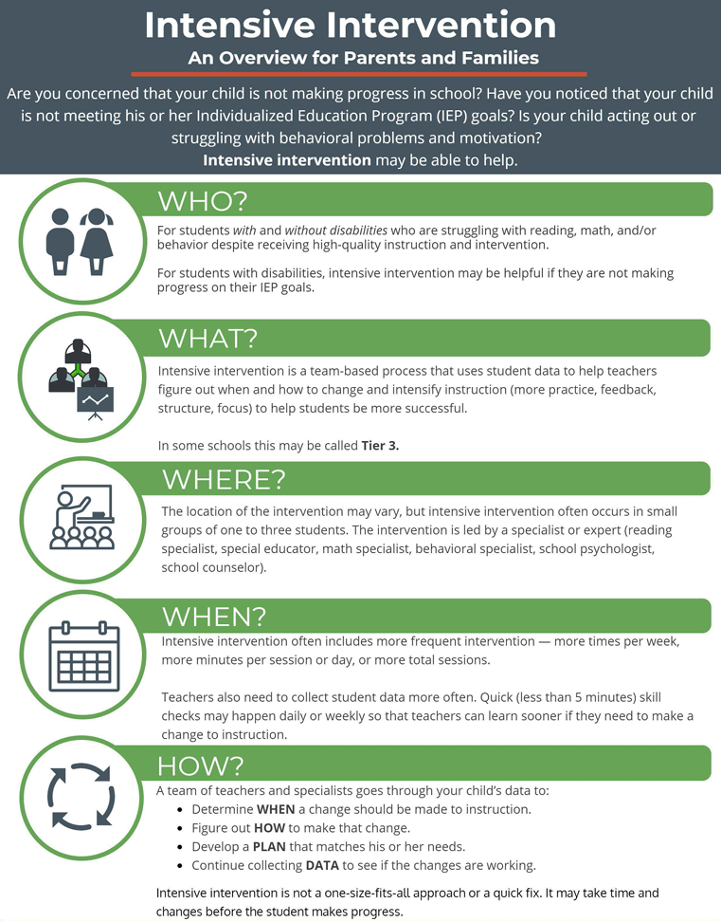
Literacy Discussions: Assessment and Intervention
Discuss Literacy Instruction and Intervention
Talk About
Intensive Intervention
Talk About
Literacy Assessment and Data
Is it:
Accurate?
Timely?
Accessible and Meaningful?
Learn More
Notes:
When discussing literacy instruction, you can also talk about literacy assessments and data. School staff should share key assessment tools, rubrics, grading criteria, or strategies to help you determine together if your child is successful in learning literacy content, skills, or completing an assignment. It is important for schools to understand your reasons for wanting data on your child’s literacy learning so they can decide the range of data to share and what to prioritize. When you share information about your child - like interests, behaviors, and challenges - it helps the school to support your child’s learning by making curriculum and instruction more relatable, motivating, and targeted to your child. Assessment results and data should also be accurate and timely and presented to you in accessible and meaningful ways. There are many paths available for sharing data but also challenges to communicating data well.
When discussing intensive intervention, know that children with or at risk for reading difficulties usually gain certain reading skills and knowledge more slowly than typical readers. That is why they need much more intensive instruction to keep typical growth patterns in reading. Intensive intervention is an ongoing process that often requires school teams to make a number of changes before your child’s performance improves. Intervention may look different over time for children. Your child’s school should engage you in the process right from the start. When appropriate, conversations about literacy instruction, intervention, and assessment should also include your child. If your child receives intervention, he or she is likely to be more invested when the what and why of intervention is understood and he or she may be less likely to feel embarrassed or confused when participating. It is important for you and the school to imprint early that reading difficulties are nothing to be ashamed of.
Let's learn more about intensive intervention by reviewing an infographic.
Click Learn More for to view and discuss the infographic "Intensive Intervention: An Overview for Parents and Families". Tell participant they can use the infographic to learn more about intensive interventions.
https://intensiveintervention.org/sites/default/files/17-3324_NCII-Family-Overview-508.pdf

Slide 32





Literacy Discussions: Ask the Question
Discuss Literacy Instruction and Intervention
How is reading taught in the school and by whom? What reading skills do you focus on?
When does literacy instruction and intervention happen and for how long?
How many other children join?
How does the instruction/intervention align with my child’s specific language and literacy needs?
What school materials or trainings about literacy are available to me?
Notes:
To start discussing literacy instruction and intervention with your child’s school, ask:
How is reading taught in the school and by whom? What reading skills do you focus on?
When does literacy instruction and intervention happen and for how long?
How many other children join?
How does the instruction/intervention align with my child’s specific language and literacy needs?
What school materials or trainings about literacy are available to me?
Responses should build common understanding and promote joint action between home and school.

Slide 33





Literacy Discussions: Ask the Question
Discuss Literacy Instruction and Intervention
What screening practices for language and literacy does the school use and when?
What information does the school collect on my child’s language and literacy progress?
​How is the information used to make decisions about my child’s language and literacy needs?
How are you monitoring my child’s language and literacy progress?
​How are children with reading difficulties identified?
Notes:
Here are some additional questions to prompt discussions about literacy assessments and data about your child’s
What screening practices for language and literacy does the school use and when?
What information does the school collect on my child’s language and literacy progress?
How is the information used to make decisions about my child’s language and literacy needs?
How are you monitoring my child’s language and literacy progress?
How are children with reading difficulties identified?
Responses should build common understanding and promote joint action between home and school.

Slide 34
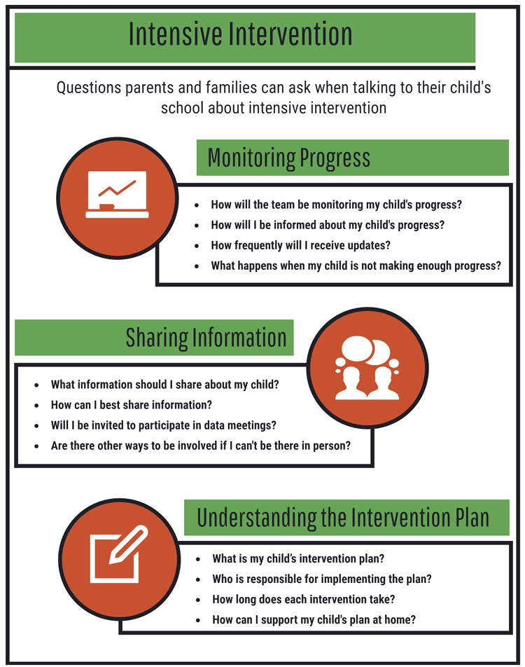
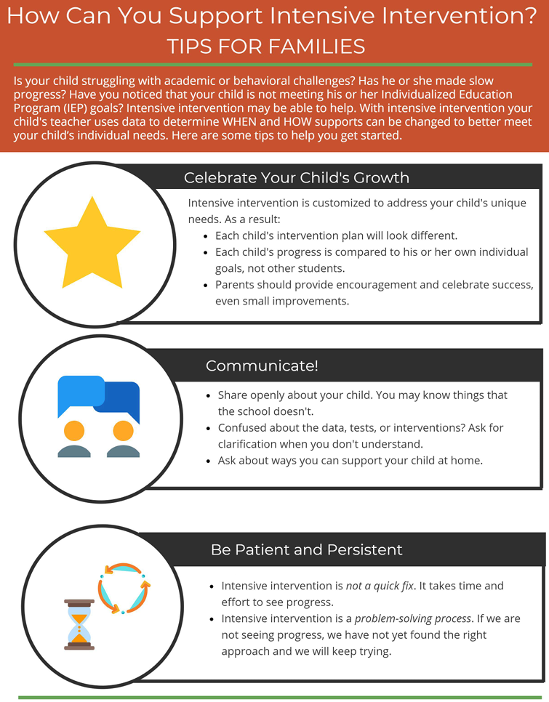
Literacy Discussions: Additional Resources
Discuss Literacy Instruction and Intervention
Intensive Intervention: Questions Parents and Families Can Ask
How Can You Support Intensive Intervention? Tips for Families
Notes:
Intensive Intervention - https://intensiveintervention.org/sites/default/files/17-3324_NCII-Family-Questions-508.pdf
How Can You Support Intensive Intervention? Tips for Families - https://intensiveintervention.org/sites/default/files/17-3324_NCII-Family-Tips-508.pdf

Slide 35
Questions ?
Notes:
Before we wrap up this session, are there any questions?

Slide 36
Discuss Literacy Instruction and Intervention
The big ideas...
Knowing what scientific research says about how kids learn to read can help you determine if the literacy approach, strategy, or program being used with your child is evidence-based.
It is important to identify if the evidence-based literacy practices are appropriate for your child’s grade level or if any key practices are missing.
Discussing literacy instruction and intervention can help you determine if the literacy approach, strategy, or program being used with your child is designed and delivered effectively.
Notes:
Summarize the big ideas for participants:
• Knowing what scientific research says about how kids learn to read can help you determine if the literacy approach, strategy, or program being used with your child is evidence-based.
• It is important to identify if the evidence-based literacy practices are appropriate for your child’s grade-level or if any key practices are missing.
• Discussing literacy instruction and intervention can help you determine if the literacy approach, strategy, or program being used with your child is designed and delivered effectively.
You have now completed the section on discussing literacy instruction and intervention. Click on the bar to continue.
Note: This completes Session 2: Discuss Literacy Instruction and Intervention.

Slide 37
Session 3:
- Practice Literacy Skills at Home
Notes:
In this session we’ll explore simple, meaningful ways to support your child’s reading development at home—from preschool through high school. You don’t need special training or materials. What matters most is spending time talking, reading, and practicing skills in ways that feel natural for your family.

Slide 38
How Families Can Partner With Schools on Literacy Development
Communicate and Interact Often
Discuss Literacy Instruction and Intervention
Practice Literacy Skills at Home
Address Concerns Together
Families should ask the school how best to communicate with each other, and should feel comfortable asking questions if more information is needed.
Families should know what literacy standards their child is working on, review whether those expectations are appropriate, and ask whether the instruction and interventions are evidence‑based and focused on the skills their child needs most.
Families should talk with the school about home literacy activities that match the child’s skill level.
Families should discuss with the school which activities or tasks the child has trouble with at home, and how you helped. Learn about the school’s system of learning support.
Notes:
Next we will look at Practicing Literacy Skills at Home – Begin by asking how you can support your child at home with questions like: “What activities will help her practice the skills learned at school?” “What strategies should I use to help my child read or write?” “What tools are available to help my child practice these skills?” At home, families can try out different activities and tools and share with the school what worked well and what did not. Let the school know if more information or support is needed, and discuss other ways to practice the skills learned at school, such as at the library or through literacy services in the community.
Resource Link: How Families Can Partner With Schools on Literacy Development – National Center on Improving Literacy
How Families Can Partner With Schools on Literacy Development - NCIL

Slide 39

Practice Literacy Skills at Home
Families should talk with the school about:
Home literacy activities that match their child’s skill level.
What literacy resources are important to share with one another to better understand and support their child’s literacy development
How our language system works to listen, speak, read, and write well
Notes:
Families should talk with the school about:
Home literacy activities that match their child’s skill level.
What literacy resources are important to share with one another to better understand and support their child’s literacy development
How our language system works to listen, speak, read, and write well

Slide 40

Practice Literacy Skills at Home
Why Home Practice Matters
Home practice strengthens the skills taught in class.
Frequent practice strengthens reading skills.
Children learn best when school and home reinforce the same skills.
Even 10–15 minutes a day can make a measurable difference.
Families can support reading at home with simple, meaningful activities connected to what children learn in school.
Start by asking the school how you can best support your child’s reading and writing at home.​
Notes:
As we move into this next section, we’ll look at simple, meaningful ways families can support literacy at home. You don’t need to be a reading expert to make a big difference. Small moments — reading together, talking about stories, noticing words — all help strengthen the skills your child is learning in school. Our goal is to help you feel confident and supported as you practice these skills at home. Families don’t need to be reading experts. Small, consistent moments—talking, reading, noticing words—add up.

Slide 41
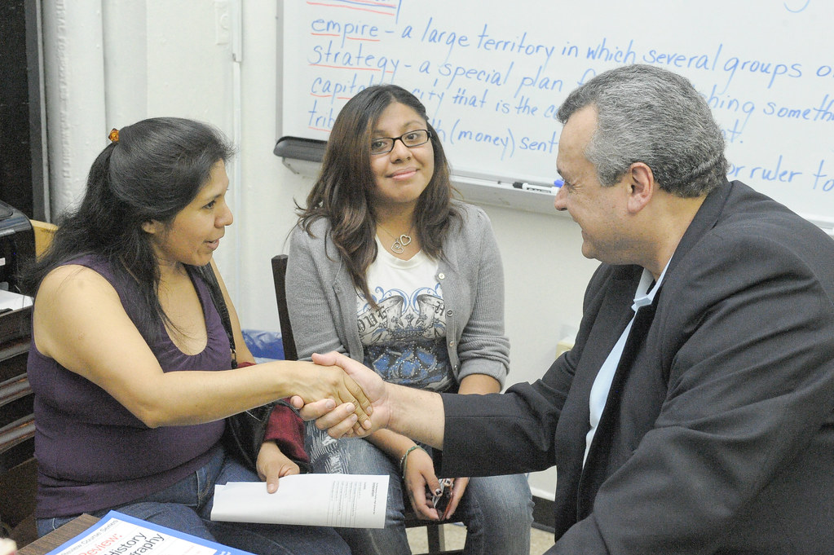
Practice Literacy Skills at Home
How to Partner With the School
Ask what reading skills your child is working on.
  “What activities will help my child practice the skills learned at school?”
  “What strategies should I use to help my child read or write?”
  “What tools or materials are available to support practice at home?”
Request one simple activity to practice at home.
Share what works well for your child.
Ask for demonstrations if you’re unsure how to help.
Use school communication tools (email, apps, websites).
Notes:
This slide highlights simple ways families can support literacy at home. You don’t need special training—just stay connected with your child’s teacher. Ask what skills your child is working on and what one activity you can try at home. Share what’s working well, and don’t hesitate to ask for a quick demonstration if you’re unsure how to help. And remember, tools like email, apps, and school websites make it easy to stay in touch and partner together.

Slide 42
Practice Literacy Skills at Home
Try Activities Connected to School Learning
Start with one simple activity and build from there.
Examples of home activities:
  Reading together and talking about the story
  Practicing letter sounds, sight words, or vocabulary
  Using writing for real purposes (notes, lists, reflections)
  Reading articles or books related to school topics
  Listening to audiobooks to build vocabulary and comprehension
Notes:
At home, you can try out simple activities that reinforce what your child is learning. This might look like reading together and talking about the story, practicing letter sounds or vocabulary, or encouraging your child to write notes, lists, or short reflections. Older students might read articles related to school topics or listen to audiobooks. The key is to start small — even one short activity can make a difference.

Slide 43

Practice Literacy Skills at Home
Use Tools and Resources the School Recommends
Examples of tools your school may offer:
Literacy kits with books, games, and practice materials
Online reading platforms or leveled texts
Graphic organizers for comprehension
Word lists, sound cards, or writing prompts
Apps for vocabulary or fluency practice
Ask for:
Clear directions
A demonstration
Examples of how to use the tools at home
Notes:
Schools are often willing to recommend tools and resources. In fact, many schools offer tools that families can use at home. These might include literacy kits, online reading platforms, word cards, writing prompts, or graphic organizers. If your school shares a tool with you, don’t hesitate to ask for clear directions or a demonstration. Teachers want you to feel comfortable using these materials, and they’re happy to show you how they work. Let's look at some examples.

Slide 44

Practice Literacy Skills at Home
Additional Resource
Learn More
Notes:
As you support your child, remember that consistency matters more than perfection. Short, daily practice is more effective than long sessions. Celebrate your child’s effort, not just accuracy. Let them choose books or topics when possible. And most importantly, keep reading a relaxed and enjoyable part of your routine. When families and schools work together, children grow stronger as readers and learners. Here is an additional resource from the Meadows Center that is filled with videos on how to help your child practice literacy skills at home.
Click "Learn More" to visit the Meadows Center website page and explore the various videos available to parents
Resource link: Helping Kids Learn at Home - The Meadows Center - https://meadowscenter.org/resource/helping-your-kid-with/

Slide 45
Practice Literacy Skills at Home
The big ideas...
Two important foundational skills in early reading instruction are phonemic awareness and phonics.
For children who struggle to read, working with phonemes and decoding words can be especially difficult.
Learning to listen, speak, read, and write well also includes developing oral language skills and reading fluently and with meaning.
Notes:
Summarize the big ideas for participants:
• Two important foundational skills in early reading instruction are phonemic awareness and phonics.
• For children who struggle to read, working with phonemes and decoding words can be especially difficult.
• Learning to listen, speak, read, and write well also includes developing oral language skills and reading fluently and with meaning.
Every family can support literacy. You don’t need special training—just time, conversation, and encouragement. When families and schools work together, children grow stronger as readers, thinkers, and learners.
Note: This completes Session 3: Share Literacy Resources.

Slide 46
Questions ?
Notes:
Before we wrap up this session, are there any questions?

Slide 47
Session 4:
- Address Concerns Together

Slide 48
How Families Can Partner With Schools on Literacy Development
Communicate and Interact Often
Discuss Literacy Instruction and Intervention
Practice Literacy Skills at Home
Address Concerns Together
Families should ask the school how best to communicate with each other, and should feel comfortable asking questions if more information is needed.
Families should know what literacy standards their child is working on, review whether those expectations are appropriate, and ask whether the instruction and interventions are evidence‑based and focused on the skills their child needs most.
Families should talk with the school about home literacy activities that match the child’s skill level.
Families should discuss with the school which activities or tasks the child has trouble with at home, and how you helped. Learn about the school’s system of learning support.
Notes:
For the final session we will examine how to Address Concerns Together - Take time to understand the school’s position and openly communicate your view. Work together to find a solution to address your child’s learning needs that you both can support. If you and the school disagree, get advice from others on next steps. Ask questions: “How is my child’s language and literacy learning being supported in this system?” “How are you monitoring my child’s language and literacy progress?” “What might happen next if my child continues to struggle?”
You and your child’s teacher can discuss what your child has learned and what skills he or she is still working on. You should share your understanding of your child’s learning needs and tell the teacher what activities or tasks are giving your child trouble at home and how you’ve helped.
Resource Link: How Families Can Partner With Schools on Literacy Development – National Center on Improving Literacy
How Families Can Partner With Schools on Literacy Development - NCIL

Slide 49

Learning Objectives
Address Concerns Together
To learn what makes reading a complex and unnatural process
To learn how to appropriately address children’s literacy needs early
To learn about reading disabilities, including dyslexia
Notes:
Families should discuss with the school which activities or tasks the child has trouble with at home, and how you helped. Learn about the school’s system of learning support.
Ask:
“How is my child’s language and literacy learning being supported in this system?”
“How are you monitoring my child’s language and literacy progress?”
“What might happen next if my child continues to struggle?”
Take time to understand the school’s position and openly communicate your view. Work together to find a solution to address your child’s learning needs that you both can support. If you and the school disagree, get advice from others on next steps.

Slide 50
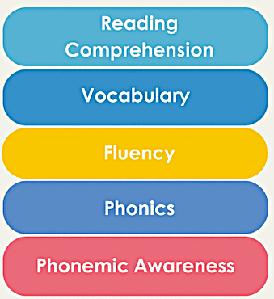

A Complex and Unnatural Process
Address Concerns Together
Explicit and Systematic Reading Instruction
Watch Video
Video provided by:
Learn More
Notes:
Learning reading is a complex and unnatural process. This may explain why so many children do not learn to read through exposure to books and language alone. All children benefit from explicit, systematic reading instruction in phonemic awareness, phonics, fluency, vocabulary, and comprehension. Yet, some children continue to struggle with reading even with high-quality classroom instruction. By appropriately addressing your child’s literacy needs early, your child can learn to read.
Click Watch Video to see Linda Farrell discuss why every student can become a better reader. ​
Video: Play Watch Video Reading Rockets (0:35) ​
Link: Reading expert Linda Farrell: Every student can become a better reader - YouTube
I go to some schools and students really aren’t scoring well on their tests. And there are a number of reasons for that. And what is so satisfying is when teachers say, “I know they’re not scoring well on their tests but they can, they can.” We know how to do this. Help us do even more. And that is fabulous because every student can learn more. Every student can learn more. And, I have yet to find a student who cannot learn to decode. ​
​
Click Learn More for how to recognize reading problems in your child.
Resource: Distribute, review, and discuss Recognizing Reading Problems with participants. Tell participants they can use the document to identify signs for risk of reading difficulties and what to do next.
Link: Recognizing Reading Problems | Reading Rockets
https://www.readingrockets.org/topics/assessment-and-evaluation/articles/recognizing-reading-problems
Guiding question to check for understanding: What is your key takeaway from the video?

Slide 51
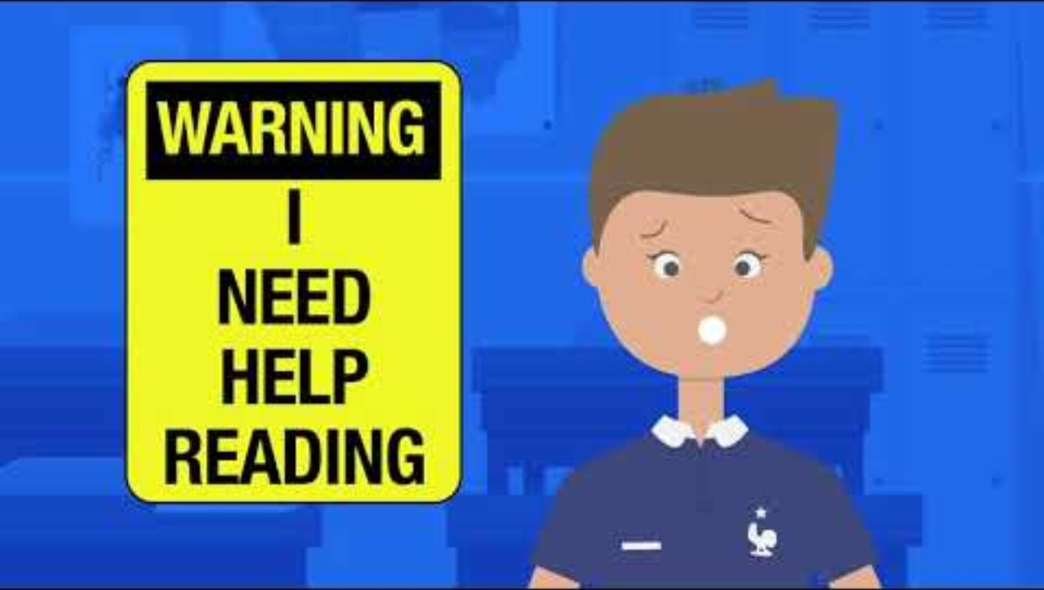

Signs of Risk for Reading Difficulties
Address Concerns Together
Child Find
Learn More
Video provided by:
Notes:
If you or your child’s teacher is concerned that your child’s reading difficulties are unexpected and unusual, seek further information from the school and others about next steps. One type of learning disability in reading is dyslexia. Other learning disabilities in reading may be related to challenges in comprehension or a combination of skills. You can request that the school evaluate your child for a reading disability if you suspect one.
Here’s a quick video on what to do if you’re worried about your child’s reading. This will help you find ways to talk to your child about his language or reading issues.
Start Video: I'm Worried About My Child's Reading - What Do I Do? (1.35) - https://youtu.be/KaoWhLPlh3k
TRANSCRIPT: In second or third grade, most kids read smoothly at a natural speed and with expression. It is important to understand the warning signs of a learning issue. The earlier a learning issue is detected the better chance a child will have of succeeding in school. It is important to know that children with learning disabilities process information differently. At yourself, one: Is your child making a lot of errors when reading and the task of reading seems to be difficult? Two: Is their spelling not connected to the sounds they hear in words? Often there are wild guesses as to how a word is spelled. Three: Has the teacher mentioned it takes a long time for your child to copy from the board? Four: Does your child struggle to follow along as you or the teacher reads a story aloud? Do they seem distracted or like their minds are wandering? If you read them a story and they have no understanding of what happened, that is a warning sign that there might be a problem. The earlier you can get help for your child the better. Teachers are only with your child for nine months. But parents may have observed and sensed the problem over the course of years. Don’t hesitate to ask for help and not be satisfied until there is a solution in place. Whether that means a school evaluation, private tutoring, or a reading evaluation with a licensed child psychologist.
Click Child Find for more information. In the Individuals with Disabilities Education Act (IDEA), the federal special education law, a child with characteristics of dyslexia or other literacy-related disabilities may qualify for IDEA services under the category of a specific learning disability.
Click Learn More for more information. Resource: Distribute, review, and discuss Child Find: What It Is and How It Works to participants. ​
Resource link: What_Is_Child_Find__Child_Find_Law_and_Evaluation_Process.pdf
Remember, addressing concerns together with the school will lead to effective outcomes for your child.

Slide 52




Ask the Question
Address Concerns Together
How is my child’s language and literacy learning being supported in this system of literacy services and support?
What types of support are offered to my child if he or she is struggling to read or write?
What accommodations does the school provide to help my child read or write?
What might happen next if my child continues to struggle?
Notes:
To start addressing concerns about your child’s literacy development with your child’s school, ask:​
How is my child’s language and literacy learning being supported in this system of literacy services and support?​
What types of support are offered to my child if he or she is struggling to read or write?​
What accommodations does the school provide to help my child read or write?​
What might happen next if my child continues to struggle?​
​
Responses should build common understanding and promote joint action between home and school.​
​
Resource: Distribute, review, and discuss Route to Reading: Form a Pit Crew with participants. Tell participants they can use the infographic to prepare for conversations with school staff.

Slide 53

Check for Understanding
What can I say or do to find out more about my child's literacy supports and services at school?
Think about what you've learned about partnering with your child’s school to help Dave. He is interested in learning about his child's school system of literacy support and services and how his child is being supported within that system. What can Dave say or do to find out more? Choose the answer that best fits.
Find out what opportunities are provided to help with literacy learning at the school.
Discuss what literacy skills his child has learned and what they are still working on.
Ask for literacy activities matched to his child's skill level and share what worked well and what did not.
Request information on his child's literacy progress and talk about what happens if he has concerns about the progress being made.
All of the above.
Notes:
Think about what you’ve learned about partnering with your child’s school to help Dave. Dave is interested in learning about his child’s school’s system of literacy support and services and how his child is being supported within that system. What can Dave say or do to find out more? Choose the answer that best fits. Find out what opportunities are provided to help with literacy learning at the school; discuss what literacy skills his child has learned and what he or she is still working on; ask for literacy activities matched to his child’s skill level and share what worked well and what did not; request information on his child’s literacy progress and talk about what happens if he has concerns about the progress being made; or all of the above.
Click for the animated answer
​
Note: Provide time for participants to review and discuss the scenario. Then, ask participants to discuss the correct answer with their tablemates. Poll participants on the answer and click Submit to see if correct.

Slide 54
The big ideas...
All children benefit from explicit, systematic reading instruction in phonemic awareness, phonics, fluency, vocabulary, and comprehension.
Some children continue to struggle with reading even with evidence-based classroom reading instruction.
If you or your child’s teacher is concerned that your child’s reading difficulties are unexpected or unusual, seek further information from the school and others about next steps.
Notes:
Summarize the big ideas for participants:
• All children benefit from explicit, systematic reading instruction in phonemic awareness, phonics, fluency, vocabulary, and comprehension.
• Some children continue to struggle with reading even with evidence-based classroom reading instruction.
• If you or your child’s teacher is concerned that your child’s reading difficulties are unexpected or unusual, seek further information from the school and others about next steps.
You have now completed the section on addressing concerns together. Click on the bar to continue.
Note: This completes Session 4: Address Concerns Together.

Slide 55
Questions ?
Notes:
Before we wrap up this workshop, are there any final questions?

Slide 56


Notes:
The National Center on Improving Literacy’s mission is to increase access to, and use of, evidence-based approaches to screen, identify, and teach pre-K to grade 12 students with literacy-related disabilities, including dyslexia. This tutorial expands upon information in NCIL’s partnering with your child’s school literacy brief and infographic. Click the partnering with your child’s school icon to access the literacy brief and infographic and click the NCIL icon to learn more about the National Center on Improving Literacy.
Resource: Distribute copies, review, and discuss the Partnering with Your Child’s School literacy brief and infographic with participants. Tell participants
Note: This is the end of Session 4

Slide 57

How Can I Learn More?
The research reported here is funded by a grant to NCIL from the Office of Elementary and Secondary Education, in partnership with the Office of Special Education Programs (Award 3: S283D160003). The opinions expressed are those of the authors and do not represent views or policies of OESE, OSEP, or the U.S. Department of Education. You should not assume endorsement by the Federal government.
Notes:
Want to learn more? Search the NCIL Resource Repository for literacy resources and activities you can do with your child at home or in your community. Sort by audience, topic area, and resource type to find resources matched to skills in this tutorial. Click the icon to take you there.

Slide 58
Thank You!
[insert contact information]
Notes:
Slide for inserting contact information so participants can communicate with you after the workshop.

