Slide 1



The National Center on Improving Literacy (NCIL) is a partnership among literacy experts, university researchers, and technical assistance providers, with funding from the United States Department of Education.
Our Mission is to increase access to, and use of, evidence-based approaches to screen, identify, and teach students with literacy-related disabilities, including dyslexia.
Notes:
If there is a video, the link will be provided in the slide notes. The transcript for the video is provided so that you can decide if you want to show the video, or if you want to cover the topic through a discussion.
Hidden slides are optional and may be used at the presenter's discretion based on the needs of the audience.
Underlined text = specific contexts (e.g., zoom vs in-person)
Regular text = Presenter notes (reminders or instructions)
Regular text with bullet = specific instruction
* Asterisks indicate hints or ideas for customization
CLICK, directions for animated slides
Bold text = Presenter Script (what the presenter should say)
Italic text = Ideas for activity or interaction
Yellow highlighted text is for you to customize based on your state/grade for the presentation.
The pink backpack on a slide indicates there are resources to either be distributed during the workshop, or to provide for participants to review later. You can click on the icon directly from the slide to access the online version. The URL is included in the speaker notes. If the training is in person, you may choose to print some out and distribute as handouts.
---
Greet participants and begin workshop with introductions as needed. Follow the facilitation procedure notes appropriate for the workshop session.
Welcome to the National Center on Improving Literacy’s workshop on learning about your child’s reading development. Children who struggle learning early literacy skills are at risk for reading and academic difficulties later. As a parent or caregiver, being informed about the parts of literacy, how your child learns to read, and why he or she might struggle can help you make better decisions about your child’s education. This workshop is part two of a four-part series on key roles that families can play for children’s literacy success.

Slide 2
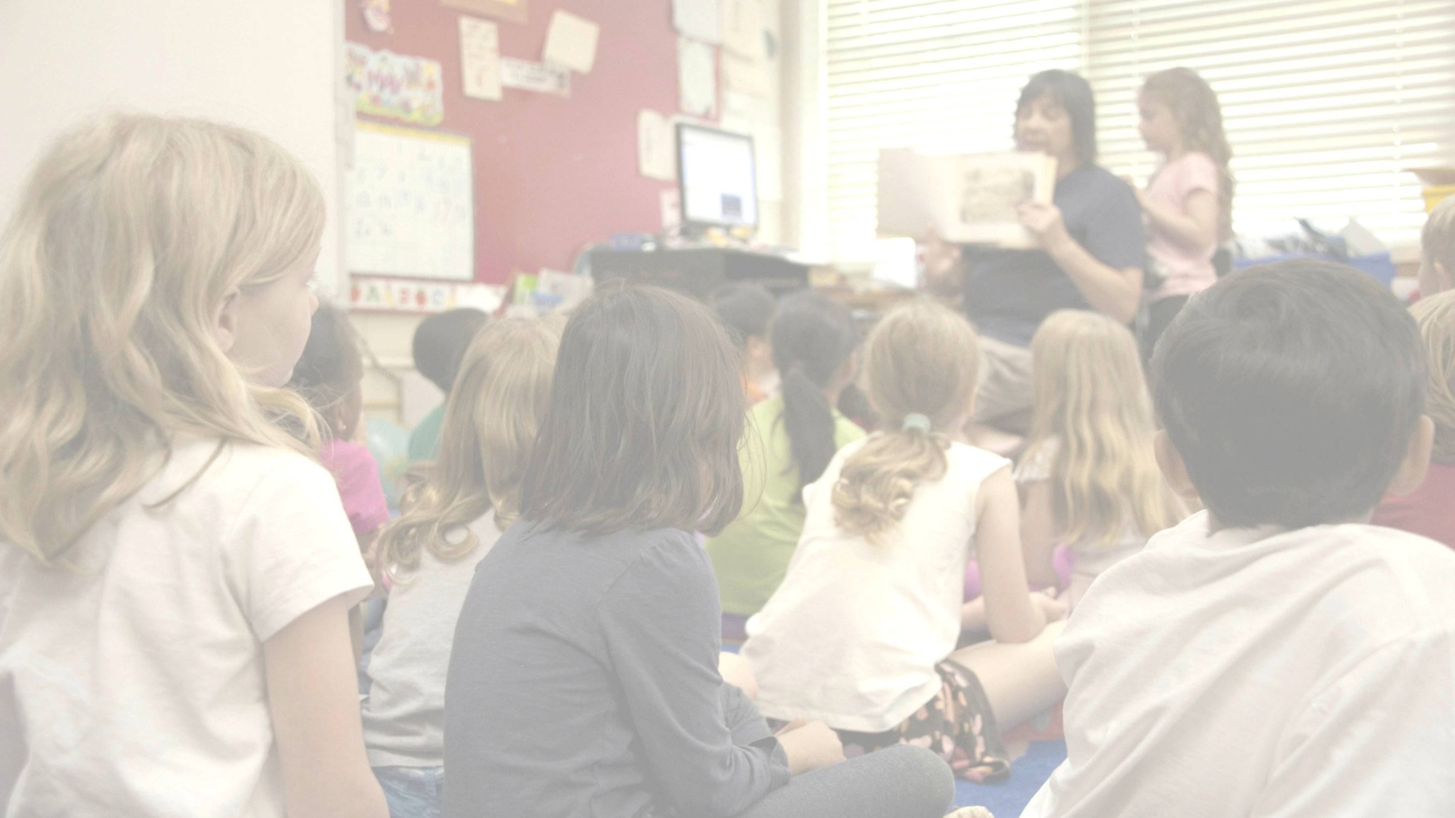
Learn About Your Child's Reading Development
Children who struggle to learn early literacy skills are at risk for reading and academic difficulties later. Being informed about the parts of literacy, how children learn to read, and why they might struggle can help you make better decisions about your child's education.
The research reported here is funded by a grant to NCIL from the Office of Elementary and Secondary Education, in partnership with the Office of Special Education Programs (Award #: S283D160003). The opinions expressed are those of the authors and do not represent views or policies of OESE, OSEP, or the U.S. Department of Education. You should not assume endorsement by the Federal government.
Notes:
Children who struggle learning early literacy skills are at risk for reading and academic difficulties later. Being informed about the parts of literacy, how children learn to read, and why they might struggle can help you make better decisions about your child's education.

Slide 3

Welcome!
This workshop is part of a series on key roles that families can play for children's literacy success.
Notes:
The National Center on Improving Literacy’s mission is to increase access to, and use of, evidence-based approaches to screen, identify, and teach pre-K to grade 12 students with literacy-related disabilities, including dyslexia.

Slide 4

Learning Objectives
To learn evidence-based information on the skills needed to learn to read
To learn how to interact with children in ways that support and monitor their language and reading development
To acquire evidence-based information on how reading typically develops in children, including key reading-related milestones
To learn evidence-based information on the reasons why children might struggle to read and the signs of risk for reading difficulties in children at different age levels
To improve the ability to determine if children are receiving effective reading practices in school and whether children have reading difficulties
Notes:
You may want to customize the objectives based on your audience.
Go over the learning objectives for the workshop.

Slide 5

Agenda
Skills Needed to Learn to Read
How Reading Typically Develops
Why Children Might Struggle to Read
Signs of Risk for Reading Difficulties
Notes:
This workshop provides information on the skills of reading, how children typically develop these skills, why some children struggle learning to read, and the signs of risk for reading difficulties, including dyslexia.
By the end of this workshop, you will be able to determine whether your child has reading difficulties, if he or she is getting the right instruction, and the effective practices to ask for in your child’s school.

Slide 6

Skills Needed to Learn to Read
Notes:
Reading involves many different skills that must be taught to your child. Learning these skills does not come naturally. They take practice to master, just like playing a sport or learning arithmetic. Explicit instruction in phonological awareness, phonics, fluency, vocabulary, and comprehension in school is necessary for your child to learn to read. You can also help your child read by practicing skills learned at school.

Slide 7
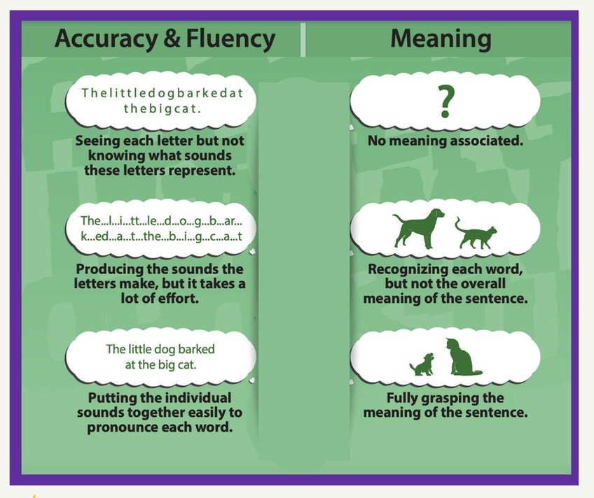
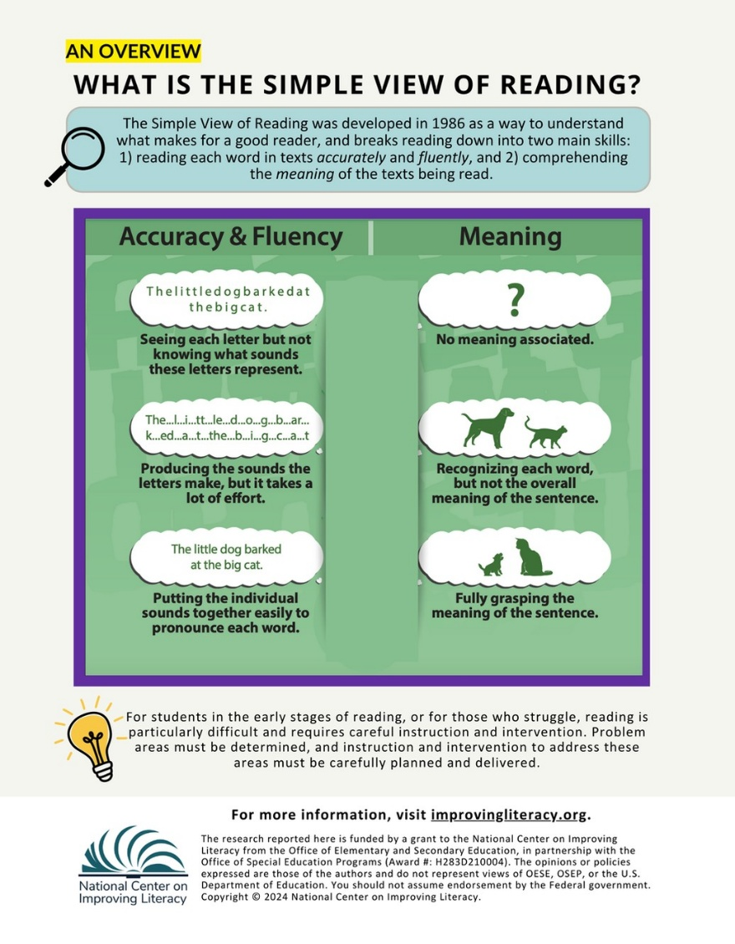

Skills Needed to Learn to Read
Notes:
What is reading? Reading is a complex system of making meaning from print that requires many skills. Reading successfully involves both correct word reading (accuracy and fluency) and understanding material read (meaning). This is called the simple view of reading. Explicit and systematic instruction in the skills needed to read accurately, fluency, and with meaning is key to becoming a skilled reader later. These skills are discussed next.
Distribute handout and/or Click the backpack or the Simple View handout to show https://www.improvingliteracy.org/resource/learning-to-read-the-simple-view-of-reading
Review the content of the handout or encourage families to review on their own.

Slide 8


Video provided by:
Notes:
In this video, Dr. G. Reid Lyon discuss the process of reading.
Start video: Reading Rockets (3.34) - https://www.youtube.com/watch?v=hzmnUalHtqs
TRANSCRIPT: You know, it's hard to say, if you ask yourself whether or not reading skills are more limited today than 40 years ago, it's tough to answer that question. For example, whether there's an epidemic at this point in time. What we do know is that 40 years ago, kids had many more options if they did not acquire reading skills well. There were many more vocational and occupational kinds of tracks people could go to. We can't make the comparisons because the types of data that we would need to do so just aren't available. What we do know is that in this time, reading is critical. It's much more critical because of the internet. It's much more critical to make a living. You see a lot of kids, individual differences in kids as they come into the early grades and even preschool and kindergarten on their development of these basic capabilities. Some teachers will say, well, you don't have to teach all of these skills because I got quite a few kids who seem to know them just on their own. It does appear natural. When we study those children and then go back and study what they did at home, we find that their parents were very good teachers. These are not naturally acquired skills. Reading is a skill. It's like piano playing. It's like tennis. It's like anything that incorporates a number of different subcomponents. The upshot is parents can be extraordinarily good teachers and provide a number of foundational skills that lead teachers sometimes to think that it is a natural process. It's not taught. It's just inherent. That's not true. Reading is not natural. I can't stress this enough. If reading were natural, why are there so many language, oral language using cultures on the planet who have not yet developed a written language? And if reading were natural, why are there so many young kids from poverty who yet have not acquired the skill in some way? Teachers have to be accountable for what they do in their classrooms and with children. They don't have any control over the background circumstances for that child. They don't have any control, typically, over the home life and the interactions at home once that kid leaves the classroom. What they do have control over is knowing their stuff, stuffing kids every day with that, and making sure that they're assessing as they go along in a systematic fashion so that they know the effects of what they're doing on that youngster's development and behavior. They are accountable for that. And unfortunately, even though the world is going to revolve around that classroom and do things that she or he has no control over, she does have control over what she knows, how she applies it, how she measures its effectiveness, and how the kids end up. It is accountability. Tough word, but we have to be accountable.
Lead a discussion with participants using these guiding questions:
What skills are needed for your child’s sports or hobbies?
In what ways do you help them in these activities?
How might this help look for supporting your child’s skills in reading?

Slide 9
Skills Needed to Learn to Read
Spoken Language
Written Language
Spoken and Heard
Written and Read
Language can be . . .
The foundation of reading and writing is based on spoken and written language skills.
Notes:
To write and read words correctly and with understanding, your child starts developing key skills at an early age. The foundation of reading and writing is based on the interaction between spoken language and written language skills. Language can be spoken and heard or written and read. Strong language skills build a better foundation for learning to read and write.

Slide 10

Skills Needed to Learn to Read
Spoken Language
Understanding and using sounds, words, and ideas from speaking and listening.
Notes:
Spoken language is understanding and using sounds, words, and ideas from speaking and listening. You can use and talk about sounds, vocabulary, and grammar with your child. Experience listening and speaking improves language skills. Limited experience, or difficulties with speech, language, and communication skills can interfere with learning to read.

Slide 11
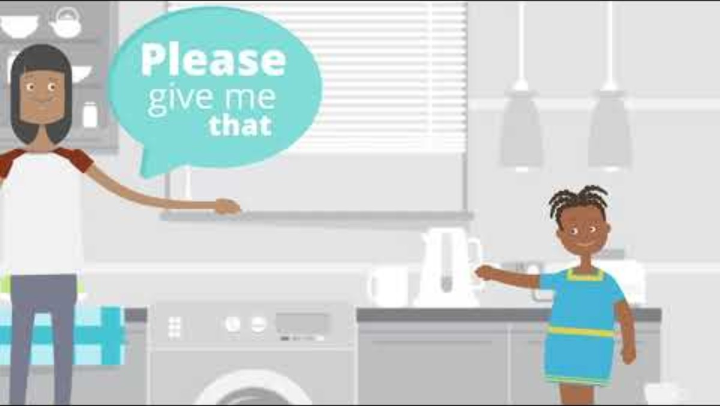

Skills Needed to Learn to Read
Video provided by:
Notes:
This video shows how to help your child develop spoken language.
Start Video: Read Charlotte (.46) - https://www.yout-ube.com/watch?=bnTRau1ykzIAZyn7
TRANSCRIPT: Kids can handle more than we think when it comes to vocabulary. When talking with kids, we often use words we know they’ll understand. But it’s easier than you think to teach them new words, and expanding their vocabulary is key to becoming a strong reader. Try using more descriptive words when talking with young children. When you catch yourself saying, “ Please give me that.” Try saying, “Please hand the pitcher to mommy.”
Ask participants the following questions to answer: “Let’s try it out. Instead of saying,
“Please put your clothes away, what could you say?” (Please put your clothes in the laundry basket/hamper/closet/dresser)
“It looks like you’re feeling mad, what could you say?” (It looks like you’re feeling angry/upset/bothered/frustrated)

Slide 12

Skills Needed to Learn to Read
Written Language
Understanding and using sounds, words, and ideas from reading and writing.
Notes:
Written language is understanding and using sounds, words, and ideas from reading and writing. There is a clear relationship between spoken and written language. This relationship is stressed in the “simple view of reading”. Once your child can read printed words, he or she applies the same skills used to understand spoken words to understand what is being read.

Slide 13
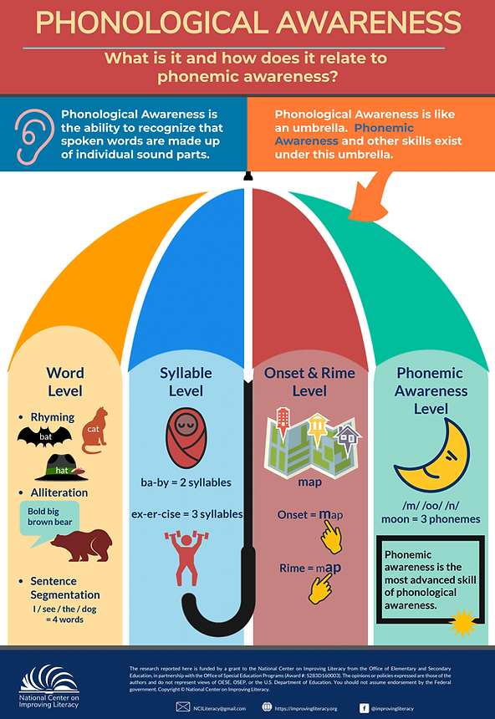
Skills Needed to Learn to Read
Spoken Language
Phonological Awareness
The ability to recognize that spoken words are made up of individual sound parts.
Phonemic Awareness
The ability to identify and play with individual sounds in spoken words.
Notes:
One part of spoken language is phonological awareness. Phonological awareness is the ability to recognize that spoken words are made up of individual sounds parts, including individual sounds called phonemes. Phonemic awareness is the ability to identify and play with individual sounds in spoken words. To read and spell, your child must understand how language works so he can read words later. Children with reading difficulties may develop phonological awareness slower than typical readers. As your child gets older, the need for phonological awareness instruction typically lessens unless he continue to struggle with these skills.
Distribute handout and/or Click the backpack or the Phonological Awareness handout to show https://www.improvingliteracy.org/resource/phonological-awareness-what-is-it-and-how-does-it-relate-to-phonemic-awareness
Review the content of the handout or encourage families to review on their own.

Slide 14
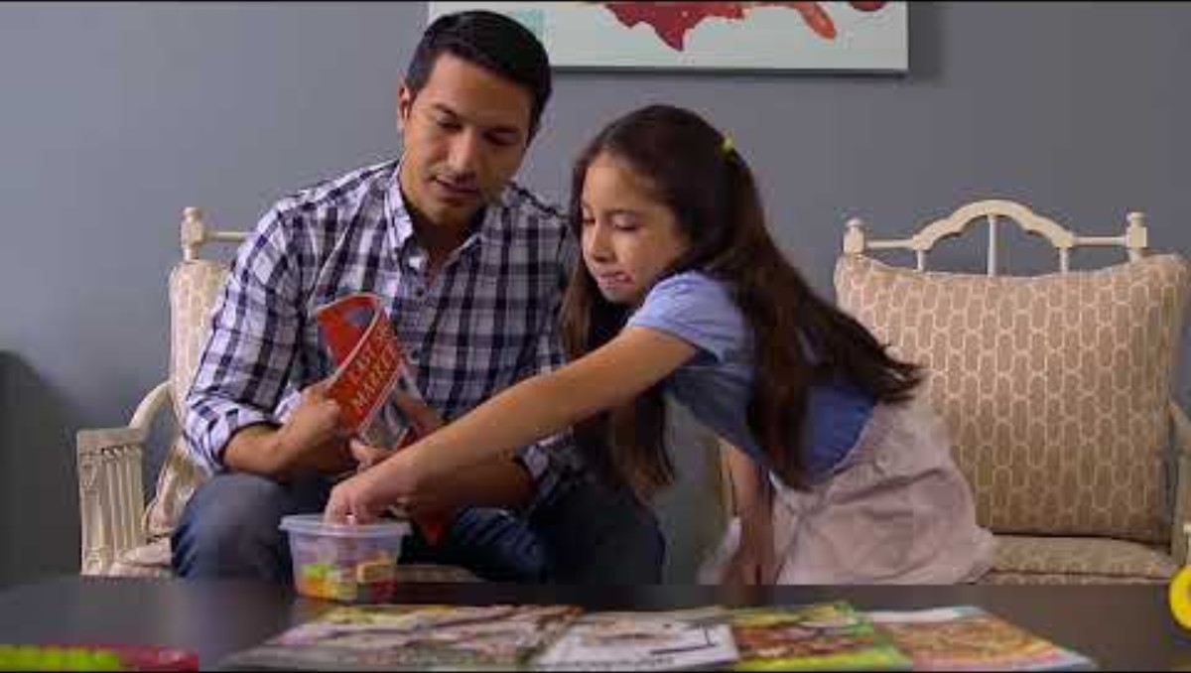
Skills Needed to Learn to Read
Video provided by:
Notes:
This video shows us what effective phonological awareness instruction looks like.
Start Video: Read Charlotte (1.26)​ - https://www.youtube.com/watch?v=CPderfCMNEo
TRANSCRIPT: What is phonemic awareness? This is the key to learning to read. It is the ability to hear, identify, and play with sounds and words. When children can identify sounds, this will help them when they begin to read. Phonemic awareness is the realization that within a word are individual sounds or phonemes. Just to be clear, phonics focuses on teaching sounds-spelling relationships and is associated with print. Phonemic awareness tasks are oral. Sometimes kids leave off the ending sounds to words. Like mom, I hurt my han instead of hand. Have a pile of items like Legos and sit at a table. Each time they hear a sound in a word have them put a Lego on the table. Man: What’s the first sound you hear in the word back? Girl: /b/. Man: Good, good. Now what’s the second sound you hear in back? Girl: /a/. Man: Good job. And what is the last sound you hear in back? Girl: /ck/. Man: Great, good job. Narrator: They can go back and touch each Lego to repeat /b/-/a/-/ck/, then say back.

Slide 15
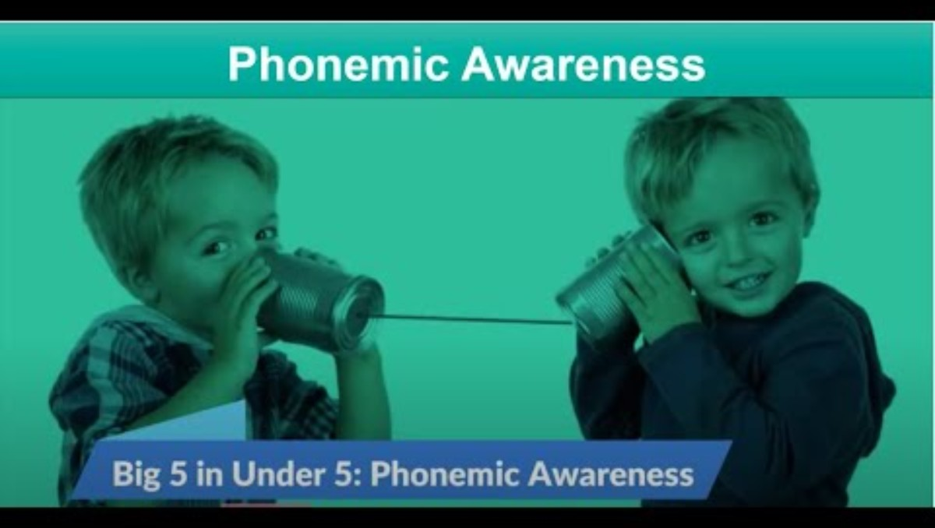
Notes:
This video goes into more depth on Phonemic Awareness.
Start Video: NCIL (4.52) - https://youtu.be/TLsCodzmJ6U?feature=shared
TRANSCRIPT What is Phonemic Awareness? It is the ability to identify and manipulate individual sounds in spoken words. It is essential for learning to read in an alphabetic writing system and a strong predictor
of children who experience early reading success – so in other words, if a child can do phonemic awareness tasks, they will most likely be a good reader. To understand phonemic awareness, it’s important to understand that it is the most advanced skill of Phonological Awareness. Phonological Awareness is the ability to recognize that spoken words are made up of individual sound parts. It is like an umbrella under which Phonemic Awareness exists with other levels of phonological awareness. These levels progress from larger sound units to the smallest sound unit, and includes the ability to distinguish sounds at a word-, syllable-, onset-rime-, and phoneme-level. So, phonemic awareness is a skill within phonological awareness that emphasizes an ability to play with words at the smallest unit of sound by identifying, categorizing, isolating, blending, segmenting, adding, deleting, and substituting individual phonemes in words. So, what does Phonemic Awareness look like? For starters, it is an auditory skill. It is the task of being able to pull apart words into their individual phonemes, the smallest unit of language, when heard. Purposeful phonemic awareness instruction includes: Identifying: recognizing a first sound in a word. What is the first sound you hear in cat? /k/ Matching: Taking a beginning sound and noticing it is the same as other beginning sounds. Choose a picture that matches the first sound /d/. Dog and Door. Categorizing: Grouping beginning sounds together that are the same. Is the /k/ in cat the same as the /m/ in map? Is it the same as the /k/ in cap? Is the /k/ in cat the same as the /k/ in can? Cat, cap, and can start with the same sound. Blending: Putting phonemes together to say a word. What word is made up of the sounds /k/ /ă/ /t/? "cat“ Segmenting: Saying each phoneme in a word. What are all the sounds you hear in cat? /k/ /ă/ /t/ Deleting: Removing a phoneme to change a word. What is “Cat” without the /k/ sound? “at.” Substituting: Changing a phoneme to make a new word. What word would you have if you changed the /t/ in cat to an /n/? “can” and Adding: which is Adding a phoneme to make a new word. Add /k/ to rash. What is the new word? /k/ rash=crash. How do we teach phonemic awareness? Keep lessons short. Less than 15 minutes. Focus on only 1 or 2 phonemic manipulation activities in a lesson. Use materials that reduce memory load and help represent sounds. For example, using pictures to help children remember the words and to focus their attention or using a 3-square strip or blocks to represent sounds in a word. Tie it to your instruction in reading and writing. So, present an auditory task focused on phonemic awareness, then include the same target sounds in words that students will practice reading or spelling. Once children can blend and segment sounds easily, use letters during lessons as a transition to phonics. Seeing the letters help children associate which sounds go with which letters. Finally, why is phonemic awareness important? It helps children get ready for reading and writing, understand that words are made of smaller sounds and helps them sound out words as they read and write. One of the common differences between readers who struggle and those who don’t, is strong phonemic awareness. First graders who cannot blend sounds into words, or segment words into sounds are likely in need of phonemic awareness intervention. Some students will also need word-level and spelling instruction to explicitly link sounds to print. Thanks for watching the Big 5 in Under 5: Phonemic Awareness. If you are interested in learning more, check out the National Center on Improving Literacy’s Implementation Toolkits.

Slide 16
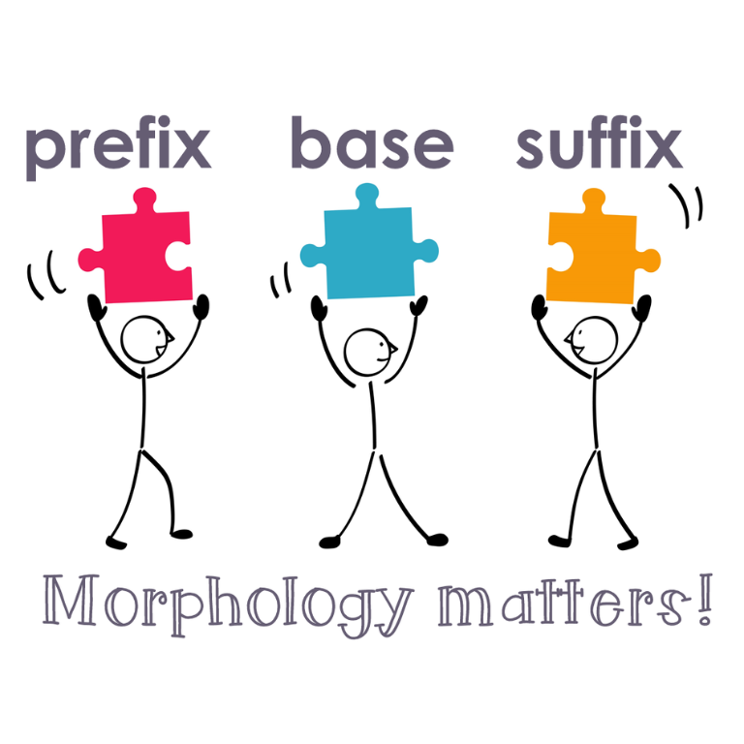
Skills Needed to Learn to Read
Spoken Language
Phonological Awareness
Vocabulary
Knowing what words mean and how to say and use them correctly.
Morphology
The knowledge of word parts that have meaning such as affixes, roots, and base words.
Notes:
Another part of spoken language is vocabulary. To read, your child must understand the meaning of words, phrases, and ideas and how to say and use them correctly. He learns vocabulary in two ways: indirectly, by hearing and seeing words as he listens, talks, and reads; and directly by adults teaching him the meanings of words and word parts. Before he can read, your child often learns the meaning of words, phrases, and ideas in books read aloud by listening to and talking about them. For example, understanding what the word “hot” means and that there are other words with similar meanings, such as humid, sultry, sizzling, and sweltering. Your child will also use word parts and their meanings, or morphology, to understand what words mean. For example, here is the word “friend.” When an “s” is added to the end, it makes it plural – more than one friend. If an “-ly” is added to the end of “friend,” it becomes “friendly,” and the meaning changes to acting like a friend. When “un-” is added to the beginning of “friendly,” the word changes to “unfriendly,” and so does its meaning – not friendly.

Slide 17
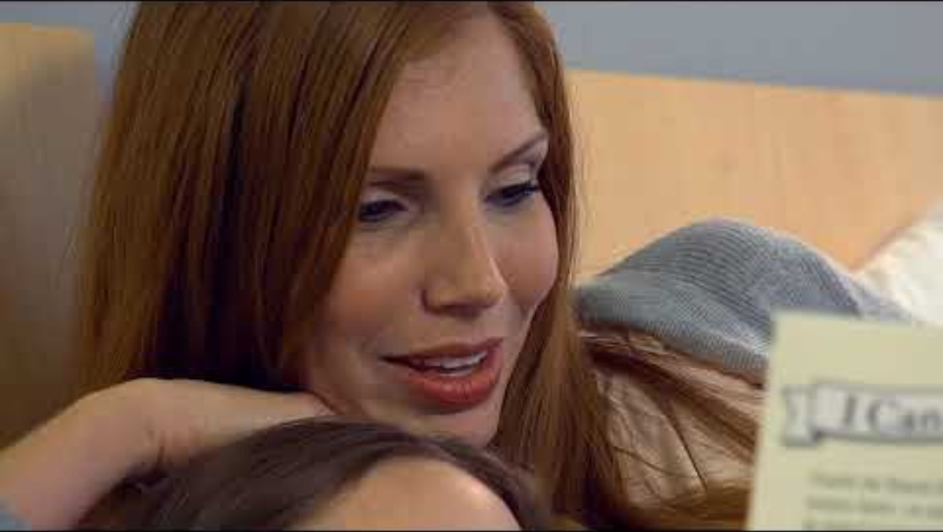
Skills Needed to Learn to Read
Video provided by:
Notes:
This video shows you how to help your child with vocabulary.
Start video: Read Charlotte (1.30) - https://www.youtube.com/watch?v=ulkX1aRTqTQ
TRANSCRIPT: Tier one words are words that kids often show up to kindergarten already knowing like baby, father, jump, and birthday. They are words that are used in every day conversation, so the meanings of these words don’t have to be taught. Tier two words, however, need to be taught in order to strengthen a child’s comprehension skills. These are words like remorse or tend. When you come across these words in a story, think of these as teachable moments. Woman: So the rabbit felt remorse for what he had done. Do you know what the word remorse means? (child shakes her head no) Woman: He felt badly and he wished he had been nicer to the frog. Can you say the word remorse? Child: remorse. Woman: That’s good. Has there ever been a time where you felt remorse, maybe? Felt really bad or guilty for something you’ve done? Child: Yeah, when I didn’t let Jessica play with the ball. Woman: Yeah, it’s okay, though. Narrator: Instead of replacing remorse with bad so that your child understands, teach them the meaning of remorse. By doing this, you’re helping your child say the word and then use the word in their own context, so it becomes familiar to them and helps grow their vocabulary.
“Think back to the questions we discussed before: “Please put your clothes away, what could you say?” (Please put your clothes in the laundry basket/hamper/closet/dresser). “It looks like you’re feeling mad, what could you say?” (It looks like you’re feeling angry/upset/bothered/frustrated). Let’s think of a kid-friendly way to explain some of these tier two words, like hamper. For example, “A hamper is a holder for dirty clothes.”
Have participants pair up to write a kid-friendly explanation on a sticky note for one of the words shared in the earlier activity and have a couple of volunteers share out or post responses on chart paper.

Slide 18

Skills Needed to Learn to Read
Spoken Language
Phonological Awareness
Vocabulary
Listening Comprehension
Is the ability to understand what others read and say to you
Notes:
The last part of spoken language in listening comprehension. Before your child can read, she often makes sense of books read aloud to her by listening to and talking about the sounds, letters, words, and ideas she hears. This is called listening comprehension, or the ability to understand what others read and say to you. Vocabulary and knowledge of the world are closely linked. When your child knows things about the world she is better able to understand what she reads.

Slide 19

Skills Needed to Learn to Read
Written Language
Print Awareness
Knowing about print and books and how they are used.
Alphabet Knowledge
The ability to name letters and know their sounds.
Notes:
One part of written language is print awareness. Print awareness is knowing about print and books and how they are used. Children who know about print understand that the words they see in print and the words they speak and hear are related. Alphabet knowledge is the ability to name the 26 letters in the English alphabet and know their sounds. Children who go to kindergarten knowing and writing the alphabet have an easier time learning to read.

Slide 20

Skills Needed to Learn to Read
Videos provided by:
Notes:
This video shows us how to pronounce letter sounds.
Start video: Read Charlotte (1.24)​ - https://www.youtube.com/watch?v=3vgbN8_h3LE
TRANSCRIPT: Narrator: It’s common for adults to think saying letter sounds is easy. If you’re teaching children to read, it’s important you know the correct sounds, so you can teach them how to blend them into words. Some letters have more than one sound. We’re going to start with the sounds you should teach young readers first. /a/, /b/,/c/, /d/, (pronouncing each sound and displaying its letter in the alphabet).​
Provide time for participants to pair up and practice making the letter sounds.
Encourage participants to “clip” the consonant sounds at the end when saying them so as not to add a schwa sound (i.e., try not to add a vowel sound after). For example, the sound of b is /b/ not /buh/.

Slide 21

Skills Needed to Learn to Read
Videos provided by:
Notes:
Here’s an idea for how to help your child with letters and sounds.
Start Video: Read Charlotte (.56) - https://www.youtube.com/watch?v=TBl2d1j6AVU
TRANSCRIPT Narrator: Kids must learn the letters of the alphabet and the sounds of the letters. When they understand the connection between letter and their sounds, then they will begin to understand that letters put together form words. This is the very foundation of reading. What sound does each letter make? Point out letters when you see them at the grocery store on signs, on junk mail at home, or the letters we see in our names. What sound do you hear at the beginning of boat? /b/. Practice this each time you ride in the car together. Tell your child words, and have them make the beginning sound they hear, then tell you the matching letter.
Guiding question to check for understanding: Why is print awareness and alphabet knowledge important for learning to read?

Slide 22
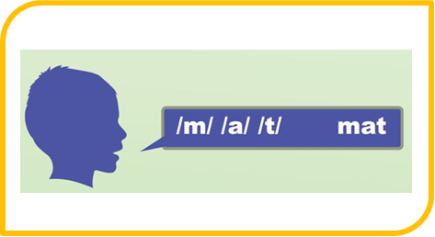
Skills Needed to Learn to Read
Written Language
Print Awareness
Knowing about print and books and how they are used.
Phonics
Is the process of using letter-sound relationships to read and spell words.
Alphabetic Principle
The understanding that letters match individual sounds in words.
Notes:
Another part of written language is phonics. Phonics is the process of using letter sound relationships to read and spell words. Phonics instruction helps your child learn the alphabetic principle — the understanding that letters match individual sounds in words. To read and spell, your child must understand that words are made of letters, that letters represent the sounds we hear in speech, and use these letter-sound connections to sound out, or decode, words or encode, or write words. Children with reading difficulties may develop word reading skills slower than typical readers. As your child get older, the need for phonics instruction typically lessens unless she continue to struggle with these skills.
Distribute handout and/or click first backpack to show https://www.improvingliteracy.org/resource/alphabetic-principle-linking-sounds-to-letters
Review the content of the handout or encourage families to review on their own.
Distribute handout and/or click second backpack to show https://www.improvingliteracy.org/resource/the-alphabetic-principle-from-phonological-awareness-to-reading-words
Review the content of the handout or encourage families to review on their own.

Slide 23
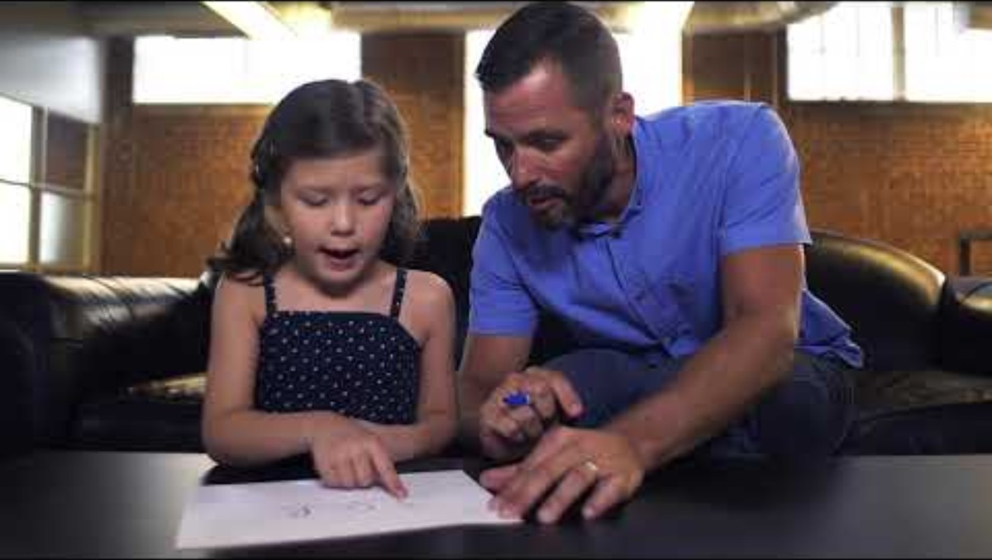
Skills Needed to Learn to Read
Video provided by:
Notes:
Here’s how you can support your child in phonics.
Start Video: Read Charlotte (.32) - https://www.youtube.com/watch?v=zONOzZOsKEQ
TRANSCRIPT Learn to read short words. Grab a blank piece of paper. Write two or three letter words like hat, top, or it. Draw a line under it. Draw a dot under each letter. Then practice reading the word while sliding your finger under each letter, dot to dot. Practice reading it slowly and quickly.

Slide 24
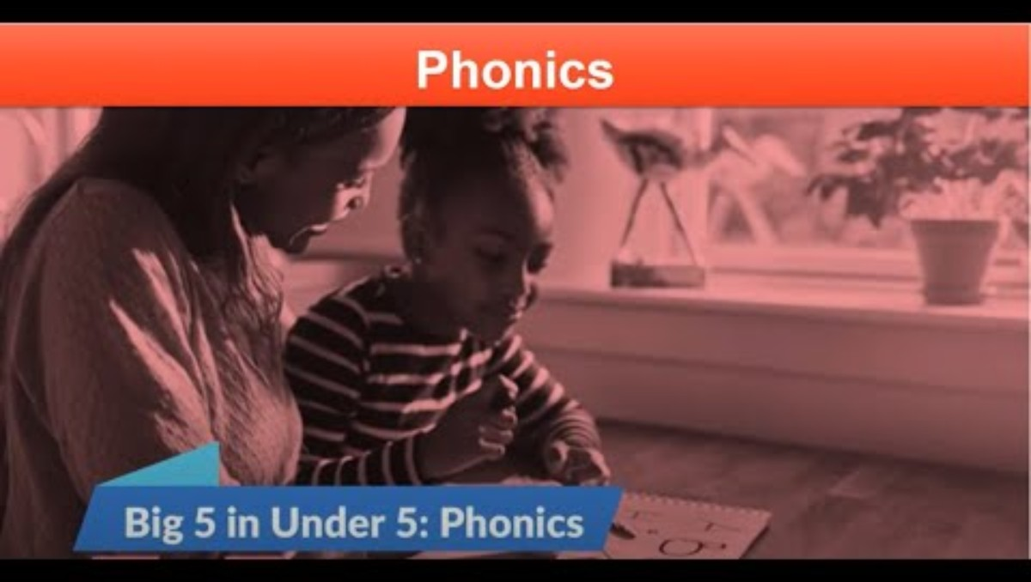
Notes:
This video goes into more depth on Phonics
Start Video - https://youtu.be/zHQSSu6BNe0?list=PLZXVpwHTPnn3d3ojpqMNE0Fa2ZUw3qIGT
TRANSCRIPT: What is Phonics What is Phonics? Phonics is reading instruction on understanding how letters and groups of letters link to sounds to form letter-sound relationships and spelling patterns. When children know the letter B says /b/ and t-i-o-n says /shun/, they’re using phonics. The ability to apply these predictable relationships to familiar and unfamiliar words is crucial to reading success. Phonics is not a particular reading program. It is an important part of explicit and systematic instruction for beginning readers. Systematic Phonics What does phonics look like? Systematic phonics instruction begins with teaching basic letter-sound correspondence - the relationship of the letters in the alphabet to the sounds they represent - and progresses to more complex letter-sound relationships so that students can decode regular and irregular words. Phonics instruction should be targeted. It should be evidence-based, engaging, systematic, and explicit. Letter Sound Relationships So, how do we teach phonics? While there isn’t a specific, agreed upon instructional sequence for introducing letter-sound relationships, it’s good to begin with the sounds that will enable students to begin reading words as quickly as possible. Start with letter-sounds of high utility such as m, a, and s so students can begin working with words as soon as possible. Work with just a few sounds at a time by teaching each letter of the alphabet and its most common corresponding sound. Instruction should include naming the letter or letters that represent the sound. Separate and stagger letter-sound relationships that are auditorily confusing (b and v) or visually similar (b and d) to promote mastery of one before introducing the other that may create confusion. When introducing each letter-sound relationship in isolation (versus when reading connected text), associate a word beginning with that letter-sound and follow up by introducing an object or picture of that word. Visually representing a word containing the letter-sound being taught can help a student remember the relationship between the letter and the sound. Use that word to create a short sentence or story, read the sentence aloud and then introduce the object or picture. By reinforcing the letter-sound with both the letter in print and the object, this helps the student recall the sound when they encounter the letter later. It’s important to note that pictures as part of phonics instruction are used to associate the sound to the letter and help with memory of that letter and it's sound. The pictures are not used to predict or decode words. Letters should be introduced in uppercase and lowercase when teaching the relationships between letters and sounds. Provide multiple opportunities for students to practice with letter-sound relationships. Once students have a good grasp of the letter-sound relationship you are targeting and are moving on to connected text, focus solely on the letters and sounds in the words . Pictures are not part of the continued building of phonics skills. Why is Phonics Important Finally, why is phonics important? Phonics helps crack the code of written language. Knowing the sounds of letters will help children read - decoding. And helps children know which letters to use when writing – encoding. It’s important to note that phonics is what connects instruction in phonemic awareness, the ability to identify and play with individual sounds in spoken words, to actual print. Phonics has a profound impact on fluency: The ability to read words, phrases, sentences, and stories correctly, with enough speed, and expression. and reading comprehension: the ability to understand what you are reading. Correctly and quickly decoding, or sounding out words, allows children to focus their attention and energy on understanding what they read. Which is what we want all children to be able to do. Thanks for watching the Big 5 in Under 5: Phonics. If you are interested in learning more, check out the National Center on Improving Literacy’s Alphabetic Principle and Phonics toolkit. And watch for the rest of our Big 5 in Under 5 series.
Guiding question to check for understanding: Why is phonics instruction important for learning to read?

Slide 25

Skills Needed to Learn to Read
Written Language
Print Awareness | Phonics | Reading Comprehension
The ability to understand what you read.
Notes:
The last part of written language is reading comprehension. As a reader, your child applies many of the same skills she uses when listening to books to make sense of ones she’s reading. This is called reading comprehension, or the ability to understand what you are reading. Your child’s reading comprehension can also improve when she writes about what she reads. The next slide has a video to help you learn This video helps us learn what effective vocabulary and comprehension instruction looks like.

Slide 26
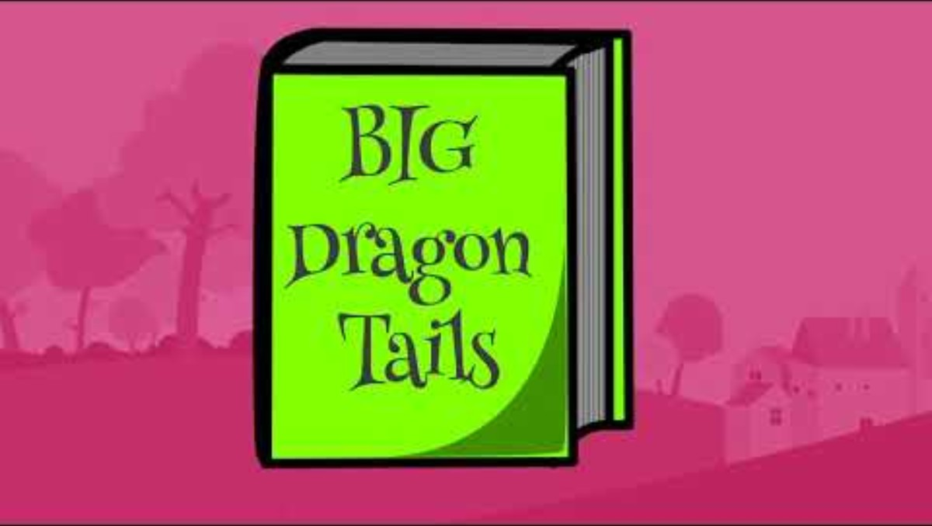
Skills Needed to Learn to Read
Video provided by:
Notes:
This video helps us learn what effective vocabulary and comprehension instruction looks like.
Start video: Read Charlotte (1.17) - https://www.youtube.com/watch?v=uUcthGj_RVU
TRANSCRIPT We want children to be making meaning from all the books and stories they are reading. As they read more and more on their own, we want to make sure they are developing skills to deepen their comprehension. We can check this by asking some questions before, during, and after reading. Before: while reading the title and looking at the cover, ask your child, “Does this story seem to remind you of anything you’ve ever seen in your own life?” During: while reading the story, check in to see if they’re getting the gist of the text. “Can you tell me what that means?” After: when they’ve reached the end of the story, have them think back on it. “What are some interesting facts from that story? Does this remind you of another story you’ve read?” Activating kids’ thinking about a story before they read, checking in with them as they read, and reflecting back after they read is a powerful strategy to help kids build meaning from the texts they read.
Guiding question to check for understanding: What should effective comprehension instruction look like?​

Slide 27

Skills Needed to Learn to Read
Fluency
Spoken Language
Written Language
Phonological Awareness | Vocabulary | Listening Comprehension
Print Awareness | Phonics | Reading Comprehension
Fluency is the ability to read words and reading material correctly, with enough speed (rate) and expression.
Notes:
Spoken and written language interact thorough the skill of fluency. Fluency is the ability to read words and reading material correctly, with enough speed (rate) and expression. To do this, your child needs to correctly and quickly apply all of his or her spoken and written language skills. Reading connected text daily, like phrases, sentences, and passages, is important to build fluency skills. Fluent word reading is helped by your child’s knowledge of both vocabulary and grammar. Reading fluently allows time for making sense of what is being read. Often, beginning readers do not read fluently.

Slide 28
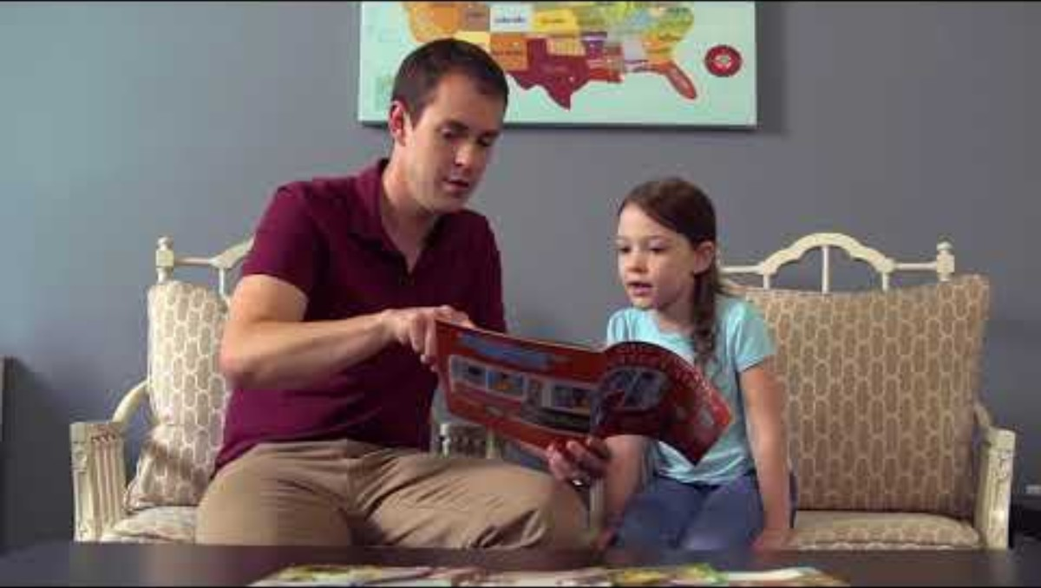
Skills Needed to Learn to Read
Video provided by:
Notes:
This video shows you how to help your child with fluency.
Start video: Read Charlotte (1:51) - https://www.youtube.com/watch?v=J5PtrGaIvRI
TRANSCRIPT: Fluency is being able to read words in stories easily, quickly, and correctly. Kids who can read accurately, quickly, and with expression, will have a much easier time understanding what they’ve read because they won’t be stuck on sounding out words. There are three ways to enhance fluency skills: echo reading, partner reading, and repeated reading. Echo reading: Man: I’m going read the line first and then you’re going repeat after me, okay? The man across the way was tuning a guitar. Child: The man across the way was tuning a guitar.” Man: yes! Narrator: Partner reading: this gives parents the chance to model good fluency or smooth reading for the child. It also gives them the opportunity to listen to their child read and offer helpful feedback. Man: The library opens at nine o’clock, but Lola is ready to go long before then. Child: The librarian buzzes them through the machine. Narrator: Repeated reading, this is when a kid reads the same paragraph or page over and over again, reading more smoothly and with more expression each time. Child: Now the moment had come to launch the boat. Would it float? It did. Woman: Okay, that’s great, but let stop you for a second. When you read, you want to sound like you’re talking, like when we talk to each other, right? So, say it more like you’re talking like, “Now the moment had come to launch the boat. Would it float? It did!” You try.” Child: Now the moment had come to launch the boat. Would it float? It did. Woman: Good job.
Guiding question to check for understanding: What should effective fluency instruction look like?

Slide 29
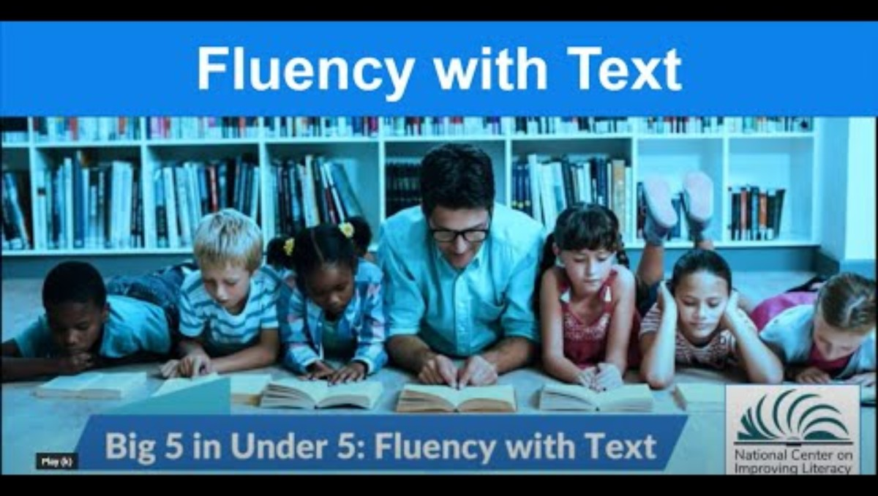
Notes:
This video goes into more depth on Phonics
Start Video: NCIL (3:12) Https://youtu.be/bzTENV9kkpk
TRANSCRIPT: Intro What do we mean when we talk about fluency? Fluency with text is reading words with no noticeable cognitive or mental effort. It’s when the fundamental skills are so "automatic" that it doesn’t require conscious attention. So what does that mean exactly? Let’s give some examples. People can perform many tasks with automaticity, or automatically. Like walking, riding a bike, or driving a car. Fluency, like riding a bike, develops through practice. Students go from sounding out individual letters and letter combinations, to reading words quickly and effortlessly, with lots of opportunities for practice until reading the words can be performed with a high rate of success. Fluency in Oral Reading Fluency in oral reading has 3 parts: Accuracy which is reading with few errors. Reading speed or the rate at which a student reads. And prosody or the skill of reading aloud with proper intonation, phrasing, and expression. To be a fluent reader, all three of these components must be in place. What Fluency Readers Look Like So, what do fluent readers look like? Fluency research says that successful readers rely primarily on the letters in the words rather than context or pictures to identify familiar and unfamiliar words. They process virtually every letter. They use letter-sound correspondences to identify words. They have a reliable strategy for decoding words. And they read words a sufficient number of times for words to become automatic. Why Fluency Why should we focus on fluency? To gain meaning from text, students must read fluently. Proficient readers are so automatic with each component skill (phonological awareness, decoding, vocabulary) that they focus their attention on constructing meaning from the print. These component skills need to be well developed to support understanding. It is not enough to be simply accurate; the skill must be automatic. So, fluency is not an end in itself but is the bridge to comprehension. Fluent reading frees up cognitive resources to better process the meaning of the words. How to Build Fluency Now that we know why it’s necessary, how do we help build fluency? Effective fluency instruction should include repeated readings, or practice, with passages that the student can read with a high level of accuracy. It should be brief, about 15 to 30 minutes, it should include corrective feedback, students should be able to set goals and graph progress, and teachers should keep in mind that fluency is only part of the bigger picture. Thanks for watching the Big 5 in Under 5: Fluency with text. If you are interested in learning more, check out the National Center on Improving Literacy’s Fluency toolkit. And watch for the rest of our Big 5 in Under series.

Slide 30
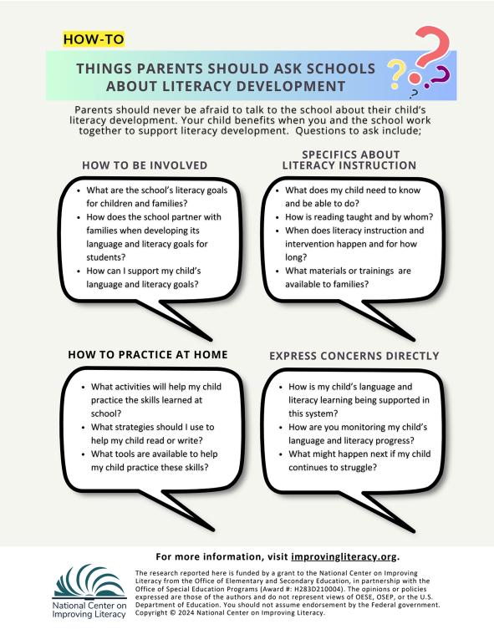
Skills Needed to Learn to Read
Notes:
Here are some ways you can help set the stage for your child’s language and reading success. Click the image to read more about them. Click Watch Video to hear about the ABCs of active reading at home. When your child starts school, ask: Does the reading program include all skills of reading?, how does my child review and practice reading skills? and how does my child receive teacher feedback on his reading skills and progress?
Distribute handout hand/or click the backpack or flyer to show https://www.improvingliteracy.org/resource/how-families-can-partner-with-schools-on-literacy-development
These are some questions you can ask when talking to your child’s teacher.
Review the content of the handout or encourage families to review on their own.

Slide 31
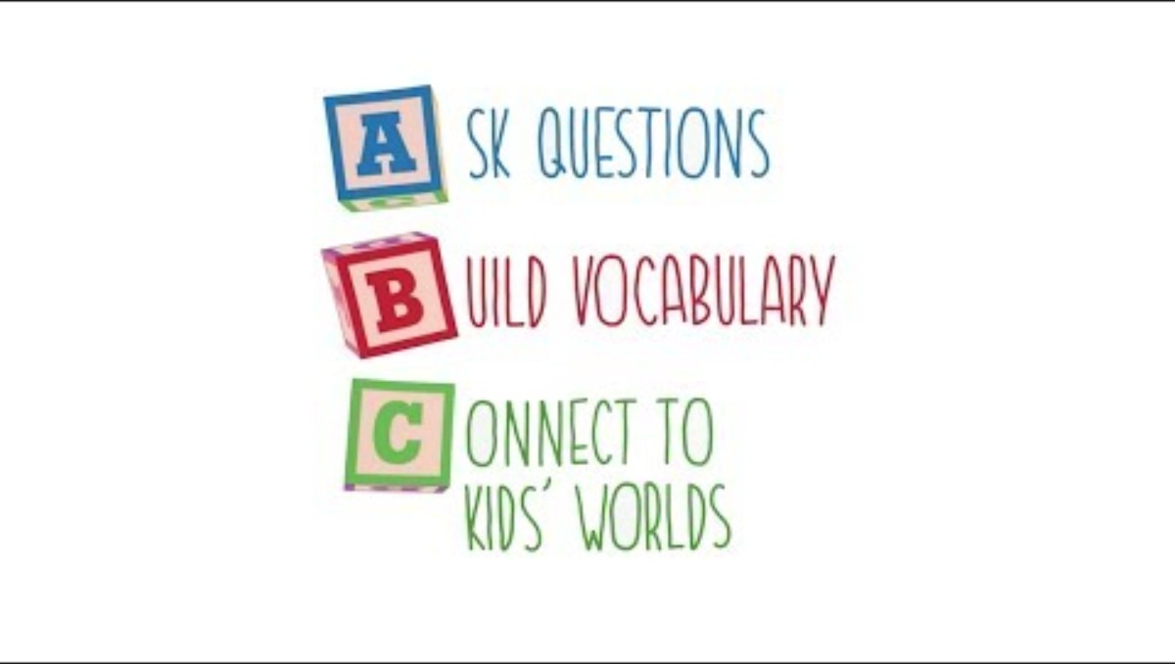
Skills Needed to Learn to Read
Video provided by:
Notes:
This video shares some ideas on how to actively read with your child at home.
Start Video: Read Charlotte (3:40) - https://www.youtube.com/watch?v=lLmloCC-0rM
TRANSCRIPT: So you care for a child, a son, daughter, maybe a sibling, our grandchild, maybe even an entire classroom of children. It’s fun, rewarding and oh my gosh, sometimes overwhelming. It’s hard to keep up with all the dos, don’ts, must-haves, and don’t even get me started on all the opinions on the internet. We know reading is important to children’s development, so what you might not know is the difference between reading to kids and reading with them. It’s called active reading and it works with children six months to sixth grade and you can do it anywhere. Riding the bus, during snack time, or morning drop-off, waiting for food to be delivered at a restaurant, before bedtime. It only takes 15 minutes to have an impact. Here’s how it works. Just remember ABC. A: ask questions, the kind that start a conversation about the book. Questions that begin with words like: what, how, who and why. You can start before you even open the book by asking, “Look at the cover and title. What do you think the story will be about?” Or, once you’re reading say, “Tell me what’s happening on this page? What do you think will happen next?” Open-ended questions engage kids in books and gets them talking and thinking about them. Next the B of the ABCs of active reading: Build vocabulary. Learning new words help kids become stronger readers. You can help children identify new words by asking what words mean. For example, you might ask, “What’s a beverage?” You can connect words with pictures by asking questions such as, “Who is drinking the beverage?” and connect new words to those they already know by saying something like, “A beverage is a type of drink like the milk you have every morning.” You can also act out the book by using facial expressions, sounds, or movements to show them what the words mean. For example, don’t just say the word whisper, actually whisper as you say it. Finally, the C of the ABCs of active reading: Connect to kids’ worlds. Relate the book to things children already know to help them learn more about the world around them. For example, you might pick a moment in the story and say, “Tell me about your favorite thing to do in the park.” Or if you’re reading a book about the weather you might say, “It’s raining on this page. Do you remember when it was raining? What do you like to do when it’s raining? Yes, jump in puddles! Do you see anyone jumping in puddles in this picture?” That’s it, the end. A ask questions, B build vocabulary, and C connect to kids’ worlds. Active reading for just 15 minutes, just three times a week, makes a huge difference in children’s language development and reading ability. And when you make it a part of your day, it becomes a fun and rewarding habit that you and the children you care about, enjoy and look forward to. For more examples, questions and resources on active reading, visit ReadCharlotte.org. Open books, open opportunities start engaging in active reading today to give kids the tools they need to be strong readers and begin a lifelong love of reading.

Slide 32

Notes:
This is a similar video as the previous video, but it is in Spanish.
If appropriate Start video: Read Charlotte in Spanish (3:43) - https://youtu.be/SnHCv96H10w
TRANSCRIPT: usted atiende a un niño un hijo o una hija tal vez su hermano o su nieto o hasta toda una clase llena de niños es divertido gratificante y además a veces sumamente abrumador cuesta saber lo que se debe o no hacer que tener y en cuanto a las opiniones en internet mejor ni hablamos sabemos que la lectura es importante para el desarrollo de los niños quizás no sepa la diferencia que hay entre leerles a los niños y leer con los niños se llama lectura activa y se practica con niños de 6 meses al sexto grado se hace en cualquier lugar en el autobús al comer al llevar al niño a la escuela al esperar que le sirvan en un restaurante antes de dormir solo toma 15 minutos para tener impacto funciona así recuerde tres cosas uno hacer preguntas que inicien una conversación sobre el libro y que empiecen con las palabras qué cómo quién Y por qué puede comenzar antes de abrir el libro y decir mira la portada y el título de qué crees que se trata la historia o bien mientras lean diga cuéntame qué sucede en esta página qué crees que sucedería después las preguntas abiertas despiertan el interés de los niños y los hace hablar y pensar dos El segundo paso de la lectura activa enriquecer el vocabulario al aprender nuevas palabras los niños son mejores lector tores ayúdesnos una bebida relacionen las palabras con las imágenes con preguntas como quién se está tomando una bebida relacionen las palabras con las que ellas sepan diga por ejemplo una bebida es algo que se toma como la leche que tomas por la mañana actúe la historia con expresiones faciales sonidos o movimientos que expliquen el significado de las palabras por ejemplo en vez de solo decir la palabra susurro mejor susurr Ela tres el último paso es relacionar la lectura con el mundo de los niños relacione el libro con lo que ya sepan para que aprendan más acerca del mundo que les rodea por ejemplo podría tomar un pasaje de relato y decir dime qué es lo que más te gusta hacer en el parque o si leen un libro sobre el tiempo diga viendo en esta página recuerdas el día que llovió qué te gusta hacer cuando llueve saltar en charcos ves a alguien saltando en charcos en la imagen llegamos al final uno hacer preguntas dos enriquecer el vocabulario y tres relacionar la lectura con el mundo de los niños la lectura activa 15 minutos tres veces por semana marca gran diferencia en el desarrollo del lenguaje y la capacidad de lectura al hacer la parte del día llega a ser un hábito divertido y gratificante que tanto usted como los niños que atienden disfrutan y aguardan con interés para más ejemplos preguntas y recursos sobre la lectura activa visite readchar org Abre libros Abre oportunidades implementa la lectura activa y brinda los niños los medios para ser buenos lectores y cultivar el amor por la lectura Oh

Slide 33

How Reading Typically Develops
Notes:
Your child typically move through several stages as he learns to read. You play a key role in his reading development at every stage. You are your child’s first teacher because you can lay the foundation for becoming a skilled reader right from the start. You also can continue to help your child with the reading skills needed to be a successful reader as he grows.

Slide 34
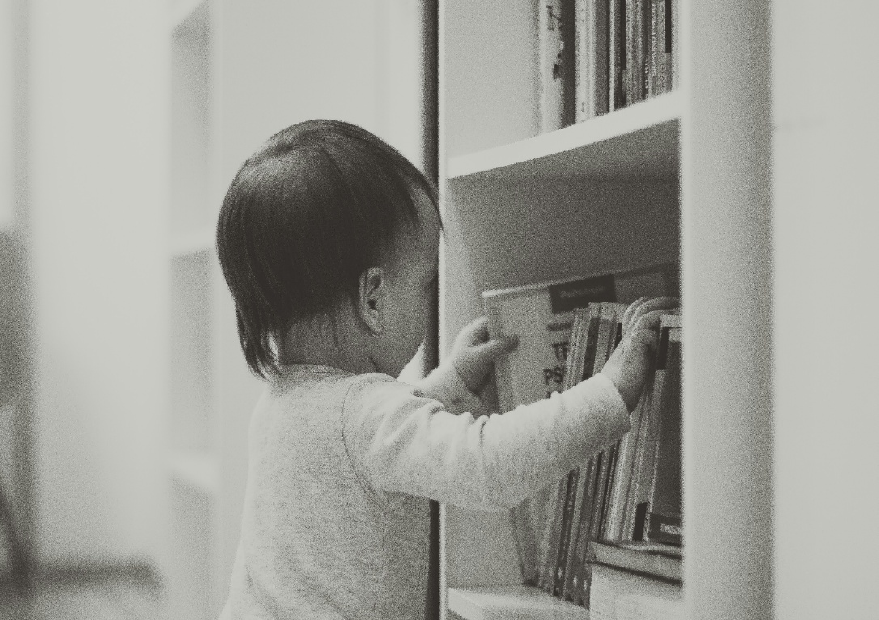
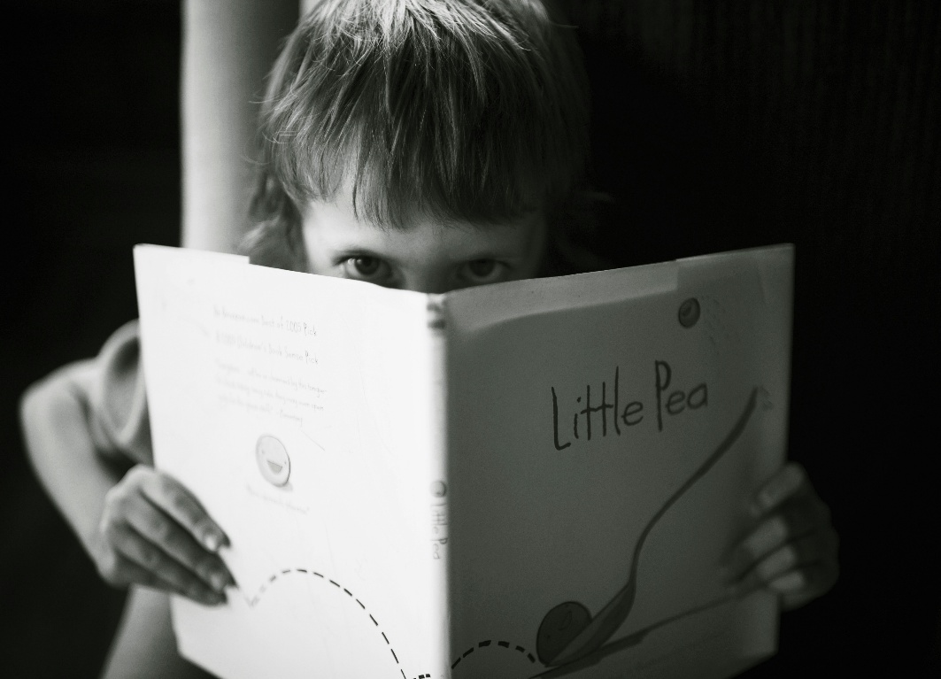


How Reading Typically Develops
Continuum of Learning
Emergent Readers
Early Readers
Transitional Readers
Fluent Readers
Notes:
Learning to read, like in all learning, happens across time. It involves learning many skills that must work effortlessly together. Your child usually learns and masters these skills at particular ages. He often begins to understand what reading is about by watching and listening to others read. His knowledge and abilities deepen and expand as reading skills are learned and practiced. Understanding what is expected at different ages can help you notice when your child’s skills are progressing appropriately or not. There are signs to look for in your child that may show a risk for reading difficulties later. These difficulties are often noticeable very early when your child has trouble learning key language and early literacy skills compared to his peers. You play an important role in your child’s education by sharing signs of risk in your child with others like your pediatrician.

Slide 35

How Reading Typically Develops
Video provided by:
Emergent Readers:
About Birth to Age Six
Notes:
From birth to age six, your child is an emergent reader trying to make sense of words she hears and is learning how print works. She is budding in many important areas for becoming a skilled reader. For example, in spoken language, she is recognizing words and their meanings, learning letters and their sounds, and understanding books read aloud.
This video goes into details how reading typically develops.
Starrt Video: Reading Rockets (5:46) - https://www.youtube.com/watch?v=hj_qOqOuZd8
TRANSCRIPT:
Teacher: How do you say it? Children: Azul, Azul!! Narrator: Long before children set foot in a classroom, we can start giving them the skills they’ll need to become strong readers. Dr. Needleman: Learning to read is much more than a set of skills you get in school. There is a whole foundation that gets built over the first years of life. Narrator: Laying that foundation starts with mom and dad. All it takes is some quality time. Two year old Ava Johnson and her mother Kimberly spend time reading and talking together every day. Ava: She loved books from the very beginning. Then she used to chew on the corners and just start to play with turning the pages. Now she’s gotten to the point where she really appreciates the story itself. Narrator: Ava is lucky; only 60% of parents of children under five say they read to their kids every day, leaving the rest to play a dangerous game of catch up. Dr. Robert Needleman knows that children who are not read to early often start school at a disadvantage. Dr. Needleman: We know from very close study that when parents read with their children, they are really teaching language. Language is tremendously important for children’s emotional development and also for their ability to succeed in school. Narrator: That’s because early language development and later reading skills are intimately connected. The more you talk with a baby or toddler, the bigger that child’s vocabulary will be by age three. So even if parents are not reading with their kids, they should be talking with them at all the time. Child: Oh oh, what happened? The box fall out? Woman: The box is falling out, isn’t it? Dr. Todd Risley: When you only talk a little bit, it’s only business. It’s, “come here,” “sit down,” “Stay there.” It’s simple, it’s not abstract. It’s not fun. When you talk more, you’re not talking more business; it’s about something else. That’s the good stuff and the more the child talks, the larger the vocabulary they have, the more different kinds of words and phrases that they use in their oral language, the easier and more readily they become readers. Narrator: Studies show that children who enter kindergarten with poor language skills have a very hard time catching up. The single best predictor of how children will do in school is how much they know before they get there. Dr. Needleman: If you look at the parents with the least amount of education, 30 percent of them say that they are reading aloud with their children every night, 70 percent don’t. So that shows us what a long way we have to go. Narrator: To get there, Dr. Needleman co-founded Reach Out and Read. It’s a national organization that works with health care providers like Dr. Nicole Lang to offer early literacy training as part of regular pediatric care. Dr. Needleman: The inspiration for Reach Out and Read was the realization that reading was a tremendously important part of children’s development and yet, we in pediatrics didn’t know anything about it. Narrator: Since pediatricians see both children and parents from day one, they’re in a great position to help kids get a head start on reading. Pediatrician: We have so many frequent well-child visits and we teach families how to be healthy and this is a part of that. You know, he may just want to put this in his mouth because he’s teething and that’s normal too. Dr. Needleman: When we bring a book into the exam room and we actually see how that child responds to the book, and see how the parent responds to the child responding to the book. It gives an in to talk with the parent about a very important topic which is: what can you do to help your child grow up intellectually alive? Dr. Lang: Sometimes there can be literacy problems with the parents or grandparents – or if they weren’t read to as a child they don’t see the importance of reading to their own children. I just say talk to them, sing to them, read to them. Narrator: Dr. Lang also tells parents to watch for early milestones in learning to read. At six months old, Isaiah should be reaching for the book, eager to turn pages. Man: Can we find a candle? Narrator: Two year old Justin should be pointing, and identifying pictures. He should be able to say at least 50 words and talk in two to three word sentences. Justin: Where’s da lion? Narrator: Children who miss milestones should be checked for hearing issues or developmental problems. Kids with lots of ear infections should see a doctor too because the infections can lead to language delays. But even for kids like Justin, who are doing well, the time spent reading together can really pay off. Dr. Needleman: How much reading is enough for you? Adult: Is that the book you want to read? Dr. Needleman: If parents say well you know, I read to him 5 minutes every day. I ask the parent how does it feel, Oh, We love it. Ok, so, if you love it make it 10 minutes, and if you love 10, make it 15. We know that when children grow up to be successful readers they have been read to often, on average, 30 minutes a day. Woman: I feel so fortunate to have had such good exposure to reading and books my whole life. Reading isn’t just a luxury – it’s really about your health and a child’s wellbeing. Dr. Needleman: Whether children are read to at home on a regular basis becomes one other way that disadvantage gets transmitted from generation to generation – and we have an opportunity to interrupt that cycle. Dr. Lang: We’re giving them lots of good information that they are taking to heart – and when we talk about reading and how important that is they say – ok, well I should be doing this too. Just as I give my child fruits and vegetables, you, I’ll also read to them. That’s what you must do – and the beetle lent the spider a helping leg or two.

Slide 36

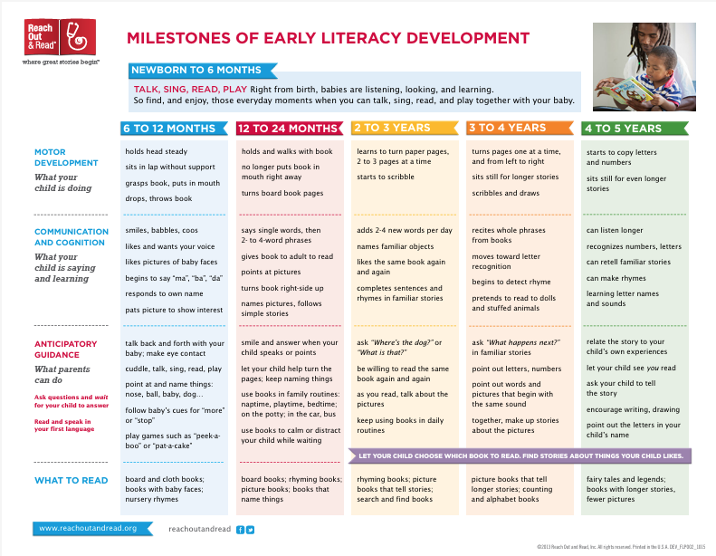

How Reading Typically Develops
Risk
Factors
Signs of Risk for Reading Difficulties in this Stage Include Trouble:
Learning to talk
Naming the letters of the alphabet
(including in their own name)
Noticing and naming rhymes
Noticing and playing with individual sounds in spoken words
Quickly naming aloud a series of familiar items
(like letters, numbers, colors, or objects)
Emergent Readers:
About Birth to Age Six
Notes:
Signs of risk for reading difficulties in this stage include trouble learning to talk, naming the letters of the alphabet (including in their own name), noticing and naming rhymes, noticing and playing with individual sounds in spoken words, and quickly naming aloud a series of familiar items (like letters, numbers, colors, or objects).
Distribute handout and/or click the first backpack or the A Child Becomes a Reader handout to show - https://lincs.ed.gov/publications/pdf/reading_pre.pdf
A Child Becomes a Reader shows what you can do at home, what to look for in preschool, and key accomplishments by age five.
Review the content of the handout or encourage families to review on their own.
Distribute handout and/or click the second backpack or the Milestones document to show - https://www.gradelevelreadingsuncoast.net/wp-content/uploads/2018/05/RORmilestones_English.pdf
This milestones document shows expectations from birth through age five. Scan through this information in relation to child’s age.
Review the content of the handout or encourage families to review on their own.

Slide 37

How Reading Typically Develops
Risk
Factors
Signs of Risk for Reading Difficulties in this Stage Include Trouble:
Quickly naming letters
Learning letter-sound connections
Noticing and playing with individual sounds in spoken words
Remembering words seen many times before
Early Readers:
About Ages Six to Seven
Notes:
From age six to seven, your child is an early reader, usually linking speech sounds to letters to make words, learning to decode words, and beginning to make sense of what he reads. He is developing in many areas important for becoming a skilled reader. For example, in recognizing words and their meanings, reading, and spelling and writing.
Signs for risk for reading difficulties in this stage include trouble quickly naming letters, learning letter-sound connections, noticing and playing with individual sounds in spoken words, and remembering words seen many times before.
Distribute handout and/or click the backpack or a Child Becomes a Reader to show https://www.nichd.nih.gov/sites/default/files/publications/pubs/documents/readingk-3.pdf
Review the content of the handout or encourage families to review on their own.

Slide 38

How Reading Typically Develops
Video provided by:
Early Readers:
About Ages Six to Seven
Notes:
This video is a quick look at how a six- or seven-year-old reads.
Start Video: Read Charlotte (.37) - https://youtu.be/LDPriDmOIRc
TRANSCRIPT By the end of first grade, lots of kids stumble on the tougher words when they are reading. Child: Soft and silent, she swoo-, sw-, sw-, swooped? Woman: Yes, yes. Child: Through the trees to Sarah, and Percy, and Bill. Narrator: Be patient and give your child time to work through it. Self-correcting is an important skill to develop around this time.

Slide 39

How Reading Typically Develops
Risk
Factors
Signs of Risk for Reading Difficulties in this Stage Include Trouble:
Remembering words seen many times before
Sounding out unknown words
Reading fluently instead of word by word
Spelling words correctly
Transitional Readers:
About Ages Seven and Eight (Grades 2-3)
Notes:
From age seven to eight, your child is a transitional reader, usually reading “like she talks” and knows how to decode unfamiliar words and read with understanding, but may still need support with more difficult reading material. She should be progressing in recognizing multi-syllable words and their meanings, reading a variety of longer material, and spelling and writing independently. Click Risk Factors to see what to look out for. Click Learn More for checklists to track your child’s language and reading accomplishments from age two through grade three. Notice where she is showing success and what skills she’s still working on. Look for a steady pattern of growth with a few slower or faster periods. This is a healthy sign of your child’s reading development. Use the results from the checklists to talk to your child’s teacher, early childhood provider, or pediatrician if you have any concerns about your child’s reading progress.
Signs for risk for reading difficulties in this stage include trouble remembering words seen many times before, sounding out unknown words, reading fluently instead of word by word, and spelling words correctly.
Distribute handout and/or Click the backpack or the “Literacy begins at Home” handout to show https://lincs.ed.gov/publications/pdf/Literacy_Home.pdf
Review the content of the handout or encourage families to review on their own.
You can use the results from the checklists to talk to your child’s teacher, early childhood provider, or pediatrician if you have any concerns about their child’s reading progress.

Slide 40
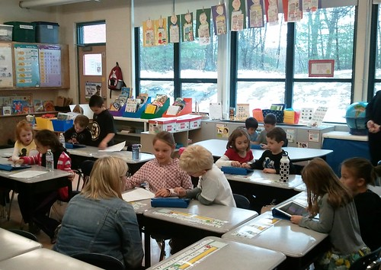
How Reading Typically Develops
Risk
Factors
Signs of Risk for Reading Difficulties in this Stage Include Trouble:
Reading fluently instead of word by word
Mispronouncing long, unfamiliar words
Remembering the ideas in reading material
Spelling words correctly
Fluent Readers:
About Ages Eight and Up (Grade 3+)
Notes:
From ages eight and up, your child is a fluent reader, often reading independently with confidence and understand longer and more difficult types of material. He should be using word parts to figure out words and relating sections of the story to one another.
Signs for risk for reading difficulties in this stage include trouble reading fluently instead of word by word, mispronouncing long, unfamiliar words, remembering the ideas in reading material, and spelling words correctly.

Slide 41
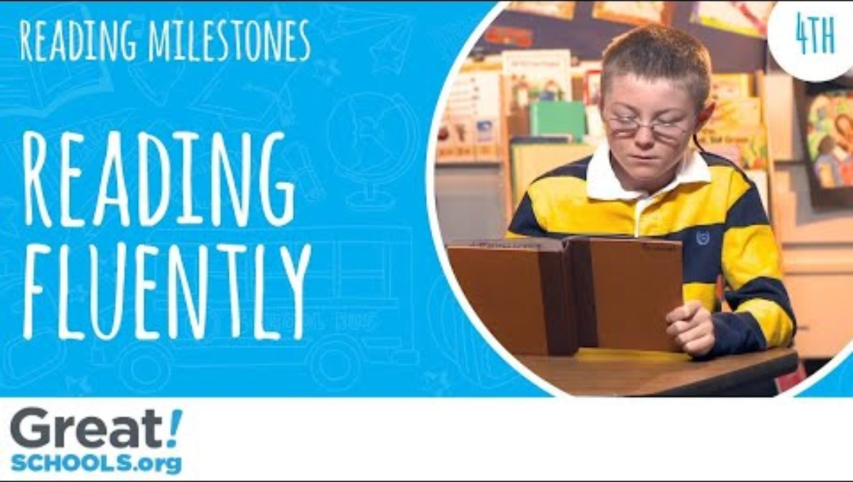

How Reading Typically Develops
Video provided by:
Fluent Readers:
About Ages Eight and Up (Grade 3+)
Notes:
This video shows a fourth grader use knowledge of letter-sound relationships to decode, or sound out, words.
Start Video: Great Schools (1.39) - https://youtu.be/2k_-59OOcYc
TRANSCRIPT Narrator: What does a fluent reader in fourth grade look like? Have you heard your fourth grader read lately? At this age they’ll probably be reading pretty smoothly and at a speed that doesn’t get in the way of them understanding what they read. Child: When l I was still a baby my father watched me and fed me and changed my diapers and did all the millions of other things a mother normally does for her child. Narrator: You’ll probably see them correct themselves as they read or needing help with pronunciation. Each kid will sound a little differently as they read. Child: Early methods used by miners to keep the tunnels from caving didn’t always work. Child: I think that all the love he had felt for my mother when he…she was alive he now lavished upon me. Narrator: A smooth reader still has to understand, so make sure after they’ve read a bit that you can tell that they’re understanding what they read. Teacher: What can you infer about what his relationship is, Danny’s relationship is with his dad? Child I think that he really likes his dad because he works all day with the shop and stuff and then he works at the filling station and his dad is raised him like his whole life so he’s pretty much been taken care of. Narrator: So how do you know if your child’s on track? Well, come summer, fourth graders who read fluently read more complex texts smoothly and with some expression, read at a natural speed, self-correct mistakes as they go, and don’t just read the words. They understand what they read.
Lead a discussion with participants on What does it mean to be a fluent reader?

Slide 42
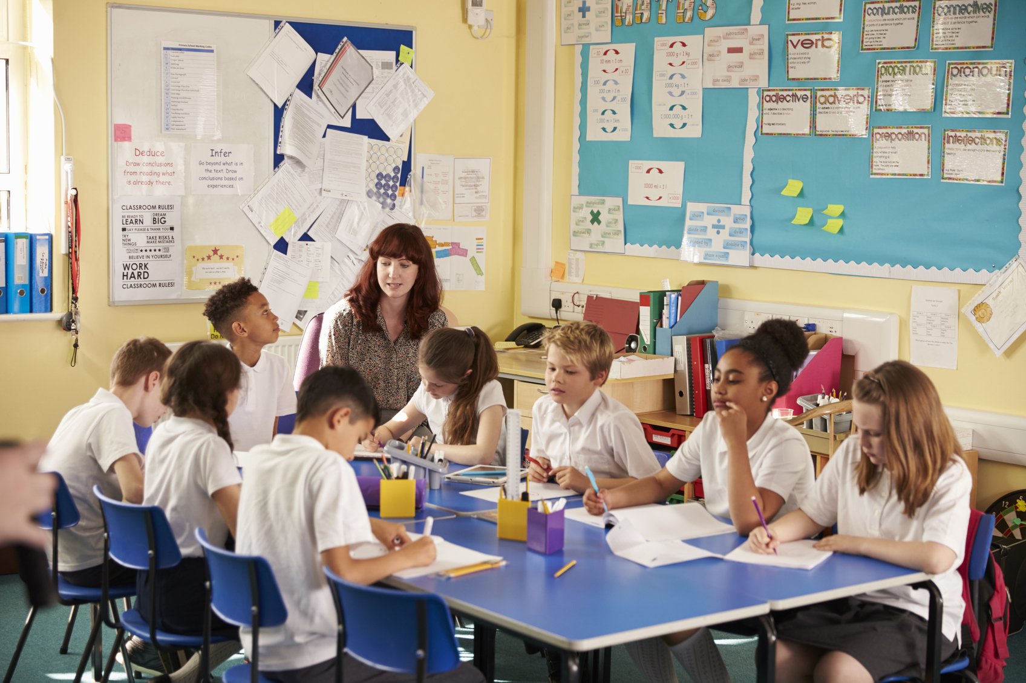
How Reading Typically Develops
Risk
Factors
Signs of Risk for Reading Difficulties In this Stage Include Trouble:
Remembering the ideas in reading material
Spelling words correctly
Taking notes and completing homework
Slow and effortful reading
Middle Schoolers
Notes:
In middle and high school, your child is often reading material that has many viewpoints and more complex language and ideas. She should be drawing on what she knows from other reading material and experiences to judge what she reads and come to conclusions.
Signs for risk for reading difficulties in this stage include trouble remembering the ideas in reading material, spelling words correctly, taking notes and completing homework, and slow and effortful reading.

Slide 43

How Reading Typically Develops
Video provided by:
Middle Schoolers
Notes:
Next, we’ll hear a middle schooler reading aloud.
Start Video: Great Schools (2.31) - https://youtu.be/c58usoDrfjc
TRANSCRIPT: You’ve probably heard that common middle school complaint at least once or twice in your household, “This is so long and so boring!” Well, they’re right on one count, books are getting longer, and harder in middle school. And now, before they get to high school, is the time to make sure your child’s reading is up to snuff. By now, kids are pretty comfortable reading the words on the page, but they should be able to go deeper than that. First, vocabulary. Harder, unfamiliar words are popping up constantly, but they should be able to figure out the meaning of these words. Here, Clara is trying to figure out a scientific word by applying what she knows and context clues. Teacher: What does solar storms mean? Child: Umm, I’m not sure. Teacher: If you don’t know what that means how might you try to figure it out? Child: I could look at the context clues in that paragraph, like storms, not like actual storms with like rain and stuff. But like they could come across like they might have a lot of rocks flying at them or stuff like that. Narrator: Second, just as in elementary school, kids should be able to show their understanding by pointing to specific sentences in the text that support what they know. But in middle school, they are asked to make more complex inferences. Child: I think this story takes place in a utopia society so it’s way in the future and I don’t think that they have books. Teacher: Ok, and what evidence do you have to show that? Child: Umm, when Margie wrote “Today Tommy found a real book!” and you can tell by her excitement with the exclamation point. So I inferred that since she was happy that he found a real book it must be rare or almost impossible to find a real book. Narrator: Lastly, because texts are getting harder, you find your middle schooler struggling through what he reads. That’s ok. The key at this age is not that they be able to read something easily, but rather that they can stick with reading even when it’s hard. You can help by encouraging stamina and good reading strategies to help them understand what they read. The more they understand, the easier it will get. So, how do you know if your child’s reading skills are up to snuff? Well, by the end of middle school, kids should be able to: figure out the meaning of unknown words, show understanding of more complex ideas with evidence from the text, and stick with reading even when it’s tough and long.

Slide 44

How Reading Typically Develops
High Schoolers
Notes:
This document provides middle and high school grade-level descriptions of what children should know and be able to do and what practices to look for in classrooms.
Distribute handout and/or Click the backpack or the “10 Key Reading Practices” to show https://meadowscenter.org/wp-content/uploads/2022/04/10Keys_Secondary_Web1.pdf
Review the content of the handout or encourage families to review on their own.

Slide 45

How Reading Typically Develops
Video provided by:
High Schoolers
Notes:
In this next video we’ll see how high schoolers show understanding when reading.
Start Video: Great Schools (2.44) - https://youtu.be/b-LsZ7TKGgE
TRANSCRIPT: Do you know that 70% of high school students need some form of reading help and remediation? You might be surprised as to why. Narrator: Bobby Cupp, High School Teacher. One common misconception about reading is that someone who can read the words in a text, also deeply understands those words. Child: After growing up poor in a mostly African-American neighborhood in Cincinnati, the young adults have reached their early twenties. One by one their brains were scanned by an MRI. Narrator: Does your child really understand what she reads? Kids who don’t really understand what they’re reading might hesitate and have trouble answering questions about it. Teacher: What is these couple of paragraphs about? Child: Umm, I’m not sure. Narrator: But kids who do understand can show you they do. They can tell you the key ideas in a text and point to the sentences in that text that support those ideas. Child: I feel like the main idea is talking about how lead has influenced the crime rates and skills in like, school and how you perform. It talks about it right here, after they introduced the lead and how it affected the people that grew up in Cincinnati. Narrator: And as the vocabulary gets harder, they can figure out the meaning of unfamiliar words. Child: It says, “I’ve gotten off to a disastrous start”. It means like the start is horribly wrong. Narrator: Because texts are more complex, even good readers won’t understand everything they read. That’s ok, but they need good strategies for sticking with it, to try to understand it. First, kids can reread the text. Teacher: If you’re not sure what can you do? Child: Go back and reread. Narrator: They can ask questions. Child: The main question I had was where the majority of the lead exposure was coming from? Narrator: And they can make notes and annotations. So how do you make sure your child is understanding what he reads? Teacher: Parents can encourage their students to take a challenging piece of text, paragraph by paragraph. Narrator: So take a few minutes and make sure your high schooler is really understanding when they read. Man: What are you reading about? Child: I’m reading about how butterflies fly and navigate. Man: What’s the main idea? Child: Well the main idea is how, when it’s clear and sunny they navigate via the sun; and when it’s a cloudy day they follow the magnetic poles of the earth. Narrator: So does your child understand what they read? If they can identify key ideas, and sentences that support those ideas, figure out the meaning of unfamiliar vocabulary and stick with it when they don’t understand, chances are they do.

Slide 46
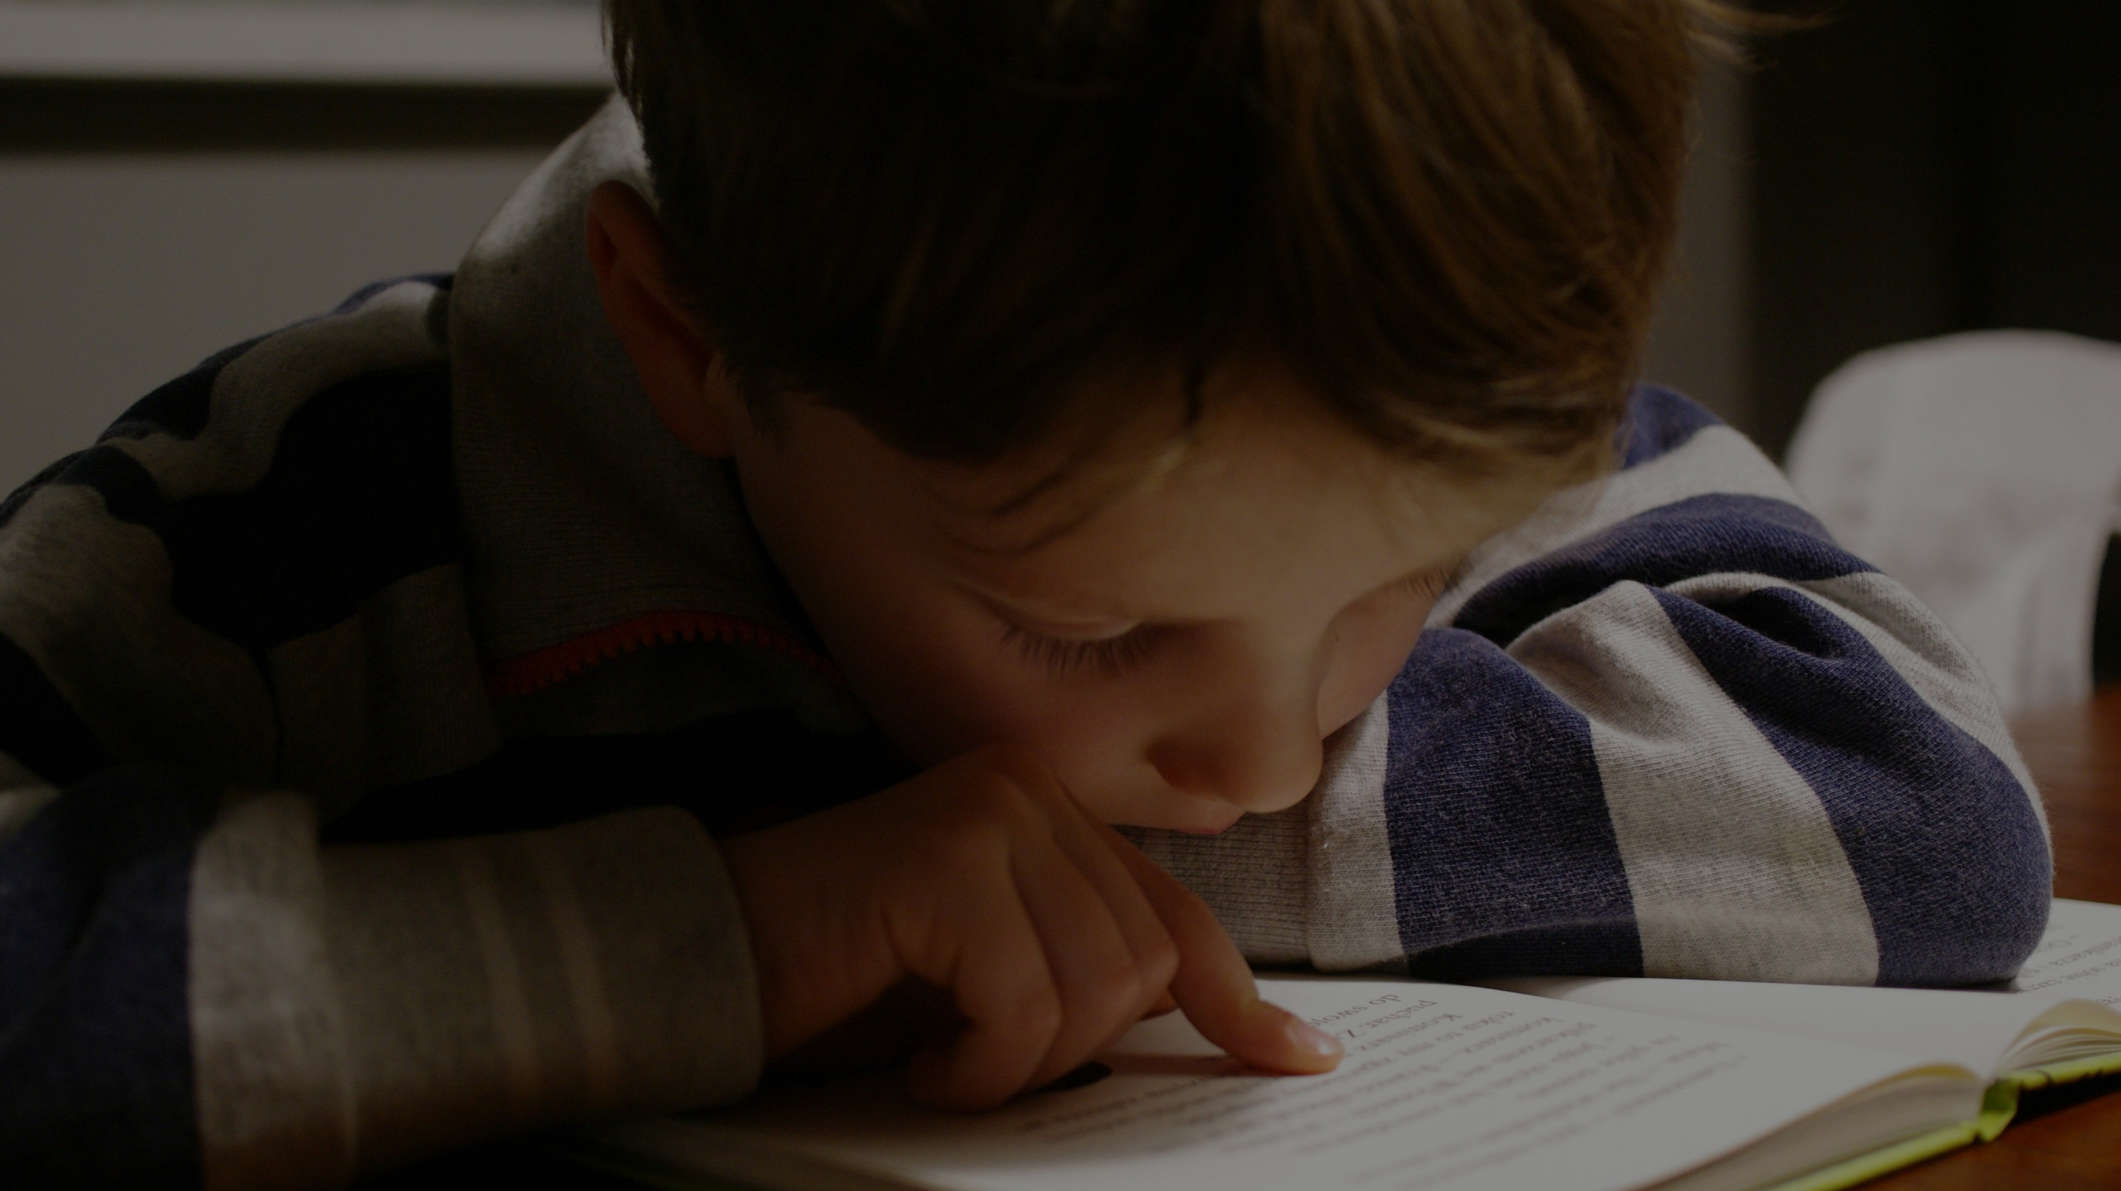
Why Children Might Struggle to Read
Notes:
Why your child might struggle to read. Sometimes it is just temporary, while other times it may point to a deeper learning issue.

Slide 47

Why Children Might Struggle to Read
Learning to read is a complex process.
Notes:
Learning to read is a complex process involving many skills and your child can struggle for many reasons. Reading difficulties are most common in the earliest stages of reading, but some children continue to struggle or show new difficulties in later grades. It is important to find out early if your child is lagging behind so he doesn’t miss out on the kind of early reading instruction and practice that helps him become a successful reader later. Schools can do this by screening all children’s early reading skills starting in kindergarten.

Slide 48
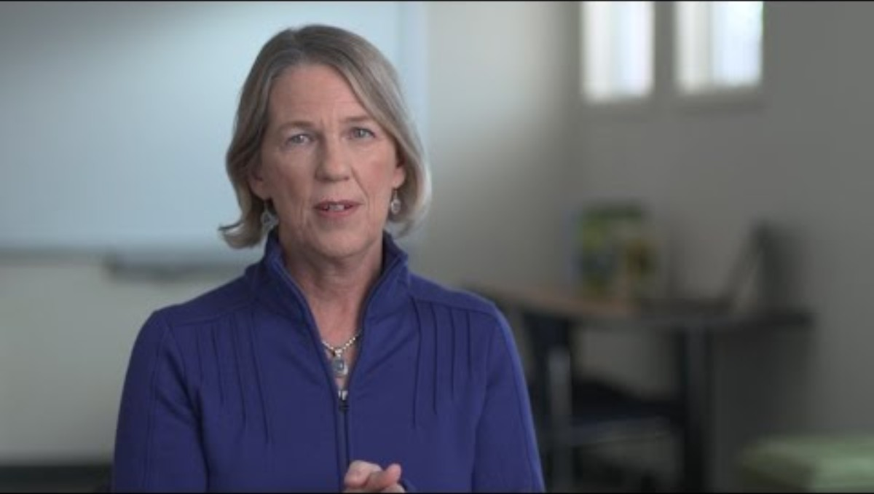

Why Children Might Struggle to Read
Video provided by:
Notes:
Here we’ll listen to Margie Gillis discuss why learning to read is harder than learning to speak.
Start Video: Understood (2.07) - https://youtu.be/Dpi83OQEDaQ
TRANSCRIPT: Margie Gillis: Learning to speak and understand language is natural for most human beings. We are biologically wired to do that and it is part of our human heritage. We’re born to do that and unless we have some language problem that we’re born with, we acquire a language just by being exposed. By being with caregivers, parents, siblings, peers that surround us with language. And it’s just magical to see it unfold. Learning to read, on the other hand, is a cultural invention. So our brains just don’t come with that wiring. And it’s relatively recent, five thousand years, that we’ve had some system that actually represents spoken language. We didn’t have, you know, an alphabet. We wouldn’t be able to convey our thoughts, and perpetuate, you know, ideas. So it’s a wonderful thing, but it’s a challenging thing. Because what we have to do, is to use areas of the brain, left hemisphere, that are really wired for humans to acquire language. And we have to build a neuro circuitry to be able to skillfully and automatically, effortlessly, pull words off the page while making meaning. And for some children, that is just a very difficult thing to do. It has nothing to do with intelligence. It has nothing to do with exposure. It has everything to do with, “I was born with this brain.” And skilled reading instruction will address those neurobiological differences.
Lead discussion: Why is learning to read harder than learning to speak?

Slide 49


/s/-/u/-/n/
Why Children Might Struggle to Read
/c/-/a/-/r/
Notes:
Your child might struggle to read because they have trouble recognizing speech sounds. For example, saying the beginning sound “s” in the spoken word “sun”, blending and taking apart individual sounds in spoken words, like /s/-/u/-/n/ is sun and car is /c/-/a/-/r/, and saying the sound parts in longer spoken words. Learning how spoken words can be broken into smaller speech sounds helps your child hear how language works so they can read and spell words later.

Slide 50
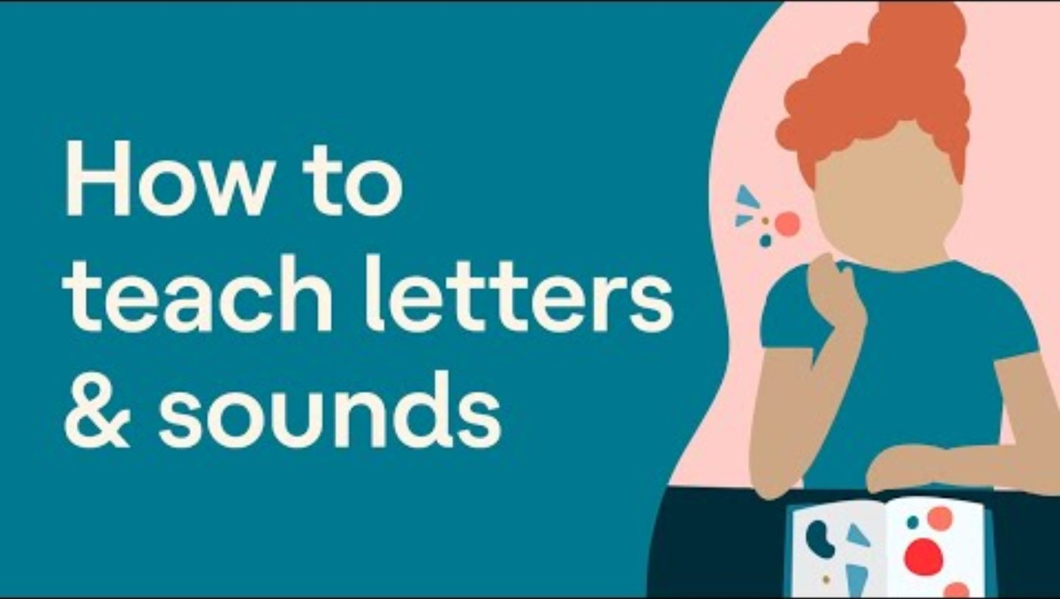
Why Children Might Struggle to Read
Video provided by:
Notes:
Here you’ll learn about ways you can help your child with speech sounds and connecting them to letters.
Start Video: Understood (3.00) - https://www.understood.org/en/articles/video-helping-kids-connect-letters-and-sounds-in-everyday-activities
TRANSCRIPT Children with reading issues often struggle to connect letters to sounds or to rhyme words. Learning how sounds fit together to make words is a critical step toward becoming a good reader and speller. This is often a big issue for kids with dyslexia. That’s why it’s important to help your child practice these skills often and in a way that’s fun and low-stress for both of you. For example, you might see the letters “C” and “H” on the handles of a faucet while you’re helping your child wash up. You can say, “Look, this handle says ‘C’ because it’s the cold water, ccccold. Can you think of other words that start with a /c/ sound? Or at the grocery store, you can make a game out of looking for items that start with the same sound as your child’s name. Rhyming’s easy to work into everyday life, too. Just singing rhyming songs together is a terrific way to help your child have fun with rhyme. Also, if you’re out and about and your child points out, for example, a cat, you can suggest that you try to see how many words you can both think of that rhyme with cat. Take this idea one step further by helping your child break apart the sounds in words. So you can say, “Hey there’s a chair. What word would we have if you took away the /ch/ from chair?” When your child figures out that the answer is air, then ask, “What word would you make if you added a /h/ sound to the beginning of air?” You can keep going from there.
“Let’s try it out. Here’s a pen. Can you think of another word that starts with the /p/ sound? “
Ask participants to respond (e.g., paper, party, puppy).
“Can you think of a word that rhymes with pen?”
Ask participants to respond (e.g., ten, hen, when, glen).
Rhyming words are words that sound the same at the end. “What sound would we have if we took away the /p/ from pen?”
Ask participants to respond (en).
“What word would we make if we added a /th/ sound to the beginning of /en/”
Ask participants to respond (then).

Slide 51
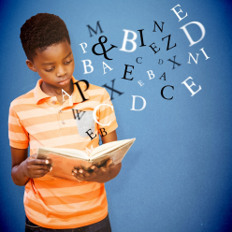

Sub-
Why Children Might Struggle to Read
Trouble recognizing words.
Notes:
Your child might struggle to read because he has trouble recognizing individual words. His ability to sound out words successfully, or decode, strongly contributes to his reading success. Using word parts and their meanings when sounding out words helps your child link known words with unknown ones. For example, knowing the meaning of “sub,” which is under or below, in the word “subway” may help him understand the words “subgroup” and “subdivide.” Children with reading difficulties often struggle to recognize the meanings of word parts compared to typical readers. Phonics instruction helps develop your child’s decoding skills. Knowing and using phonics gives him a strong tool for reading words correctly and making sense of what he’s reading.
Display the following words on chart paper: play, playing, playful, replay, playhouse. Put the word play in the middle and put the other words around it. Connect the other words to play with lines. Point out the known word play (in the middle) and then underline it in all of the words to show how the words are related to one another. Discuss how the meanings of the words change based on the word parts (play + -ing = playing, meaning “to play now”; play + -ful = playful, meaning “full of play”; re- + play = replay, meaning “to play again”; play + house + playhouse, meaning “a house to play”). Point out that using word parts like base or root words, affixes, and word parts helps children to connect known words to unknown ones to decipher their pronunciations and meanings. Ask participants to think of sentences using the words play, playing, playful, replay, and playhouse appropriately.

Slide 52
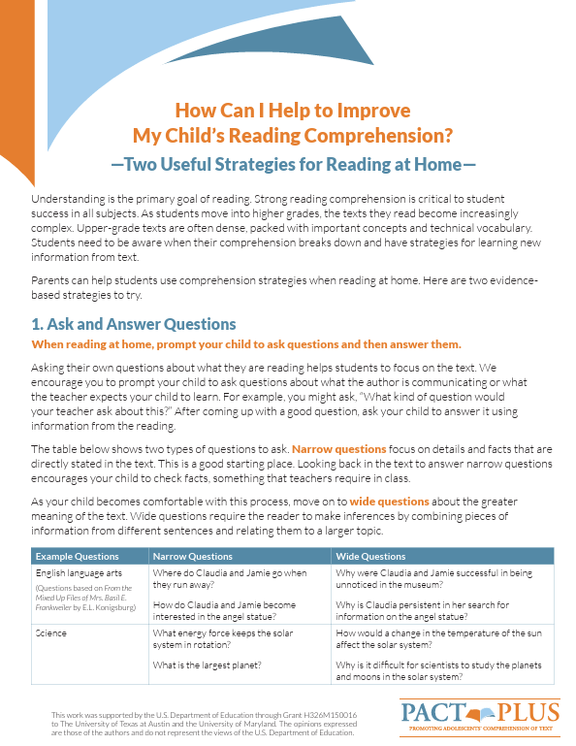

Why Children Might Struggle to Read
Trouble understanding what is read.
Notes:
Your child might struggle read because she has trouble understanding what she reads. Children who find reading difficult often do not read very much. So, they miss out on lots of amounts of reading practice that builds their fluency and vocabulary. Fluent readers are usually able to concentrate better on the meaning of what they are reading instead of thinking about decoding words. If your child has limited background knowledge of words and their meanings, it makes it more difficult for her to learn the meaning of new words. Over time, her limited background knowledge and vocabulary begin to gradually affect her ability to understand what she reads.
Distribute handout and/or click the backpack or the “How Can I Help” to show https://meadowscenter.org/resource/how-can-i-help-to-improve-my-childs-reading-comprehension-two-useful-strategies-for-reading-at-home/
Review the content of the handout or encourage families to review on their own.

Slide 53
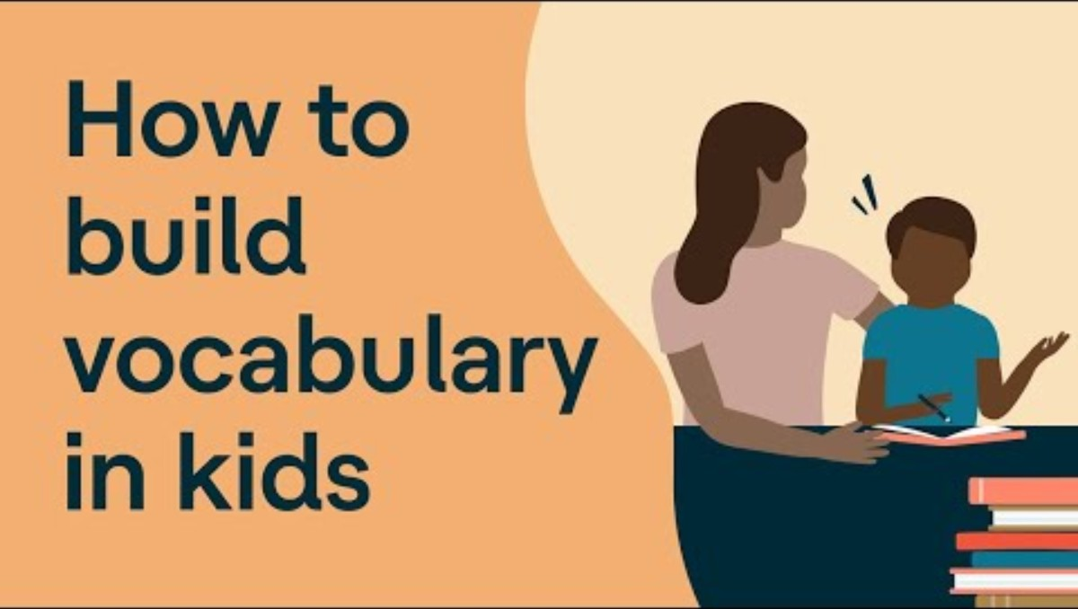
Why Children Might Struggle to Read
Video provided by:
Notes:
Here’s a brief video on ways you can help your child build her vocabulary.
Start Video: Understood (3.07) - https://youtu.be/2e2N07-wCvQ
TRANSCRIPT: Elizabeth Babbin: When we think about kids learning to read, many of us focus on sounding out words. And, of course, that's hugely important. But there are other elements that are really important, too, like building up your child's vocabulary. If your child struggles with reading, he will not be exposed to as many words in print as stronger readers. When kids are struggling,
they usually spend less time reading. Who likes being frustrated? And they're probably reading shorter, simpler books than their classmates. This is especially true for kids with dyslexia. Here's how you can make this a regular part of your daily routine. Let's say you read a story together that uses the word "reluctant.“ Pause and explain what it means. Then describe how it's being used within the context of that story. You might say, "In the story, Jessie was reluctant to go into the swimming pool because the water was so cold.“ But don't stop there. It's really helpful if you can follow with your own example. "I was always reluctant to go roller skating when I was a kid because I was afraid I'd fall.“ Then ask your child to come up with several of his own examples. Ask him about things that he's reluctant to do. Maybe he'll tell you that he's reluctant to eat a certain food or to share his favorite gadget with his sister. It's also good to have him make some judgments about how to use the word. For example, you might say, "If you were tired, would you be reluctant to run around the track?“ Or, "If you're thirsty, would you be reluctant to drink some water?“ If your child enjoys drawing, he might even like to do a vocabulary sketch. For example, if he hates broccoli, he could draw himself in front of a bowl of broccoli with a speech bubble that says, "I'm reluctant to eat broccoli.“ Doing these things with your child can help him understand and remember what the new word means. Another great way to build vocabulary is to use technology. Audiobooks and text-to-speech can be great tools for struggling readers. You can find helpful apps and other resources like Bookshare on Understood's Tech Finder tool. Building your child's vocabulary will help him develop a greater command of language and ideas, and that can make all the difference in becoming a successful reader.

Slide 54

Why Children Might Struggle to Read
Limited English language skills.
Notes:
If your child has limited English language skills, they might struggle to read because they may not yet understand the English language when it is spoken. It is very difficult for your child to read a language when he does not speak and understand it when listening. If your child speaks another language well then instruction in his native language can be used to extend his native literacy skills to reading in English.

Slide 55

Why Children Might Struggle to Read
Limited experience with books.
Notes:
Your child might struggle because they lack experience with books and print before coming to school. Kindergartners who are underprepared in language and early literacy skills are especially in need effective reading programs and explicit instruction. They usually need extra support to address issues related to their lack of experience, like in knowing how books work or connecting speech to print. Extra support can help children overcome early reading difficulties based on inexperience. It is never too late to share book experiences with your child.

Slide 56
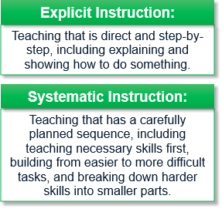

Why Children Might Struggle to Read
Mismatch between instruction and need.
Notes:
Your child might struggle to read because of a mismatch between classroom instruction and her individual needs. Children with or at risk for literacy-related disabilities like dyslexia require effective and ample reading instruction in foundational reading skills. These skills include learning the structure of language, like speech sounds and the alphabetic principle, and applying these skills in books daily. Reading instruction in these skills should be explicit and systematic. Explicit instruction is teaching that is direct and step-by-step, including explaining and showing how to do something. Systematic instruction is teaching that has a carefully planned sequence, including teaching necessary skills first, building from easier to more difficult tasks, and breaking down harder skills into smaller parts.
Distribute handout and/or Click the backpack to show https://www.readingrockets.org/topics/dyslexia/articles/effective-reading-interventions-kids-learning-disabilities
Review the content of the handout or encourage families to review on their own.

Slide 57
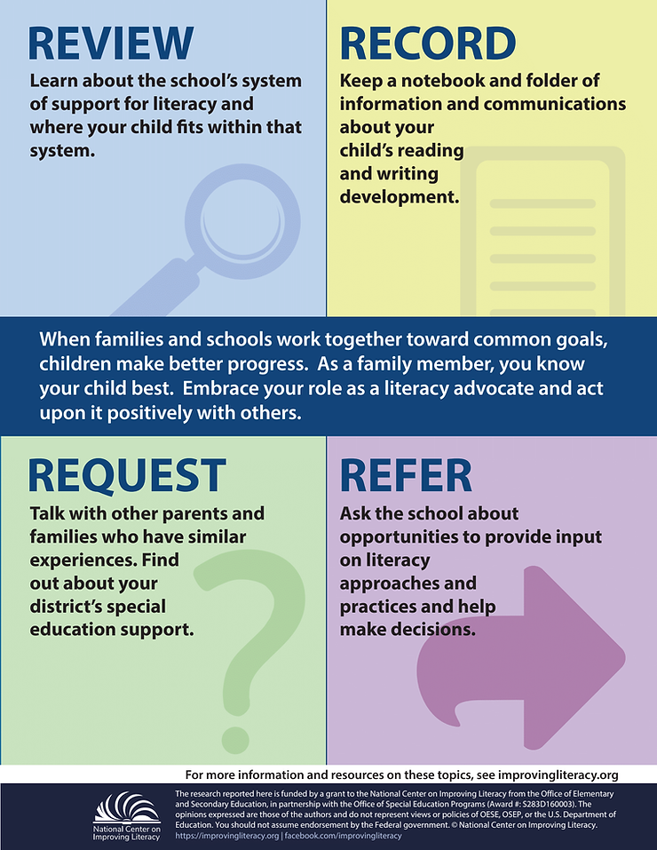
Why Children Might Struggle to Read
Mismatch between instruction and need.
Effective reading instruction in foundation reading skills includes:
Learning the structure of language
  Speech sounds
  Alphabetic principle
Applying these skills in books daily
Notes:
When your child still struggles even with effective instruction, interventions are needed that target the specific types of skills and knowledge that are interfering with her reading growth and have evidence of effectiveness for improving these skills and knowledge. Effective instruction is a key ingredient for helping prevent reading difficulties. You can ask your child’s school: are phonological awareness, phonics, and spelling taught explicitly and systematically?, does the phonics instruction focus on blending and segmenting sounds to read and spell words?, are there opportunities for my child to read books that have the phonics skills she’s learned in them?, and when my child reads aloud, is she encouraged to look carefully at printed words and use decoding skills to read unfamiliar words?
Distribute handout and/or Click the backpack or the “Review, Record, Request, Refer” handout to show - https://www.improvingliteracy.org/resource/advocating-for-my-child-s-literacy-needs
Review the content of the handout or encourage families to review on their own.

Slide 58
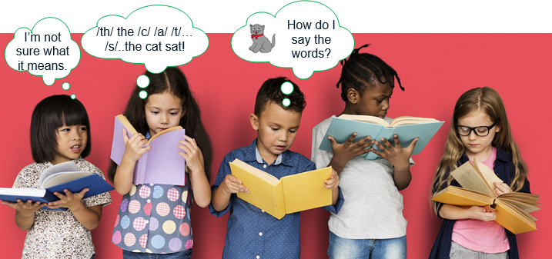
Why Children Might Struggle to Read
“I Can’t Do It!”
Notes:
All children with reading difficulties are not the same. Because children may struggle to read for different reasons, your child often has a specific profile of strengths and weakness in reading skills and strategies. For example, some children may read words quickly and correctly, but may have trouble understanding. Others may read words well but do so slowly. Some children might struggle with word reading but understand. While others may have difficulty in one or more of these areas. Whatever the reason, your child needs instruction that is more explicit and intensive than those who don’t struggle.
Point out the girl that says she can’t do it. “What can you say when you hear these kinds of comments?”
Distribute handout and/or Click the backpack or cloud to go to https://www.understood.org/en/articles/what-to-say-when-child-says-i-cant-do-it
Review the content of the handout or encourage families to review on their own.

Slide 59

Signs of Risk for Reading Difficulties
Notes:
Signs of risk for reading difficulties. There are signs to look for in your child that may show a risk for reading difficulties later. These difficulties are often noticeable very early when your child has trouble learning key language and early literacy skills compared to his peers. You play an important role in your child’s education by sharing signs of risk in your child with others.

Slide 60
Signs of Risk for Reading Difficulties
Emergent and Early Readers Have Trouble . . . | Transitional and Fluent Readers Have Trouble . . .
Noticing and naming rhymes | Sounding out unknown words (decoding)
Noticing and playing with individual sounds in spoken words (phonemic awareness) | Remembering words seen many times before (sight word recognition)
Naming the letters of the alphabet (including the letters in their own name) | Reading fluently ("Like you talk") instead of word by word
Quickly naming aloud a series of familiar items, like letters, numbers, and colors (rapid naming) | Remembering the ideas in reading material (comprehension) Spelling words correctly
Notes:
Signs of risk for reading difficulties for emergent and early readers include trouble noticing and naming rhymes; noticing and playing with individual sounds in spoken words (phonemic awareness); naming the letters of the alphabet by the start of kindergarten and naming the letters in your name; or quickly naming aloud a series of familiar items, like letters, numbers, or colors (rapid naming). Signs of risk for reading difficulties for transitional and fluent readers include trouble sounding out unknown words (decoding); remembering words seen many times before (sight word recognition); reading fluently ‘like you talk’ instead of word by word; remembering the ideas in reading material (comprehension); or spelling words correctly.

Slide 61
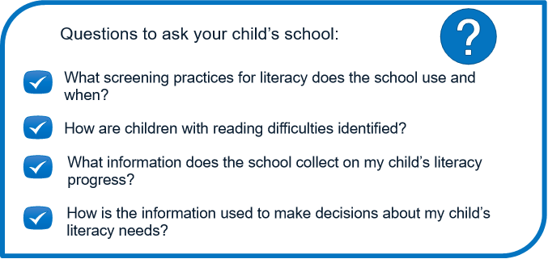
Signs of Risk for Reading Difficulties
Screening Assessment
Is there an issue?
Diagnostic Assessment
What is the issue?
Notes:
To spot difficulties, your child’s school may first screen all children for reading difficulties at different times during the year. The purpose of screening is to see if your child has an issue that may affect her reading development. If so, additional reading assessments are often necessary to pinpoint what the issue might be. These are called diagnostic assessments. If your child’s school administers screening assessments, ask your child’s teacher about her scores and what they tell you about whether she is on track to meet grade level goals and if additional assessments are needed. Assessment information helps to inform your child’s reading profile and the type of instruction and support that is best matched to her needs. To determine the assessment practices used in your child’s school, ask: what screening practices for literacy does the school use and when?, how are children with reading difficulties identified?, what information does the school collect on my child’s literacy progress?, and how is this information used to make decisions about my child’s literacy needs?
For help understanding the specific problems your child may be having with reading and suggestions for things to do. Target the Problem! Is a tool to help parents and classroom teachers understand the specific problems a child may be having with reading. They’ll find practical suggestions on what they (and kids themselves) can do to help children with their reading difficulties.
Distribute handout and/or Click the backpack to go show https://www.readingrockets.org/helping/target
Review the content of the handout or encourage families to review on their own.
Distribute handout and/or Click the backpack to go show https://www.understood.org/en/learning-attention-issues/signs-symptoms/could-your-child-have/im-concerned-my-child-might-have-learning-and-attention-issues-now-what
Review the content of the handout or encourage families to review on their own.

Slide 62
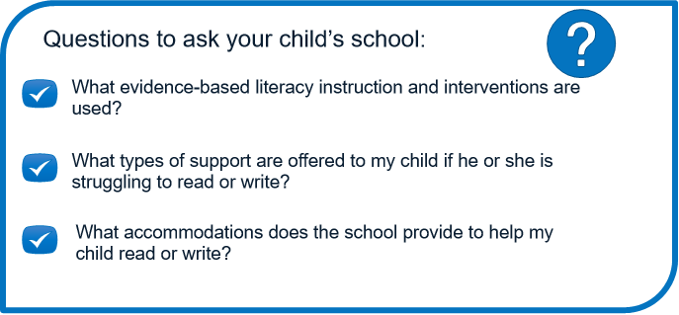
Signs of Risk for Reading Difficulties
What is the issue?
Notes:
Difficulties can be spotted early, so please speak to your child’s teacher or pediatrician if you have concerns about his progress at school. Share if there is a family history of reading difficulties. Tell if he has language delays, trouble remembering the letters in his name, avoids books, refuses to read, says that reading is hard, or feels embarrassed about reading aloud. Ask for your child to be assessed on the skills that he is having difficulty with and to discuss the results. Questions to ask your child’s school include, what evidence-based literacy instruction and intervention are used?, what types of support are offered to my child if he or she is struggling to read or write?, and what accommodations does the school provide to help my child read or write? All children can learn to read but some need additional help early to read well.
Distribute handout and/or Click the backpack to show https://www.understood.org/en/articles/how-to-talk-to-your-child-about-learning-and-thinking-differences
Read aloud the At a Glance statements and then the Key Takeaways statements to participants.
Encourage participants to review the additional information on their own.

Slide 63
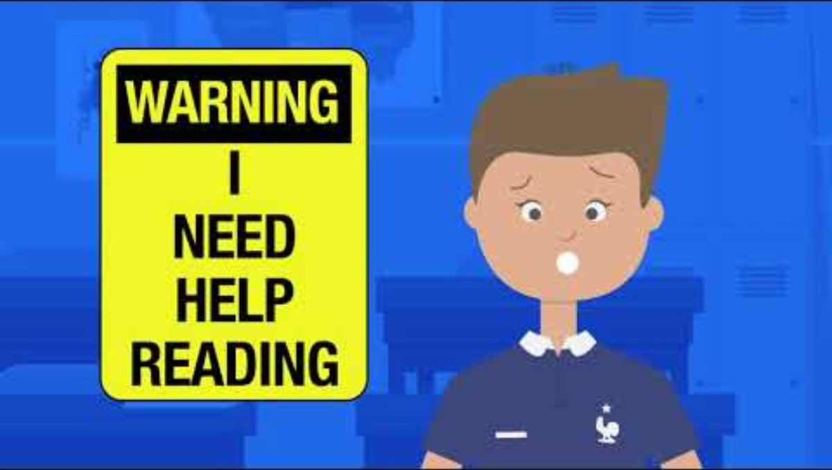
Signs of Risk for Reading Difficulties
Video provided by:
Notes:
Here’s a quick video on what to do if you’re worried about your child’s reading. This will help you find ways to talk to your child about his language or reading issues.
Start Video: I'm Worried About My Child's Reading - What Do I Do? (1.35) - https://youtu.be/KaoWhLPlh3k
TRANSCRIPT: In second or third grade, most kids read smoothly at a natural speed and with expression. It is important to understand the warning signs of a learning issue. The earlier a learning issue is detected the better chance a child will have of succeeding in school. It is important to know that children with learning disabilities process information differently. At yourself, one: Is your child making a lot of errors when reading and the task of reading seems to be difficult? Two: Is their spelling not connected to the sounds they hear in words? Often there are wild guesses as to how a word is spelled. Three: Has the teacher mentioned it takes a long time for your child to copy from the board? Four: Does your child struggle to follow along as you or the teacher reads a story aloud? Do they seem distracted or like their minds are wandering? If you read them a story and they have no understanding of what happened, that is a warning sign that there might be a problem. The earlier you can get help for your child the better. Teachers are only with your child for nine months. But parents may have observed and sensed the problem over the course of years. Don’t hesitate to ask for help and not be satisfied until there is a solution in place. Whether that means a school evaluation, private tutoring, or a reading evaluation with a licensed child psychologist.

Slide 64
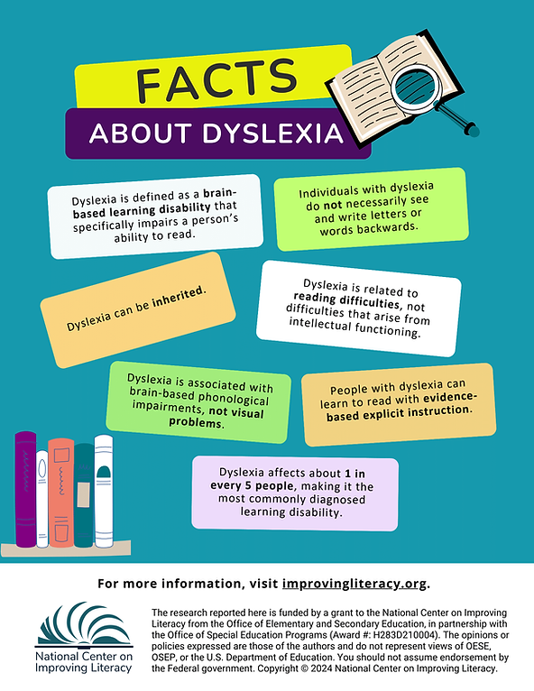
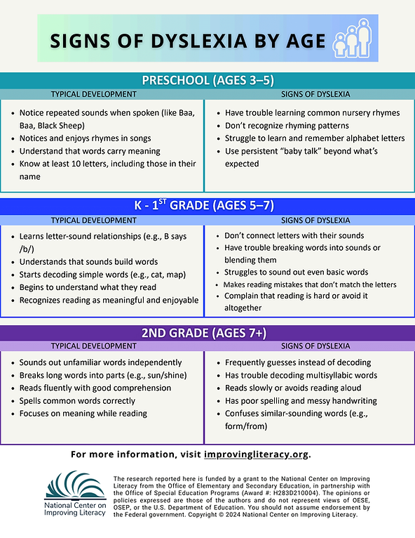


Signs of Risk for Reading Difficulties
Child Find
Notes:
If you or your child’s teacher is concerned that her reading difficulties are unexpected and unusual compared to her learning in other areas, seek further information from the school and others about next steps. One type of learning disability in reading is dyslexia. Other learning disabilities in reading may be related to deficits in comprehension or a combination of skills. You can request that the school evaluate your child for a reading disability if you suspect one. In the Individuals with Disabilities Education Act (IDEA), the federal special education law, a child with characteristics of dyslexia or other literacy-related disabilities may qualify for IDEA services under the category of a specific learning disability.
Here are two NCIL products about Dyslexia
Distribute handout and/or Click the backpack to show
https://www.improvingliteracy.org/resource/defining-dyslexia
https://www.improvingliteracy.org/resource/understanding-dyslexia-signs-to-watch-for-by-age
Here are several links to get more information about the legal requirements of Child Find and FAQs asked by parents about special education services
Share links or display
https://www.understood.org/en/articles/child-find-what-it-is-and-how-it-works
https://sites.ed.gov/idea/
https://www.parentcenterhub.org/lg1/
Tell participants that this resource answers questions often asked by parents about special education services, including about evaluation and eligibility.
Encourage participants to review the additional information on their own.

Slide 65
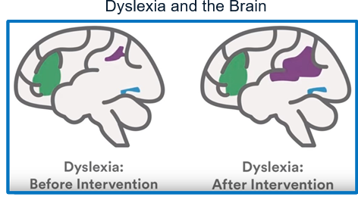
Signs of Risk for Reading Difficulties
Notes:
Dyslexia is a life-long condition that is neurobiological in nature. The brains of children with dyslexia work differently than children without it. Children with dyslexia trigger different brain areas and use different pathways when reading than typical readers. When children with dyslexia receive successful intervention, it changes how the brain works. How does the reading brain work?

Slide 66
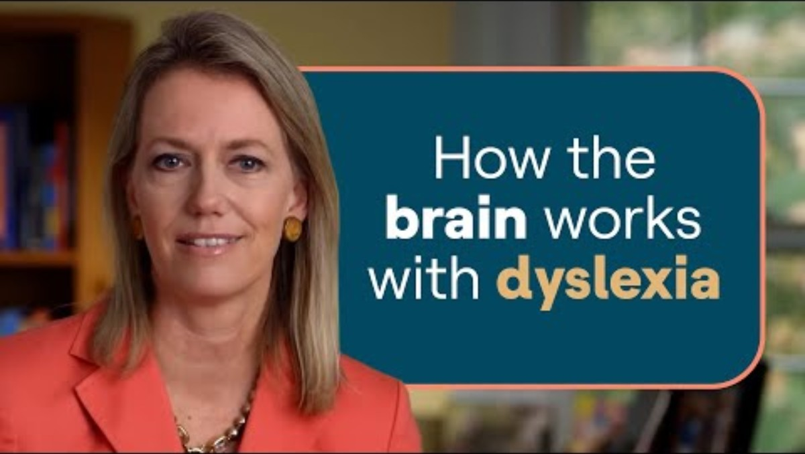
Signs of Risk for Reading Difficulties
Video provided by:
Notes:
In this next video, we’ll learn how brain scientists, Like Dr. Guinevere Eden, are working to figure out why some children struggle to read and others don’t.
Start Video: Understood (9.34) - https://youtu.be/QrF6m1mRsCQ
TRANSCRIPT: We’ve known for some time what children with dyslexia look like in terms of their reading skills, ah, skills in areas of language – like rhyming and what’s called phonemic awareness. But the brain research has really added to this by showing us what the brain looks like when people read and what the brain looks like when people with dyslexia read. And there are some differences. When we think about reading, we need to remember that we are really probing a person’s ability to understand that words are made up of sounds and that those sounds have a representation in their written counterparts, in the letters. And this is where things can become very difficult for a child, understanding that a word that sounds like one continuous sound, like “cat” or “dog.” is actually made up of three sounds that are joined together so seamlessly that you would hardly know that they are, in fact, three sounds and because of that are represented by these three letters. Key Takeaway: Dyslexia involves trouble connecting the sounds that make up words with the letters that represent those sounds. Something that many of us take for granted and forget is just how complicated reading is. There is nothing about our brain that was designed to learn to read. When our brains learn to read, we rearrange them quite significantly, and we draw on a range of skills that were designed to do other things. The same mechanisms that we use when we read, which is accessing the sound representation of language, that area in the brain is involved when we read. It’s clearly become directed towards reading and not just spoken language. And it is integrated with areas in the back of the brain that help us recognize words that we then at some point begin to recognize by sight, because the oral part of language is important in helping us put the sound representation on words. But after we see a certain word a number of times, we don’t necessarily have to sound it out every time. But we begin to move it to a part of the brain that helps us visually support recognizing a word by sight. The more we see those words, the less we have to actually sound those words out. But we recognize them almost like a picture. And it does seem that, in fact, the area in our brain that we use to see pictures in our visual environment becomes hijacked by reading. Reading, as it established in the brain, says, “Move over. Now I’m going to use this part of the brain to help us recognize word forms.” And then we also have a part of the brain that helps us pronounce the word and pull out the right pronunciation, and that is in the front of the brain. So reading is made up of different components. And likewise what we see in the brain is a network that reflects those different components that we use for reading. Key Takeaway: Reading uses different parts of the brain to sound out unfamiliar words; Recognize familiar words by sight; think about how to pronounce the words. When we study children or adults with dyslexia, we find that some of those areas aren’t activated quite the same as they are in people who do not have dyslexia. The imaging research has given us a kind of a very nice inside view of the reading brain and how it differs in struggling readers. And it’s also given us an opportunity to ask the question: what happens children or adults who have had difficulties with reading when they are given some tutoring and they’re given the skills that they need to sound out those words, to really apply the code to allow them to pronounce the words and get better and more fluent at doing that? The research shows that if you are very explicit in instructing children about the rules of phonics and understanding how language is structured and then how it relates to the written counterpart, and if you use methods that show children in a very structured way, in a very intensive way, how that works, that that really is a key component to a successful intervention. And once you understand the relationship between sounds and letters and you can read, then you need some time to become more fluid reader, give your brain the time to not just increase the skills in phonological processing but also now have the experience of encountering words again and again so that you can commit them your visual word memory and have the practice and then go on to use that skill to derive meaning. What isn’t considered an effective intervention are the kinds of things that focus on trying to train eye-movement control, trying to change a child’s ability to balance, and those kinds of things. Key Takeaway: Effective interventions for kids with dyslexia teach the relationship between sounds and letters in a very explicit and structured way; help struggling readers recognize words they have seen before; do not focus on things like balance or eye movement. Really at the heart of dyslexia is a difficulty in mapping language to print, and it is that skill that these interventions really address as a way to give the child the key that they need to access written language. And the imaging has shown us areas in the brain that now, after the intervention has occurred and after their reading has improved, areas that increase in brain activity and other areas that are compensating and helping out to make that person a better reader. And those kinds of insights tell us something about the mechanisms of reading and struggling readers and perhaps why certain brain areas participate in the process of making a person a stronger reader. And that’s where the neuroscience insight helps. The scientists can look at those brain changes and deduce from that, well, what are the areas in that brain that support that change and why those areas? Is it the language areas in the left hemisphere that we use for language and reading, or is it some other areas? And the researchers use that information to try and understand why those brain areas, why did they change, what is it about their relationship to the intervention that makes this a good intervention? Key Takeaway: Researchers are using brain imaging to understand how structured literacy interventions help people with dyslexia. One of the things that we’re learning from brain imaging is how malleable the brain is in several different ways. So, for example, when we learn to read, our brain is changing quite dramatically through that process. People who become skilled readers differ from those who never learn to read in brain anatomy and brain function. So reading itself is a process that changes the brain. And then the other thing we can do is ask questions about, well, what about children who are struggling readers and adults who are struggling readers? Maybe as an adult you would think you can’t make any more gains in reading, but in fact you can. And your brain is still changing, changing in ways to support those skills to make you become a better reader. Key Takeaway: Our brains are very changeable. Even adults with dyslexia can change their brains to become better readers. And what we are also now beginning to see with brain imaging research is a focus on other skills that we have, skills that maybe even be enhanced in people with dyslexia. So now we see sort of a new phase of research where people are beginning to ask questions like, why is it that we hear reports of people with dyslexia being better at seeing the big picture, maybe at being better at visual-spatial skills, so working in a visual environment and being very good at pulling together a lot of visual information and seeing the big picture. Key Takeaway: Researchers are beginning to study visual-spatial skills and other strengths that may be linked to dyslexia. If you translate that into a laboratory environment, you may test that by asking people to see images where your ability to detect differences really require you taking in the big picture rather than just focusing on the detail. And those have shown that people with dyslexia, when faced with that kind of a task, are better than those who do not have dyslexia. And now the question with the imaging is, how is that information processed in the brain and how does it speak to the other differences we see in those brains? Is there a tradeoff? Does the dyslexia come with a heightened skill or does the experience with dyslexia produce that heightened skill? And what does that look like in the brain? Take Aways: Different parts of the brain are used to sound out unfamiliar words, recognize familiar words by sight and pronounce the words. Effective reading interventions can change the brains of kids and adults who have dyslexia. Brain researchers are starting to study strengths that may be linked to dyslexia.
Guiding question to check for understanding: What are the key takeaways about dyslexia?

Slide 67

Check for Understanding
Think about what you've learned about your child's reading development to help John. John has a son who avoids reading aloud and says that reading is hard. What can John look or listen for when helping his son that might explain his feelings about reading? Choose the answer that best fits.
What should I look or listen for when my son is reading?
Has trouble noticing and playing with individual sounds in spoken words.
Has trouble reading "like you talk" instead of word by word.
Has trouble spelling words correctly.
Has trouble sounding out unknown words.
All of the above.
Notes:
Think about what you’ve learned about your child’s reading development to help John. John has a son who avoids reading aloud and says that reading is hard. What can John look or listen for when helping his son that might explain his feelings about reading?
Provide time for participants to review and discuss the scenario. Then, ask participants to discuss the correct answer with their tablemates. Poll participants on the answer.
The Correct Answer is All of the above.
Discuss with participants to clarify any confusion.

Slide 68

Learning About Your Child's Reading Development
Thank You
Notes:
Thank you for attending this workshop on learning about your child’s reading development.
Review the big ideas from the sessions and clarify as needed.

Slide 69

Questions ?
Notes:
Take questions from participants and discussing answers on session content and related information at the end of the workshop.

Slide 70
Thank You!
[insert contact information]
Notes:
[Slide for inserting contact information so participants can communicate with you after the workshop.]

