Slide 1
Self-Advocacy for Children and Young Adults With Dyslexia
[insert - Presenter Name]
[insert - Presenter Title]
If you have questions after the presentation, please contact: [insert contact name and email]
or
Contact | National Center on Improving Literacy at nciliteracy@gmail.com
Notes:
How to present this slide deck:​
​
This slide deck is intended to be use and modified to meet the needs of your organization. The following information should be used to assist you, the presenter, as you modify the slides to meet the needs of your audience. At the bottom of the notes on this slide is the script to introduce this presentation. ​
​
Text coding:​
Bold text = Presenter Script (what the presenter should say)​
​
Italic text = Ideas for activity or interaction​
​
Underlined text = specific contexts (e.g., zoom vs in-person)​
​
Yellow highlighted text is for you to customize based on your state/grade for the presentation​
​
Regular text = Presenter notes (reminders or instructions)​
​
Regular text with bullet = specific instruction​
​
Information in Notes:​
* Asterisks indicate hints or ideas for customization​
​
If there is a video, the link will be provided in the slide notes. The transcript for the video is provided so that you can decide if you want to show the video, or if you want to cover the topic through a discussion.​
​
CLICK, directions for animated slides ​
​
Slides Information: ​
Hidden slides are optional and may be used at the presenter's discretion based on the needs of the audience. ​
​
The pink backpack on a slide indicates there are resources to either be distributed during the workshop, or to provide for participants to review later. You can click on the icon directly from the slide to access the online version. The URL is included in the speaker notes. If the training is in person, you may choose to print some out and distribute as handouts.​
​
---​
​
Greet participants and begin workshop with introductions as needed. Follow the facilitation procedure notes appropriate for the workshop session.​
​
Welcome to the National Center on Improving Literacy’s workshop on learning about your child’s reading development. Children who struggle learning early literacy skills are at risk for reading and academic difficulties later. As a parent or caregiver, being informed about the parts of literacy, how your child learns to read, and why he or she might struggle can help you make better decisions about your child’s education. This workshop is part two of a four-part series on key roles that families can play for children’s literacy success. ​
​
​
​

Slide 2



The National Center on Improving Literacy (NCIL) is a partnership among literacy experts, university researchers, and technical assistance providers, with funding from the United States Department of Education.
Our mission is to increase access to, and use of, evidence-based approaches to screen, identify, and teach students with literacy-related disabilities, including dyslexia.
Notes:
Today’s workshop was created by the National Center on Improving Literacy. The National Center on Improving Literacy’s mission is to increase access to, and use of, evidence-based approaches to screen, identify, and teach pre-K to grade 12 students with literacy-related disabilities, including dyslexia.

Slide 3
Self-Advocacy for Children and Young Adults With Dyslexia
This workshop is part of a series on the key roles families play in supporting children’s literacy success. It is designed for students in grades Pre-k - 12 who want to better understand how reading develops and advocate for their literacy needs. Students will learn basic literacy background knowledge and the essential skills they need to become confident, capable advocates for their own success.
The research reported here is funded by a grant to NCIL from the Office of Elementary and Secondary Education, in partnership with the Office of Special Education Programs (Award 3: S283D160005). The opinions expressed are those of the authors and do not represent views or policies of OESE, OSEP, or the U.S. Department of Education. You should not assume endorsement by the Federal government.
Notes:
Welcome to the National Center on Improving Literacy’s tutorial on Advocating for the Literacy Needs of Children. This workshop is part of our ongoing series on the key roles families play in supporting children’s literacy success. Each session builds on the idea that families are essential partners in helping children grow as readers—from the earliest years all the way through high school.
Today’s workshop is designed for parents and caregivers of students in Pre‑K through 12th grade who want to better understand how reading develops and how to advocate for their child’s literacy needs. Together, we’ll explore some important literacy background information as well as how to embrace your role as your child’s advocate and how to work in partnership with the school toward shared goals for your child. No matter your child’s age or reading level, you play a powerful role in their learning.

Slide 4
Learning Objectives
During this session, participants will:
Build foundational knowledge about dyslexia and develop the confidence, skills, and strategies needed to effectively advocate for their own literacy needs.
Empower themselves to understand their learning profile, use accommodations, communicate with teachers, and take an active role in shaping their educational success.
Notes:
During our time together, you will:
Acquire background knowledge about how literacy develops, what effective instruction looks like, and how to recognize when a child may be struggling. This foundation helps you feel informed and empowered when speaking up for your child’s needs.
Explore common questions and actions related to literacy advocacy. We’ll look at what families often wonder, what steps make a difference, and how you can use simple, practical strategies to effectively advocate for your child’s literacy needs.
Become familiar with what to do when advocacy feels difficult. Sometimes the process can be confusing or overwhelming. We’ll talk about how to stay persistent, how to communicate clearly, and what options you have when you need more support.
By the end of this session, you’ll walk away with knowledge, tools, and language you can use right away to partner with your child’s school and support their growth as a reader.

Slide 5

Agenda
Introduction
Empowerment
Understanding
Taking Control
Concluding Questions
Notes:
0.2 Table of Contents
Audio:
Welcome! Today we will be covering many important topics such as empowerment, understanding, taking control, and a few resources at the end for middle and high school students.

Slide 6

Hello!
I am Jacob Blumenstein. I co-founded KidsRead2Kids and work with NCIL and the International Dyslexia Association to help kids like me see their limitless potential.
Notes:
Meet Jacob, before we begin, I want to introduce him and share a little about him. Jacob is currently a student at the University of Michigan studying Business with a minor in Computer Science. It took Jacob a lot of hard work behind the scenes to get there.
Growing up, Jacob didn’t know he was dyslexic. he struggled a lot in school and often felt alone. He lost motivation in class and confidence in himself, but over time, eventually he realized how special his learning challenge is and how he can manage it. He saw all the positives his dyslexia offers. Through his creative thinking he perseveres through challenges and approaches situations from multiple angles. Jacob co-founded KidsRead2Kids and started working with NCIL and the International Dyslexia Association to help those like him see their limitless potential. It wasn’t easy, but he is eager to share what he has learned.

Slide 7
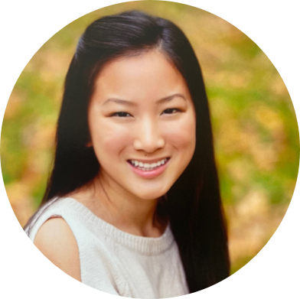
Hi!
I am Kelly. I’m a college freshman planning to study Economics with a double minor in mathematics and business. I am also a fellow person with dyslexia.
Notes:
This is Kelly. One of her hobbies is playing piano; she has played since the age of 4. She also enjoys running or hiking outdoors when the weather is nice. Currently, she is attending college, and plans to study economics with a double minor in mathematics and business. She’d like to share her dyslexia discovery story with you.
Kelly says, “Growing up in elementary and middle school, I was always in the accelerated courses and received good grades. I was that obnoxious kid that asked why this and why that. I loved math and always had a passion for learning. I didn’t have a clue that I was dyslexic.”
However, during Kelly’s freshman year of high school, she a wall. She struggled to keep up with the readings, and as she compared herself with her friends, she noticed that the assignments took me way longer. She says, “I felt lost and confused. I kept telling myself that I was just having a hard time adjusting to the new standards of high school. I busied myself with dance, running, music, and extracurricular clubs to distract myself from the foreign feeling of being lost.”
Kelly was scared to admit to her parents that she was struggling, because she questiong what would they think of her. One evening, Kelly managed to gather her courage and mention her newfound problem to her mom. At first Kelly’s mom brushed it aside and told her that it was normal to feel overwhelmed at the start of high school and that she would get used to it. So, again, she suppressed her uneasy feelings and distracted herself with extracurriculars.
As the school year progressed, Kelly continued to have to stay up later and work much longer than my friends. Kelly said, “I felt this constant pressure to receive good grades, because it was what my family and friends expected of me, but most of all it was what I expected of myself. I couldn’t let myself fail.”
Eventually, Kelly spread myself too thin. The stress became overwhelming and her parents decided to get her tested. Kelly was diagnosed with moderate to severe dyslexia. It turns out that she was overcompensating when she was younger and that was the reason it stayed hidden for so long. Surprisingly, Kelly was relieved and said, “I was relieved to finally put a name to problems I was having, but that was not the end of my struggle.”
Unfortunately, Kelly’s high school did not honor her accommodations due to my high academic achievements. The counselors deemed that her learning disability did not meet the criteria to receive extended time or anything else so not much changed. Kelly was frustrated. Although she did not receive accommodations, it made her resilient and showed that her she could prevail over her dyslexia; it did not have control over her. But as Kelly says, “I wish I had spoken up sooner and advocated for myself.” Like Kelly, you do not need to struggle in silence. Do not be afraid to reach out to your parents or teachers if you need help. They want to help you, but they don’t know what’s going on until you tell them.
Kelly’s advice for students with dyslexia is, “Everyone’s experience with dyslexia is different. It affects and challenges people in a variety of ways. Don’t negatively compare yourself to others because you aren’t the same. You can’t change the cards you were given; however, you can change your attitude. Stay positive and no matter how many times you may fall, keep getting back on your feet, because you’re just one step closer to succeeding.”
Left In Just In Case -- Just A Note
As you can see, everyone’s story is different.
In addition, consider linking to one of these: *I could say: if you would like to hear the story of a person with dyslexia from an Afriacan American descent, watch this video*
Thriving With Learning and Thinking Differences: Poet and Activist LeDerick Horne:
https://www.youtube.com/watch?v=XJTQiSl8FeI
LeDerick Horne on Growing Up With Learning and Thinking Differences:
https://www.youtube.com/watch?v=EBcgN-OKLlE

Slide 8
Congratulations!
Viewing this presentation is one more step to becoming an empowered learner. All of use here are so proud of you!
Notes:
Congratulations! Joining this presentation is one more step to becoming an empowered learner. From all of us here, we are so proud of you. This tutorial focuses on self-empowerment, understanding your learning challenge, and advocating for yourself. Stick with us, and you’ll be a master advocate in no time!

Slide 9

Introduction
What is advocacy and why is it important?
Notes:
The first

Slide 10

Introduction
What is a literacy advocate?
Why am I a natural literacy advocate?
How can I advocate effectively?
Notes:
Let’s start with the basics. In order to advocate for ourselves, we must know what advocacy really means. What is a literacy advocate? A literacy advocate is someone who can speak up for his or her literacy needs—for example, explaining to a teacher why you need to use a computer in class.
Now, why are you a natural literacy advocate? You are the person who can best advocate for yourself because you know yourself the best! If something is hard in school or a learning structure is not helping, you will be the first to know. You can use that power to make your life at school a little bit easier by advocating for accommodations that work for you.
Finally, how can you advocate effectively? Well... this question is not as easy to answer. Still, luckily for you, we are going to examine some possible answers in this tutorial. We’ll be reviewing the actions: Review, Record, Request, and Refer — but we’ll get more into that later. In order to advocate effectively, we first must understand what we are advocating for and feel empowered to do so.

Slide 11

understanding
What is dyslexia?
Notes:
Understanding
Let’s talk about what dyslexia is…

Slide 12
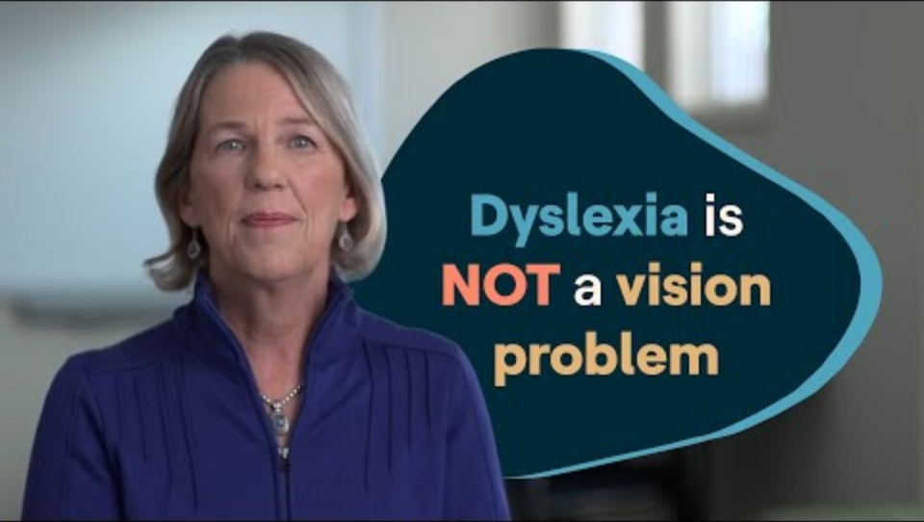
Understanding: dyslexia
What is dyslexia, and why does it differ amongs people?
Watch Video
Notes:
3.2 Understanding: Dyslexia
Dyslexia is a very common learning challenge that is different for everyone. No, it is not just something that makes words fly off the page! Let’s watch this video from Understood to learn a little more.
Dyslexia is a learning challenge in the brain. Just like how everyone’s brain is different, not everyone’s dyslexia is the same! For me, my biggest struggles recalling information, like when there is a word on the tip of my tongue. Or when I am reading, it can feel like my brain is lifting weights it cannot hold. Or even when my hands start fidgeting to keep my brain awake when it is working too hard. However, when we struggle, we do not struggle alone.
If embedded video doesn’t work, Click “Watch Video” to learn more about what dyslexia is.
Video link:https://www.youtube.com/watch?v=kE3DqJP-nkI

Slide 13

85%
Of students with an LD have dyslexia symptoms
469,812
Students with reading challenges in the U.S.
15-20%
Of the population has some version of dyslexia
Source: https://dyslexiaida.org/dyslexia-basics/
Notes:
Let’s take a look at some dyslexia facts:
The International Dyslexia Associateion states that about 14% of the school population nationwide has a condition that qualifies them for special education. Of those, 7% are classified as having a learning disability. And 85% of those students have a primary learning disability in reading and language processing.
That is a total of 0.833% of students. And as there are approximately 56.6 million students in American elementary and secondary schools. There are about 469,812 students with diagnosed reading challenges.
But that is only diagnosed cases. There is an estimated 15-20% of people with dyslexia-like symptoms in the entire population!
Source:
https://dyslexiaida.org/dyslexia-basics/

Slide 14
Understanding: the evaluation process
The importance of getting evaluated
Talking to specialists
What your documentation means
Learn More
Notes:
An important piece of information for you to know is Understanding: The Evaluation Process
Don’t let the stigma of a learning challenge stop you from getting the accommodations you need. Once you understand your challenge, it’s much easier for your teachers and school to provide your accommodations. Talk to a family member about how you can get evaluated. This is not a test to study for.
Simply get a good night’s sleep and a good breakfast and be yourself! It’s also key that the instruction, accommodations, or modifications that are proposed are appropriate for your learning needs. If not, share with family members and the school team what kind of instruction, accommodations, or modifications would be most helpful to you and lead to your success.
If you have any questions, talk to a learning specialist or an educator specializing in students with different learning preferences. Once you get tested, you can plan together.
Without formal documentation, there is no guarantee your school will give you the accommodations that you need.
Click “Learn More” for more information about the benefits and process of evaluation.
Video: Inside a Dyslexia Evaluation (20:44)
Hyperlink: https://www.youtube.com/watch?v=DNu4WiQaVTI

Slide 15

Understanding: accommodations
It's important to understand that your accommodations are here to level the playing field, NOT to give you an unfair advantage. Some kids may think you're lucky that you get these, but it's not luck at all. Even with all your accommodations, things still might not be equal.
Notes:
Understanding: Accomadations
Read the information in the text box to participants.
Then say:
Some schools offer modifications as well. Modifications change the content a student is taking, while accommodations change the approach of completing it. Accommodations are usually more common.

Slide 16

Understanding: accommodations (continued)
Extra time
Not graded for spelling
A quiet place
A scribe
Use of a computer/calculator
Use of audiobooks/digital textbooks
Language waiver
Assistive technology
Try it Out
Notes:
Understanding: Accomodations
Depending on your needs, here are a few common accommodations:
Extra time on assignments and tests
Not being graded for spelling
A quiet place to take a test
A scribe (someone to read the test aloud to you)
Use of a calculator
Audiobooks
Use of a computer
Digital textbooks
Language waiver
Having a language waiver may limit a student’s choice for higher education depending on the state and college.
Many accommodations can fall under the term “assistive technology.” This implies using technology to help a student, such as digital textbooks that allow interactive highlights or a computer with Microsoft Office’s educational tools. There are also plenty of text-to-speech tools, speech-to-text tools, word predictions, and grammar checkers. Some resources I love are Speechify, Grammarly, and Microsoft Office. Most technologies I just mentioned can be requested as accommodations in school.
Click “Try it Out” to see a tool to share information about learning needs, including accommodations. Explain that students and families can share this information with their teachers.
Link: https://or.dyslexiaida.org/wp-content/uploads/sites/20/2019/09/AccommodationsOct2019.pdf

Slide 17

Understanding: your rights
Know your rights and know your laws
Check out NCIL's State of Dyslexia Map or Decoding Dyslexia for information about dyslexia laws in your state
You should not have to request your accommodations, modifications, or services within your IEP over and over again
Learn More 1
Learn More 2
Notes:
Understanding: Your Rights
As a person with dyslexia, it is important that you know your rights. Here’s some information to help:
Great sources to check out are NCIL and Decoding Dyslexia. They have a great wealth of information about state laws related to dyslexia. Click “Learn More” to access NCIL’s State of Dyslexia Map.
Also, the Individuals with Disabilities Education Act (IDEA) is a federal law that gives rights and protections to eligible children with disabilities and ensures that they receive special education and related services in school. Let’s take a look at what is says.
Click “Learn More 1” and review IDEA with participants.
Resource link: IDEA_Fact_Sheet_Understood.pdf
https://assets.ctfassets.net/p0qf7j048i0q/5mCyZWw2Px6V0rd7eM6pD9/2cd896d2bcc9568ed70d86d02c8581b3/IDEA_Fact_Sheet_Understood.pdf
It can be difficult to advocate for accommodations, modifications, or services within your IEP if they’re not honored. For example, if your IEP says that you can use assistive technology, you shouldn’t have to request it over and over again. Remind school staff that these types of accommodations, modifications, and services must be provided according to your IEP. Try bringing these up to your teachers and administration if they are not honored, and explain why they’re essential to you.
Click “Learn More 2” for ways to help deal with this process of self-advocating.
Hyperlink:
5 self-advocacy sentence starters for middle-schoolers with dyslexia
https://www.understood.org/en/articles/5-things-your-middle-schooler-with-dyslexia-can-say-to-self-advocate

Slide 18
You are NOT Alone
It is so important you know that.
Notes:
At the end of the day, one of the most important things to understand is that you are not alone. These struggles are real, I know. I have had them myself. It can often feel like you’re the odd one out. That your classmates are much smarter than you. That you are the only one struggling. It is a very lonely feeling. However, you’re not alone. There are so many other kids who have gone through this, myself included, cheering you on one step at a time. We are all in this together.

Slide 19

empowerment
You deserve to advocate for yourself.
Notes:
It all starts with you. But first, we need to talk about you. Before you can advocate for yourself, you must understand that you deserve advocating for.

Slide 20

Empowerment: The First Step
It all starts with you!
Empowerment is the first step.
Watch Video
Notes:
Empowerment: The First Step
We met Jabob and heard a little bit about his experiences in in introductory slides, but there is so much more to tell. Let's watch a video Jacob made a couple of years ago about the gifts that dyslexia brings.
Click “Watch More” to see a video all about empowerment.
Hyperlink:
https://www.youtube.com/watch?app=desktop&v=ptwUL2ZRR10
There will be struggles and hardships along the way, but don't let that stop you! Find what you are passionate about and see all the good you have to offer the world. Let’s see who else is dyslexic.

Slide 21

Meet some famous people with dyslexia!
Watch Video
Notes:
NOTE: as the presenter you have a few options for the next 6 slides:
You can show this short video and skip the next five (5) slides
Skip the video and share the next 5 slides (unhide slides)
Show the video AND review the next 5 slides (unhide slides)
Speaking of positive impacts on the world, there are so many other people with dyslexia like us doing just that! Don’t just take my word on it; look at some of the most inspiring role models in our community.
Watch video with participants
If the embedded video does not work, click on the “Watch Video” box
Video: Famous Dyslexics
Video link: https://youtu.be/FrOvfIgiDZc?si=dl2pk1dLdxS_a8YC
Transcript: so you're dyslexic congratulations you were part of a club of some pretty extraordinary people here's a roundup of some of our favorites albert einstein keira knightley tom cruise jamie oliver whoopi goldberg inver cambradd the founder of ikea the comedian marcus brickstock sally gardner she's an author who sold over 2 million copies of her books in the uk alone oh and roll dial will smith johnny depp prince harry orlando bloom leading space scientist and presenter dr maggie aderin pocock walt disney henry winkler aka mr rock in the cbbc series hank winston churchill the famous artist Picasso richard branson obe and steve jobs founder of apple oh and me i'm on the left okay i'm not famous but i am a director and i've worked with a few people you might just recognize so with ten percent of the population having dyslexia you are part of a rather incredible bunch congratulations you

Slide 22

Spotlight: inspirational people with dyslexia
Anderson Cooper: Broadcast journalist
Ann Bancroft: Polar Explorer
Anne M. Burke: Illinois Supreme Court Justice
Beryl Benacerraf: Doctor and Professor
Brad Falchuk: Creator of hit TV shows
Cher: Musician
Dav Pilkey: Children's Book Author
David Flink: CEO of Eye to Eye
Dax Shepard: Actor/Podcaster
Daymond John: Entrepreneur
Henry Winkler: Actor
Ingvar Kamprad: Founder of Ikea
Jay Leno: Comedian
Jennifer Aniston: Actress
Joe Whitt, Jr.: NFL Coach
Lindsey Stirling: Violinist
Michael Bennet: U.S. Senator
Muhammad Ali: Boxer / Activist
Orlando Bloom: Actor
Paul McCartney: Beatles
Princess Beatrice: British Royalty
Tommy Hilfiger: Designer
Whoopi Goldberg: Actress
Reference List: Notable Individuals with Dyslexia - Wikipedia; Understood.org; WebMD; Disabled World; Eye to Eye National; Public Interviews / Media Profiles
Notes:
And there are so many more… musicians, audio engineers, construction workers, computer scientists. Successful people with dyslexia are found anywhere there is passion.
Empowerment is the first step. You must understand that you are NOT broken. You are NOT stupid. Just because you learn a little differently doesn’t mean you are any less smart. Remember our role models — if they can get through it, so can you!
Reference List: Notable Individuals with Dyslexia - Wikipedia; Understood.org; WebMD; Disabled World; Eye to Eye National; Public Interviews / Media Profiles

Slide 23

"Imagine a dyslexic from London meeting the queen of England. It's mind-boggling stuff, but that shows how much potential you have."
-Maggie Aderin-Pocock
Turn to a partner and share:
One challenge you’ve faced in school or life
One strength or talent you have that helps you push through challenges
Notes:
Read quote.
Take a look at this quote from Maggie Aderin-Pocock. She’s reminding us that someone who struggled with reading grew up to meet the Queen of England—and that this shows how much potential each of us has.
ACTIVITY:
Think quietly for a moment: What part of this quote stands out to you the most—the challenge, the achievement, or the message about potential?
Click to animate the instruction box.
Pair or Small Group Share (40–50 seconds):
Turn to a partner and share:
One challenge you’ve faced in school or life
One strength or talent you have that helps you push through challenges
Encourage them to connect it back to the quote: How does this quote change the way you think about your own potential?
Whole-Group Wrap-Up (20–30 seconds):
Invite 1–2 volunteers to share something they heard or said
This quote reminds us that challenges don’t limit potential—they reveal it. Every one of you has strengths that can take you farther than you think.
Maggie Aderin-Pocock Quote
Source: https://dyslexia.yale.edu/story/maggie-aderin-pocock-ph-d/

Slide 24

Empowerment: it's okay to struggle
It's okay to struggle!
Download your textbooks.
Use a digital note-keeping tool.
Organize.
Notes:
Empowerment: It’s Ok To Struggle
When you have a learning challenge like dyslexia, struggling is simply part of the job. Every one of these successful role models struggled in some way or another. When you do struggle, here are some ways to work with it:
One: Download your textbooks. Join organizations like Bookshare to get books in an ebook form. You can change the font and typeset and listen to words. This helps if you are read slowly. If you need help with reading, resources at NCIL and KidsRead2Kids are here to help! Speechify is also an excellent tool that can read nearly anything to you — I currently use it myself!
Two: Use digital note keeping tools and a digital planner to stay organized. These apps can help you in school. Some apps that work are Speechify, digital calendar apps, iOS reminders, notability, Quizlet, learning ally, Microsoft office products, and so much more. Assistive technology is your friend!
Three: Organize. Place your more challenging classes in your schedule when your brain is more awake (for me, morning is best). And plan breaks to give your brain a rest. Add a study hall if you need more time to work. Also, stay after school to get help from teachers.

Slide 25

Empowerment: you are more
It is so important you know just how smart you are.
You are not defined by your challenges; you are defined by your strengths.
Kids might not understand. Teachers might not understand. But believe me, you are more than your dyslexia.
Notes:
Empowerment: You Are More
It is so important you know just how smart you are.
You are not defined by your learning challenges; you are defined by your strengths.
Other kids might not understand. Teachers might not understand. But believe me, you are more than your dyslexia.

Slide 26

Taking control
What now?
Learn More
Notes:
Taking Control
Now that you understand your learning challenge more, here are some ways to take control of your learning growth.
Before we begin, let’s click on the “Learn More” box for some tips on how to deal with major parts of taking control and being a self advocate.
Link: https://youtu.be/L4r5j44JR2M?si=EYMNOG0VG43XtZfg
Transcript:
Have you heard the term self-advocacy before? Have you had a teacher or parent tell you you should be a self-advocate? What does that even mean? Self-advocacy is an important skill for all individuals. Self-advocacy means speaking up for yourself and making sure that your needs are met. It's normal in elementary school and high school for your parents and teachers to advocate on your behalf, talking to your teachers about grades and homework and communicating about your needs and IEP if you have one. However, when you finish high school and go to college or university it will be expected that you can do that advocacy for yourself. Even if that's two, five or seven years away. Starting early and building this skill over time will make it easier when you get there. But there are a lot of reasons that being a self-advocate is hard. Sometimes we don't know what to ask for or why we need it. Sometimes we don't believe that we deserve what we need. Sometimes we're embarrassed or ashamed to ask for help or accommodations. Sometimes we don't have the skills necessary to be an advocate. Sometimes we've had bad experiences in the past which make us not want to try again. All of these things are normal, and we want to help you tackle those issues and work towards being your own self-advocate. Not only so you can get what you need in the classroom but also so that you can practice the skills needed to be an independent adult in the future.
After watching the video ask participant to share a time when they advocated for themselves.

Slide 27
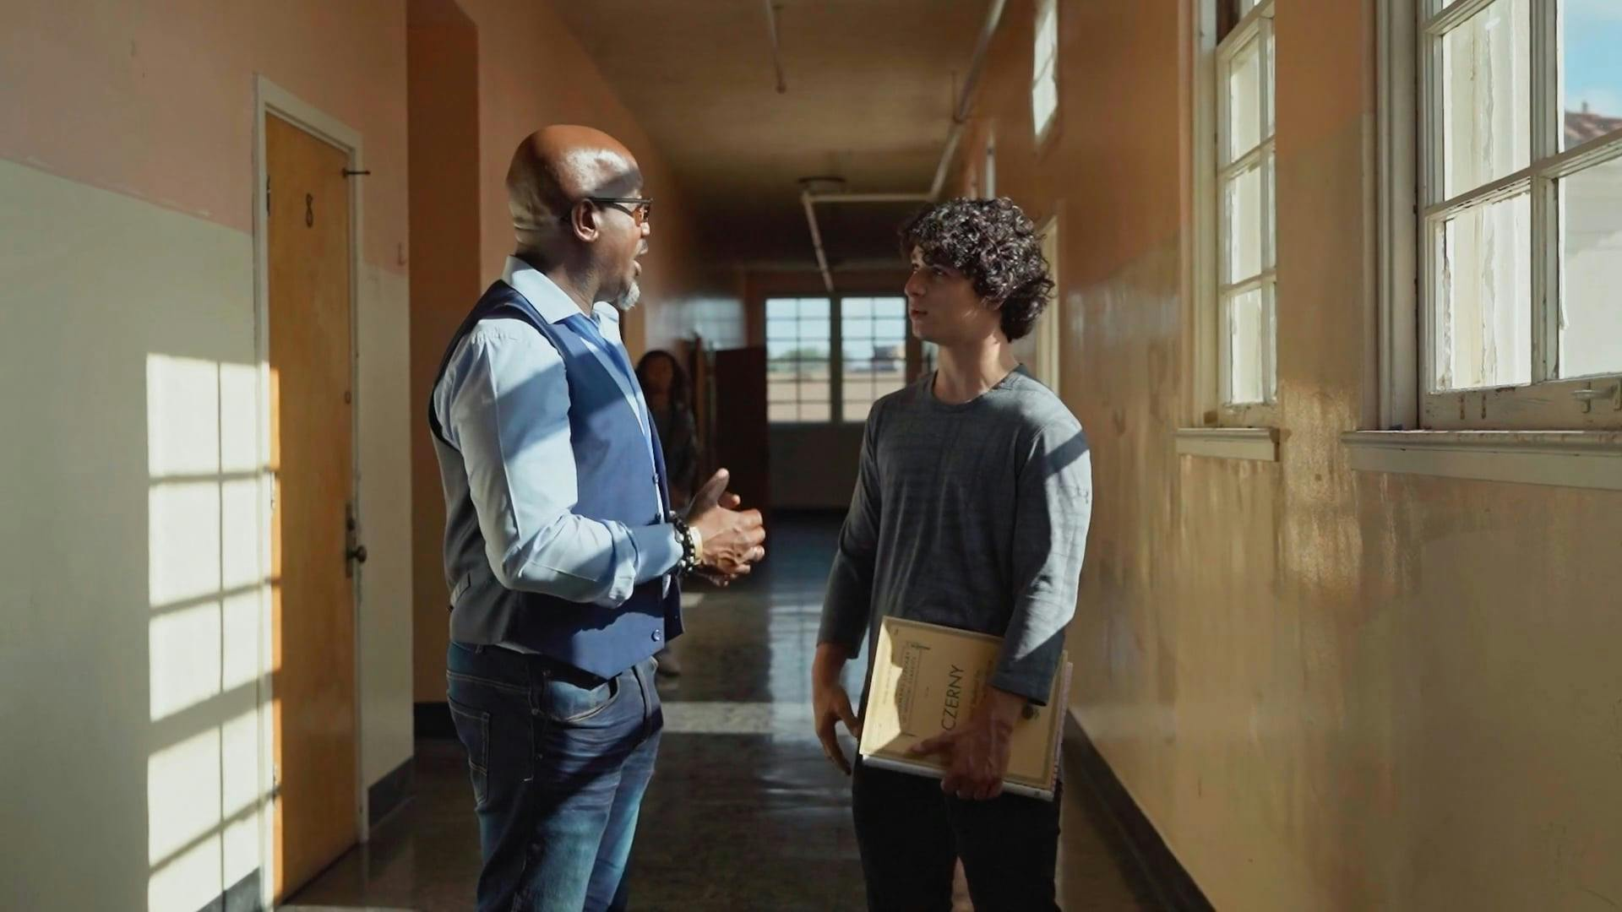
Taking control: Advocating for Yourself
How to get what you need
Step 1: Figure out what you need.
Step 2: Find someone at school who can help.
Step 3: Talk to your teachers.
Step 4: Check in and follow up.
Learn More
Notes:
Taking Control: Advocating for Yourself
Distribute the resource: Advocating for Yourself in Middle School and High School How to Get What You Need
Resource link: YASA YLDP Advocating for Yourself in Middle School and High School
Review the handout with participants:
Step 1: Figure out what you need. Start by talking with your parents or guardians about what kinds of accommodations would help you succeed in school based on your disability. These might include things like: extra time on tests or a note taker
Step 2: Find someone at school who can help. Look for a trusted adult at school—like a teacher, counselor, or vice principal—who is willing to support you and help you get the accommodations you need. You can also ask other students who receive accommodations about what works for them and who they talk to.
Step 3: Talk to your teachers. Try to set up a meeting with all your teachers, along with your parents or guardians and your case manager. This is your chance to speak up and explain what you need to succeed in class.
Step 4: Check in and follow up. Throughout the school year, it’s important to check in with your case manager to talk about how things are going. Let them know what’s working and what’s not.

Slide 28
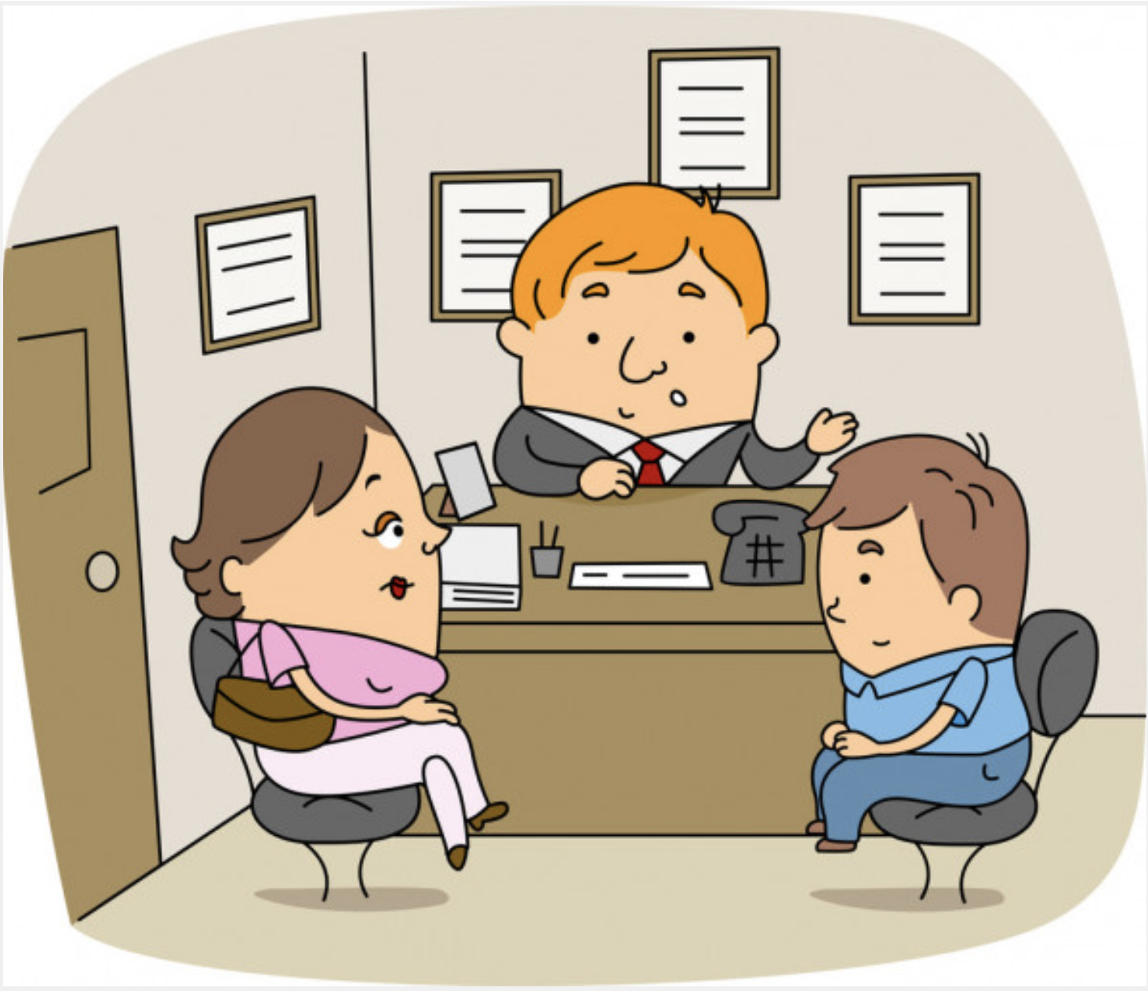
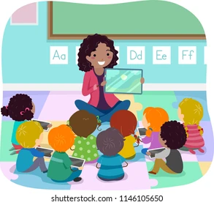

Taking control: review
Learn your school's system of literacy support and services
See where you fit
What does your school provide?
School counselor
Special Education Department
Individual teachers
Notes:
In addition to what we just went over, there are four ways to Take Control of your learning. The first way is called REVIEW.
It is important to learn your school’s literacy services and support system and where you fit within it. This can be tricky. Talk to your teachers and check your school or district website or other sources for information. Look for explanations about its framework or approach to supporting students with different learning needs. Imagine you’re a secret agent who is infiltrating the system. Your mission: to find what services and supports are available to make your learning experiences the best they can be. Then, talk with your family members or teachers about the information.
For example, suppose you want to see how your teachers react to learning disabilities like dyslexia. In that case, you can talk to a learning specialist about which teacher is best for your needs. Then, create a class schedule. You can also speak to your special education department to discuss strategies and plans to stay on top of your schoolwork.
Maybe it is better to have math and English in the morning when your brain is fresh and move your electives to the afternoon when you’re a little more tired. Or maybe you don’t take a foreign language, so you can just focus on English (although you should talk to a college professional about this decision).
Also, if you’re ever feeling sad or uneasy, it is sometimes nice to talk with someone, like the school counselor.
Remember to also work with your teachers. You can often stay after school, arrive early, or come in during lunch to ask questions and get additional help.
Whatever your school situation may be, there to help you. Make sure you utilize every part you can!

Slide 29

Taking control: record
Keep notes of information and communications between teachers and administrators about your reading and writing development
Work together with your parents or family members!
Notes:
The second way to Take Control of your learning is called RECORD.
Make sure you discuss your reading and writing development with school staff. Be sure to keep notes on information and communications between school staff and you. It’s essential to document them so you can always refer to past discussions.
Work together with your family members! You’re not alone in your struggles. Both you and your family members must work together to have these conversations and find the best way to get the support you need.
I personally like using a digital device to type because it’s easier for me, and I can keep it everywhere, but use what works best for you!

Slide 30

Taking control: request
Talk with other friends and family members who have similar experiences
Google and AI are your friends too!
Notes:
The next way to Take Control of your learning is called REQUEST
Don’t be afraid to request information from others. Talk with other friends and families who have similar experiences. Find out what worked for them and how it can work for you.
Remember, Google and AI like ChatGPT or CoPilot are your friends too! When we’re struggling, it can often feel like we’re alone. The important thing to remember is that you’re not, and there are so many people out there who can offer advice. Using Google can help find information and resources that some of your friends might not have.

Slide 31

Taking control: tips and tricks
As you learn, so do your teachers.
  Talk to them on day one.
  Work with a learning specialist.
  Show them what you see!
Feel confident in your accommodations!
Notes:
Today I want to remind you of something important: as you learn, your teachers learn too. We’re all growing together. That means your voice matters from day one.
So, on the first day of class, talk to your teachers. Let them know what helps you learn best. You’re not bothering them—you’re giving them the information they need to support you.
You also have a whole team behind you. Learning specialists are here to help you understand your strengths, your challenges, and the strategies that work for you. Working with them isn’t a sign of weakness; it’s a sign of leadership in your own learning.
And don’t forget: show your teachers what you see. If something is confusing, if a direction doesn’t make sense, or if a different format helps you understand better, speak up. You’re helping us teach you in the way you deserve.
Most importantly, feel confident in your accommodations. They’re not extra. They’re not special treatment. They’re tools that help your brain do its best work. Using them is something to be proud of.
You have every right to learn in the way that works for you—and your teachers and family are there to support that.

Slide 32

conclusion
Let's clear some things up!
Notes:
5.1 Conclusion

Slide 33

Common thoughts
Help! Even after all of this, I'm still struggling in school.
No matter how hard I try, I still read behind or slower than my peers.
My handwriting is terrible!
I like audiobooks, but my parents/teachers think it's cheating.
I don't feel comfortable being my own advocate.
I feel like my teachers are against me.
Learn More
Notes:
Common Thoughts
I understand if after this tutorial you might have some questions — that’s okay! Here are some answers to common thoughts and concerns.
Help! Even after all of this, I’m still struggling in school: That’s okay! Working with your dyslexia is not going to be easy, and your accommodations will not fix everything. It’s okay if you still struggle in school. Find something you’re passionate about and stick to it.
No matter how hard I try, I still read behind or slower than my peers: That’s okay! Studies show this is completely typical for students with dyslexia. The normal speed that a student with dyslexia reads is about two to three years behind others. Although you’re behind now, you’ll likely catch up. The delay doesn’t represent your intelligence, just how long it takes to learn decoding skills. The use of audiobooks will help to shorten the delay.
My handwriting is terrible!: Many students with dyslexia also struggle with dysgraphia. I have dysgraphia too. Dysgraphia is difficulty with the physical act of writing. Some may also find it hard to organize and express their thoughts and ideas in written form. Using a computer may be a whole lot easier for you. Don’t beat yourself up.
I really like to use audiobooks, but my teachers and family members think it’s cheating: Your brain doesn’t process audiobooks any differently than print books. It is not cheating! I use audiobooks myself.
I don’t feel comfortable being my own advocate: That’s okay! Many people feel uncomfortable with speaking out. You could work with your family members or a friend to deliver the same information. I know I felt uncomfortable initially, but the more I worked on it and learned about my dyslexia, the more I felt comfortable talking to my teachers.
I feel like my teachers are against me: Your teachers are here to help you! With open communication and honesty, together, you can thrive in school.
Remember:
Your grades in school do not determine your success
You don’t choose a cardiologist based on their handwriting
An accountant does not have to be an expert in the civil war
You don’t pick an artist based on their spelling skills
I want to take a moment to show you a site you can check out if you have more worries like this.
Click “Learn More” and quickly explore U of M Dyslexia Help’s Self-Advocacy guide with participants
Hyperlink: http://dyslexiahelp.umich.edu/dyslexics/living-with-dyslexia/self-advocate-for-your-dyslexia

Slide 34

Check for understanding
What are the important steps in advocating for yourself?
  O Review the school's system.
  O Record teacher and administrator conversations.
  O Request help from those who have similar experiences.
  O Refer the school to workshops and engagement activities that demonstrate positive literacy approaches.
  O All of the above.
Notes:
Check For Understanding
Read the question and answers to the participants.
What are the important steps to advocate for yourself?
O Review the school's system.
O Record teacher and administrator conversations.
O Request help from those who have similar experiences.
O Refer the school to workshops and engagement activities that demonstrate positive literacy approaches.
O All of the above.
After you have reqd the question and answers, read through each answer again having participants give you a private thumbs up on the one or ones they think are correct.
Click for the animated answer to appear.
The answer is "all of the above." All four other answers are significant steps to take when advocating for yourself.

Slide 35



THANKS!
Any Questions?
You can find more info at:
NCIL: improvingliteracy.org
jacob@kidsread2kids.com
Notes:
Thank You Slide
I hope this workshop was helpful to you. Remember: you can do this! You’re not alone! Again, from all of us here, at NCIL, and at KidsRead2Kids, are so proud of you for taking the beginning steps to become a self-advocate.

Slide 36

Additional Resources
Here are some additional resources to help you in the future:
  https://kidsread2kids.com
  https://www.bookshare.org
  https://www.getspeechify.com/
  https://learningally.org/
  https://www.understood.org
Notes:
General Resources
Before we go, here are a few more general resources to help you in the future.
Links:
https://improvingliteracy.org/kid-zone
https://kidsread2kids.com
https://www.bookshare.org
https://www.getspeechify.com/
https://learningally.org/
https://www.understood.org

Slide 37
Thank You!
[insert contact information]
Notes:
Slide for inserting contact information so participants can communicate with you after the workshop.

