Slide 1
Advocating for Your Child’s Literacy Needs
[insert - Presenter Name]
[insert - Presenter Title]
If you have questions after the presentation, please contact: [insert contact name and email]
or
Contact | National Center on Improving Literacy at nciliteracy@gmail.com
Notes:
How to present this slide deck:
This slide deck is intended to be use and modified to meet the needs of your organization. The following information should be used to assist you, the presenter, as you modify the slides to meet the needs of your audience. At the bottom of the notes on this slide is the script to introduce this presentation.
Text coding:
Bold text = Presenter Script (what the presenter should say)
Italic text = Ideas for activity or interaction
Underlined text = specific contexts (e.g., zoom vs in-person)
Yellow highlighted text is for you to customize based on your state/grade for the presentation
Regular text = Presenter notes (reminders or instructions)
Regular text with bullet = specific instruction
Information in Notes:
* Asterisks indicate hints or ideas for customization
If there is a video, the link will be provided in the slide notes. The transcript for the video is provided so that you can decide if you want to show the video, or if you want to cover the topic through a discussion.
CLICK, directions for animated slides
Slides Information:
Hidden slides are optional and may be used at the presenter's discretion based on the needs of the audience.
The pink backpack on a slide indicates there are resources to either be distributed during the workshop, or to provide for participants to review later. You can click on the icon directly from the slide to access the online version. The URL is included in the speaker notes. If the training is in person, you may choose to print some out and distribute as handouts.
---
Greet participants and begin workshop with introductions as needed. Follow the facilitation procedure notes appropriate for the workshop session.
Welcome to the National Center on Improving Literacy’s workshop on Advocating for the Literacy Needs of Children. Children who struggle learning early literacy skills are at risk for reading and academic difficulties later. As a parent or caregiver, being informed about the parts of literacy, how your child learns to read, and why he or she might struggle can help you make better decisions about your child’s education.

Slide 2



The National Center on Improving Literacy (NCIL) is a partnership among literacy experts, university researchers, and technical assistance providers, with funding from the United States Department of Education.
Our mission is to increase access to, and use of, evidence-based approaches to screen, identify, and teach students with literacy-related disabilities, including dyslexia.
Notes:
Today’s workshop was created by the National Center on Improving Literacy. The National Center on Improving Literacy’s mission is to increase access to, and use of, evidence-based approaches to screen, identify, and teach pre-K to grade 12 students with literacy-related disabilities, including dyslexia.

Slide 3
Learn How to Support Your Elementary Child's Literacy Development​
This workshop is part of a series on the key roles families play in supporting children’s literacy success. It is designed for parents and caregivers of students in elementary grades who want to better understand how reading develops and advocate for their child’s literacy needs. Families will learn basic literacy background knowledge and the essential skills they need to become confident, capable advocates for their child’s success.​
The research reported here is funded by a grant to NCIL from the Office of Elementary and Secondary Education, in partnership with the Office of Special Education Programs (Award #: S283D160005). The opinions expressed are those of the authors and do not represent views or policies of OESE, OSEP, or the U.S. Department of Education. You should not assume endorsement by the Federal government.
Notes:
Welcome to the National Center on Improving Literacy’s tutorial on Advocating for the Literacy Needs of Children. This workshop is part of our ongoing series on the key roles families play in supporting children’s literacy success. Each session builds on the idea that families are essential partners in helping children grow as readers—from the earliest years all the way through high school.
Today’s workshop is designed for parents and caregivers of students in Pre‑K through 12th grade who want to better understand how reading develops and how to advocate for their child’s literacy needs. Together, we’ll explore some important literacy background information as well as how to embrace your role as your child’s advocate and how to work in partnership with the school toward shared goals for your child. No matter your child’s age or reading level, you play a powerful role in their learning.

Slide 4

Learning Objectives
During this session, participants will:
Acquire background knowledge in literacy development, instruction, and identifying struggling readers to foster confidence to advocate for your child
Explore common questions about literacy advocacy and actions to effectively advocate for your child’s literacy needs
Become familiar with what to do when advocating for your child's literacy needs is difficult
Notes:
During our time together, you will:
Acquire background knowledge about how literacy develops, what effective instruction looks like, and how to recognize when a child may be struggling. This foundation helps you feel informed and empowered when speaking up for your child’s needs.
Explore common questions and actions related to literacy advocacy. We’ll look at what families often wonder, what steps make a difference, and how you can use simple, practical strategies to effectively advocate for your child’s literacy needs.
Become familiar with what to do when advocacy feels difficult. Sometimes the process can be confusing or overwhelming. We’ll talk about how to stay persistent, how to communicate clearly, and what options you have when you need more support.
By the end of this session, you’ll walk away with knowledge, tools, and language you can use right away to partner with your child’s school and support their growth as a reader.

Slide 5

Agenda
Literacy Knowledge
  Literacy Development
  Instruction
  Identifying Reading Difficulties
Advocating for Your Child's Literacy Needs
  Common Questions
  Actions to Effectively Advocate
When Advocacy Becomes Difficult
Notes:
Before we dive into today’s learning, I want to start with a simple but powerful truth: you are your child’s strongest literacy advocate.
Every child deserves the chance to grow as a reader—to feel confident, curious, and capable. And families play a central role in making that happen. Today, we’re going to explore what it means to advocate for your child’s literacy needs and how you can do that in ways that feel clear, supportive, and doable.
We’ll talk about:
The background knowledge you need in the Science of Reading, the Simple View of Reading, and the data tools used to identify at-risk readers to help you feel confident advocating for your child.
Advocating for Your Child’s Literacy needs by looking at what a literacy advocate is, why advocacy matters so much for your child’s reading development, why families and caregivers are uniquely positioned to speak up for their child’s needs, and how to advocate—what it looks and sounds like in real life by exploring methods you can use to effectively advocate for your child.
And what to do when challenges arise.
The goal is not to overwhelm you with information, but to empower you. You don’t need to be a reading expert to advocate for your child. You just need to be engaged, observant, and willing to ask questions. And you’re already doing that by being here today.
So let’s take this step together and explore how you can support your child’s literacy journey with confidence and clarity.

Slide 6
Workshop Materials
The Science of Reading
Understanding Dyslexia: Myth vs. Facts
How Families Can Partner with Schools on Literacy Development
Skills for Effective Parent Advocacy
Advocating for My Child’s Literacy Needs
How Do I Know What Questions To Ask?
Eligibility for Special Education Under a Specific Learning Disability Classification: Joint Principles
Sample Virtual IEP Meeting Agenda
IEP Tip Sheet for Parents – An Overview of the IEP
Notes:
Science of Reading and the Simple View of Reading Overview
Defining Dyslexia
Understanding Dyslexia: Myth vs. Facts
How Families Can Partner with Schools on Literacy Development
Skills for Effective Parent Advocacy
Advocating for My Child’s Literacy Needs
How Do I Know What Questions To Ask?
Eligibility for Special Education Under a Specific Learning Disability Classification: Joint Principles
Sample Virtual IEP Meeting Agenda

Slide 7

Building Literacy Knowledge
Literacy Development, Instruction, and Identifying Struggling Readers

Slide 8
literacy knowledge
Literacy Development
Identifying Struggling Readers
Instruction
Science of Reading
Explicit Instruction
Understanding Your Child’s Reading Development
Evidence-Based Practices
Screeners and Assessments
Diagnosis and Classification
Intervention and Supports
Dyslexia
How Reading Skills Develop Over Time
Notes:
In this section we will explore three crucial areas to understanding what you need to ensure your child becomes a proficient reader. Whether you have concerns about your child’s progress in learning to read, suspect your child may have a reading disability, or your child is receiving special education services for reading; you can build your capacity so you can successfully advocate for your child’s literacy development. An important first step is to review or learn more about topics that will enable you to advocate well. It will also help you better understand the school’s system of literacy supports and services and where your child fits within that system. For example, you might wonder how children learn to read. Understanding the process of learning to read can help you identify whether your child is having reading difficulties and prepare you to advocate for his or her learning needs.
If you suspect your child has a reading disability or if your child has a diagnosed reading disability, and wonder if he or she may be eligible for special education, you might want to learn about diagnosis or special education classification. Your child may be receiving reading interventions and supports through the school’s system of literacy support and services. You may want information that explain these supports or services. Knowing this information can equip you for more productive and targeted conversations with school staff about your child’s literacy learning.

Slide 9




literacy knowledge
Literacy Development
How Reading Skills Develop Over Time
Emergent Readers
Early Readers
Transitional Readers
Fluent Readers
Learn More - A Path to Fluent Reading: A Developmental Timeline
Notes:
To support your child’s literacy needs, it helps to have a strong understanding of how children learn to read. Earlier we briefly talked about the Science of Reading and what schools used to identify reading difficulties. Remember, the process of learning to read is difficult, complex, and requires explicit and systematic instruction in various reading skills. These reading skills include phonological awareness, phonics, fluency, vocabulary, and comprehension. Understanding the process of learning to read can help you to recognize if your child is having reading difficulties.
The process of learning to read takes time and begins well before children enter elementary school. For example, as young infants, children hear and speak many sounds that they will later connect to written letters. Young children can also begin to develop early literacy skills by holding books and pretending to read stories that they know well. Knowing key milestones in literacy development can help you better understand your child’s needs and how to best advocate for their success.
Activity
Click on “Learn More - A Path to Fluent Reading: A Developmental Timeline”. Display on the screen. Explain to participants that the timeline explains what typical reading development looks like. Link: https://www.edweek.org/teaching-learning/the-path-to-fluent-reading-a-developmental-timeline/2019/10
Read the first sentence aloud, “No one is born a reader, but from birth everyone is learning the sounds, words, and meanings that will lay a foundation for a lifetime of literacy.”
Then, click the arrows to read aloud each stage of reading development to participants. After each stage, pause to ask participants if they have need information clarified or have any questions.
Tell participants they can use the stages to think about their child’s reading development and prepare for conversations with school staff. Provide a few minutes to participants to record any questions they have for future reference.

Slide 10

literacy knowledge
Literacy Development
The process of learning to read is difficult, complex, and requires explicit and systematic instruction in various reading skills.
Comprehension
Vocabulary
Fluency
Phonics
Phonological Awareness
Notes:
To advocate well for your child’s literacy needs, it helps to have a strong understanding of how children learn to read. Earlier we briefly talked about the Science of Reading and what schools used to identify reading difficulties. Remember, the process of learning to read is difficult, complex, and requires explicit and systematic instruction in various reading skills. These reading skills include phonological awareness, phonics, fluency, vocabulary, and comprehension. Understanding the process of learning to read can help you to recognize if your child is having reading difficulties.

Slide 11
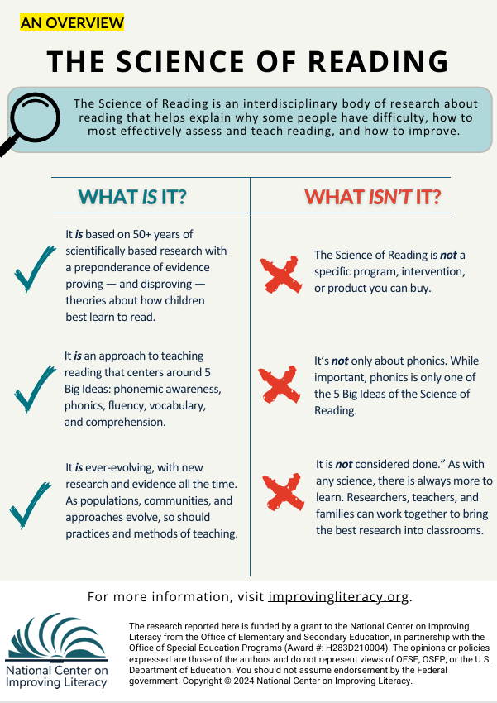


literacy knowledge
Instruction
The Science of Reading:
What It Is and What It Isn’t
What It Is
Grounded in 50+ years of research on how children learn to read
Built on the 5 Big Ideas: phonemic awareness, phonics, fluency, vocabulary, comprehension
Continually evolving as communities, populations, and instructional methods change
What It Isn't
Not a specific program, intervention, or product you can purchase
Not only about phonics – phonics is just one of the 5 Big Ideas
Not "finished"; like any science, it continues to grow as researchers, educators, and families contribute
Notes:
There are so many pieces to the Science of Reading that it can be difficult to know where to start. Here are a few highlights about what the Science of Reading is — and what it’s not. This knowledge will help you on your journey to teaching all children, including those with diverse needs and cultural backgrounds, to read.
Distribute the handout titled “The Science of Reading” for participants to review while you present the following information:
The Science of Reading: What It Is and What It Isn’t
What It Is
Based on 50+ years of scientifically grounded research that confirms and disproves theories about how children learn to read
An instructional approach centered on the 5 Big Ideas: phonemic awareness, phonics, fluency, vocabulary, and comprehension
An evolving body of research that grows as communities, populations, and instructional methods change
What It Isn’t
Not a specific program, intervention, or product you can purchase
Not only about phonics—phonics is just one of the 5 Big Ideas
Not “finished”; like any science, it continues to grow as researchers, educators, and families contribute
Handout link: The Science of Reading: An Overview – National Center on Improving Literacy

Slide 12
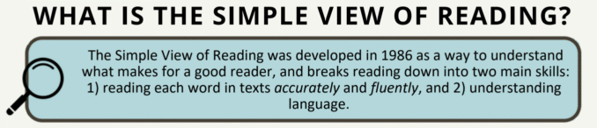
Learning to Read: The Simple View of Reading
literacy knowledge
Instruction
Word Recognition
Language
Comprehension
Reading
Comprehension
Notes:
“Let’s take a look at this idea called The Simple View of Reading. It’s a helpful way to understand what children need in order to become strong readers.”
“You’ll notice this equation on the slide: Word Recognition × Language Comprehension = Reading Comprehension. That might look a little math‑y, but don’t worry — it’s actually very simple.
Word Recognition (What we see on the left side of the equation)
Word recognition is all about being able to read the words on the page accurately and smoothly. This includes things like sounding out words, recognizing familiar words quickly, and reading with ease. When children can figure out the words, they’re free to focus on the meaning.
Families support this every time you help your child practice letter sounds, read simple books together, or point out words in the world around you — like on signs, cereal boxes, or menus.
Language Comprehension (What we see on the right side)
Language comprehension is about understanding what those words mean. It includes vocabulary, background knowledge, understanding sentences, and making sense of stories or information.
You support this every day when you talk with your child, explain new ideas, tell stories, ask questions, or read aloud and chat about the pictures and events.
Why They Work Together
The Simple View of Reading tells us that children need both pieces — recognizing the words and understanding the language — in order to truly comprehend what they read. If a child can sound out every word but doesn’t understand what the words mean, reading won’t make sense. And if a child understands language well but can’t read the words on the page, they can’t access the story independently. When both skills grow together, reading comprehension blossoms.
What This Means for Families
The great news is that families naturally support both sides of this equation. Reading together, talking together, asking questions, and exploring new words all build language comprehension. Practicing letters, sounds, and simple books builds word recognition. Every little moment counts.
So when you’re reading with your child, you’re not just helping them with a book — you’re helping them build the two essential skills that make reading possible.

Slide 13
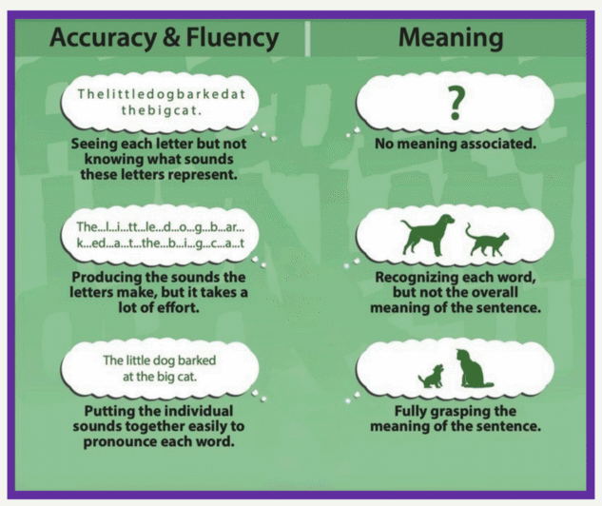
Working Together… Word Reading and Understanding
literacy knowledge
Instruction
Word Recognition Skills
Language Comprehension Skills
Notes:
This slide shows how children move from seeing letters… to reading words… to understanding what those words mean. Both sides—word reading and understanding — grow together.
Let’s start with the Left Side: Accuracy & Fluency
On the left, you’ll see three versions of the same sentence. These show what it looks like as children build their word‑reading skills. At the top, the letters are all squished together. A child at this stage might recognize some letters, but they don’t yet know how to turn them into sounds. In the middle, the child can say each sound, but it takes a lot of effort. They’re working hard to get each piece out. At the bottom, the child can put the sounds together smoothly. They can read the words accurately and more easily. This is what we mean by word recognition skills—being able to read the words on the page.
Now we will move to the Right Side: Meaning
Now look at the pictures on the right. These show what the child understands as their reading gets smoother. At first, there’s no meaning yet—just letters. Then, as they start recognizing words, they might picture a dog… and a cat… but not the whole idea. Finally, when reading becomes easier, they can understand the full meaning: a little dog barking at a big cat. This is language comprehension—understanding what the words are saying.
It’s time to bring both sides together.
Reading isn’t just sounding out words, and it isn’t just understanding language. Children need both. When word reading becomes easier, their brain has more space to think about the meaning. And when they understand language well, they can make sense of what they read.

Slide 14
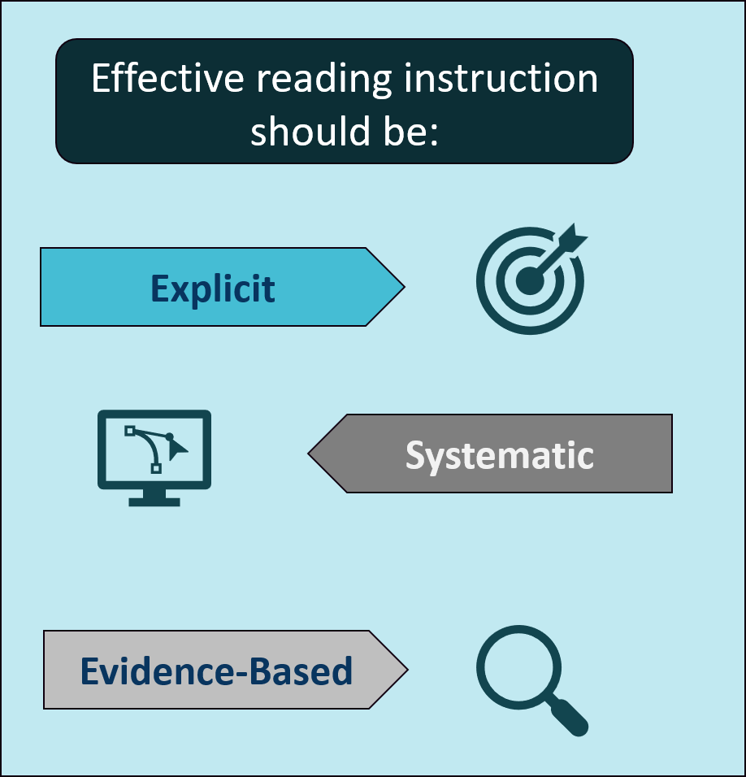
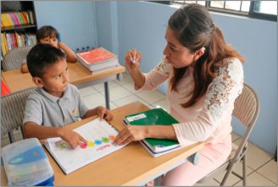
literacy knowledge
Instruction
Literacy Approaches and Practices
Notes:
Effective reading instruction should be explicit – meaning clear and direct, systematic – meaning targeted and with a plan, and evidence-based – meaning showing evidence of effectiveness for improving skills and knowledge. Knowing what makes an instructional practice evidence-based can help you judge literacy practices used at your child’s school and provide valuable input.

Slide 15
literacy knowledge
Instruction
Identifying Evidence-Based Practices
How do I know if my child is getting evidence-based instruction?
Evidence-based means that research has shown that the practice effectively improves student outcomes based on four levels of evidence.
Strong evidence — At least one well‑designed, well‑implemented experimental study.
Moderate evidence — At least one well‑designed, well‑implemented quasi‑experimental study.
Promising evidence — At least one well‑designed, well‑implemented correlational study.
Demonstrates a rationale — A clear logic model informed by research, with a study of the intervention planned or underway.
Notes:
What does it mean when an instructional practice is evidence-based? Evidence-based means that research has shown that the practice effectively improves student outcomes or that there is a strong rationale for expecting the practice to improve student reading outcomes.
ESEA identifies four levels of evidence components:
Strong evidence — Supported by at least one well‑designed, well‑implemented experimental study.
Moderate evidence — Supported by at least one well‑designed, well‑implemented quasi‑experimental study.
Promising evidence — Supported by at least one well‑designed, well‑implemented correlational study.
Demonstrates a rationale — Includes a clear logic model informed by research or evaluation, with a plan to study the intervention’s effects.
There are many resources and recommendations grounded in rigorous research on effective literacy practices for students with literacy‑related disabilities, including dyslexia. However, be aware, many approaches currently used in schools or districts have not yet been rigorously evaluated.

Slide 16


literacy knowledge
Instruction
Identifying Evidence-Based Practices
What are some evidence-based literacy practices I should advocate for?
Examples:
  Explicit instruction
  Review of previously learned skills
  Opportunities to practice
  Frequent feedback
Watch Video
Video provided by:
Notes:
There are many evidence-based practices important for teaching all children to read, like explicit instruction, reviewing previous skills, providing many opportunities to practice new skills, and giving children lots of feedback.
Let’s watch a video that goes into more detail about how to recognize some questionable or ineffective practices.
Click “Watch Video” to see how to spot some questionable or ineffective practices.
Video: Play Watch Video Avoid a Lemon – Looking Under the Hood (9:32)
Video link: https://youtu.be/L6SuCl0drRY?si=IJKeXT4q_SMtPZlc
Let’s look under the hood of the route to reading: avoid a lemon infographic. You and the school and share literacy resources to help your child and others get evidence-based literacy instruction. Learn to spot questionable or ineffective practices. Let’s start with decoding words. What is it? The ability to figure out unknown words correctly. If you are strategies that encourage your child to look away from letters to read words, like looking at the pictures, using context clues, or saying the first sound and guessing. Instead, ask for ways to help your child use knowledge of letter-sound relationships to read words. Why? Kids who can’t decode often don’t become strong readers. Reading words correctly requires knowing how letters and groups of letters link to sounds to form letter-sound relationships. Look for appropriate strategies, tips, or activities that help your child practice grade level and literacy needs appropriate phonics skills. Here’s a quick video that shows what a teacher might do to focus on letters and sounds when reading. Maryland third grader Xavier is sharing one of his favorite books with reading expert Linda Farrell. Ms. Farrell is going to help him focus on reading every word accurately. Can you read some of this to me? Can you read? Look we’re heroes because we saved the world from Flippy. It says here that scientists are going to study Flippy brain. Get the s on that. That studies…What’s this word right here? This one right here. Flippy’s. Yeah, read that whole thing again. It says here that scientists are going to study Flippy’s brain…Keep going. Dogman…I have…a important job for you. What’s that word? In. Read it again. Dogman, I have a important job for you. Read that…an important. Read it again. An important. Dogman, I have an important job…Okay, we’re going to do this. Read this with me. And…and…important…important…Yeah, so read an…and…an…im-port-tant. Im-port-tant. Okay, now read it again. Dogman, I have an important job for you. Keep going. One of the things I noticed is that teacher often will let an inaccurate reading slip by if the meaning isn’t changed. It’s close enough, move on, and that’s setting students up for poor comprehension. Take for example, a sentence like, “The horse got a cold.” If the student leaves out the article a and reads it, “The horse got cold,” the meaning changes significantly. That one little word that seems so inconsequential “a” made a difference in meaning. “The horse got cold” and “The horse got a cold” is different. We never know when that’s going to make a difference in comprehension and we have to build good, strong reading habits for students. And that means as a teacher it’s my job to help my students develop accurate reading habits so they don’t miss a question on a comprehension test because they misread a sentence. They left off an s, they left out an article, they added an article, they read present tense instead of past tense, they read a contraction incorrectly. All those can lead to poor comprehension and we need in kindergarten, first, and second grade, and even third grade to be making sure our students read accurately. It’s our responsibility. Whose wants to protect the scientists. Who’s a good boy protector? Who’s what? Who’s a good boy…good protector. Yeah! Who wants to protect and survive? And what’s that word? Severn…Okay, I’m going to tell you that v…and e…is silent, so what does that say? Serve. You got it. So read that again. Who wants to protect and serve? We’re teaching students, our children, that every letter does make a difference and that when you come to an unfamiliar word, you have to pay attention to every letter. And then when you read that word two or three times, it then becomes a word that you’ve seen before and you just read it because it’s part of your vocabulary and you’ve seen that spelling before. And what does he do? Does he save people? Yeah, he helps people…these are his…Next is learning sight words, like high-frequency words. What is it? The ability to know a word instantly and easily, including ones spelled regularly or irregularly. If you are given strategies, tips, or activities focusing your child on memorizing whole words to learn sight words, instead, ask for strategies, tips, or activities that focus your child on saying and using letter-sound relationships and letter order to learn sight words. Irregular word parts and advanced letter-sound relationships are taught to be remembered. Why? Sight word learning is not based on visual memory. It requires knowing speech sounds, letter-sound relationships, and letter order. There are too many words to learn by memory alone. Look for appropriate strategies, tips, or activities that help your child practice sight words matched to the spelling and phonics instruction she is receiving. For example, the unexpected letter or letters in in the word have been made clear in some way, like with a different color or special mark. Your child should also read and spell the word aloud. After words are taught, they should be practiced alone, in sentences, and in reading material. The more times your child encounters with word, the more likely it is that she will recognize it instantly. If your child doesn’t know a word or says it incorrectly, say the word slowly while underlining each letter with your finger. If there are unexpected letters, ask, “What sound do the letters say here? What letters make that sound in this word?” Say the word again, sliding your finder under the word. Say the letters in the word. Have your child spell the word while saying the letters. You can find helpful information about sound spelling patterns in the resources attached to this video. Lastly, we have spelling words. What is it? The ability to write words correctly. If you are given strategies, tips, or activities focusing your child on memorizing letters or letter shapes to spell words, like word searches, tracing words, or rainbow writing, instead, ask for strategies, tips, or activities focusing your child on saying and using letter-sound relationships and the right letter order to spell words. Why? Spelling is not based on visual memory. It requires knowing speech sounds, letter-sound relationships, and letter order. Look for appropriate strategies, tips, or activities that help your child practice spelling patterns matched to the phonics instruction he or she is receiving. For example, this activity uses picture cards, magnetic letters, pencil, and paper. Your child should name the card, and then segment the name into individual phonemes. Cat. C-a-t. Select the letters that correspond with the phonemes and put them in the right order. Your child should say the sound of each letter and then blend them together orally. C-a-t. Cat. Then, write the word on paper. You can find this activity in the resources attached to this video. Thanks for watching this route to reading video: looking under the hood of our avoid a lemon infographic. You can find all of our route to reading infographics in the improving literacy briefs section of our website.
Guiding question to check for understanding: Why is it important to read words accurately? What can you do to help your child read and spell words accurately?

Slide 17
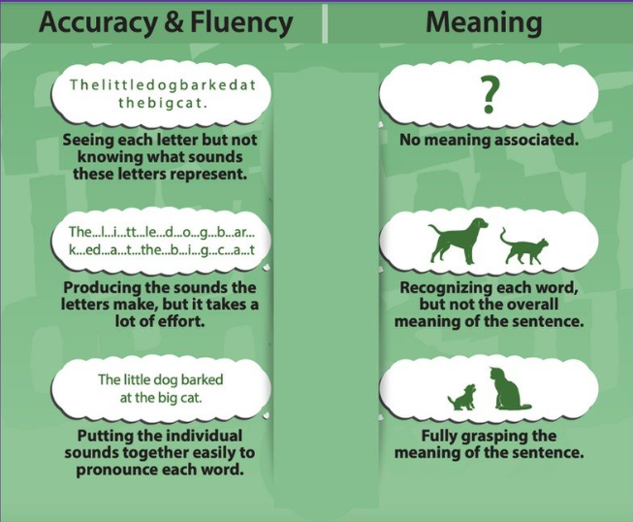
literacy knowledge
Instruction
The Simple View of Reading
Reading Difficulties
Decoding
Using knowledge of letter-sound relationships to sound out words.
Language Comprehension
The ability to understand spoken language.
Reading Comprehension
The ability to understand what you are reading.
Notes:
If your child is having reading difficulties, he or she might struggle reading individual words, understanding what is being read, or both. Most children with reading difficulties struggle with decoding, or using letter-sound relationships, to sound out words. When children struggle reading individual words correctly and quickly, it becomes more difficult for them to understand, or comprehend, what is being read.
Next, we will discuss dyslexia, a common learning disability that affects a person’s ability to read.
Resource: Distribute, review, and discuss the Simple View of Reading infographic with participants. Use the literacy brief portion of the resource to expand upon information in the infographic when reviewing with participants. Clarify information and answer questions as needed.

Slide 18
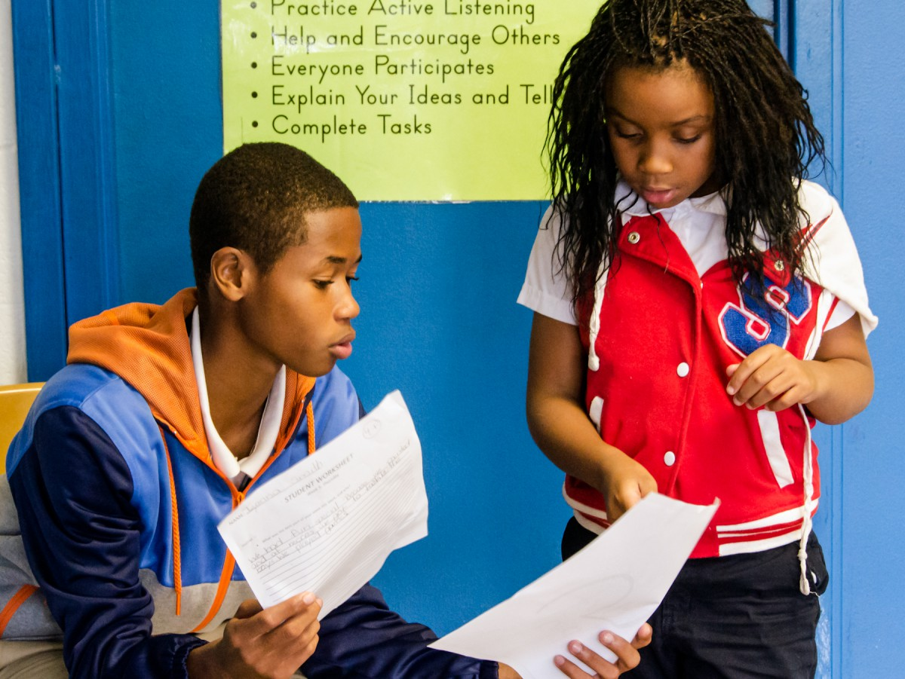
You watch your child struggle through a simple reading assignment. They guess at words, lose their place, and quickly become frustrated. You want to help, but you aren’t sure what to do. Is this normal, or a sign of something more?
You email the teacher asking for guidance. However, the response you get refers to screening data and you feel overwhelmed. What does all this information mean?
Up next, understanding how schools identify students who may have reading difficulties, including dyslexia.
literacy knowledge
Instruction
This Photo by Unknown Author is licensed under CC BY-NC
Notes:
Read the scenario to participants
You watch your child struggle through a simple reading assignment. They guess at words, lose their place, and quickly becomes frustrated. You want to help, but you aren’t sure what to do—Is this normal, or a sign of something more?
Typically, the first step for families is to send a message to the teacher asking for more information on how you can help. However, when the teacher responds, they refer to screening data which makes you feel overwhelmed because you have no idea what they are talking about.
Let’s take a look at what happens at school to identify children with reading difficulties including Dyslexia.

Slide 19
Understanding How Reading Difficulties are Identified
literacy knowledge
Identifying Struggling Readers
Why Identifying Reading Difficulties Matters
Learning to read is one of the most important goals in school
Strong reading skills help students learn across all subjects and build confidence
Reading difficulties, including dyslexia, can affect many parts of a child’s school experience
How Schools Identify Reading Difficulties
Schools now use a more complete approach, including:
Data‑driven decision making
Progress monitoring
Evidence‑based reading instruction
These tools help teachers understand both what a student knows and how they respond to instruction over time
But where do schools begin?
Notes:
Helping a child learn to read is one of the most important goals in school. When reading is strong, students can learn across all subjects and build confidence. But when reading is difficult, it can affect many parts of a child’s school experience. This is why schools are working to improve how they identify and support students with reading difficulties, including dyslexia.
For many years, schools relied mostly on test scores to decide if a child needed help. While test scores are important, they do not tell the whole story. Today, educators are using a more complete approach that includes data-driven decision making, progress monitoring, and evidence-based reading instruction. These tools help schools better understand not just what a student knows, but how they respond to teaching over time.
It is also important to make sure that reading difficulties are not caused by other factors, such as limited instruction or a lack of opportunity to learn. By looking at the full picture, schools can make fair and informed decisions about how to support each child.
Families play a key role as well. When schools share clear information about progress and instruction, families can better understand their child’s needs and support learning at home. This partnership helps create a consistent and supportive environment for the child.
In today’s schools, identifying reading difficulties is not just about labeling a problem. It is about understanding how a student learns and responding with the right support. By focusing on how students respond to instruction and using strong systems of support, schools can help every child build the skills they need for reading success.
Click for animation box to appear.

Slide 20
Screening and Assessing
literacy knowledge
Identifying Struggling Readers
What Is Screening?
Quick check to identify students at risk for reading difficulties
Works like a health screening or eye exam
All students are screened; only students showing risk get extra support
Results guide next instructional steps
What Is Assessment?
Assessment = collecting information about how a child is learning
Happens through class questions, report cards, conferences
Helps teachers adjust instruction and helps families understand progress
What is My Role in Screening
Learn what the screening measures and what scores mean
Ask teachers questions and stay in regular communication
Early, ongoing conversations help support your child’s reading success
What if My Child has Low Results?
Lower scores mean a child may benefit from extra instruction
Teachers, families, and specialists may discuss results and next steps
Screening catches concerns early so support can begin right away
Notes:
We just learned that schools use screening tools to identify reading difficulties, but what does that mean?
A reading screener is a short check that helps teachers see whether a child may be at risk for reading difficulties later on. It works a lot like an eye exam: everyone gets screened, but only the children who show signs of risk get extra support. Teachers use these results to decide what kind of instruction or help a child may need next.
Click for the animated box to appear
Assessment is simply how teachers gather information about how your child is learning. It happens in everyday ways—like questions in class, report cards, or quick checks during lessons. Today we’re focusing on one specific type of assessment called screening.
Click for the animated box to appear
Families play an important role. The best thing you can do is stay in communication with your child’s teacher—ask questions, ask for explanations, and stay connected about progress. Working together helps ensure your child gets exactly what they need to grow as a reader.
Click for the animated box to appear
If your child scores lower than expected, it doesn’t mean something is wrong. It simply means they may benefit from more practice or targeted instruction in certain reading skills. Screening helps us catch concerns early so children get support before reading becomes frustrating.

Slide 21


literacy knowledge
Identifying Struggling Readers
Diagnosis and Classification
Clinical Diagnosis
Special Education Eligibility
Determined by a medical professional
Disability or impairment that may or may not have a negative effect on education performance
May lead to medical/therapeutic treatment and services
Determined by a team of education professionals and parent)s)/guardians(s)
Disability or impairment must have an adverse effect on education performance
Entitles students to supports and services to access their education environment
Notes:
If your child continues having reading difficulties, he or she may receive a clinical diagnosis of dyslexia or another reading disability, be eligible for special education because of a learning disability, or both.
A clinical diagnosis is different from eligibility for special education in many ways. A clinical diagnosis is usually determined by a medical professional (such as a doctor or clinical psychologist).
Click for the animated box to appear
Where as, special education eligibility is determined by a team of education professionals and you. A clinical diagnosis may not always have a negative impact on your child’s education, but for special education eligibility, the disability must impact your child’s educational environment. Also, a clinical diagnosis may lead to therapeutic treatment and medical services outside of the school setting, while special education eligibility allows children to access supports and services within their educational environment.

Slide 22

literacy knowledge
Identifying Struggling Readers
Intervention
Intensive Intervention
A process of providing students with more instruction, practice, and feedback to help students be more successful. Targets specific skills and areas Typically, in small groups Push-in (within classroom) or pull-out (outside of classroom)
Learn More
Notes:
If your child is having reading difficulties, the school may be providing them with intensive intervention to address your child’s literacy needs.
Intensive intervention is the process of providing students with more instruction, practice, and feedback to help students be more successful. Intensive intervention targets specific skills and areas, typically in small groups, and can happen within or outside the classroom.
Knowing if your child is receiving intensive intervention, and what it looks like, can help you advocate for supports best matched to your child’s literacy needs.
ACTIVITY:
Click “Learn More” How Can You Support Intensive Intervention Link: How Can You Support Intensive Intervention? Tips for Families
Project the resource “How Can You Support Intensive Intervention?”
Review the “Tips for Families” with participants to provide for more information about they can support intensive intervention with their child.

Slide 23



literacy knowledge
Identifying Struggling Readers
Instructional Supports
Changes to what your child is expected to learn.
Changes to the learning environment that support your child's access to the same learning activities as his or her peers.
Technology tools that help your child complete tasks by working around reading challenges.
Accommodations
Modifications
Assistive Technology
Notes:
Additionally, the school might also be providing instructional supports to help your child perform better while learning. Supports may include accommodations, modifications, and assistive technology. Accommodations, such as extra time to complete activities or assignments, are changes to the learning environment that support your child’s access to the same learning activities as their peers. Modifications, such as shortened assignments and less content, involve changing what your child is expected to learn.
Assistive Technology, like text-to-speech tools and audiobooks, are technology tools that help your child complete tasks by working around reading challenges.
Display on the screen: 1) Accommodations: What They Are and How They Work and click the arrow to read each of the five quick tips to participants; 2) What Are Academic Modifications? Read the At a Glance information aloud to participants. Scroll down to show participants the video and information to dive deeper that they can review on their own later; and 3) Assistive Technology for Reading. Read the At a Glance information aloud to participants. Scroll down to show participants the information on other types of assistive technology tools for reading that they can review on their own later.
Accommodations: What They Are and How They Work: https://www.understood.org/en/articles/accommodations-what-they-are-and-how-they-work
What are Academic Modifications?: What are academic modifications? https://www.understood.org/en/articles/modifications-what-you-need-to-know
Assistive Technology for Reading: Assistive technology for reading https://www.understood.org/articles/en/assistive-technology-for-reading
Guiding question: Have you had any experiences with these instructional supports?

Slide 24
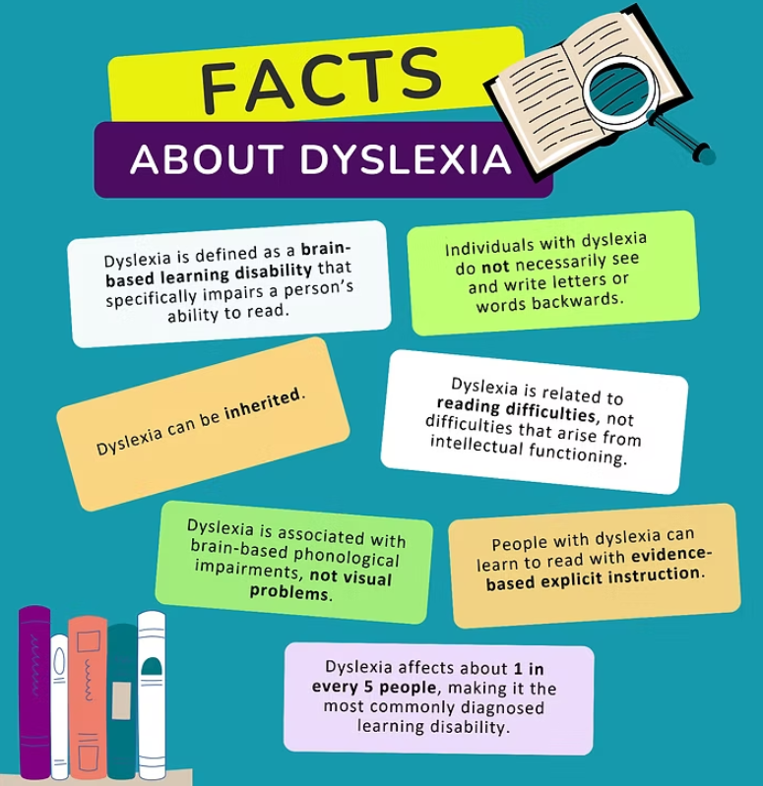
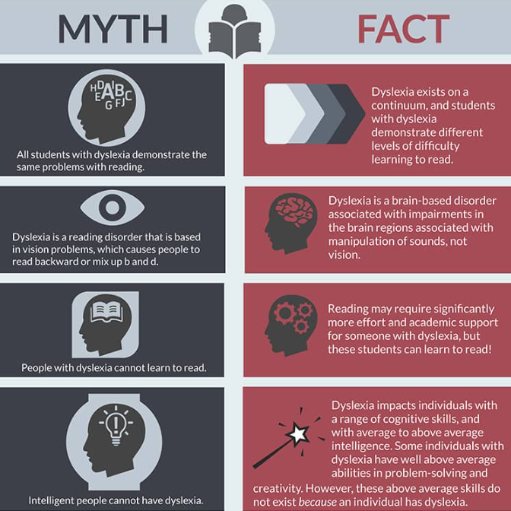


literacy knowledge
Identifying Struggling Readers
What is Dyslexia?
Dyslexia Myths vs. Facts
Learn More
Learn More
Notes:
Dyslexia affects about one in every five individuals, making it the most commonly diagnosed learning disability. It is a brain-based learning disability that specifically impairs a person’s ability to read. It is brain-based, meaning that specific portions of the brain associated with important reading processes may develop or function differently than those without dyslexia. Individuals with dyslexia may have difficulty decoding letters into blended sounds to form words, spelling, and/or quickly verbalizing printed letters and words.
Dyslexia is related to reading difficulties, not difficulties that arise from intellectual functioning. Individuals with dyslexia have otherwise typical intellectual functioning, meaning that other portions of the brain function similarly to other children.
There are many myths about dyslexia exist. For example, many people think that all individuals with dyslexia demonstrate the same problems with reading. The truth is that dyslexia exists on a continuum, meaning that individuals with dyslexia may have different levels of difficulty with learning to read.
Resources: Distribute, review, and discuss the Defining Dyslexia infographic with participants. Use the literacy brief portion of the resource to expand upon information in the infographic when reviewing with participants. Clarify information and answer questions as needed. Distribute, review, and discuss the Understanding Dyslexia: Myths vs. Facts infographic with participants.
Handout Links:
Defining Dyslexia – NCIL https://improvingliteracy.org/resource/defining-dyslexia/
Understanding Dyslexia: Myth vs. Facts – NCIL https://improvingliteracy.org/resource/understanding-dyslexia-myth-vs-facts/
Note: Click Learn More to show the landing page for NCIL’s Understanding Dyslexia Toolkit for more information on the underlying causes and effects of dyslexia.

Slide 25

literacy knowledge
Identifying Struggling Readers
Understanding Dyslexia: What Families Should Know (IDA Definition 2025)
What it means: Dyslexia is a learning difference that makes reading and spelling harder.
It looks different for every child: Challenges can vary depending on the language and writing system.
It's not about effort: Dyslexia happens because of a mix of brain, genetic, and environmental factors.
Common signs: Trouble with sounds in words (phonological) or word parts (morphological)
Possible effects: Reading may be slow or tiring, and this can affect confidence and school success.
The good news: With the right support and instruction, children with dyslexia can become strong, joyful readers at any age.
Watch Video
Video provided by:
Notes:
Families often ask, ‘What exactly is dyslexia?’ The updated IDA definition helps us see it clearly. Dyslexia isn’t about how hard a child tries—it’s about how their brain processes language. It can look different for every child, depending on the language they’re learning and the kinds of words they see. What’s most important is that early, targeted support makes a big difference. When families and schools work together—sharing strategies, celebrating progress, and keeping communication open—children with dyslexia can thrive. Every child deserves to feel confident and capable as a reader.
In 2025, the International Dyslexia Association updated its definition of dyslexia. Let’s watch a short video to get the highlights.
Watch Video What's New in the IDA's Definition of Dyslexia
Link: https://youtu.be/dRq5-Bcg93A?si=M8j0h3fsbWASIzot
Transcript:
The International Dyslexia Association updated in definition of Dyslexia for the first time in over 20 years. Both definitions focus on reading a spelling difficulties. But the new one goes further. Dyslexia is not recognized as varying in severity. Every child's experience, and path forward, may look different. Additionally, the new definition extends to life beyond the classroom. It recognizes the impact dyslexia can have on confidence, well-being, and future opportunities. Early support is essential. The new definition says it clearly: The sooner your child gets help, the better the outcome. Is a child in your life struggling with reading? Don't wait. Ask what support is available, at home and at school. For free literacy resources for families, educators, and anyone who supports a child's reading journey, visit improvingliteracy.org.
To review, this slide gives you a clear, updated understanding of what dyslexia means and what to look for. Dyslexia is described as a learning difference that makes reading and spelling more challenging—not a reflection of effort or intelligence. It also looks different for every child, especially depending on the language they’re learning and the writing system they use.
We now know dyslexia has multiple causes, including brain development, genetics, and environmental factors. Some common signs include difficulty working with sounds in words or with meaningful word parts. These challenges can make reading slow or tiring, which can affect confidence and school success.
The most important message is the good news: with the right support and effective instruction, children with dyslexia can grow into strong, confident, joyful readers at any age. Families play a key role in helping make that happen.

Slide 26
The Family - School Partnership for Successful Literacy Development
literacy knowledge
Identifying Struggling Readers
Communicate and Interact Often
Discuss Literacy Instruction and Intervention
Practice Literacy Skills at Home
Address Concerns Together
Families should ask the school how best to communicate and should feel comfortable asking questions if more information is needed.
Families should know what literacy standards their child is working on, review whether those expectations are appropriate, and ask whether the instruction and interventions are evidence‑based and focused on the skills their child needs most.
Families should talk with the school about home literacy activities that match the child’s skill level.
Families should discuss with the school which activities or tasks the child has trouble with at home, and how you helped. Learn about the school’s system of learning support.
Notes:
Families should collaborate with the school to make decisions about a child’s literacy education, promote faster development and catch trouble spots early. Here are four things families do to support their child's literacy development.
Communicate and Interact Often - Here are some ways families can share experiences and thoughts with the school: Help in the classroom, Go to meetings (school/teacher orientation, parent-teacher conferences), Join school groups (Parent-Teacher Association or Organization, Family Advisory Council), Ask questions such as: “What are the school’s literacy goals for children and families?” “How does the school partner with families when developing its language and literacy goals for students?” “How can I support my child’s language and literacy goals?”
Discuss Literacy Instruction and Intervention – Ask questions such as: “What does my child need to know and be able to do?” “How is reading taught and by whom?” “When does literacy instruction and intervention happen and for how long?” “How many other children join?” “What school materials or trainings about literacy are available to families?”
There may be a variety of tools to help a child read and write. A few examples are audio books, screen readers, special keyboards, and speech recognition software. Ad discussion with your child's school might assist in identifying what tools are available.
Practice Literacy Skills at Home – Begin by asking how you can support your child at home with questions like: “What activities will help her practice the skills learned at school?” “What strategies should I use to help my child read or write?” “What tools are available to help my child practice these skills?” At home, families can try out different activities and tools and share with the school what worked well and what did not. Let the school know if more information or support is needed, and discuss other ways to practice the skills learned at school, such as at the library or through literacy services in the community.
Address Concerns Together - Take time to understand the school’s position and openly communicate your view. Work together to find a solution to address your child’s learning needs that you both can support. If you and the school disagree, get advice from others on next steps. Ask questions: “How is my child’s language and literacy learning being supported in this system?” “How are you monitoring my child’s language and literacy progress?” “What might happen next if my child continues to struggle?”
How Families Can Partner With Schools on Literacy Development – National Center on Improving Literacy

Slide 27
literacy knowledge
Identifying Struggling Readers
Looking at the Full Picture
Reading difficulties can sometimes be linked to limited instruction or lack of opportunity
Schools consider all factors to make fair, informed decisions
The goal is to understand each child’s learning needs—not just label a problem
The Role of Families
Families are essential partners in understanding and supporting reading development
Clear communication about progress and instruction helps families support learning at home
Strong school–family partnerships create consistent support for the child
The Goal
Identifying reading difficulties is about understanding how a student learns
Schools focus on how students respond to instruction and what supports help them grow
With strong systems and the right support, every child can build the skills needed for reading success
How can I help my child?
Notes:
When we talk about identifying reading difficulties, it’s important to remember that schools look at much more than a single score or one moment in time. We look at the full picture of a child’s learning. Sometimes reading difficulties can be connected to things like limited instruction or a lack of opportunity to practice certain skills. So before making any decisions, schools consider all of these factors to make sure we’re being fair and fully informed. The goal isn’t to label a problem—it’s to understand what each child needs to grow as a reader.
Families play a huge role in this process. You know your child best, and your insights help us understand how they learn, what motivates them, and what challenges they face. When schools share clear information about progress and instruction, families can better support learning at home. And when families share what they’re seeing at home, teachers can adjust instruction at school. That partnership creates consistent support for the child, which is one of the most powerful tools we have.
Ultimately, identifying reading difficulties is about understanding how a student learns and how they respond to instruction. Schools focus on what supports help a child make progress, and we adjust as we learn more. With strong systems, good communication, and the right support in place, every child can build the skills they need for reading success.
Click for animated box to appear.

Slide 28
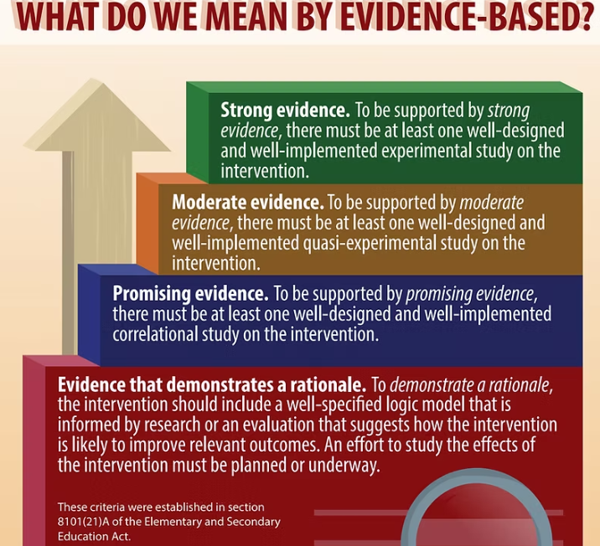

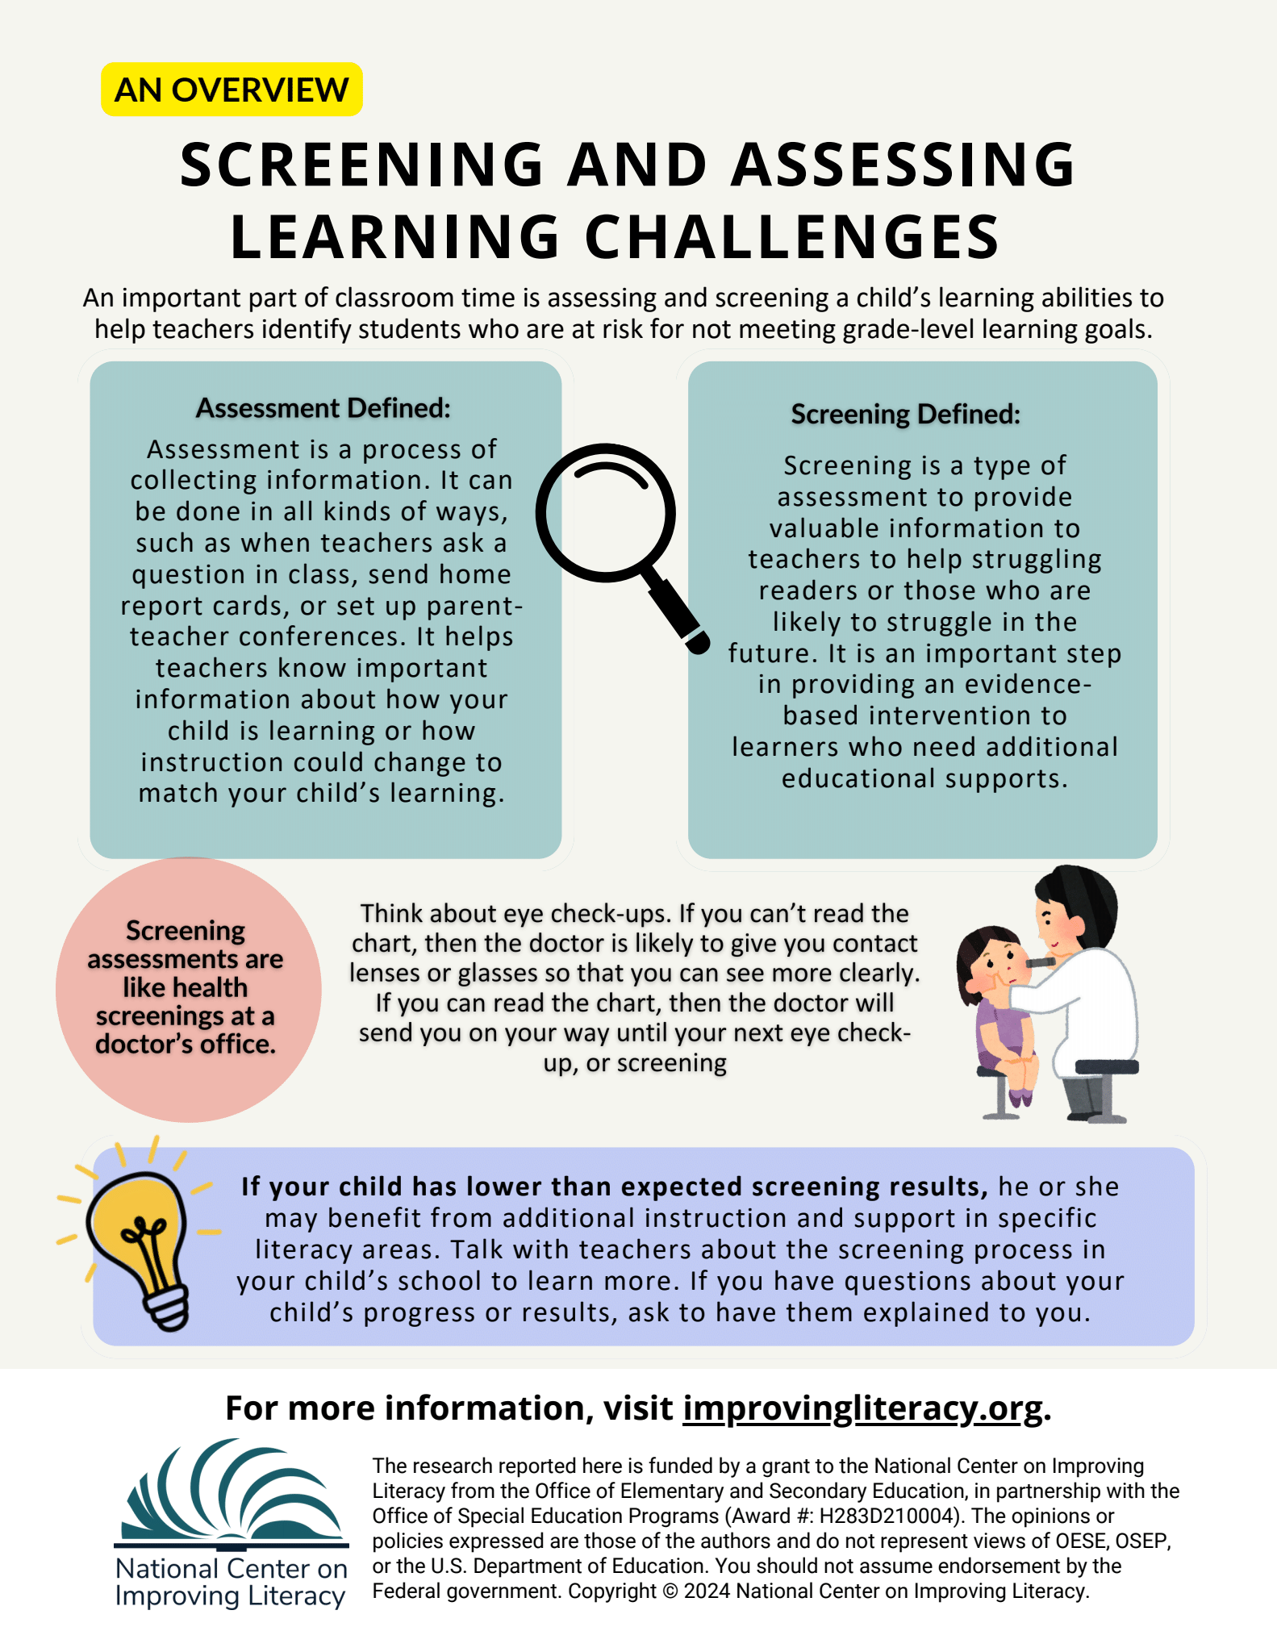
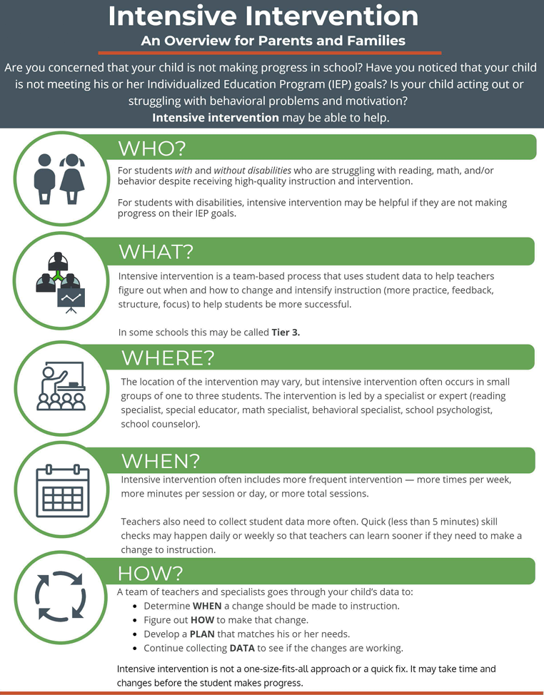
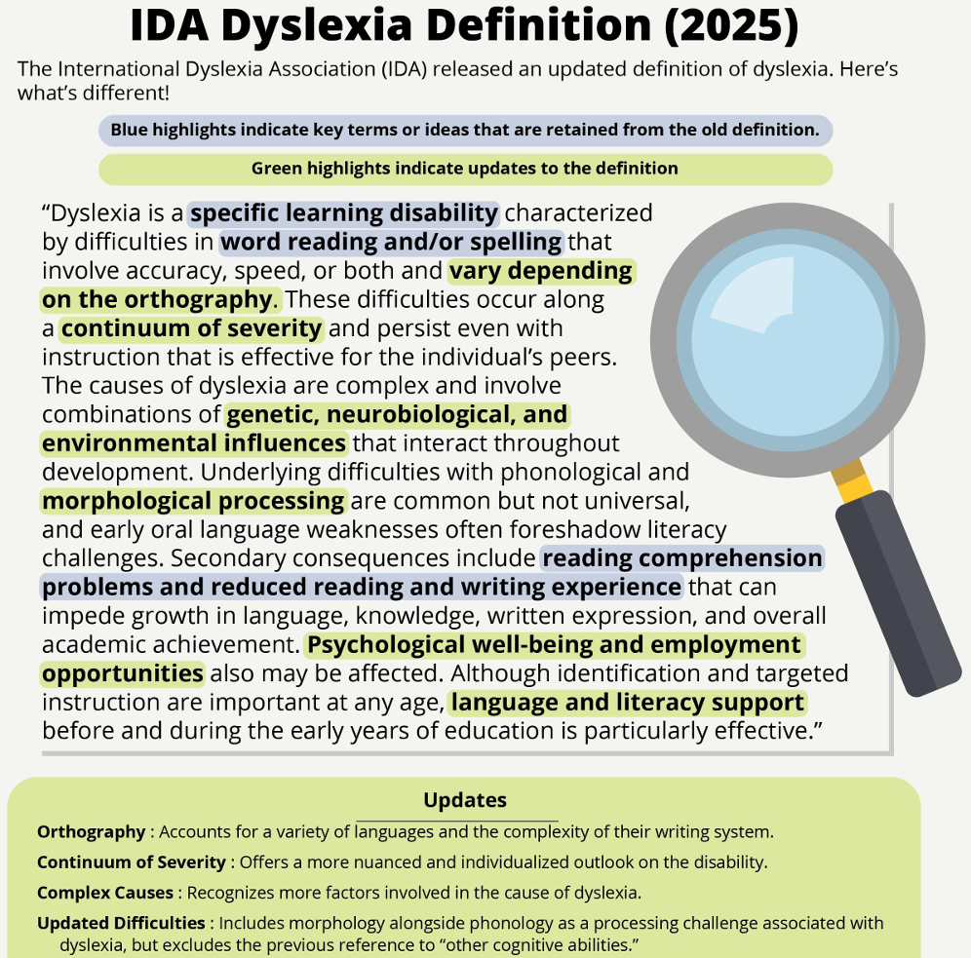
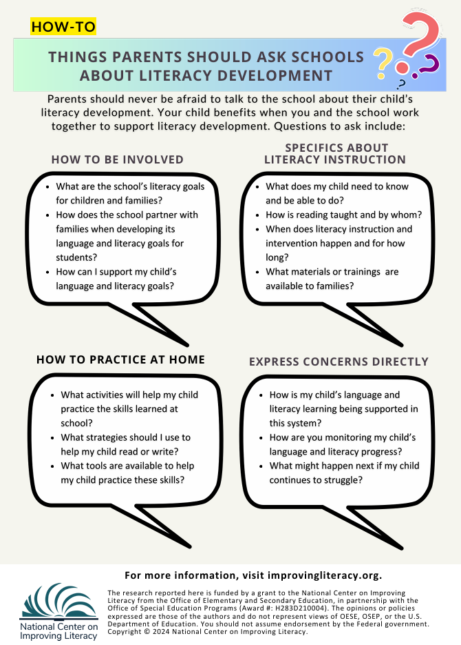






Additional Resources
What Do We Mean by Evidence-Based Literacy Resources?
10 Key Policies and Practices for Reading Intervention
Screening and Assessing Learning Challenges
Intensive Intervention: An Overview for Parents & Families
Understanding the New IDA Dyslexia Definition
How Families Can Partner with Schools on Literacy Development
Notes:
Additional Resources:
What Do We Mean by Evidence-Based Literacy Resources? – NCIL Link: https://improvingliteracy.org/resource/what-do-we-mean-by-evidence-based-literacy-resources/
10 Key Policies and Practices for Reading Intervention with participants through p. 4. Link: 10Key_ReadingIntervention_WEB.pdf
https://meadowscenter.org/wp-content/uploads/2022/07/10Key_ReadingIntervention_WEB.pdf
Screening and Assessing Learning Challenges Link: Understanding Screening: Overall Screening and Assessment – NCIL https://improvingliteracy.org/resource/understanding-screening-overall-screening-and-assessment/
Intensive Intervention: An Overview for Parents and Families Link: Intensive Intervention: An Overview for Parents and Families
Understanding the New IDA Dyslexia Definition – NCIL https://improvingliteracy.org/resource/understanding-the-new-ida-dyslexia-definition/
How Families Can Partner With Schools on Literacy Development – National Center on Improving Literacy
https://improvingliteracy.org/resource/how-families-can-partner-with-schools-on-literacy-development/
NOTE: This is the end of Session 1

Slide 29

Advocating for Your Child's Literacy Needs
Notes:
This next section focuses on what it means to advocate for your child’s literacy needs. Advocacy simply means speaking up, asking questions, and making sure your child gets the support they need to grow as a reader. You don’t have to be a reading expert to do this—you just need to stay involved and share what you notice about your child. In this section, we’ll look at practical ways you can partner with your child’s school, communicate clearly, and feel confident taking the next steps in their literacy journey.

Slide 30
What would you do…
Advocating for your child's literacy needs
You continue to watch your child struggle through reading assignments. They are still guessing at words, losing their place, and becoming more frustrated anytime they have to read. After your initial email to the teacher, you felt overwhelmed—the teacher mentioned screening data, but didn’t explain what it meant or offer any follow‑up.
Several weeks pass, and nothing has improved. Your child is still struggling, and you’re becoming more concerned. You decide to reach out to the teacher again, this time asking for specific guidance. But the response you receive is vague, with a general suggestion to “read more at home.”
You’re sensing that your child may have a reading difficulty, but you’re not sure what steps to take next—or how to get clearer answers from the school.
Discuss with your group:
What would you do next if you were this parent?
What information would you want the school to explain more clearly?
What would help you feel like a true partner in your child’s reading progress?
Notes:
ACTIVITY: The goal of this activity is for families to explore how they can advocate for clarity, collaboration, and meaningful support when they sense their child is struggling. Participants will revisit this scenario at the end of this section.
Read the scenario to participants. Give participants 5-8 minutes to discuss the guiding questions in small groups.
You continue to watch your child struggle through reading assignments. They are still guessing at words, losing their place, and becoming more frustrated anytime they have to read. After your initial email to the teacher, you felt overwhelmed—the teacher mentioned screening data, but didn’t explain what it meant or offer any follow‑up.
Several weeks pass, and nothing has improved. Your child is still struggling, and you’re becoming more concerned. You decide to reach out to the teacher again, this time asking for specific guidance. But the response you receive is vague, with a general suggestion to “read more at home.”
You’re sensing that your child may have a reading difficulty, but you’re not sure what steps to take next—or how to get clearer answers from the school.
We are going to take about 5 or so minutes for you to discuss the questions on this slide with your table or a partner.

Slide 31
What would you do – Share Out
Advocating for your child's literacy needs
You continue to watch your child struggle through reading assignments. They are still guessing at words, losing their place, and becoming more frustrated anytime they have to read. After your initial email to the teacher, you felt overwhelmed—the teacher mentioned screening data, but didn’t explain what it meant or offer any follow‑up.
Several weeks pass, and nothing has improved. Your child is still struggling, and you’re becoming more concerned. You decide to reach out to the teacher again, this time asking for specific guidance. But the response you receive is vague, with a general suggestion to “read more at home.”
You’re sensing that your child may have a reading difficulty, but you’re not sure what steps to take next—or how to get clearer answers from the school.
Discuss with your group:
What would you do next if you were this parent?
What information would you want the school to explain more clearly?
What would help you feel like a true partner in your child’s reading progress?
Notes:
ACTIVITY: The goal of this activity is for families to explore how they can advocate for clarity, collaboration, and meaningful support when they sense their child is struggling. Participants will revisit this scenario at the end of this section.
Read the scenario to participants. Give participants 5-8 minutes to discuss the guiding questions in small groups.
You continue to watch your child struggle through reading assignments. They are still guessing at words, losing their place, and becoming more frustrated anytime they have to read. After your initial email to the teacher, you felt overwhelmed—the teacher mentioned screening data, but didn’t explain what it meant or offer any follow‑up.
Several weeks pass, and nothing has improved. Your child is still struggling, and you’re becoming more concerned. You decide to reach out to the teacher again, this time asking for specific guidance. But the response you receive is vague, with a general suggestion to “read more at home.”
You’re sensing that your child may have a reading difficulty, but you’re not sure what steps to take next—or how to get clearer answers from the school.
We are going to take about 5 or so minutes for you to discuss the questions on this slide with your table or a partner.

Slide 32
Advocating for your child's literacy needs
Common Literacy Advocacy Questions...
What is a literacy advocate?
Why is advocacy important?
What skills make you a natural literacy advocate?
How do you embrace your role as a literacy advocate?
What should you advocate for in reading and writing?
How can you work collaboratively with the school to advocate for your child's literacy needs?
Notes:
As you worked through the scenario you might have noticed how challenging it can be to know what to do, the questions to ask, or even what information would be helpful for you to support your child.
Let’s take a look by answering these common questions:
What is a literacy advocate?
Why advocacy is important?
What skills make you a natural literacy advocate?
How do you embrace your role as a literacy advocate?
What should I advocate for in reading and writing?
How to work collaboratively with the school to advocate for your child's literacy needs?
Understanding this information will help you be better prepared to collaboratively work with your child’s school to ensure their needs are met.

Slide 33


Advocating for your child's literacy needs
What is a literacy advocate?
Someone who supports or speaks out for someone else's needs or rights in the areas of reading, writing, and/or language.
Notes:
A literacy advocate is someone who speaks out for someone else’s needs or rights in reading, writing, and language. Advocates can be parents or family members; educators, such as teachers, principals, and other staff; or members of the community. Advocacy can occur on an individual basis, such as advocating for the specific needs of your child, or at the group level, such as advocating for a group of students with similar needs.
Guiding question: Have you had any experiences in advocating for your child?

Slide 34

Advocating for your child's literacy needs
Why is advocacy important?
When families and schools work together, children make stronger progress. By sharing what each of you sees, you can create a plan that truly meets your child’s literacy needs.
This Photo by Unknown Author is licensed under CC BY-SA
Notes:
When families and schools work together toward common goals, children make better progress. By sharing information with one another, you can develop a plan that best addresses your child’s literacy needs. You and the school view your child through different lenses, yet both viewpoints are equally important. Be ready to explain your child’s literacy struggles and what supports and instruction will help him learn. Your ideas matter because you know your child and you are your child’s voice.

Slide 35

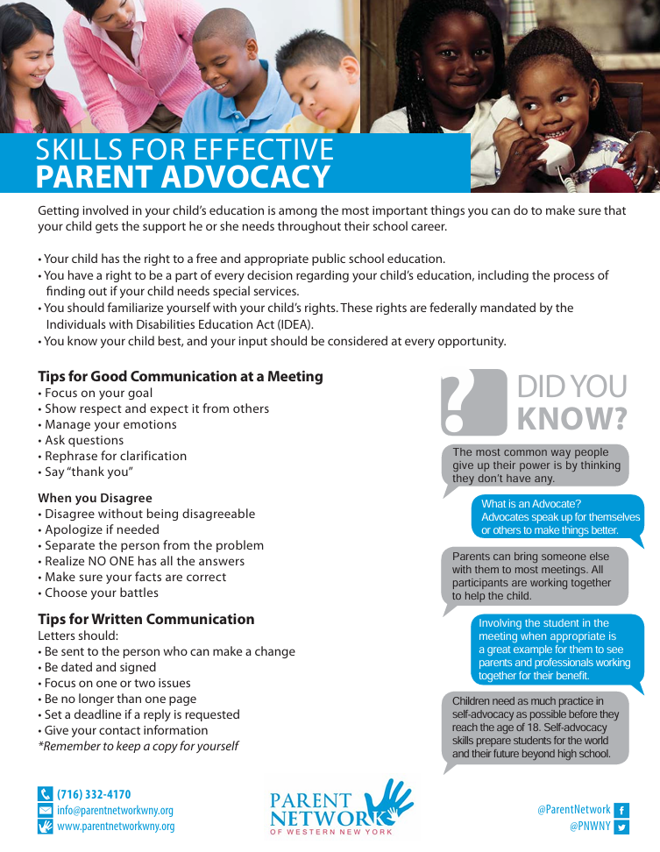

Advocating for your child's literacy needs
What skills make you a natural literacy advocate?
Every child learns to read in their own way, and families have a unique understanding of their child’s strengths and needs.
What knowledge do I hold that makes me a strong advocate for my child's reading development?
Notes:
As a parent or family member, you hold special knowledge about your child and his or her reading development. You know your child best and have seen your child’s literacy skills grow over time. You may notice important things at home that your child’s teacher is not aware of. By speaking out for your child’s literacy needs, you are making others aware of these needs and advocating for your child’s learning and development.
Give participants 1-2 minutes to reflect on the question in the box “What knowledge do I hold that makes me a strong advocate for my child's reading development?”
Resource: Distribute, review, and discuss Skills for Effective Parent Advocacy with participants. Review the six skills to be an effective advocate with participants and clarify information and answer any questions.
Resource link: https://parentnetworkwny.org/wp-content/uploads/2017/06/Advocacy-PN_FactSheet32917.pdf
ACTIVITY:
Have participants partner up and give them a few minutes to share which of the six skills they think they’re already doing well and one they would like to strengthen or learn more about and why. Bring the whole group together and ask participants to raise their hands for the skill they choose. Note the number of hands raised for each skill and use it to help you tailor information to participants needs in future sessions.

Slide 36

Advocating for your child's literacy needs
How do you embrace your role as a literacy advocate?
Recognize that you are your child’s strongest and most consistent supporter. Advocacy begins with confidence, curiosity, and collaboration. Partner with teachers, specialists, and other families to work toward shared goals.
ThePhoto by PhotoAuthor is licensed under CCYYSA.
Notes:
The question now becomes, how do you embrace your role as your child’s literacy advocate? Here are a few tips to get you started.
Recognize that you are your child’s strongest and most consistent supporter.
Advocacy begins with confidence, curiosity, and collaboration.
Partner with teachers, specialists, and other families to work toward shared goals.

Slide 37
Advocating for your child's literacy needs
What should you advocate for in reading and writing?
Learn about evidence-based practices by asking your child's school questions such as: What screening practices for literacy does the school use and when? How are children with reading difficulties identified? What evidence-based literacy instruction and interventions are used? What information does the school collect on my child’s literacy progress? How is the information used to make decisions about my child’s literacy needs? What types of support are offered to my child if he or she is struggling to read or write? What accommodations does the school provide to help my child read or write?
Notes:
Reading research shows us what works to teach children to read and write. Families should learn about evidence-based literacy approaches, including early screening for and identification of reading difficulties, additional instruction for struggling readers, and accommodations for reading and writing. Questions to ask your school include:
What screening practices for literacy does the school use and when?
How are children with reading difficulties identified?
What evidence-based literacy instruction and interventions are used?
What information does the school collect on my child’s literacy progress?
How is the information used to make decisions about my child’s literacy needs?
What types of support are offered to my child if he or she is struggling to read or write?
What accommodations does the school provide to help my child read or write?

Slide 38
Advocating for your child's literacy needs
How to work collaboratively with the school to advocate for your child's literacy needs?
Communicate and Interact Often
Practice Literacy Skills at Home
Discuss Literacy Instruction and Intervention
Find out how you will receive communication from the school and ask questions if you need more information.
Talk about what home literacy activities match your child’s skill level.
Talk about how you and the school can partner to help your child and others get high-quality and effective literacy instruction.
Address Concerns Together
Discuss what your child has learned and what skills they are still working on. Share your understanding of your child’s learning needs.
Notes:
Your child benefits when you and the school work together to support their literacy development. Working together promotes faster development and catch trouble spots earlier. Partnering with your child’s school takes effort from both the family and the school.
As we think about supporting your child’s reading development, there are four simple ways families and schools can stay connected. First, communicate and interact often—know how the school will share updates, and don’t hesitate to ask questions when you need more information. Second, practice literacy skills at home by choosing activities that match your child’s current skill level. Third, talk with the school about the instruction and interventions your child is receiving so you can work together to make sure they’re getting strong, effective support. And finally, address concerns as a team—share what you’re noticing at home, discuss what your child has learned, and identify the skills they’re still working on. Your perspective helps shape the full picture of your child’s needs.
Guiding question: What is one of your child’s literacy strengths and one challenge?

Slide 39

Actions to Effectively Advocate

Slide 40
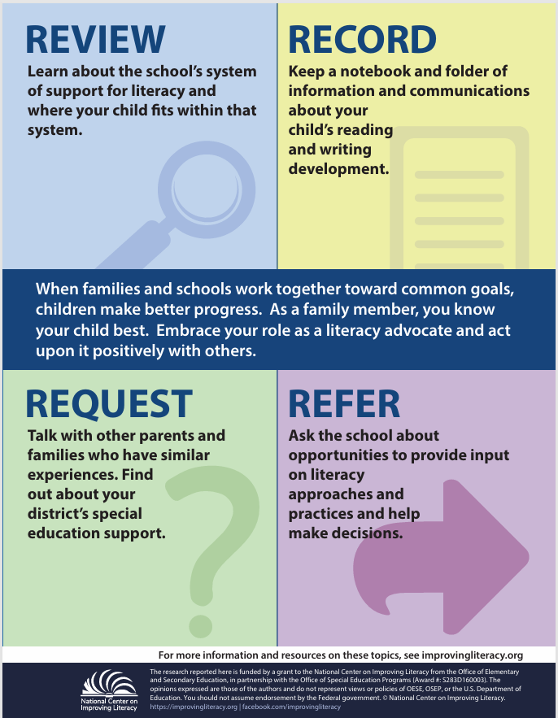

Actions to advocate effectively
Ways to Advocate:
Review
Record
Request
Refer
Notes:
Every child’s literacy journey is unique. As a family member, you know your child best. Becoming a literacy advocate means embracing your role and acting positively with others to support your child’s reading and writing development. Advocacy comes in many forms and can be done in a variety ways. Four ways to advocate for your child’s literacy needs that we’ll discuss are to: Review, Record, Request, and Refer.
Resource: Distribute copies, review, and discuss the Advocating for My Child’s Literacy Needs literacy brief and infographic with participants. Tell participants that the session topic is related to the literacy brief.
Resource link: Advocating for My Child’s Literacy Needs – NCIL https://improvingliteracy.org/resource/advocating-for-my-child-s-literacy-needs/

Slide 41
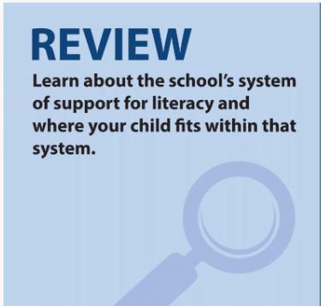
Advocating for your child's literacy needs
Learn about your school’s system of support for literacy and how your child fits within that system.
If your child receives special education services:
  Request a copy of school records.
  Learn your educational rights and responsibilities.
Notes:
Whether you have concerns about your child’s progress in learning to read, suspect your child may have a reading disability, or your child is receiving special education services for reading; you can advocate for your child’s literacy development. An important first step is to review or learn more about topics that will enable you to advocate well. It will also help you better understand the school’s system of literacy supports and services and where your child fits within that system. For example, you might wonder how children learn to read. Understanding the process of learning to read can help you identify whether your child is having reading difficulties and prepare you to advocate for his or her learning needs.
If you suspect your child has a reading disability or if your child has a diagnosed reading disability, and wonder if he or she may be eligible for special education, you might want to learn about diagnosis or special education classification. Your child may be receiving reading interventions and supports through the school’s system of literacy support and services. You may want information that explain these supports or services. Knowing this information can equip you for more productive and targeted conversations with school staff about your child’s literacy learning.

Slide 42
Advocating for your child's literacy needs
Understanding My Child's Reading Development: Prepare to advocate for your child's learning needs.
Diagnosis and Classification: If you suspect your child has a reading disability or may be eligible for special education.
Intervention and Supports: For resources that explain supports and services your child may be receiving.
Learn More about topics that will enable you to advocate effectively and to better understand the school's system of literacy support and services.
Notes:
Whether you have concerns about your child’s progress in learning to read, suspect your child may have a reading disability, or your child is receiving special education services for reading; you can advocate for your child’s literacy development. An important first step is to review or learn more about topics that will enable you to advocate well. It will also help you better understand the school’s system of literacy supports and services and where your child fits within that system. For example, you might wonder how children learn to read. Understanding the process of learning to read can help you identify whether your child is having reading difficulties and prepare you to advocate for his or her learning needs.
If you suspect your child has a reading disability or if your child has a diagnosed reading disability, and wonder if he or she may be eligible for special education, you might want to learn about diagnosis or special education classification. Your child may be receiving reading interventions and supports through the school’s system of literacy support and services. You may want information that explain these supports or services. Knowing this information can equip you for more productive and targeted conversations with school staff about your child’s literacy learning.

Slide 43
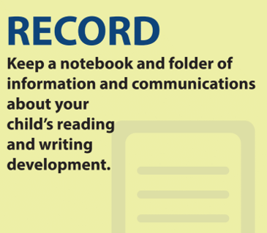
Advocating for your child's literacy needs
Record and keep information from:
Parent-Teacher Conferences
Special Education Evaluations
Individualized Education Program (IEP) Meetings
Literacy Data
Notes:
The second way to advocate for your child’s literacy needs is to record. Keeping a record of information and communications with your child’s school can help you track your child’s reading development, progress, and services over time. If your child is having reading difficulties but is not identified as a child with a disability, you can use your child’s report cards and school testing to find out how your child is doing compared to peers. Parent teacher conferences provide an excellent opportunity to communicate with your child's teacher and other education staff. You can advocate for your child’s literacy needs during conferences. If your child is being evaluated for special education eligibility, you may wonder about the evaluation process and opportunities for advocacy. If your child has already been found eligible for special education services, the school should hold annual, Individualized Education Program, or IEP, meetings to review your child's literacy progress and set literacy goals. You can advocate for your child during these IEP meetings. Additionally, you’ll want to record any literacy data collected by the school such as screening results and classroom assessment data.
Let’s take a quick look at a few tips for keeping track of all this information and then we will dive into what to record in each area.

Slide 44
Advocating for your child's literacy needs
Tips for recording include:
Keep a notebook and folder for all information about your child’s reading and writing.
Document:
  Phone calls and meetings with teachers.
  Dates, times, topics discussed.
  Decisions made and next steps.
Organized records help you track progress and advocate effectively.
Notes:
Some tips for recording include:
Keep a notebook and folder for all information about your child’s reading and writing.
Document:
Phone calls and meetings with teachers.
Dates, times, topics discussed.
Decisions made and next steps.
Organized records help you track progress and advocate effectively.
Okay, now let’s look at what information to record.

Slide 45



Advocating for your child's literacy needs
Parent-Teacher Conference
How can I communicate effectively with my child's teacher and education team?
Special Education Evaluation
Individualized Education Program (IEP) Meetings
Know what questions to ask
Tips for communicating with teachers
Literacy Data
Learn More Strategies
Learn More
Notes:
Parent-teacher conferences typically take place on a regular basis, making them an excellent way to discuss with your child’s teacher and education staff ways to support your child’s literacy development together. Effective communication is crucial during these meetings so that you, your child’s teacher, and other staff can freely share thoughts or concerns about your child’s literacy learning and supports to address his or her literacy needs. Ask questions when a teacher says your child is making progress. For example, “What does that progress look like?”
Click “Learn More” (English and Spanish) for questions you can ask about interventions, making progress, and assessments during conferences. Click “Learn More Strategies” for tips for communicating with your child’s teacher.
Resource: Distribute, review, and discuss How Do I Know What Questions To Ask? with participants. In groups, have participants identify which questions they know the answers to and which ones they may need to ask or have clarified.
Link: https://www.matrixparents.org/wp-content/uploads/2015/03/HELP-17-What-QUESTIONS-to-ask-Eng-Span.pdf
Display on the screen Beyond IEP Meetings: How I Connect With My Son’s General Education Teachers and scroll down, showing participants the information. Tell participants that it shares one parent’s perspective on what she’s learned from advocating for her son in public school. Encourage participants to review the information on their own later. Beyond IEP Meetings: How I Connect With My Son’s General Education Teachers: https://www.understood.org/articles/en/beyond-the-iep-reaching-out-to-my-sons-general-education-teachers

Slide 46



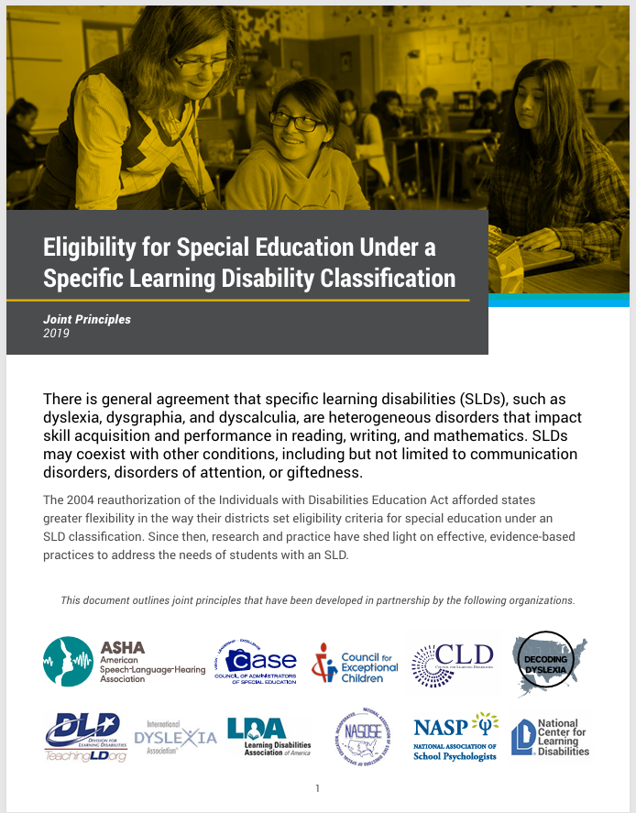

Advocating for your child's literacy needs
Parent-Teacher Conference
What do I need to know about my child's special education evaluation? How can I advocate during this process?
Special Education Evaluation
What it means to be evaluated for a Specific Learning Disability.
Your legal rights in a special education evaluation.
Individualized Education Program (IEP) Meetings
Learn More SLD
Learn More
Literacy Data
Notes:
If your child is having reading difficulties, you or education staff may request an evaluation to see if your child is eligible for special education. As soon as a disability is suspected, your child will be protected by law under the Individuals with Disabilities Education (IDEA) Act.
Knowing and understanding these legal rights can help you ensure that your child’s school does a proper evaluation and that all members of the team, including you, agree on whether your child will receive special education services. Click “Learn More” for information about these legal rights.
If the school is evaluating your child for special education because of reading difficulties, and your child is found eligible for services, your child will likely be classified under the category of a specific learning disability or SLD. Click “Learn More SLD” to learn more about this specific category of special education and what might be involved in an evaluation.
Display on the screen Parents Rights under IDEA and scroll down, showing participants the information. Read aloud to participants the first paragraph and tell participants that they can learn more about any of these by clicking on the text in red and they’ll go to a separate page describing that procedural safeguard. Encourage participants to review the information on their own later. Parental Rights under IDEA: https://www.parentcenterhub.org/parental-rights/
Resource: Distribute, review, and discuss Eligibility for Special Education Under a Specific Learning Disability Classification: Joint Principles with participants. The document outlines 8 joint principles for Specific Learning Disability (SLD) that have been developed in partnership by several organizations. Tell participants they can use the information to guide their conversations and inform actions with school staff when a disability is suspected. If time permits, see activity below. Link: Eligibility-for-Special-Education-under-a-Specific-Learning-Disability-Classification-Final.pdf
Activity: Put participants into 8 groups/pairs and assign one principle to each group/pair. Have them discuss their assigned principle and share their experiences and reflections related to it. Bring all participants back together and ask for a few volunteers to share out.

Slide 47

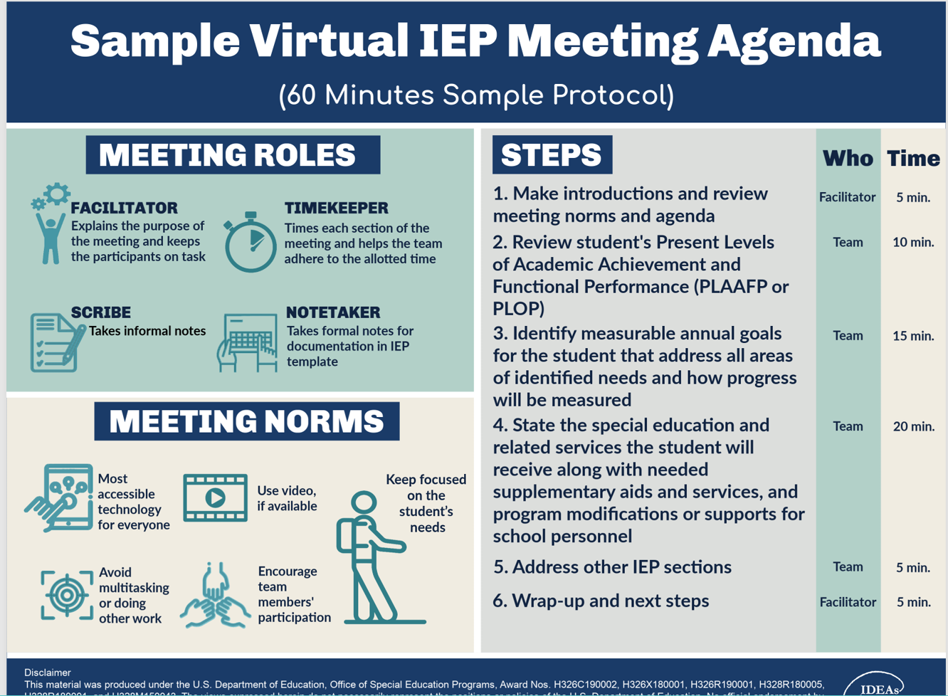




Advocating for your child's literacy needs
Parent-Teacher Conference
What do I need to know about my child's special education evaluation? How can I advocate during this process?
Learn More
Special Education Evaluation
Individualized Education Program (IEP) Meetings
Video provided by:
Watch Video
Literacy Data
Video provided by:
Watch Video
Notes:
If your child is receiving special education services, the school should be holding annual meetings to review your child’s Individualized Education Program, or IEP. These meetings typically include your child’s general education teacher, special education teacher, and any other education staff who support your child’s learning. As a parent or family member, you serve a very important role on your child’s IEP Team. Click “Watch Video” to learn more about the members of your child’s education team and their roles at IEP meetings.
The purpose of IEP meetings is to discuss your child’s literacy development over the past year, review progress towards meeting literacy goals, discuss services and supports, and set new literacy goals for the following year.
IEP meetings can be over-whelming and it may be helpful to prepare ahead of time. The more prepared you are for the meeting, the better prepared you will be for advocating for you child’s literacy needs.
Click “Watch Tips Video” to see how to prepare ahead of time.
Video: Play Watch Video Emiliann’s IEP Team (3:54)
video Link: https://youtu.be/wTQvd_bKTOo?si=oZ2CzYYBTTskmY99
Transcript: Back in Maryland, at Huntingtown Elementary, Emiliann Simpson finally got what she needed a team of people committed to making sure she becomes a good reader. Here’s the line up. At mom, we have mom. Jennifer Simpson, who knows Emiliann better than anyone else. We have her parent advocate, Emiliann’s homeroom teacher, her speech/language pathologist, and her special ed teacher. The assistant principal coordinates the team, and the head coach, overseeing all the players, is principal Ramona Crowley. Seven people may seem like a lot, but that’s what it takes to carry out a plan that meets all of Emiliann’s needs now that she’s been formally identified as a special education student. Today, assistant principal Jennifer Young has convened Emiliann’s year-end IEP meeting. An IEP is an individualized education plan required by law for any child in special education. Okay, the first thing we’re going to do this morning is we’re going to review Emiliann’s progress. This meeting is a time to review her work for the year, talk about areas where she’s still struggling, and make plans for next year. She still has problems when she reads a book to me, or to her sister. And I’m like, “Well, who was the one who went to the store?” And she has to actually physically go back and look at the pictures. That’s what we’re working on. That’s the comprehension. Right. I mean that is the major part of the reading. We’re working on that comprehension. In an IEP meeting you, as a parent, have right to ask any question you want. If the parent is not viewed as a true member of the IEP committee, then the IEP really is not servicing the full child. Schools can make decisions about educational programs, but the school is not the expert on the child. That’s the parent, and that input is critical and valued, and needs to be part of the IEP team. Jennifer says she’s finally found people wo can help Emiliann – and who will do whatever it takes to teach her to read. Is there another one? Everyone. Excellent, Emili. There’s another one. In her homeroom with Ms. Manley, Emiliann and her classmates work on learning new words. One of the things we talked about with Emiliann was that she really needs a double dose. She needs the thinking and processing skills that are provided in a general-education classroom setting, but see also needs work on her weaknesses. During her special ed time with Mrs. Scher, Emiliann gets extra practice in the basics like sounding out vowel diphthongs. What does aw say? Oo. Aw. Aw. Good. Let’s try ew. With Ms. Sayles, Emiliann gets concentrated attention on her language skills. Today, she’s working on descriptive language. She’s holding an umbrella. It is purple and the handle was brown. I heard some colors. Everyone’s happy to see Emiliann’s progress. Her overall goal was to improve her expressive language. And I must say that Emiliann is doing very well. Yeah, her spelling has been phenomenal, because before, she couldn’t get – out of ten words, she’d get three. But now, she’s doing – she’s bringing home, “Look, Mom. I got a hundred percent” you know? And I’m like, “Woo-hoo!” The school will continue to monitor Emiliann regularly and adjust her instruction when they need to. And it looks like Emiliann is on her way. Super. Okay. She still has an issue. She still has problems. They still have an IEP, but she likes to read now. She reads to her sister. They read things on the signs. She reads things on cereal boxes. Just things she would never even try, she does. That alone, makes me do cartwheels. In many schools, pulling together a team like Emiliann has may be different. But your job is to keep searching for help – either inside the school or out – because so much is at stake. But I love that little puppy.
So, what is your key takeaway from this video? Give participants 1 – 2 minutes to respond.
Now let's take a look at a sample IEP agenda and examine the different parts and talk about what happens during the IEP.
Resource: Distribute, review, and discuss Sample Virtual IEP Meeting Agenda with participants. Tell participant they can use the information to prepare for an IEP meeting. Ask participants to share if they’ve ever participated in a virtual IEP meeting and the ways it was the same and different from the sample. Link: sample-agenda.pdf
Video: Play Watch Tips Video 10 Tips for a Better IEP Meeting (5:49)
Video Link: https://youtu.be/qmXUWVzBGD4?si=meIspvQz7tRg9UZ7
Transcript: Hi everyone! I’m Trynia from Understood. IEP meetings can be challenging and emotional, but by following a few important tips, you can help get the support your child needs in school. In this video, we’ll count down our top ten tips for a better IEP meeting. At 10 we have: Gather and review documents ahead of time. IEP meetings involve a lot of paperwork. The more information you have organized ahead of time, the more productive the meeting will be. Before the meeting, gather copies of all official documents. This includes your child’s IEP, as well as any recent progress reports and report cards. Ask the teacher for samples of your child’s homework, tests, and student notes. Also be sure to ask the school for copies of any important reports. As you look over the documents, ask yourself, “Where is my child making progress? Or still struggling? What supports and services are helpful? Are there any new challenges? Tip 9: Invite allies and supporters. It isn’t easy to sit through a long meeting and talk about your child’s struggles. If you need support, invite someone to join you. It’s your legal right. It could be a friend or a family member, a professional who works with your child, or an advocate. Explain to them ahead of time how you think they can help. You might even ask to connect with them before the meeting to discuss your concerns, get their input, and plan your approach. Once you decide who to bring, make sure you let the school know before the meeting date. Tip 8: Create a list of your questions and concerns. After reviewing your child’s records and getting input, you may have lots of things you want to discuss at the meeting. It can help to draft a simple list of the points you plan to make. Boil it down to the basics; your concerns, questions, and suggestions. You can refer to this list during the meeting. Tip 7: Be clear on the goals for your child. For example, you may want your child to read at grade level, or be prepared for college. Make sure the IEP team understands your expectations. During the meeting, the IEP team will decide on the IEP goals that will guide your child’s plan. These goals should align with your personal goals for your child. Together, you and the team can figure out the best resources and instructional approaches. Be sure to ask questions about what the team proposes. You can even suggest changes yourself. Tip 6: Be open-minded and collaborative. Everyone on the IEP team brings something to the table. School staff can offer experience and understanding of your child’s needs and strengths. If someone brings up and issue or a solution that you’re not sure about, hear them out. Sometimes issues come up in school that don’t appear at home. School is a different environment with different rules and expectations. By working with the IEP team and your child’s teacher, you can better address all of your child’s needs. Tip 5: Share your expertise. No one on the IEP team knows your child the way you do. The other team members may be experts on education, but you’re an expert on your child. So, don’t be afraid to speak up. Share your perspective on your child’s personality, strengths, interests, struggles, and successes. Describe how your child behaves when doing homework, playing sports, and doing other activities outside of school. This will give the team insights into your child, and ideas for how to provide the right type of support. Tip 4: Advocate for yourself and your child. Special education and IEPs can be complicated. Even if you’re well prepared, you may hear new terms during an IEP meeting. When this happens, ask for an explanation. There are no dumb questions. It’s your right to understand every detail and decision. If you’re unsure about the IEP drafted in the meeting, don’t feel pressured into agreeing to it. You have the right to take the drafts home and think it over. After the meeting, be sure to stay in touch with the team. Following up on what the team said it would do is an important part of advocacy. Tip 3: Get your child involved. At some point, you may want to your child attend or even lead their own IEP meetings. But even before then, it’s important to get your child involved in the process. Before you go to an IEP meeting, ask your child what’s going well in school and what isn’t. You may be surprised at how insightful kids can be. After the IEP meeting, make sure to tell your child what happened in an age-appropriate way. Talk about any new services or changes. When kids get involved early, it helps them get ready to take responsibility for their own education someday. Tip 2: Focus on your child’s strengths. In IEP meetings, it’s easy to get bogged down in the areas where you child struggles. Make sure to send some time in the meeting focusing on your child’s strengths. It’s as simple as asking the IEP team, “What is your child doing well in class? In what areas did your child score highly on any evaluation?” Think about ways you can harness those strengths to help you child make progress in school. And the top tip for a better IEP meeting is: Keep track of everything in one place. How can you keep track of the test results, report cards, official documents, and other paperwork related to your child’s IEP? The best way to stay on top of it all is to keep everything in one place. We suggest putting all important documents in an IEP binder. You can also use the binder to keep track of notes you’ve taken at IEP meetings, and concerns you’ve jotted down. Need help with organization? Check out the description below for a link to a free IEP binder download that you can use. In the download, you’ll get an IEP binder checklist, a school contact sheet, a communication log, and a goal tracker. It’s truly a game changer if you want a better IEP meeting. Finally, let us know in the comments what you think is the most important tip for IEP meetings and why. We’d love to hear from you!
Guiding question to check for understanding: What do you think is the most important tip and why?

Slide 48
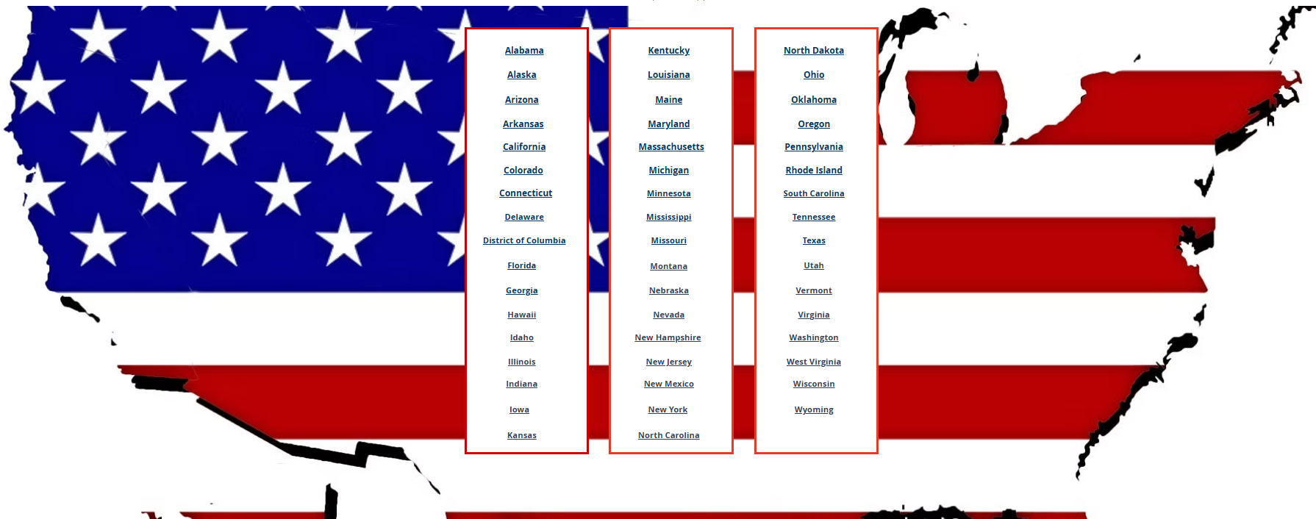
Advocating for your child's literacy needs
Helps measure literacy skills
Done regularly throughout the year
Helps identify students at risk for reading difficulties
Helps to better understand how students are performing
Parent-Teacher Conference
Data Collection
Special Education Evaluation
Learn More
Learn More
Individualized Education Program (IEP) Meetings
Literacy Data
NCIL State of Dyslexia Map
Notes:
There are several ways you can participate in committees and groups in your school, district, and broader community. For example, your school may have a leadership team that oversees its system of literacy support and services for all students. Ask about joining the team so you can share your perspective and that of other families with team members.
Your school district should have also a local Special Education Parent Advisory Council. This council is parent-driven group that provides input to the local school district on system-level challenges in special education and related services. In different states, these groups may go by different names.
Click “Learn More” for a guide to local special education parent advisory councils. Link: Part II: Chapter 1 – A View from the States – Advocacy in Action
Also, organizations like the International Dyslexia Association, Decoding Dyslexia, and the Parent Center Network, have state support branches across the United States for families of children with dyslexia and other literacy-related disabilities.
Click “Learn More” to learn about IDA in your state.
Display on the screen Advocacy in Action: A Guide to Local Special Education Parent Advisory Councils with participants. Tell participants The Center for Parent Information and Resources offers this guide as a road map to help bring stakeholders together, suggests strategies to help them engage in dialogue, and discusses best practices to help them work together to benefit the local community. Scroll down to show participants how to access the Table of Contents and three parts of the guide. Encourage participants to further review the website on their own. Advocacy in Action: A Guide to Local Special Education Parent Advisory Councils: https://sepacguide.parentcenterhub.org/
Note: Click Find Your State to locate your state’s agencies and display the information. Provide time to review with participants the information and answer any questions. Encourage participants to further review the information on their own. Find State Agency & Parent Center Information: https://www.cadreworks.org/find-state-agency-parent-center-information

Slide 49
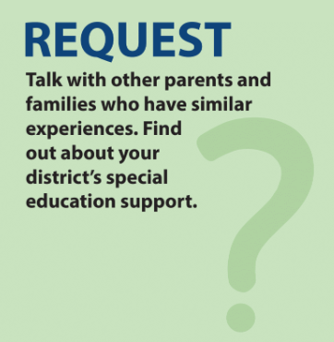
Advocating for your child's literacy needs
Request information and support from others to help you advocate for your child’s literacy needs.
Request information about what your district has in place to support your child and family such as:
Special education support
Special education advisory committees
Attend and participate in community groups to learn about opportunities to connect with others such as:
PTA meetings
Family support groups
Notes:
The third way to advocate for your child’s literacy needs is to request. It is common to feel uneasy being an advocate for your child’s literacy needs, especially if you’re new to doing it. You may gain confidence or insight by requesting information from others or talking with families in your child’s school or in the community who have similar experiences. You and other families can share your experiences and learn from one another. They may also know about supports and opportunities that may be available to support your child’s literacy development.
Reaching out to others for support is a great way to demonstrate advocacy. Partnering with other families can also encourage your child’s school to make changes to literacy instruction, assessment, and intervention that would benefit all children in the school.

Slide 50

Advocating for your child's literacy needs
What supports are there to help my child with reading?
Share your experiences to learn from one another.
Encourage the school to make changes to literacy instruction, assessment, and intervention to benefit all children.
Family
Community
Notes:
Here we are focusing on how families can request the right support for their child’s reading needs. Asking questions like, ‘What supports are there to help my child with reading?’ opens the door to real collaboration. We also encourage families to share experiences with one another—because learning together builds confidence and community. And when families speak up, schools are more likely to strengthen literacy instruction, assessment, and intervention in ways that benefit all children. Advocacy starts with a simple request, and it can lead to meaningful change.

Slide 51
Advocating for your child's literacy needs
Finding a Community
What can I learn by talking with other families with similar experiences?
You’re not alone
Hope and encouragement
Real-life strategies
Community and belonging
Advocacy tips
Notes:
Families of other children with reading difficulties have likely been in your position before and had similar concerns. They’ve probably had many of the same questions as you and have experience with navigating difficult conversations with education staff. Just as they may help you through the process, you may help others too.
What you might learn by talking with other families with similar experiences Click for each text box to appear
You’re not alone — Families share similar struggles, questions, and emotions.
Real‑life strategies — Parents exchange what has worked at home, at school, and in navigating services.
Advocacy tips — Families learn how others have approached IEP meetings, evaluations, and school communication.
Hope and encouragement — Hearing from families further along in the journey helps reduce fear and build confidence.
Community and belonging — A safe, supportive environment where families feel understood and validated.
Click “Watch Video” to learn more about the benefits of finding support from other families.
Video: Play Watch Video I Am Dyslexic
Video link: I AM DYSLEXIC - Short Animated Student Film
Guiding question to check for understanding: What resonates most with you about the conversation between Suzanne and Margie and why?

Slide 52
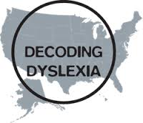


Advocating for your child's literacy needs
Participating in the Community
How do I find and join special education support committees and groups?
Notes:
Many parents want to know where to start, and one of the most effective steps is joining local or national groups that understand these systems. Organizations like the International Dyslexia Association, Decoding Dyslexia, and the Center for Parent Information & Resources offer guidance, training, and state‑specific contacts. These groups help families learn their rights, find resources, and connect with others who share similar experiences. Exploring these networks is a powerful way to strengthen your advocacy and feel supported along the way.

Slide 53
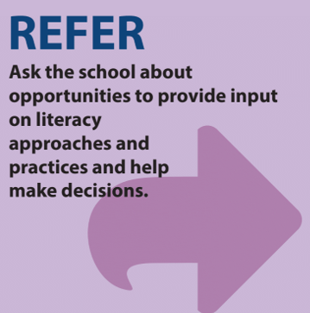
Advocating for your child's literacy needs
Ask your school about opportunities to provide input on literacy approaches and practices.
Participate in decision-making when possible.
Request workshops or engagement activities that bring families, schools, and communities together.
Shared learning strengthens literacy outcomes.
Notes:
The fourth way to advocate for your child’s literacy needs is to refer. This means to refer back to your knowledge about literacy to ask your school about opportunities to provide input on literacy approaches and practices.
Participate in decision-making when possible.
Request workshops or engagement activities that bring families, schools, and communities together.
Shared learning strengthens literacy outcomes.
Many schools welcome family voices in decision‑making. You can also request workshops or engagement activities that bring families, educators, and community partners together to learn about reading and writing instruction.

Slide 54
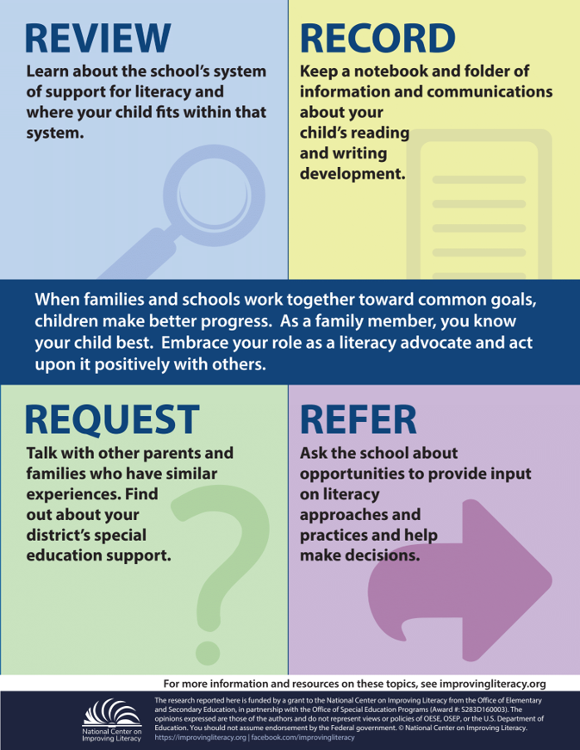
Summary
Advocating for your child's literacy needs
Review: Learn about the school’s system of support for literacy and learn where your child fits within that system. If your child is receiving special education services, ask for a copy of their school records and know your educational rights and responsibilities.
Record: Keep a notebook and folder of information and communications about your child’s reading and writing. Note what was discussed during calls and meetings with the teacher or school. Write down dates, times, topics, decisions, and next steps.
Request: Talk with other parents and families who have similar experiences. Find out about your district’s special education support, like special education advisory committees, and attend PTA meetings to learn about opportunities to connect with others.
Refer: Ask the school about opportunities to provide input on literacy approaches and practices and help make decisions. Request workshops and engagement activities that bring the school, home, and community together to learn about reading and writing instruction.

Slide 55
Let’s return to our scenario…
Advocating for your child's literacy needs
Several weeks have passed, and your child is still struggling with reading assignments. They continue guessing at words and losing their place. At this point, anytime they have to read, they just shut down. However, over the past few weeks, the teacher has shared more guidance and suggestions because they also see that your child is struggling. Additionally, the teacher has sent home additional information for you to help your child.
While you appreciate how supportive the teacher has become, you’re still sensing that your child may have a reading difficulty and want more help from the school. What can you do to work collaboratively with the school to get answers?
Using the knowledge and advocacy methods you just learned, discuss with your group:
  The steps would you take next if you were this parent
  The information would you want the school to clarify or explain in more detail
  The questions could you ask to better understand your child’s reading needs
  The actions the school and you could take to help you feel like a true partner in your child’s reading progress
Notes:
ACTIVITY: Give participants 8-10 minutes to discuss in small groups. The goal of revisiting this activity is for families to apply what they learned to meaningfully support their struggling
Discuss with your group:
What would you do next if you were this parent?
What information would you want the school to explain more clearly?
What would help you feel like a true partner in your child’s reading progress?
child.

Slide 56
Share Out
Advocating for your child's literacy needs
Several weeks have passed, and your child is still struggling with reading assignments. They continue guessing at words and losing their place. At this point, anytime they have to read, they just shut down. However, over the past few weeks, the teacher has shared more guidance and suggestions because they also see that your child is struggling. Additionally, the teacher has sent home additional information for you to help your child.
While you appreciate how supportive the teacher has become, you’re still sensing that your child may have a reading difficulty and want more help from the school. What can you do to work collaboratively with the school to get answers?
Using the knowledge and advocacy methods you just learned, discuss with your group:
  The steps would you take next if you were this parent
  The information would you want the school to clarify or explain in more detail
  The questions could you ask to better understand your child’s reading needs
  The actions the school and you could take to help you feel like a true partner in your child’s reading progress
What happens if your child is not getting the support they need?
Notes:
ACTIVITY Share Out: After groups have had time to discuss, ask one or two groups to summarize their discussion
Click for the animated box to appear.
Note: This ends section 2.

Slide 57

When Advocacy Becomes Difficult
Notes:
Okay so you have tried working with the school but you keep facing challenges and obstacles to supporting your child’s literacy – what do you do next?

Slide 58


When advocacy is difficult
Collaborating with the School:
What Families Need to Know
Conflict ​is a natural part of any collaborative effort or ongoing relationship
Advocating for your child is essential
“Wait and see” is not supported by research
Parents’ persistence often leads to earlier support and better outcomes
Confusion about labels should not delay identifying why a child struggles
Watch Video
Video provided by:
Notes:
It can be difficult to advocate for your child’s literacy needs. While your advocacy efforts can be empowering and successful, they can also be frustrating and less successful because you may face delays when you raise concerns about your child's reading. Unfortunately, this may happen for many reasons and often, school responses can vary, and terms like dyslexia are sometimes used inconsistently, which adds to the confusion. So it is understandable that disagreements are a natural part of working together. When advocacy doesn’t go as you expect, it can be hard to have cordial and productive conversations. However, it is crucial to remember that you and the school rely on each other to meet the literacy needs of your child to ensure they become a proficient reader. This mindset is what often helps you and the school work together to solve conflicts early.
Let's hear from an expert. Dr. John Gabriel is a neuroscientist and in this video he explains a few of the reasons why parent get frustrated with advocating for their child.
Click “Watch Video” or on embeded video
Video: Play Watch Video NCIL (1:33) Link: Ask an Expert - What is your advice to parents of struggling readers?
Parents have a great challenge in navigating the school systems on behalf on their children. And the best thing they can do is to get some form of evaluation, which can be a huge challenge. They’re often expensive if they’re not promoted by the school, but parents who advocate for their children often are effective and without that, unfortunately, the school systems sometimes wait. Understandably, they’re waiting to make it really clear it was a struggling reader. But from everything we know from education and psychology and neuroscience, waiting is not a good strategy. Waiting for failure and beginning with that is waiting too long. So, I think that the parents just be as active as they can. It’s often a great struggle depending on the teacher and the school they deal with. There’s an incredible variation in how understanding and supportive schools are and I talk with many parents who are very frustrated about what seems to be a slow or confused response from their school. One of the things that’s confusing is that many schools will say that we cannot tell you your child has dyslexia and is this kind of an arcane, technical point about what dyslexia means as a label and whether it’s a clinical label or an educational label. But, for many parents it is much more confusing because there’s a common sense use of the term is what parents go by. So, this is very confusing that the use of that terminology alone has been a source of great frustration for families trying to understand why their children struggle.
Guiding questions to check for understanding: Have you had this experience? If so, how have you navigated the situation? What strategies or information helped?
Give participants 1-2 minutes to share their experiences.

Slide 59


When advocacy is difficult
Disagreements are a natural part of working together.
Learn More
Rely on Each Other
ThePhoto by PhotoAuthor is licensed under CCYYSA.
Try it Out Activity
Notes:
In a perfect world, you and the school rely on each other and harmoniously collaborate to meet the literacy needs of your child. However, in reality disagreements are a natural part of working together and the best and easiest way to manage conflict is to prevent it in the first place.
Let's take a look at some phrases you can use to communicate with your child's school to assist in building a collaborative working relationship to reduce conflicts.
Click “Learn More” for information on how to communicate with your child’s school.
Click “Try It Out” for phrases you can use to redirect conversation and calm tense situations.
Display on the screen 10 Defusing Phrases to Use at IEP Meetings with participants. Scroll down to review each of the phrases with participants. Ask participants to share phrases they’ve used that have been effective.
Link: https://www.understood.org/articles/en/10-defusing-phrases-to-use-at-iep-meetings
10 defusing phrases to use at IEP meetings
If time permits, see activity below.
Activity: Place chart paper around the room, one for each of the 10 phrases. At the top of each chart paper, write the situation for when each of the phrases were used (e.g., disagreeing about how to interpret laws or test results). Have participants do a carousel walk and add phrases they might use to successfully to respond to each of the situations. Provide additional time for participants to review the charts when completed.

Slide 60

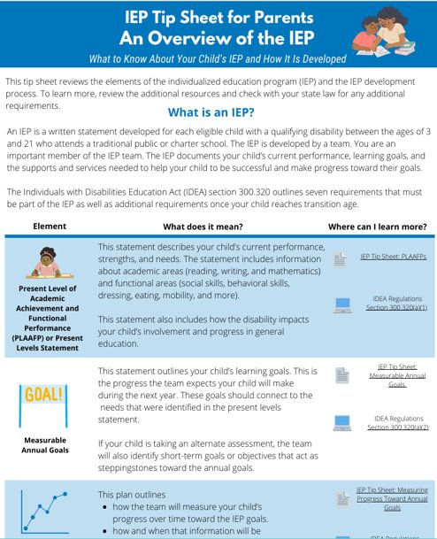


When advocacy is difficult
Know Your Rights
Request an IEP Team Meeting at any time IEP goals must be closely monitored by the school If your child is not making adequate progress toward his or her goals, the IEP Team must revise the IEP to address your child's needs.
Notes:
Remember, you and your child have many rights. You have a right to be fully informed about your child’s progress and to request an IEP Team meeting at any time.
If your child has an IEP, schools must closely monitor your child’s progress in meeting challenging literacy IEP goals. If your child is not making expected progress toward his or her annual IEP goals, the IEP Team must revise, as appropriate, the IEP to address your child’s lack of progress.
Ongoing progress monitoring gives you and the school an opportunity to identify and fix barriers to learning and ensure that literacy goals are meaningful and measurable. Together, you can determine if and how your child’s services and supports need to change. Working together can lead to better literacy services and supports for your child.
Distribute resource - IEP Tip Sheet for Parents – An Overview of the IEP. Give participants 2-3 minute to review the tip sheet.
Link: IEP Tipsheet for Parents, An Overview of the IEP
https://promotingprogress.org/sites/default/files/2022-10/IEP-overview-parent.pdf
After looking over the IEP Tip Sheet, how do you know whether your child is making meaningful progress toward their literacy IEP goals, and what information do you need from the school to feel confident in that understanding? Also, if progress monitoring shows your child isn’t meeting their goals, what changes to instruction, services, or supports might you want the IEP Team to consider?
Give participants 1 – 2 minutes to share out responses.

Slide 61
The School and You are Not on the Same Page…Now What?
When advocacy is difficult
If you’re having trouble understanding school information or processes, or you feel your questions aren’t being answered, it may help to:
Seek support and guidance from outside the school. You can contact:
  Your state’s Parent Training and Information Center (PTI),
  A Community Parent Resource Center (CPRC), or a
  Protection and Advocacy (P&A) organization
Consult a professional who can offer advice and help you navigate next steps
Consider bringing a trusted friend to meetings to take notes and help you represent your child’s needs
Notes:
If you’re having trouble understanding school information or processes, or you feel your questions aren’t being answered, it may help to seek support from outside the school. You can contact your state’s Parent Training and Information Center (PTI), a Community Parent Resource Center (CPRC), or a Protection and Advocacy (P&A) organization for guidance. A professional can offer advice and help you navigate next steps. You might also bring a trusted friend to meetings to take notes and help you represent your child’s needs.

Slide 62
Summary
When advocacy is difficult
Advocating for your child’s literacy needs can be empowering but also challenging, especially when disagreements arise. Staying focused on shared goals helps families and schools resolve issues early.
Families have important rights, including being fully informed about progress and requesting an IEP meeting at any time. If a child isn’t making expected progress on literacy goals, the IEP team must adjust the plan.
Ongoing progress monitoring helps families and schools identify barriers, revise supports, and ensure literacy goals are meaningful.
If school processes feel unclear or your questions aren’t being answered, you can seek help from your state’s PTI, a CPRC, a P&A organization, or bring a trusted friend to meetings for support.
Notes:
Advocating for your child’s literacy needs can feel both rewarding and challenging. Families and schools may not always agree, but you share the same goal—supporting your child’s growth as a reader.
You have important rights, including being fully informed about your child’s progress and requesting an IEP meeting at any time. If your child isn’t making expected progress on literacy goals, the IEP Team must adjust the plan. Ongoing progress monitoring helps everyone identify barriers and make sure supports are effective.
If school information feels unclear or your questions aren’t being answered, you can reach out to your state’s Parent Training and Information Center, a Community Parent Resource Center, or a Protection and Advocacy organization. You can also bring a trusted friend to meetings for support.
You don’t have to advocate alone—there are people and resources ready to help you and your child
Note: This completes Session 3: How to Advocate for Your Child’s Literacy Needs (Part 3) and What to Do When Advocacy is Difficult.

Slide 63

Check for Understanding
What can I do to find out more about advocating for my child's literacy needs?
Meet Tony. His fifth-grade son is struggling with reading. Think about what you’ve learned about advocating for your child's literacy needs to help Tony. He wants to ensure that his son's school is using evidence-based literacy practices and that supports and services are best matched to his son's literacy needs. What can Tony do to advocate for his son?
Review: Learn about the school's system of support for literacy and learn where his child fits within that system. Record: Keep a notebook Request: Talk with other parents and families who have similar experiences Refer: Ask the school about opportunities to provide input on literacy approaches and practices and help make decisions All of the above
Notes:
Think about what you’ve learned about advocating for your child’s literacy needs to help Tony. Tony wants to ensure that his child’s school is using evidence-based literacy practices and that supports and services are best matched to her child’s literacy needs. What can Tony say or do to find out more? Choose the answer that best fits. Review: Learn about the school’s system of support for literacy and learn where her child fits within that system; Record: Keep a notebook and folder of information and communications about his child’s reading and writing; Request: Talk with other parents and families who have similar experiences; Refer: Ask the school about opportunities to provide input on literacy approaches and practices and help make decisions; or all of the above. Click submit after choosing your answer.
Note: Provide time for participants to review and discuss the scenario. Then, ask participants to discuss the correct answer with their tablemates. Poll participants on the answer
Click for animation to see if correct answer (all of the above).

Slide 64
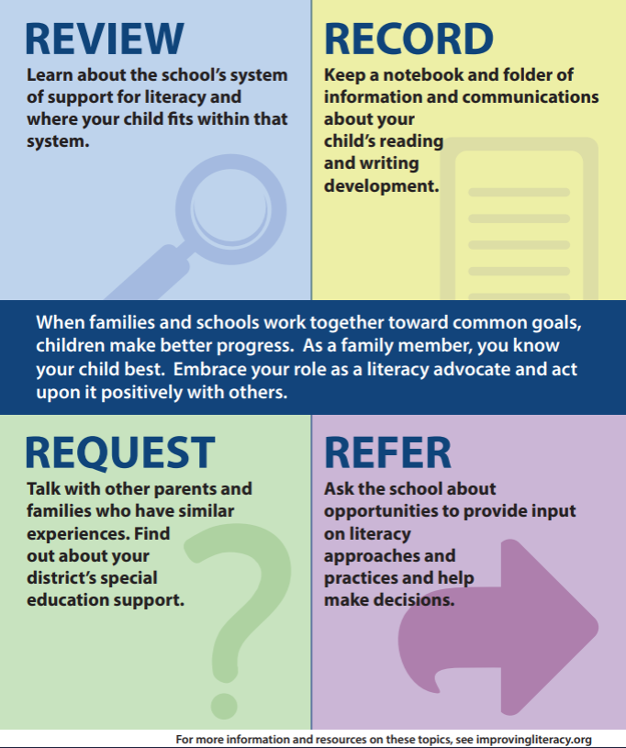

Thank You
https://improvingliteracy.org/resource/advocating-for-my-child-s-literacy-needs/
Notes:
The National Center on Improving Literacy’s mission is to increase access to, and use of, evidence-based approaches to screen, identify, and teach pre-K to grade 12 students with literacy-related disabilities, including dyslexia. This tutorial expands upon information in NCIL’s Advocating for My Child’s Literacy Needs literacy brief and infographic.

Slide 65

How can I learn more?
National Center on Improving Literacy
https://improvingliteracy.org
The research reported here is funded by a grant to National Center on Improving Literacy from the Office of Elementary and Secondary Education, in partnership with the Office of Special Education Programs (Award #: S283D160005). The opinions or policies expressed are those of the authors and do not represent views of OESE, OSEP, or the U.S. Department of Education. You should not assume endorsement by the Federal government. Copyright © 2021 National Center on Improving Literacy.
Notes:
Want to learn more? Search the NCIL Resource Repository for literacy resources matched to information in this tutorial. Sort by audience, topic area, and resource type to find resources you’re looking for. Click the NCIL title to take you there.

Slide 66

Questions ?
Notes:
Slide to use for soliciting questions from participants and discussing answers on session content and related information at the end of the workshop. Review the big ideas from all three sessions and clarify as needed.

Slide 67
Thank You!
[insert contact information]
Notes:
Slide for inserting contact information so participants can communicate with you after the workshop.

