Slide 1
Element V. Mutual Support Involving Families and the School
Overview

Slide 2
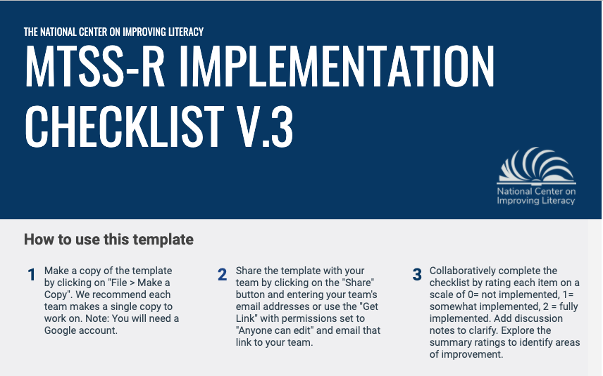
Element V. Mutual Support Involving Families and the School
Children learn to read in and out of school. Families can play a major role in helping their children learn to read through activities they engage in outside of school as well as inside of school. The key to successful family–school partnerships is communication that is equal and bi-directional, where families and schools share important information about reading and the family’s child. Effective co-communication includes opportunities for families to learn about the school's reading program, their child's participation in that program, and how family members can support the reading development of their child.
Section 1: General

Slide 3
Families and schools can partner for children’s literacy success by:
talking and interacting often
discussing literacy instruction and intervention
sharing literacy resources
addressing concerns together
https://improvingliteracy.org/kit/families-and-schools-partnering-childrens-literacy-success

Slide 4
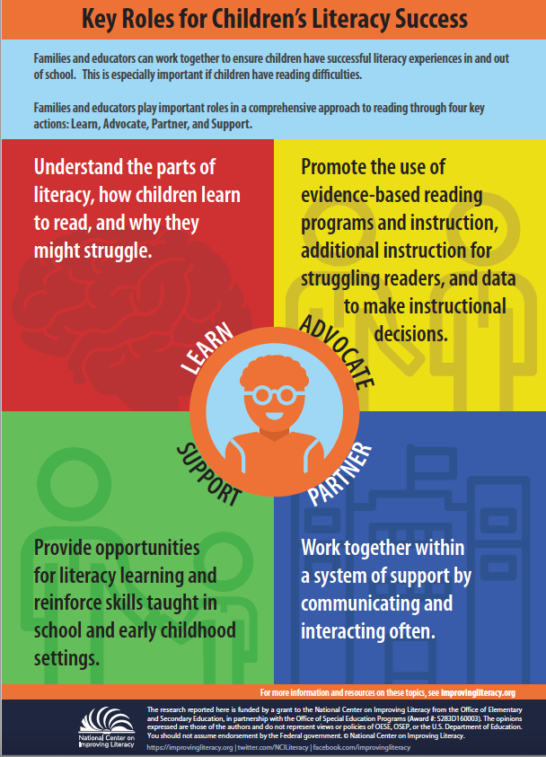
Families and educators play important roles in a comprehensive approach to reading through our key actions:
Learn
Advocate
Partner
Support
Notes:
Learn: understand the parts of literacy, how children learn to read and why they might struggle.
Advocate: Promote the use of evidence-based reading programs and instruction, additional instruction for struggling readers, and data to make instructional decisions.
Partner: Work together within a system of support by communicating and interacting often.
Support: Provide opportunities for literacy learning and reinforce skills taught in school and early childhood settings.

Slide 5
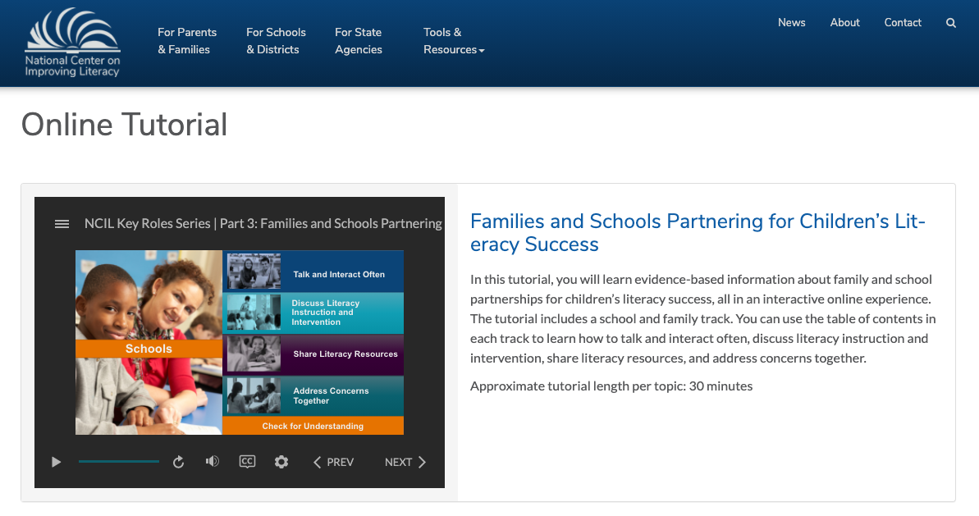
Toolkit: Families and Schools Partnering for Children’s Literacy Success
This toolkit includes:
An Online Tutorial
Research Briefs & Infographics
Tools & Resources
https://improvingliteracy.org/kit/families-and-schools-partnering-childrens-literacy-success
Notes:
You will learn:
Tips for starting or enhancing discussions about literacy instruction and intervention
Ways to increase your joint understanding of evidence-based literacy practices
Strategies for addressing concerns about children’s literacy development together

Slide 6
Element V. Mutual Support Involving Families and the School
Evaluate and Score

Slide 7
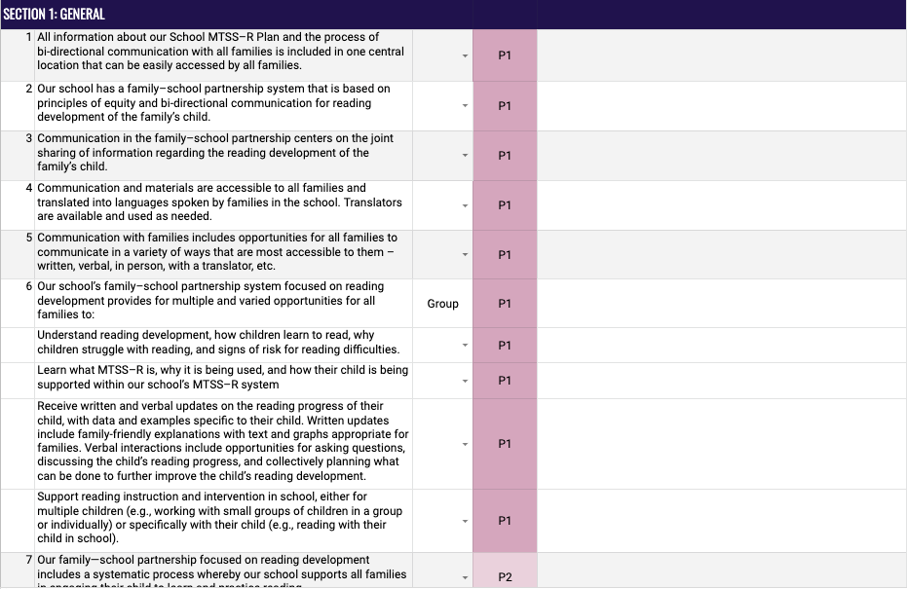
Evaluate and Score: Mutual Support Involving Families and the School
Rating Scale
Element Items
Phase Indicator
Discussion Notes

Slide 8

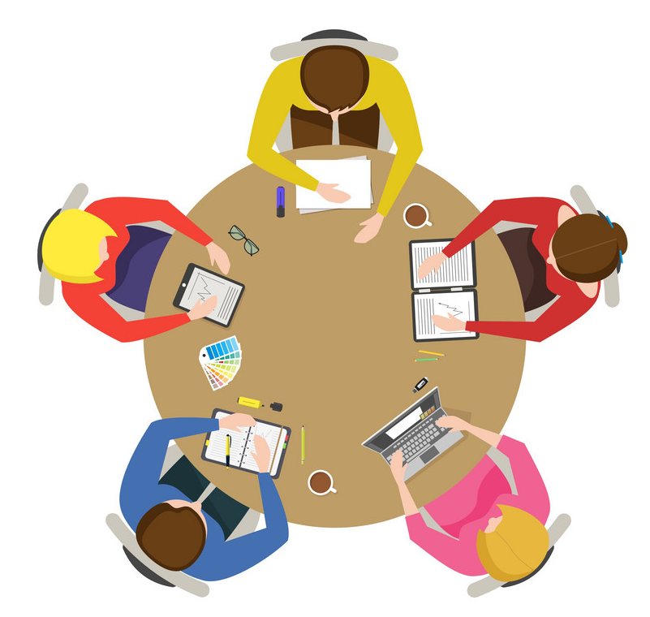
Element V. Mutual Support Involving Families and the School
Pause this presentation and work with your team and score each section of this Element.
Section 1: General
Notes:
.

