Slide 1
MTSS-R Leadership Team:
Prioritization
The research reported here is funded by a grant to the National Center on Improving Literacy from the Office of Elementary and Secondary Education, in partnership with the Office of Special Education Programs (Award #: H283D210004). The opinions or policies expressed are those of the authors and do not represent views of OESE, OSEP, or the U.S. Department of Education. You should not assume endorsement by the Federal government. Copyright © National Center on Improving Literacy.
Notes:
Introduce yourself
If the group is small, give participants a chance to share about themselves (name, experience, school, etc.) If the group is large, ask them to put hands up if teach K…teach 1st…teach 2nd… Use this information to gauge who you are presenting to and where to address focus for presentation.

Slide 2
Agenda
Outline Continuous Improvement Model
Evaluate student data and MTSS-R Checklist data
Prioritize data to identify greatest area of focus

Slide 3
Materials
Completed MTSS-R Checklist
Beginning of Year (BOY) Universal Screening Data

Slide 4
Engage in a Continuous Improvement Model to Solidify MTSS-R Elements
Notes:
This self-evaluation—or reading system audit—will help the school determine what their major priorities should be in building or solidifying their MTSS–R system.

Slide 5
Evaluate
1. Evaluate
Collect, review and analyze implementation data and student performance data.
Collect, review and summarize:
Student data (i.e., universal screening data)
MTSS-R Checklist data
Implementation data (middle and end of year)
Notes:
Today we’ll focus on student data and MTSS-R checklist data– we’ll look at implementation data at MOY and EOY when we look back to action plan.

Slide 6
Prioritize
2. Prioritize
Use your analysis of data to identify greatest area(s) of focus to support instruction and intervention.
Examine data to gauge the health of your system and determine the overall level of priority for action planning.
Examine:
Student data (i.e., universal screening data)
MTSS-R Checklist data
Implementation data (middle and end of year)

Slide 7
Prioritize: Review Student Universal Screening Results

Slide 8
Review Student Data
How do you decide what is a priority?
Use universal screening data to determine the percentage of students at each of the three risk indicators – Low Risk, Some Risk and At Risk – to determine the level of priority the school should assign to improving reading instruction and intervention.
Beginning of Year Benchmark Assessment (Universal Screening) | Beginning of Year Benchmark Assessment (Universal Screening)
Health Indicator | % of Students at: Low Risk | % of Students at: Some Risk | % of Students at: At Risk
 | Core Instruction | Supplemental Intervention | Intensive Intervention
Low Priority | > 80% | < 20% | < 10%
Moderate Priority | 60–80% | 20–50% | 10–25%
High Priority | < 60% | > 50% | > 25%
Notes:
Describe the table that will be used to determine the level of priority for goal setting.

Slide 9
Prioritize at the school level
Example:
Table:
School (example):
Beginning of Year Benchmark Assessment (Universal Screening) | Beginning of Year Benchmark Assessment (Universal Screening)
Health Indicator | % of Students at: Low Risk | % of Students at: Some Risk | % of Students at: At Risk
 | Core | Supplemental Intervention | Intensive Intervention
Low Priority | > 80% | < 20% | < 10%
Moderate Priority | 60–80% | 20–50% | 10–25%
High Priority | < 60% | > 50% | > 25%
Beginning of Year Benchmark Assessment (Universal Screening)
 | % of Students at: Low Risk Tier I Core Instruction | % of Students at: Some Risk Tier II Supplemental Intervention | % of Students at: At Risk Tier III Intensive Intervention
School | 50% | 22% | 28%
Grade 1 | 49% | 29% | 23%
Grade 2 | 51% | 15% | 33%
High Priority
Moderate Priority
High Priority
Notes:
Use the table on the left to determine the priority level for the need to take action.
Walk through the priority levels for the school in this example.

Slide 10


Tier I is the Highest Priority for Action Planning!
School (example):
Look at the order of priority for the Tiers of instruction:
Core Instruction (Tier I)
Supplemental Intervention (Tier II)
Intensive Intervention (Tier III)
Beginning of Year Benchmark Assessment (Universal Screening)
 | % of Students at: Low Risk Core Instruction | % of Students at: Some Risk Supplemental Intervention | % of Students at: At Risk Intensive Intervention
School | 50% | 22% | 28%
Grade 1 | 49% | 29% | 23%
Grade 2 | 51% | 15% | 33%
Highest
High Priority
Moderate Priority
High Priority
Notes:
In this example, the health indicators have determined that the Core instruction system and the Intensive intervention system are both in the “high priority” category. Prioritize Tier I, or Core, instruction first.
All active participants in this instruction!

Slide 11


Team Discussion: Review Student Data and Prioritize Tier
Beginning of Year Benchmark Assessment (Universal Screening) | Beginning of Year Benchmark Assessment (Universal Screening)
Health Indicator | % of Students at: Low Risk (Core) | % of Students at: Some Risk (Supplemental Intervention) | % of Students at: At Risk (Intensive Intervention)
Low Priority | > 80% | < 20% | < 10%
Moderate Priority | 60–80% | 20–50% | 10–25%
High Priority | < 60% | > 50% | > 25%
Fill out the BOY Universal Screening Data table with percentages for each area.
Using the Health Indicator table, determine the priority level for the need to take action.
According to the student data, mark the Tier of instruction to prioritize
  Tier I: Core Instruction
  Tier II: Supplemental Intervention
  Tier III: Intensive Intervention
Beginning of Year Benchmark Assessment (Universal Screening)
 | % of Students at: Low Risk Core Instruction | % of Students at: Some Risk Supplemental Intervention | % of Students at: At Risk Intensive Intervention
School
Grade 1
Grade 2
Notes:
At your Early Fall MTSS-R Team meeting, you will use a prioritization worksheet to prioritize items for action planning.

Slide 12
Prioritize: Review MTSS-R Checklist Results
Instruction and Intervention (Element I)
Notes:
Start with Instruction and Intervention bc that has the most direct impact on student learning

Slide 13
Team Discussion: Are Your Student Data Results Aligned with Your MTSS-R Checklist Results?
For example, if your student data indicates that Core instruction is a priority (e.g., only 50% of the students in your school are at the Low-Risk indicator), does your MTSS-R Checklist scoring also indicate that your Tier I systems are a priority?
If not, review the MTSS-R Checklist, discuss those items, and adjust your scoring where needed.

Slide 14



Review MTSS-R Checklist Results:
How do you decide what is a priority?
Phase 1 | Phase 2 | Phase 3
Readiness Activities | Initial Implementation | Advanced Implementation
Notes:
We have prioritized the Checklist element items to assist teams in planning goals and actions.
The items are prioritized based on phases of implementation: Readiness, Initial Implementation and Advanced Implementation.

Slide 15

Phase 1: Readiness
Getting Ready for High-Quality Implementation
Goals:
Establish leadership team knowledge of MTSS-R and key MTSS-R elements
Establish school staff knowledge of the science of reading and evidence-based instructional strategies
Establish effective, data-driven MTSS-R Leadership and PLC teams
Establish school MTSS-R System Infrastructure for high quality implementation
Notes:
Review goals of each phase.

Slide 16

Phase 2: Initial Implementation
High-Quality Implementation of All MTSS-R Elements
Goals:
Establish high quality school-based implementation of key MTSS-R elements
Establish high quality reading staff implementation of the science of reading and evidence-based instructional strategies
Expand on MTSS-R Leadership and PLC use of data to inform instructional adjustments
Notes:
Review goals.

Slide 17

Phase 3: Advanced Implementation
Refining High-Quality Implementation of All MTSS-R Elements
Goals:
Data-driven refinement high quality school-based implementation of key MTSS-R elements
Data-driven refinement high quality reading staff implementation of the science of reading and evidence-based instructional strategies
Data-driven refinement MTSS-R Leadership and PLC teams’ use of data to inform instructional adjustments
Notes:
Review goals

Slide 18

Misconception Alert
Phase 1 | Phase 2 | Phase 3
Readiness | Initial Implementation | Advanced Implementation
You will be working on some items from Phase 2 and Phase 3 at the same time you are working to fully establish Phase 1.
Notes:
Of course, schools will be a different levels of what they have in place across the phases. This slide acknowledges that they may have Phase 2 and Phase 3 items in place, or may be working on some of those items, but the highest priority will be on Phase 1: Readiness first, and then moving through the phases.

Slide 19
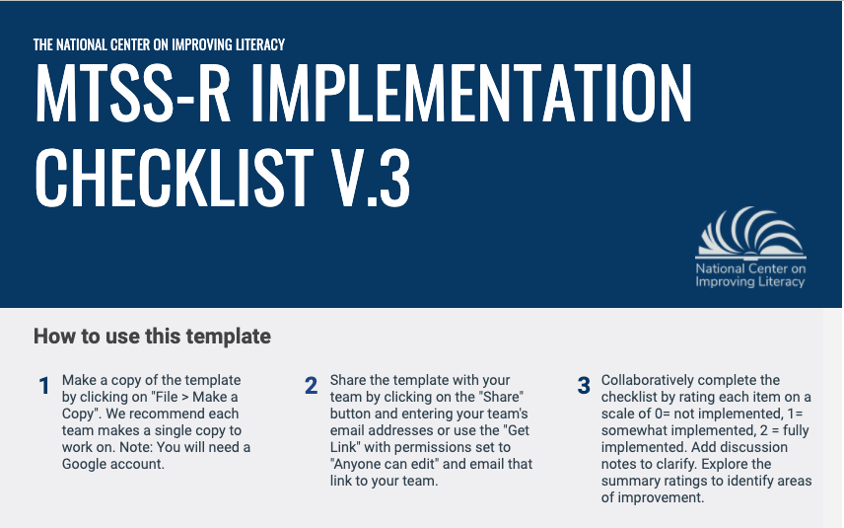
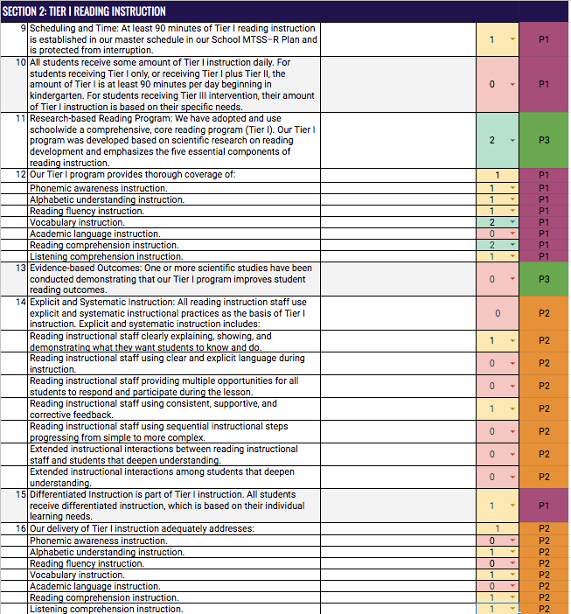
Team Discussion:
Review Checklist and Identify Priority Items
Review Element I. Instruction and Intervention Checklist Items for Your Priority Tier
Highlight areas of focus beginning with Phase 1 items
Phase 1 | Phase 2 | Phase 3
Readiness | Initial Implementation | Advanced Implementation
Notes:
Once users have scored the MTSS-R items, the Google form will allow them to review the items by phases of implementation.

