Slide 1
MTSS-R Leadership Team:
Action Planning
The research reported here is funded by a grant to the National Center on Improving Literacy from the Office of Elementary and Secondary Education, in partnership with the Office of Special Education Programs (Award #: H283D210004). The opinions or policies expressed are those of the authors and do not represent views of OESE, OSEP, or the U.S. Department of Education. You should not assume endorsement by the Federal government. Copyright © National Center on Improving Literacy.
Notes:
Introduce yourself with a brief history of your background and experience with ECRI.
If the group is small, give participants a chance to share about themselves (name, experience, school, etc.) If the group is large, ask them to put hands up if teach K…teach 1st…teach 2nd… Use this information to gauge who you are presenting to and where to address focus for presentation.

Slide 2
Agenda
Create an action plan for prioritized area of focus
Discuss implementation plan
Notes:
Talked about this at day 3 and 4 trainings—may look familiar, may have forgotten about this—either way is ok!

Slide 3
Materials
Completed MTSS-R Checklist
Action Plan Format

Slide 4
Plan

Slide 5
Plan – Create an action plan for the prioritized areas of focus
2. Plan
Create an action plan for the prioritized areas of focus
Determine the Instruction and Intervention goal for your priority Tier of instruction
Describe actions necessary to support this goal:
Notes:
The focus of the school GOAL will always be on instruction and intervention!

Slide 6
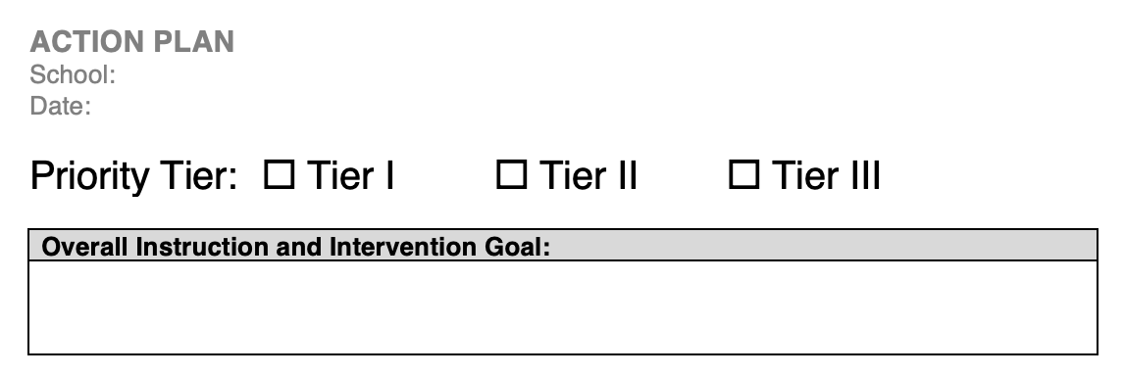

Action Planning
Determine an Instruction and Intervention goal for your priority tier of instruction
Example:
All reading instruction staff will use explicit and systematic instructional practices as the basis of Tier I instruction.
Notes:
Walk through the items that should be on the Action Plan.
Goal should be pulled from Phase 1 action on checklist—across tiers.

Slide 7


Team Discussion: Determine an overall instruction and intervention goal
Notes:
Walk through the items that should be on the Action Plan

Slide 8
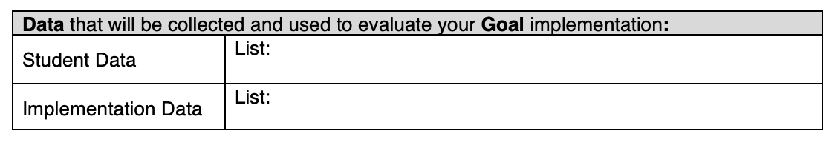
Action Planning Continued
Action Planning
Determine data that will be collected and used to evaluate your Goal implementation:
Example:
MOY and EOY Universal Screening Data
Core Program Implementation Data
Notes:
Walk through the items that should be on the Action Plan
This is how you evaluate progress toward your goal. If addressing needs in tier 1, MOY and EOY data should have impact on student data.
Implementation data– if we expect instruction to be delivered explicitly and systematically, need to be sure that instruction is being delivered this way.

Slide 9
Team Discussion: Determine data that will be collected and used to evaluate your Goal implementation
Notes:
Walk through the items that should be on the Action Plan

Slide 10
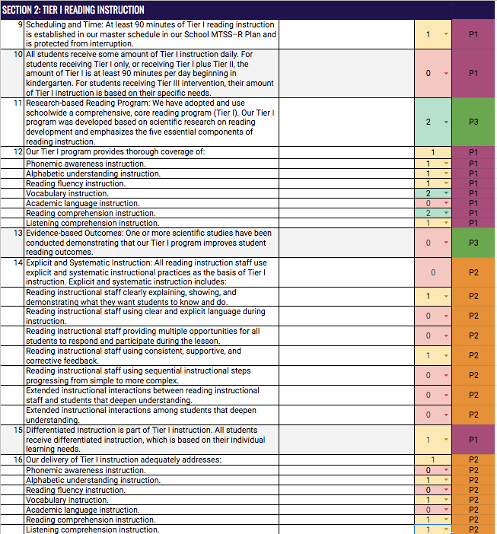
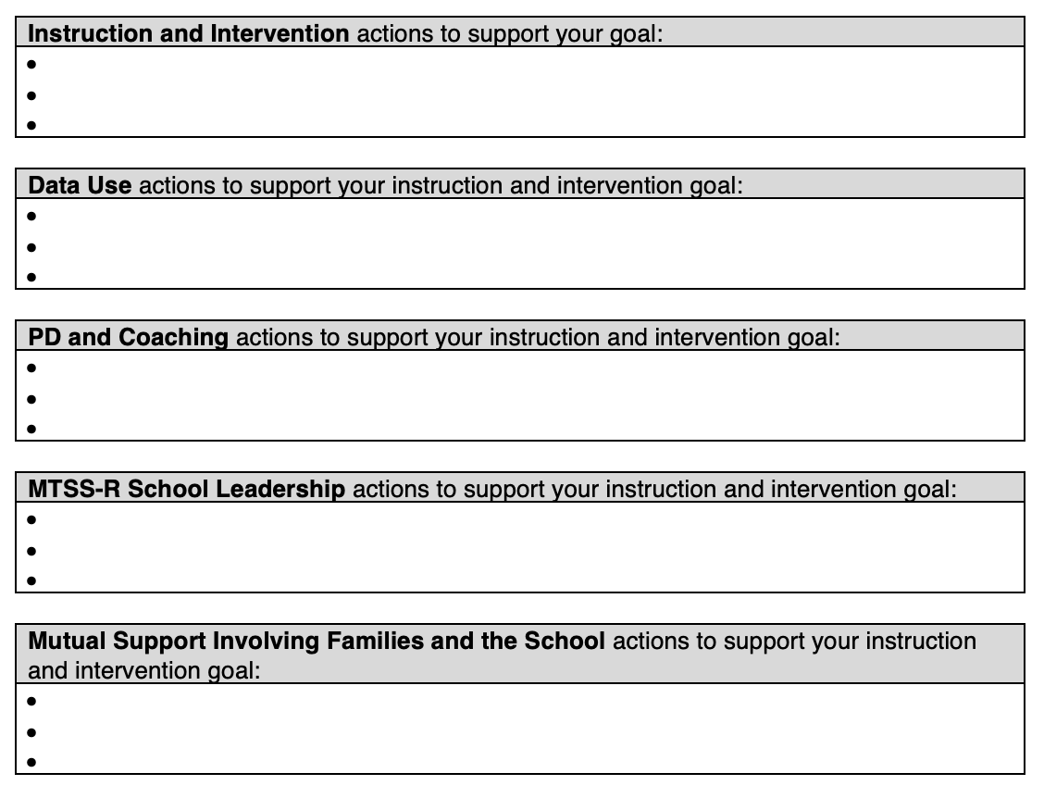
Team Discussion: Complete the Action Planning
Review Checklist items from each of the elements to identify actions that will support the instruction and intervention goal
Notes:
Walk through the items that should be on the Action Plan
Things I haven’t done yet that would support delivering explicit and systematic instruction.
Think about what you want to prioritize– focus on P1 and some pieces of P2 you can loop in.
Think about how this links back to supporting larger instruction/implementation goal.

