Slide 1
Element III. Professional Development and Coaching
Overview

Slide 2
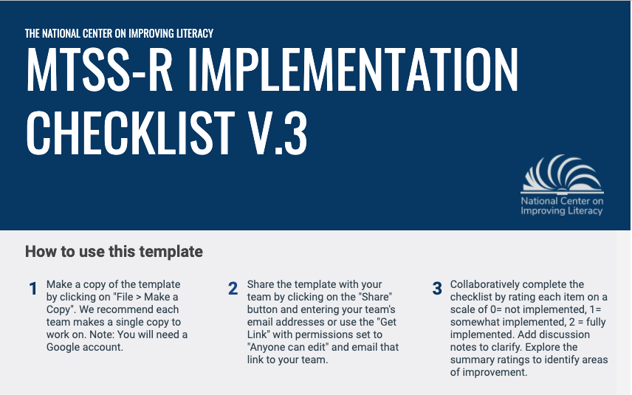
Element III. PD and Coaching
The school’s professional development (PD) and coaching system is the primary way high-quality implementation and continuous improvement of MTSS-R and its major elements is achieved. Before MTSS-R implementation begins all staff should receive PD and coaching in high-quality implementation. After MTSS-R implementation begins all staff should receive ongoing PD and coaching as needed to continuously improve MTSS-R implementation.
Section 1: General Considerations
Section 2: School-Based Workshops
Section 3: Job-Embedded Technical Assistance
Section 4: Classroom-Based Instructional Coaching

Slide 3

Types of PD and Coaching
School-Based Workshops
Job-Embedded Technical Assistance
Classroom-Based Instructional Coaching

Slide 4
School-Based Workshops
Purpose: Ensure all school personnel (including leadership) develop the working knowledge necessary to drive improvement efforts in the MTSS-R practices.
PD workshops should focus on building a solid knowledge base in:
the science of reading
MTSS-R implementation
high-quality implementation of reading instruction and intervention in Tiers I, II, and III
Training is provided to all relevant staff prior to implementation

Slide 5
Job-Embedded Technical Assistance
Purpose: On an ongoing basis, support reading instructional staff to plan and deliver high-quality reading instruction, incorporating student and implementation data.
Job-embedded TA includes:
Professional Learning Communities (Grade-Level Meetings)
Practice-Based Learning Opportunities
Out-of-Classroom Practice

Slide 6
Classroom-Based Instructional Coaching
Purpose: On an ongoing basis, train and support reading instructional staff in classroom settings to implement high quality reading instruction and support students to become independent, successful readers.
Classroom-based instructional coaching includes:
Implementation Data Collection
Model Lessons
Side-by-Side Coaching
Performance Feedback

Slide 7
Ensure professional development and coaching is data-driven
When planning for PD and coaching supports, examine available implementation and student data
Individual teacher level data - informed by fidelity of implementation data
Grade level data - student performance and/or teacher fidelity of implementation data
Schoolwide data - student performance and/or teacher fidelity of implementation data
Gaumer Erikson, A.S., Noonan, P.M., Brussow, J. & Supon Carter, K. (2016)
Notes:
WHAT is the Key principal action: *Ensure professional development is informed from data
Data are at the foundation of making instructional decisions and that is true for making decisions regarding learning and training for teachers/staff.
School leaders have some responsibilities for staff learning as with student learning.
The leader's role in professional learning for teachers include: determining, implementing, monitoring and supporting PD in a school.

Slide 8
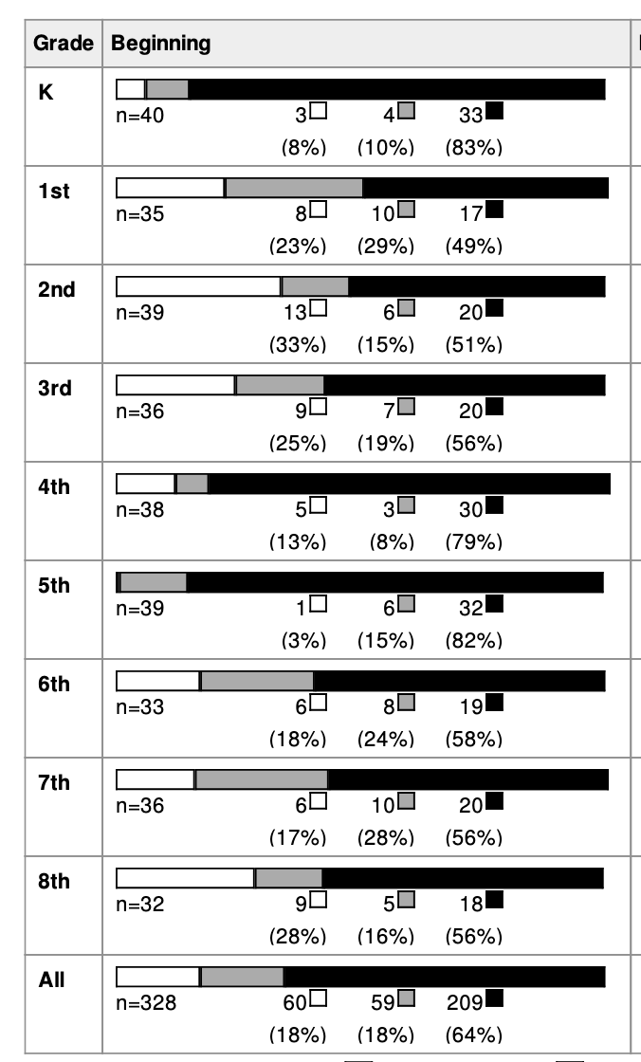
EXAMPLE: Review School and Grade-Level Student Data
School Goal:
80% of students performing in the core support range.
Black = core support, or minimal risk
Gray = strategic support, or some risk
White = intensive support, or at risk
Notes:
For purposes of our example, we are only showing grades K-3 from this school example. But these processes can be used at all grade levels.

Slide 9
What can these data tell me at the school level?
Review the data.
How many students at our school…
Scored in the intensive support/at risk range (white)? 60 (18%)
Scored in the strategic support/some risk range (gray)? 59 (18%)
Scored in the core support/minimal risk range (black)? 209 (64%)
One possible takeaway: Only 64% of the students in the school scored in the core support range, so we’ve identified a need for support.
Notes:
The core support plan is not working well enough to support at least 80% of the students (only 64% have scored in the core support range).

Slide 10
What can these data tell me at the grade level?
Review the data.
Is the need for support specific to certain grades (look at black shading)?
Which grades have met the goal of 80% of students performing in the core support range?
Grade K: 83%
Which grades have not met the goal of 80% of students performing in the core support range?
Grade 1: 49%
Grade 2: 51%
Grade 3: 56%
One possible takeaway: We are most concerned about grades 1, 2, and 3.

Slide 11
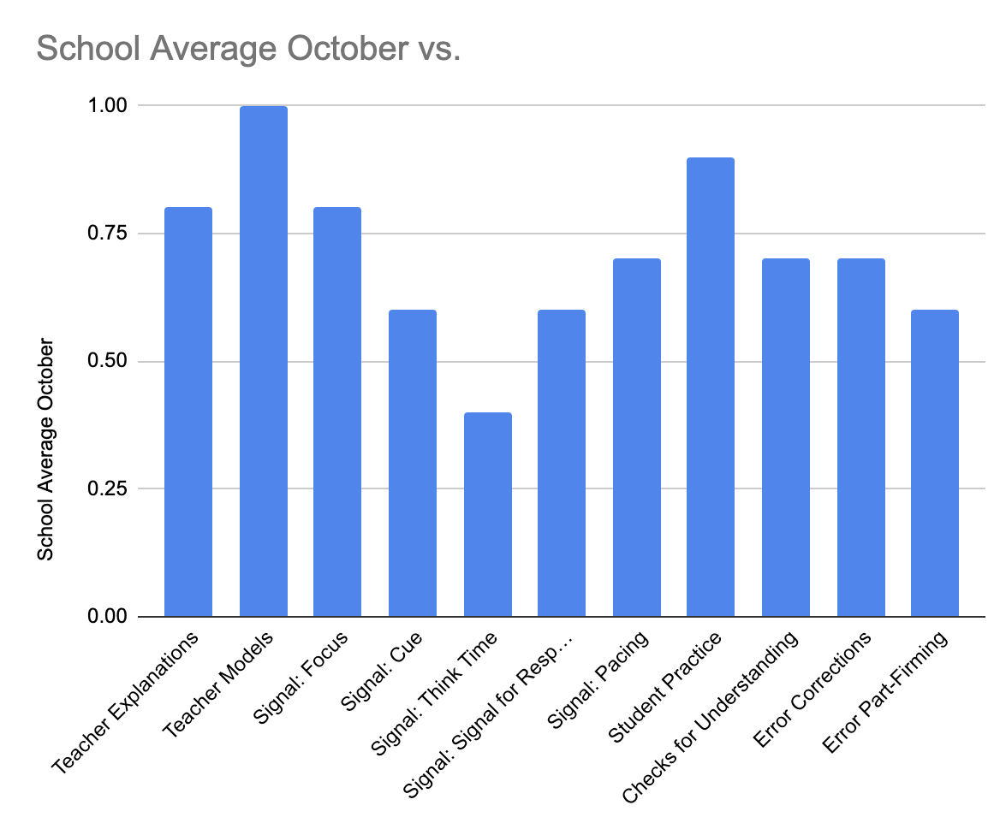
Implementation Data: What can we learn?

Slide 12
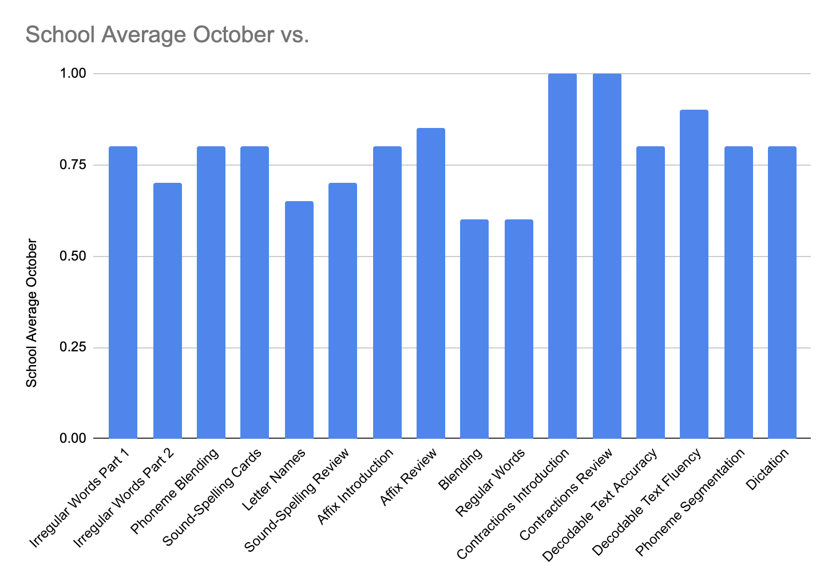
Implementation Data: What can we learn?

Slide 13
Determine Additional PD and Coaching
School-Based Workshops
Job-Embedded Technical Assistance
Classroom-Based Instructional Coaching
Topic: Blending Routines and Clear Signaling Procedures
Topic: Blending Routines and Clear Signaling Procedures
Topic: Blending Routines and Clear Signaling Procedures
Participants: All Staff
Participants: All Staff Practice during PLCs
Participants: All Staff
Timeline: December
Timeline: January and February
Timeline: December through February
Notes:
Change table to annotate

Slide 14
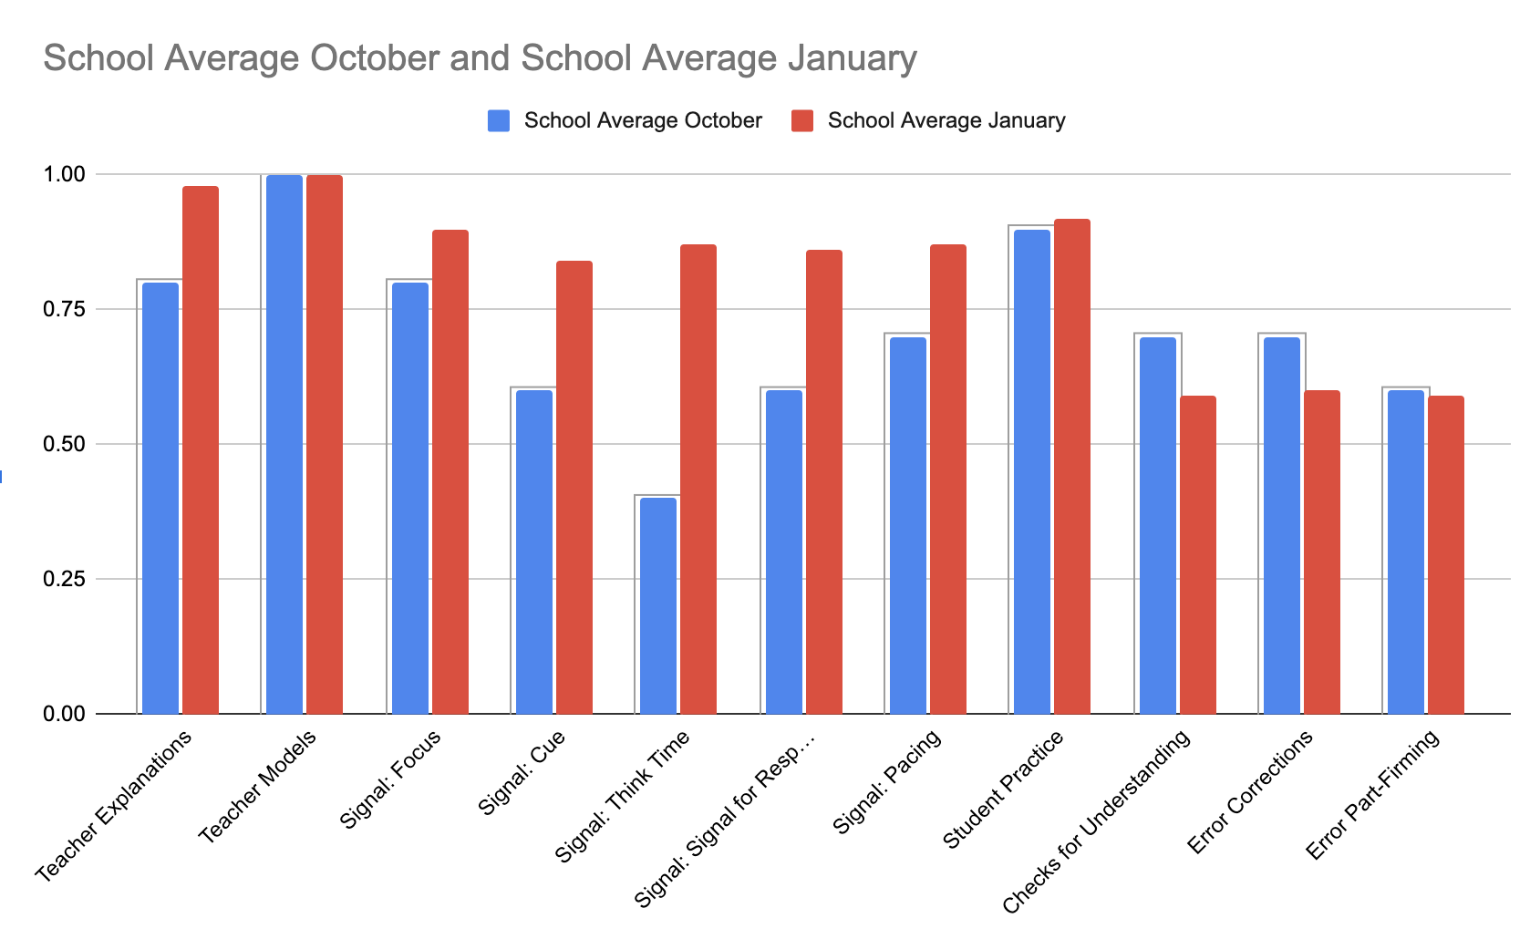
How successful were we?

Slide 15
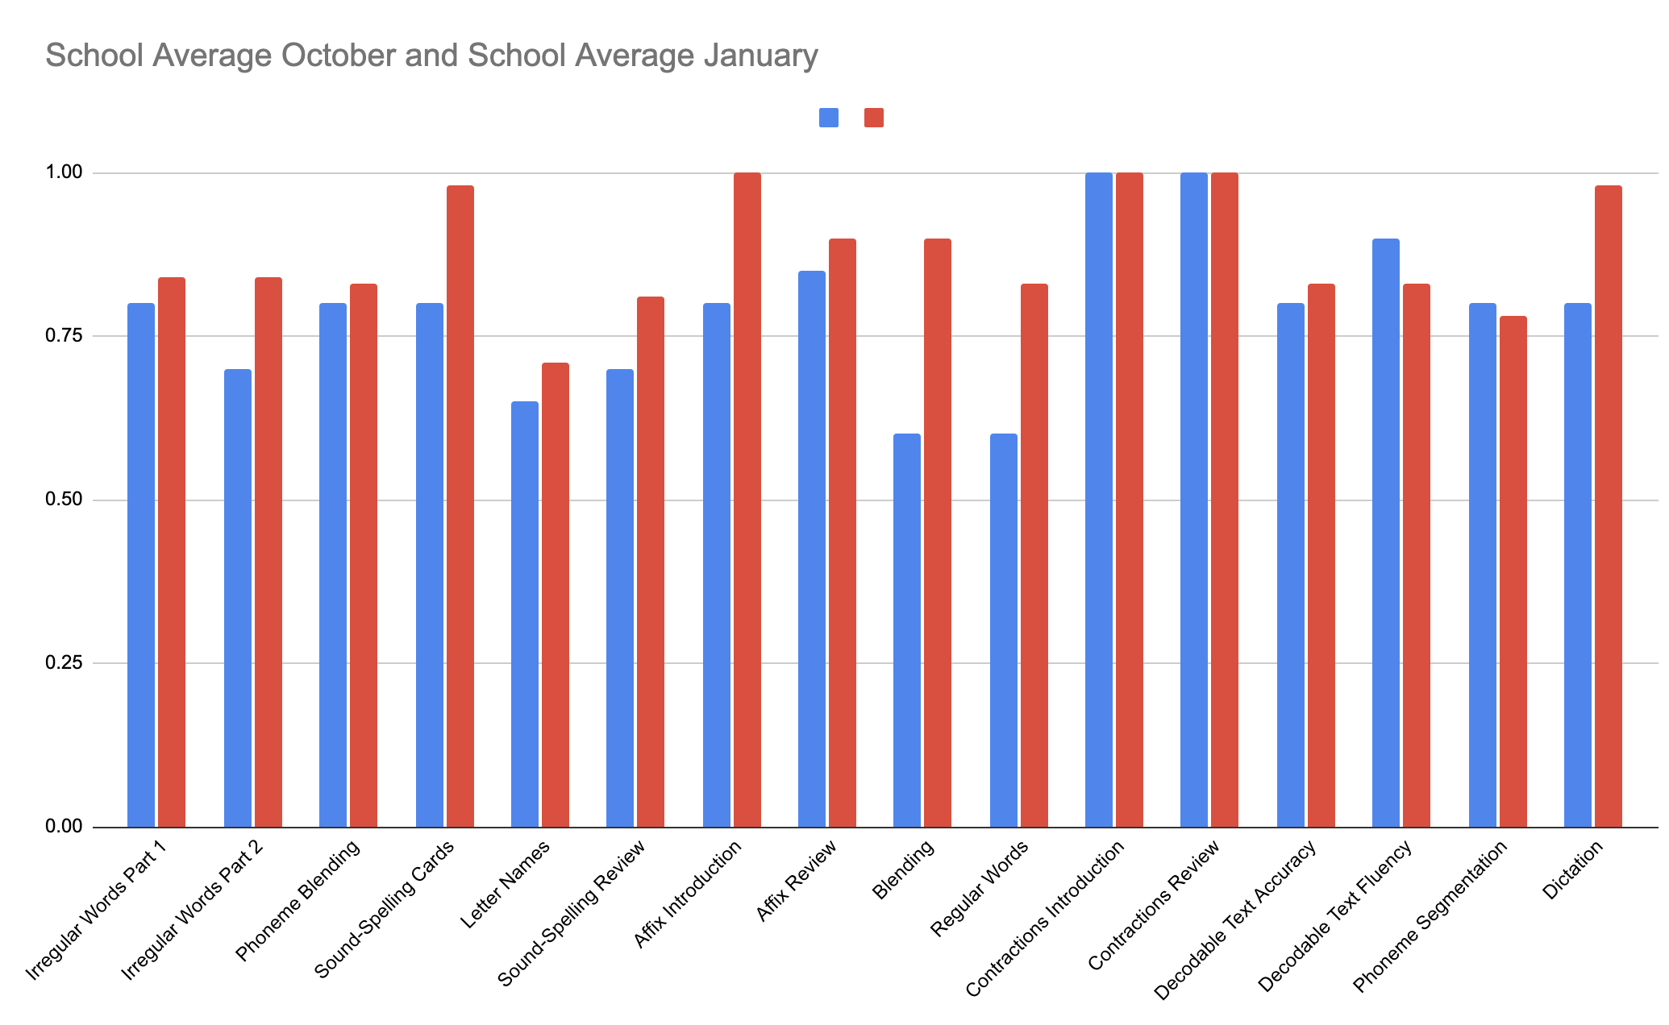
How successful were we? What are our next steps?

Slide 16
Element III. Professional Development and Coaching
Evaluate and Score

Slide 17
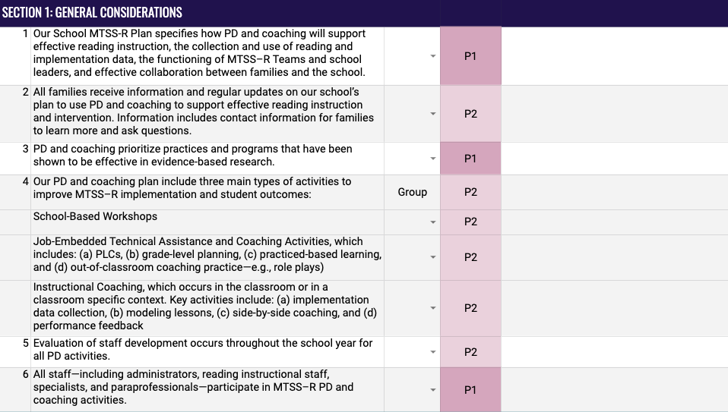
Evaluate and Score: PD and Coaching
Rating Scale
Element Items
Phase Indicator
Discussion Notes

Slide 18


Element III. PD and Coaching
Work with your team and score each section of this Element.
Section 1: General Considerations
Section 2: School-Based Workshops
Section 3: Job-Embedded Technical Assistance
Section 4: Classroom-Based Instructional Coaching
Notes:
.

