Slide 1

Cultivating Leaders to Grow Young Readers
Multi-tiered System of Support in Reading (MTSS-R): Evaluation and Planning
Dr. Scott Baker
Carol Dissen
The research reported here is funded by awards to the National Center on Improving Literacy from the Office of Elementary and Secondary Education, in partnership with the Office of Special Education Programs (Award #: S283D160003). The opinions expressed are those of the subject and do not represent views of OESE, OSEP, or the U.S. Department of Education. © National Center on Improving Literacy.
https://improvingliteracy.org | twitter.com/NCILiteracy | facebook.com/improvingliteracy
Notes:
Introductions (both)

Slide 2




Teaching EACH and ALL, Implementation Matters, Balance Rigor and Relevance, Centralize, Translate, and Localize
Teaching EACH and ALL
Implementation Matters
Balance Rigor and Relevance
Centralize, Translate, and Localize
The research reported here is funded by awards to the National Center on Improving Literacy from the Office of Elementary and Secondary Education, in partnership with the Office of Special Education Programs (Award #: S283D160003). The opinions expressed are those of the subject and do not represent views of OESE, OSEP, or the U.S. Department of Education. © National Center on Improving Literacy.
https://improvingliteracy.org | twitter.com/NCILiteracy | facebook.com/improvingliteracy
Notes:
Awarded to: University of Oregon
Major partners: RMC Research Corporation and the Florida Center for Reading Research at Florida State University
Start date: October 1, 2016
Focus on children in early childhood education programs through high school
Jointly administered by OESE and OSEP

Slide 3
Session Objectives
Identify the basic elements of Multi-Tiered Systems of Support in Reading (MTSS-R)
Identify how MTSS-R can improve student reading outcomes
Identify the key steps needed to set up and use MTSS-R effectively
Evaluate current MTSS-R implementation
Use analysis of data to prioritize greatest area of focus to support instruction and intervention
Create an action plan for the prioritized areas of focus
Prepare for implementation

Slide 4
Multi-Tiered Systems of Support in Reading (MTSS-R)
Part 1: Overview

Slide 5
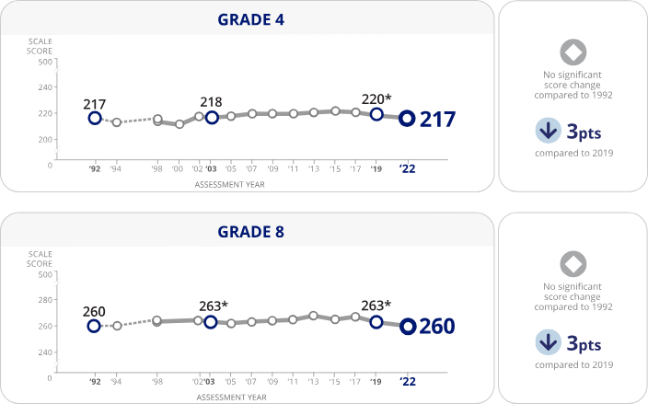

2022 National Assessment of Education Progress (NAEP) Reading
33% 4th graders scored at, or above, “proficient” level
11% of 4th graders with disabilities scored at or above proficient (2022)
Notes:
Teaching students to read successfully is one of the most important and challenging responsibilities of schools. Students who have difficulty reading not only are missing an important and enjoyable life skill, but they are far more likely than good readers to have difficulty with other school subjects, to drop out of school early, and to experience diminished education and employment opportunities throughout their lives.
Only 35% of 4th graders are reading at grade level, meaning they have the reading skills necessary to independently read and complete their school work. This troubling fact occurs despite many decades of national attention on the importance of reading.
Reading problems remain the single greatest challenge schools face.
Many schools are turning to a system called MTSS–R to provide better reading instruction to all students. MTSS–R stands for Multi-Tiered Systems of Support in Reading. The purpose of this tutorial is to cover the basics of MTSS–R. We explain what MTSS–R is, why it holds promise for improving student reading outcomes, and what the key steps are that schools need to follow to set up and use MTSS–R effectively.

Slide 6
What is a Multi-tiered System of Support in Reading?
(MTSS-R)

Slide 7


Multi-Tiered Systems of Support in Reading (MTSS-R) An Overview

Slide 8
What are the key elements for effective MTSS-R implementation?

Slide 9
Elements of a Comprehensive
Multi-tiered System of Support in Reading (MTSS-R)
Notes:
For a school to implement MTSS–R effectively, it must do five major things really well.
First, to keep students on track for reading success it must provide high-quality reading instruction. This is called core reading instruction or Tier I reading instruction.
The school must also provide effective reading interventions for students who are not on track. Tier II interventions supplement (are provided in addition to) Tier I instruction. Tier III interventions are highly intense interventions designed for students to meet their individual reading needs.
Second, schools must know which students are on track for reading success and which students are not on track so they can provide the reading instruction students need. Assessing students’ reading skills directly and frequently is the best way to do this.
Schools must also regularly monitor the progress of students who are not on track to make sure they are making good progress. Again, assessing students’ reading progress directly is the best way to do this.
Also, because MTSS–R is a data-driven process—meaning the school uses data to make ongoing improvements to the system—the school must also collect and use multiple sources of MTSS–R implementation data to continuously improve MTSS–R implementation and student outcomes.
Third, all reading teachers—those who provide Tier I instruction and those who provide Tier II and III interventions—must have ongoing support, training, professional development, and coaching to provide the best reading instruction possible. The school must allocate the resources, time, and personnel for adequate training and support. The school must also ensure that all other educators in the building—the principal, coaches, specialists, and paraprofessionals—get the training they need to effectively implement and support MTSS–R.
Fourth, high-quality implementation of MTSS–R is not possible nor sustainable without school leadership. Leadership includes having a number of MTSS–R teams that oversee all major aspects of implementation. And it includes the active engagement of key leaders in the building, including the principal, reading coaches, and lead grade level teachers.
Fifth, for all students—but especially for students who are not on track for reading success—families and schools must work together to ensure the reading needs of the student are met both inside and outside of school. This involves effective communication between the family and school, close collaboration, and regular monitoring. Families also play a vital role inside the school to support MTSS–R by serving on leadership teams and helping to support students directly.

Slide 10
How does a school implement MTSS-R?

Slide 11
Commit to Implementing Elements of a Comprehensive MTSS-R System
Notes:
A school should do two things before they take on the challenge of implementing a comprehensive MTSS–R system. First, the school should make a commitment to implement five major elements of MTSS–R: (1) Provide effective reading instruction and intervention to all students; (2) Use student reading data and MTSS–R implementation data to improve implementation and outcomes; (3) Provide adequate training, professional development, and coaching to continuously improve MTSS–R implementation and outcomes; (4) Partner with parents and families to support MTSS–R implementation outside and inside school settings, and (5) Ensure that school teams and leadership personnel are in place to establish and sustain high-quality MTSS–R implementation.

Slide 12
Engage in a Continuous Improvement Model to Build or Solidify MTSS-R Elements
Notes:
Second, the school should engage in a comprehensive self-evaluation of their current reading approach. This self-evaluation—or reading system audit—will help the school determine what their major priorities should be in building or solidifying their MTSS–R system.

Slide 13
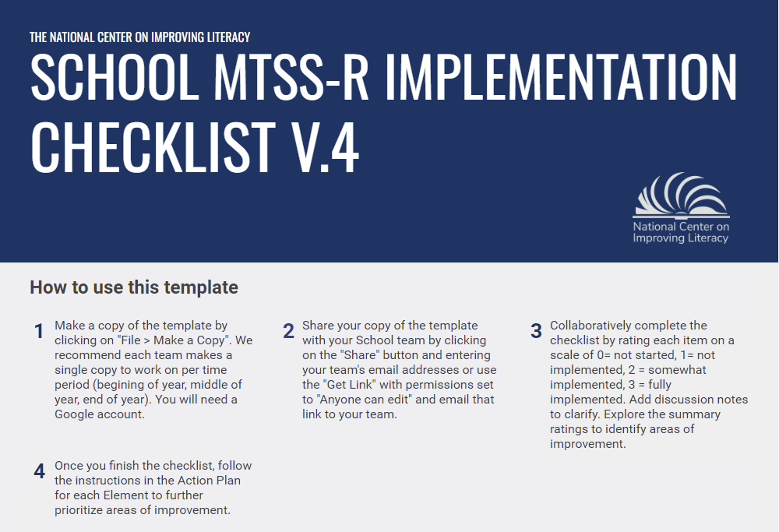
Complete a
Self-Evaluation of Current MTSS-R Elements Approach
Notes:
You will use a MTSS-R Implementation Checklist to evaluation your current MTSS-R approach for each of the elements.

Slide 14
What are the first things that a school should do to set a strong foundation for MTSS-R implementation?
Notes:
Once a school has done these two things—makes a commitment to comprehensive MTSS–R and conducts a self-evaluation of their current reading system—they are ready to begin comprehensive implementation of MTSS–R. Their self-evaluation will help them determine what specific things they should focus on. But, in general, there are five critical areas of initial implementation that establish a strong foundation for MTSS–R.

Slide 15
Establish a schoolwide MTSS-R Leadership Team
Element IV: MTSS-R School Leadership
Notes:
The school should establish a schoolwide MTSS–R Leadership Team, with the school principal as the Team Leader. The team should also include the school reading coach, reading specialists, at least one classroom teacher from each grade, and at least one parent or family member. This team has many responsibilities but the most important are establishing or solidifying the MTSS–R system, and using data to oversee the systematic improvement of MTSS–R implementation and student reading outcomes.

Slide 16


Establish and Support Grade-Level Professional Learning Communities
Element IV: MTSS-R School Leadership
Notes:
The MTSS–R Leadership Team should establish and support strong classroom instruction and intervention teams (PLCs). A professional learning community (PLC) team, or something similar, should make sure reading teachers can plan and work together on issues related to providing high-quality reading instruction and intervention in the classroom.

Slide 17



Establish Effective Core Instruction and Intervention
Element I: Core Reading Instruction and Intervention
Notes:
The school should establish a schoolwide schedule of reading instruction. This includes specifying the time each day core reading instruction (Tier I) and reading interventions (Tier II and III) are taught. Scheduling should be done for all grades and all classrooms
The school should determine what core reading instruction is and how it will be taught. The Tier I program should precisely specify what and how students are taught throughout the year. If students are successful learning the Tier I program, they should be on track for reading success. The Tier I program should be detailed in the school’s reading instruction plan. Tier I teachers should provide core reading instruction according to the Tier I reading program.
The school should determine what the Tier II interventions will be and how Tier III interventions will be adopted or developed with the individual needs of students in mind. Both Tier II and III interventions should precisely specify what and how students are taught. If students are successful in these interventions, they should be catching up to their peers who are on track for reading success. If students are not making adequate progress in the Tier II or III intervention, the intensity of the intervention should be increased to improve student reading progress. Tier II and III interventions—and how intervention intensity will be increased to improve student progress when necessary—should be detailed in the school’s reading instruction plan. Tier II and III teachers should provide intervention reading instruction according to the plan.

Slide 18
Establish a Universal Screener to Directly Assess All Students in Reading
Element II: Data Use
Notes:
The school should directly assess all students in reading to determine which students are on track for reading success and which students are not on track for reading success. Data from these universal screening assessments (meaning all students are assessed) should be used to help determine which students will receive Tier I reading instruction only and which students will need a combination of Tier I instruction and either a Tier II or III intervention to help support their needs. Universal screening assessments should be conducted two or three times per year.

Slide 19
What are some other support systems to make sure the MTSS-R foundation is solid?
Notes:
As schools establish their MTSS–R foundation in these three critical areas, they should also begin putting in place the support system necessary to make sure the foundation is solid and that MTSS–R implementation and student reading outcomes improve continuously over time.

Slide 20
Establish Collection and Use of Student Reading Data and MTSS-R Implementation Data
Element II: Data Use
Notes:
The school must ensure that student reading data and MTSS–R implementation data are collected and used in a data-driven way. In addition to universal screening data, systematic progress data should be collected with students who receive intervention. And, in some cases, reading data should be collected to plan instruction for a student, and determine how well some students are learning precisely what is being taught during instruction. Implementation data should be collected on all key elements of MTSS–R to continuously improve MTSS–R implementation.

Slide 21
Establish Processes and Procedures for All Professional Development, Coaching and Collaboration
Element III: Professional Development
and Coaching
Notes:
Resources should be earmarked, and processes and procedures established, for all of the training, professional development, coaching, teaming, and collaboration necessary to ensure that teachers, administrators, specialists, and parents receive the training and support necessary to implement MTSS–R effectively.

Slide 22
Establish Family-School Communication Systems
Element V: Mutual Support Involving Families and Schools
Notes:
The school and families should collaboratively establish a co-communication system related specifically to MTSS–R. This communication system should detail the opportunities families have to learn about MTSS–R and how they can help support MTSS–R implementation both inside of school and outside of school. It would detail the learning and training opportunities for families, how families provide important input on reading interventions for their child, and how schools provide regular feedback to parents on how their child is learning to read.

Slide 23
Engage in a Continuous Improvement Model to Strengthen MTSS-R Elements
Notes:
As schools establish their MTSS–R foundation in these three critical areas, they should also begin putting in place the support system necessary to make sure the foundation is solid and that MTSS–R implementation and student reading outcomes improve continuously over time.

Slide 24
School MTSS-R Implementation Checklist and Continuous Improvement Model for MTSS-R
Notes:
Your team will engage in a comprehensive self-evaluation of your current reading approach. This self-evaluation—or reading system audit—will help guide your team in using a continuous improvement cycle to determine what your major priorities should be for action planning in building or solidifying your MTSS–R system.

Slide 25
Bridge the Knowing-Doing Gap
“You’re likely to find talk substituting for action when no follow-up is done to ensure that what was said is actually done; people forget that merely making a decision doesn’t change anything.”
The Knowing-Doing Gap, by J. Pfeffer and R. I. Sutton (1999)
What we can change is enough to make a difference in literacy achievement with children!
Notes:
Have participants read this quote from “The Knowing-Doing Gap”. Merely making a decision, or an action plan, is not enough. Success will rely on follow-up.

Slide 26
Evaluate
1. Evaluate
Collect, review and analyze implementation data and student performance data.
Score each item on the MTSS-R Checklist to evaluate your current implementation
Collect and summarize student data
Collect and summarize implementation data
Notes:
Today we will review the MTSS-R Checklist and begin scoring. We will also review how to collect and summarize student data and implementation data to comprehensively evaluate your current systems.

Slide 27
Tool: MTSS-R Implementation Checklist
Element I: Core Instruction and Intervention
Element II: Data Use
Element III: Professional Development and Coaching
Element IV: MTSS-R School Leadership
Element V: Mutual Support Involving Families and the School

Slide 28
Prioritize
2. Prioritize
Use your analysis of data to identify greatest area(s) of focus to support instruction and intervention.
Examine data to gauge the health of your system and determine the overall level of priority for action planning.
Examine:
Student data,
MTSS-R Checklist data, and
Instruction and intervention implementation data.
Notes:
Once you’ve evaluated your data, your team will examine and analyze the data to gauge the health of your system and determine the overall level of priority for action planning. You will examine:
Student data
MTSS-R Checklist data, and
Instruction and intervention implementation data

Slide 29



Review MTSS-R Checklist Results:
How do you decide what is a priority?
Phase 1 | Phase 2 | Phase 3
Readiness Activities | Initial Implementation | Advanced Implementation
Notes:
We have prioritized the MTSS-R Checklist element items to assist your teams in planning goals and actions.
The items are prioritized based on phases of implementation: Readiness, Initial Implementation and Advanced Implementation.

Slide 30

Phase 1: Readiness
Getting Ready for High-Quality Implementation
Goals:
Establish leadership team knowledge of MTSS-R and key MTSS-R elements
Establish school staff knowledge of the science of reading and evidence-based instructional strategies
Establish effective, data-driven MTSS-R Leadership and PLC teams
Establish school MTSS-R System Infrastructure for high quality implementation
Notes:
Review goals of each phase.

Slide 31

Phase 2: Initial Implementation
High-Quality Implementation of All MTSS-R Elements
Goals:
Establish high quality school-based implementation of key MTSS-R elements
Establish high quality reading staff implementation of the science of reading and evidence-based instructional strategies
Expand on MTSS-R Leadership and PLC use of data to inform instructional adjustments
Notes:
Review goals.

Slide 32

Phase 3: Advanced Implementation
Refining High-Quality Implementation of All MTSS-R Elements
Goals:
Data-driven refinement high quality school-based implementation of key MTSS-R elements
Data-driven refinement high quality reading staff implementation of the science of reading and evidence-based instructional strategies
Data-driven refinement MTSS-R Leadership and PLC teams’ use of data to inform instructional adjustments
Notes:
Review goals

Slide 33
Review Student Data
How do you decide what is a priority?
Use universal screening data to determine the percentage of students at each of the three risk indicators – Low Risk, Some Risk and At Risk – to determine the level of priority the school should assign to improving reading instruction and intervention.
Beginning of Year Benchmark Assessment (Universal Screening) | Beginning of Year Benchmark Assessment (Universal Screening)
Health Indicator | % of Students at: Low Risk | % of Students at: Some Risk | % of Students at: At Risk
 | Core Instruction | Supplemental Intervention | Intensive Intervention
Low Priority | > 80% | < 20% | < 10%
Moderate Priority | 60–80% | 20–50% | 10–25%
High Priority | < 60% | > 50% | > 25%
Notes:
Describe the table that will be used to determine the level of priority for goal setting.

Slide 34
Example: What can these data tell me at the school level?
School Goal: 80% of students performing in the Low Risk (Core) range
Table:
School (example):
Beginning of Year Benchmark Assessment (Universal Screening) | Beginning of Year Benchmark Assessment (Universal Screening)
Health Indicator | % of Students at: Low Risk | % of Students at: Some Risk | % of Students at: At Risk
 | Core | Supplemental Intervention | Intensive Intervention
Low Priority | > 80% | < 20% | < 10%
Moderate Priority | 60–80% | 20–50% | 10–25%
High Priority | < 60% | > 50% | > 25%
Beginning of Year Benchmark Assessment (Universal Screening) | Beginning of Year Benchmark Assessment (Universal Screening)
 | % of Students at: Low Risk | % of Students at: Some Risk | % of Students at: At Risk
 | Core Instruction | Supplemental Intervention | Intensive Intervention
School | 50% | 22% | 28%
High Priority
Moderate Priority
High Priority
Notes:
Use the table on the left to determine the priority level for the need to take action.
Walk through the priority levels for the school in this example.

Slide 35
Example: What can these data tell me at the school level? Highest Priority
Example: What can these data tell me at the school level?
School Goal: 80% of students performing in the Low Risk (Core) range
School (example):
Beginning of Year Benchmark Assessment (Universal Screening) | Beginning of Year Benchmark Assessment (Universal Screening)
 | % of Students at: Low Risk | % of Students at: Some Risk | % of Students at: At Risk
 | Core Instruction | Supplemental Intervention | Intensive Intervention
School | 50% | 22% | 28%
Next, look at the order of priority for the Tiers of instruction:
Core Instruction (Tier I)
Supplemental Intervention (Tier II)
Intensive Intervention (Tier III)
Highest
High Priority
Moderate Priority
High Priority
Notes:
In this example, the health indicators have determined that the Core instruction system and the Intensive intervention system are both in the “high priority” category. Prioritize Tier I, or Core, instruction first.

Slide 36
Review Instruction and Intervention
Implementation Data
How do you decide what is a priority?
Focus on the implementation data from the High Priority tiers or grade levels identified from the student data
Flag areas needing improvement
  Is instruction being delivered as intended?
  Are lessons followed as written?
  Are explicit and systematic elements of instruction delivered correctly?
Notes:
Schools will use implementation data later in Year 1 and at each Data Summit throughout the year (middle of the year, end of the year).

Slide 37
Action Plan
3. Plan
Create an action plan for the prioritized areas of focus.
Determine the Instruction and Intervention goal
Review your MTSS-R Checklist scored items and describe actions necessary to support this goal:
instruction and intervention actions (Element I)
data use actions (Element II)
PD and coaching actions (Element III)
leadership actions (Element IV)
Mutual supporting involving families and the school actions (Element V)

Slide 38
Implement
4. Implement
Carry out the action plan and collet implementation and student performance data.
Communicate the Action Plan with all stakeholders
Execute the Action Plan
Provide ongoing support and professional development to support implementation
Collect data to study the Action Plan impact and progress toward goals
Review, evaluate, and adjust at monthly MTSS-R Leadership meetings

