Slide 1
Element II: Data Use
Overview

Slide 2
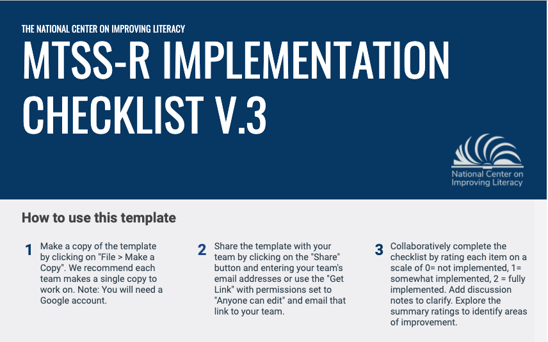
Element II. Data Use
In MTSS–R, data are used to make decisions to improve MTSS–R implementation and student outcomes. Two types of data are used for this: student data (Part I) and MTSS–R implementation data (Part II).
Section 1: Student Reading Data – General Considerations
Section 2: Student Reading Data – Universal Screening Data
Section 3: Student Reading Data – Progress Monitoring Data
Section 4: Student Reading Data – Diagnostic Assessment Data
Section 5: Student Reading Data – Lesson Mastery Data
Section 6: Implementation Data – General Considerations
Section 7: Implementation Data – Reading Instruction and Intervention
Section 8: Implementation Data – PD and Coaching
Section 9: Implementation Data – MTSS-R School Leadership
Notes:
We will spend more time practicing a section of the Instruction and Intervention section during this workshop. The scoring of the section will be completed with your team after today’s training.

Slide 3
ELEMENT II: DATA USE
Two types of data are used to make decisions to improve MTSS–R implementation and student outcomes
  Student data (Part I)
  MTSS–R implementation data (Part II)

Slide 4
A Comprehensive System of Student Reading Data
Use multiple data sources to answer essential questions:
Assessment Type | Important Question(s)
Universal Screening | Are students meeting key reading benchmarks? Which students are at risk?
Progress Monitoring | Is the student at risk making adequate progress in the intervention?
Individual Diagnostic | What specific skills has the student not making adequate progress mastered and not mastered?
Lesson Mastery | Is the student learning the instructional content just taught in the lesson?
(Clarke, 2020)
Notes:
Key messages:
We use different components of assessment to drive data acquisition that helps to answer different questions

Slide 5
Types of Student Reading Data
Assessment | Type | Timing | Duration
Universal Screening | Formative/Summative | 3x per year | Short (1-2 mins per measure) (multiple measures)
Progress Monitoring | Formative | 1-4x per month | Short (1-2 mins per measure)
Diagnostic | Formative | As needed | Medium / Long (1-10 mins per measure)
Lesson Mastery | Formative | At completion of lesson | Medium (1-10 mins per measure)

Slide 6

Universal Screening
Notes:
https://www.flickr.com/photos/62337512@N00/3005817681/in/photolist-5zBASM-dRSERw-Q21NTR-71erz-gJTVfg-25TRPuF-Fhpiyu-5KyPVj-92MxpV-8JzdNb-2hdxiRi-2hvVZ36-2dckhR2-r7pmsM-WDU5y3-Krg8ff-24h2uQ1-e3ipV6-bBLjzd-nUeesn-9sLb7d-bVNjaW-5BC3xF-bBhzUE-2426hQy-2irsSGc-2hb6LmL-2hfCK1N-GUCxeR-2inXVWi-nfeWz3-5u1ZPE-7tP5j3-aPHZFB-qVkqup-26nKnco-9t9Z6N-21xDG7f-2i4jjBZ-2hkKLxn-2iPx7js-aqZYtf-6oyZm9-6Xi8mJ-SMUyo7-747hoX-2i5u1uA-2irGdJV-9QCPxe-LQBopB

Slide 7
Universal Screening Assessments in Reading
Purpose | Identify students who are at risk for poor learning outcomes
Focus | ALL students
Tools | Brief assessments that are valid and reliable and that demonstrate diagnostic accuracy for predicting learning or behavioral problems
Time Frame | Administered three times per year (fall, winter, spring)
        National Center on RTI (2012)
Notes:
The purpose of screening is to identify those students who are at risk for poor learning outcomes. Because RTI is a framework for providing services, the outcomes you are concerned about could be anything, such as academic achievement, behavior, graduation, or post school outcomes. Sites (state, district, schools) typically identify what outcomes students are expected to achieve and then screen to see which students are not likely to achieve those outcomes. For example, if the desired outcome is graduation, a quick screen of attendance and credits – predictors of graduation – can reveal which students are not likely to meet the requirements of graduation and need additional support. If the desired outcome is mastery on end-of-year tests, student performance assessments like curriculum-based measurement (CBM) can reveal which students are not likely to meet the end of year standards and need additional support.
The focus of RTI is on all students, not just those students we may believe are at risk. Students may slip through the cracks unless there is a systematic process for screening in place. Screening is not diagnostic testing; it is a brief, reliable, and valid assessment to identify which students may need additional assessments, (such as progress monitoring or diagnostic assessments), or additional instructional support. The tools should demonstrate diagnostic accuracy for predicting learning or behavioral outcomes. In other words, they should be able to accurately identify who could be at risk.
At a minimum, screening should be administered more than once per year, such as at the beginning of the school year and the middle of the school year. Schools and districts that wish to use screening data to evaluate program effectiveness, to establish local norms and cut scores, and to provide data to the next year teacher typically choose to administer the screening assessment three times a year (e.g. fall, winter, spring) and should select a screening tool that provides alternative forms and multiple benchmarks.
Gersten et al. (2008).
The panel also acknowledges that Tier 1 includes many other components with an evidence base—for example, the evidence base on effective beginning reading instruction.
All six studies include multi-component instructional interventions.
Although students in Grades 3, 4, and 5 were not included in any of the six studies used to support this recommendation, the panel believes results from the six studies apply to students in Grades K–8.
In all six studies included in the evidence base, assessment data were used to identify students with potential problems in language and literacy development (Burns, 2011; Denton et al., 2008; Nelson et al., 2011; Ransford-Kaldon et al., 2010; Solari & Gerber, 2008; Vaughn et al., 2006).
Gersten et al. (2007).
The panel suggests using currently available measures, such as standardized tests, district benchmark tests, or English language assessments, to screen and identify students in need of additional instructional support.122 While it would be ideal to assess English learners along with native English speakers using universal screening systems with some evidence of reliability and predictive validity in literacy, the panel notes that such systems are not available in the areas of oral language and reading and listening comprehension for students in grades K–8. Valid and reliable measures do exist in foundational reading skills that can be used to screen English learners, as well as native English speakers, efficiently (see Recommendation 1 in the 2007 English learner practice guide for additional information on these measures123).
( 60 )
From the 2014 WWC Practice Guide, “The panel believes that, for many English learners, the screening process should not end with a brief screening measure that focuses on decoding and phonemic skills. Though this may be a valid indicator that the student needs extra support, in no way does this indicate that the child needs support only in foundational reading skills. Further diagnostic work, including use of information from formative assessments and informal reading assessments, should, in the panel’s view, be considered in making decisions about what support students need during small-group instruction and what specific instructional needs should be met.
Recommendation 4 (continued)

Slide 8
Examples of measures on screening assessments
Measures | Recommended Grades
Letter Naming Fluency (LNF) Letter Sound Fluency (LSF) Phoneme Segmentation Fluency (PSF) | K - 1
Word Identification Fluency (WIF) | 1-2
Nonsense Word Fluency (NWF) Oral Reading Fluency (ORF) | 1+
Maze or Maze Fluency | 4+
        IES (2009); National Center on RTI (2012)
Notes:
Key messages:
Guidance from national clearinghouses shows us that specific literacy skills should be assessed in specific grades.
While the screeners you use might not map on directly with what is used in your school, this guideline might be considered at your MTSS-R team to ensure the right students are being screened for the right skills at the right time
Additional notes:
For more information on selecting appropriate reading measures by grade, please see the NCRTI Screening Brief Predicting students at risk for reading and mathematics difficulties (National Center on Response to Intervention, 2013).
Put the NCII PM Reading Tools module on Padlet. Let Participants know it is there if they would like to explore it more.
*Updated to IES and IDA recommended grade levels: https://ies.ed.gov/ncee/wwc/Docs/PracticeGuide/rti_reading_pg_021809.pdf || https://dyslexiaida.org/universal-screening-k-2-reading/

Slide 9
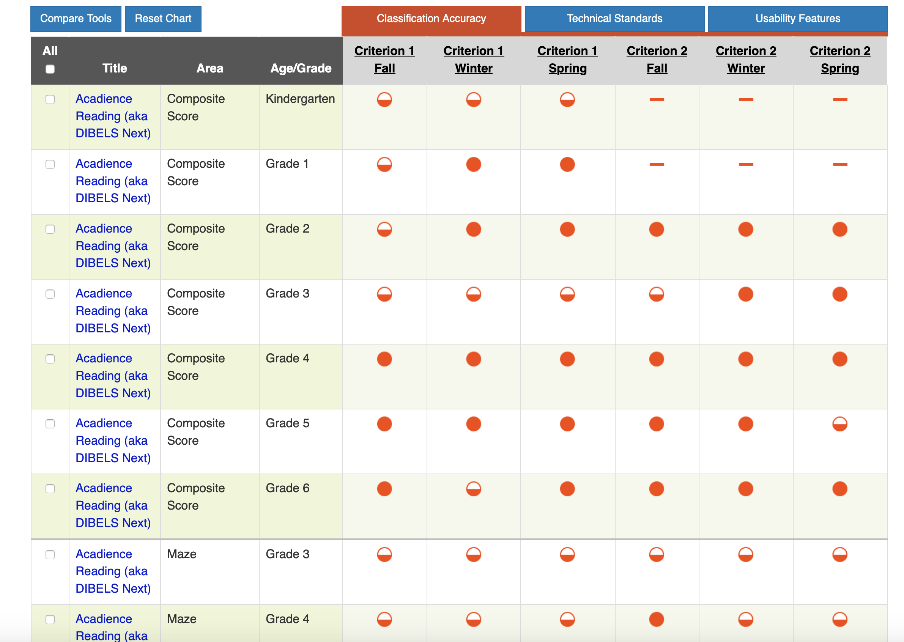
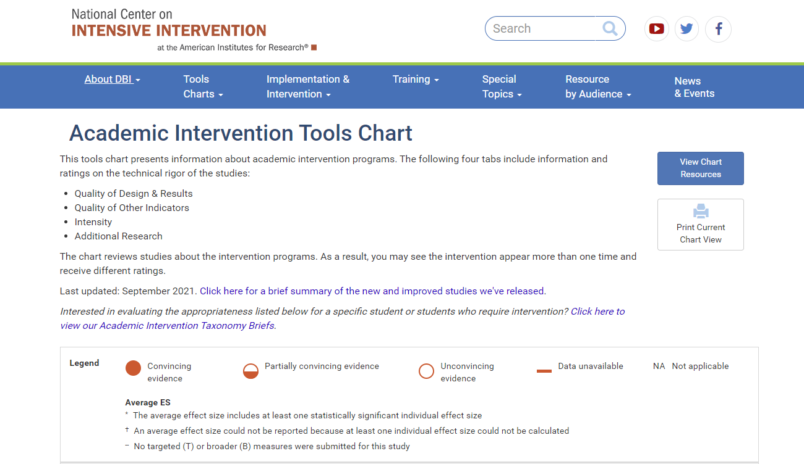
https://charts.intensiveintervention.org/ascreening

Slide 10

Use the Assessment and Coordination Plan to Document
Screening Data Plans
Grade Level: |  | Screening | Progress Monitoring | Diagnostics | Lesson Mastery | Implementation
 | Measures
 | Purpose
 | Timeline
 | What students will be assessed? |  |  |  |  | n/a
 | Who is the school expert?
 | Who is collecting the data?
 | When is the training/ retooling?
 | Who is entering the data?
 | Where is the data stored?
 | What TEAM(S) are using this data? | MTSS-R Leadership PLCs SpEd Eligibility | MTSS-R Leadership PLCs SpEd Eligibility | MTSS-R Leadership PLCs SpEd Eligibility | MTSS-R Leadership PLCs SpEd Eligibility | MTSS-R Leadership PLCs SpEd Eligibility
Notes:
Teams will document their data sources and coordination plan on this one page within their MTSS-R School Plan Workbook.
Record: (use the Assessment and Coordination Plan document)
NOTE: Schools may be unclear on how to fill out all of this information at this point. THAT is OKAY!! If they don’t have a clear answer, leave it blank. It can be filled in later.
What screening measure will be used?
Record the purpose of screening measures.
What is the timeline for collection?
What students will be assessed?
Who is the screening school expert? – Who can provide training and knows this tool better than anyone else in your building?
Who is collecting the data?
When is the training for the data collectors?
Who is entering the data?
Where is the data stored?
What school team, or teams, will use this data?

Slide 11
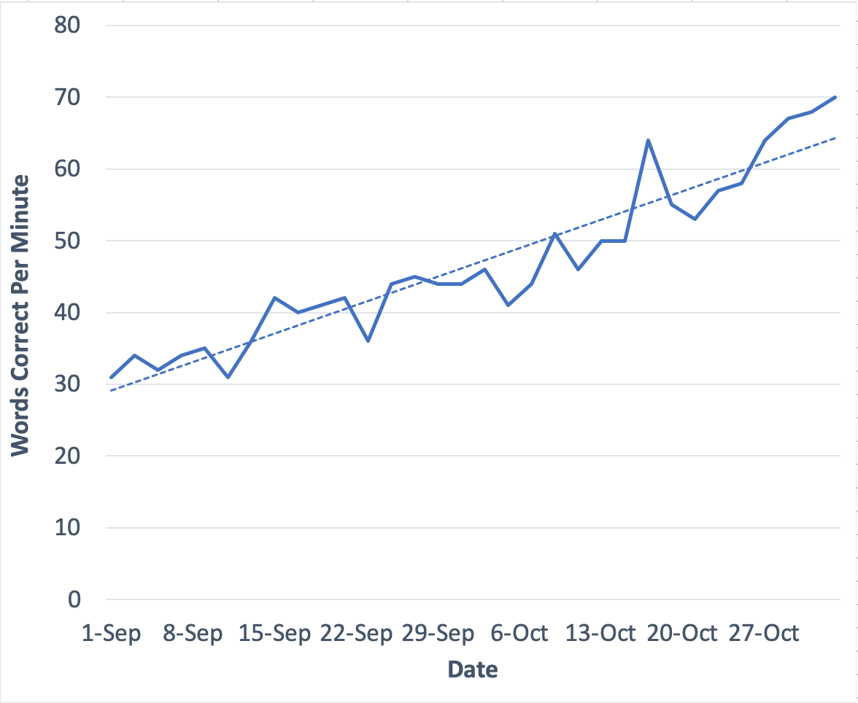
Progress Monitoring
Notes:
Made with Excel

Slide 12
Progress Monitoring in Reading
Purpose | Determine if students at risk are making adequate progress in response to intervention
Focus | All students at risk for reading problems; other students if needed
Tools | Brief assessments that are reliable and valid and sensitive to progress over time
Time Frame | Regular administration; weekly, biweekly, or monthly

Slide 13
Progress Monitoring Assessments
PM measures work well when they are aligned with screening assessments
PM measures are used more frequently, so multiple comparable forms are needed
PM measures should be aligned to students’ area(s) of difficulty (e.g. decoding or reading fluency)
PM goals should be set to determine whether students are making adequate progress

Slide 14
PM Data Can Estimate Rates of Improvement
.3 WRC
6 WRC
        National Center on RTI (2012)
Notes:
Key messages:
This is an example of weekly progress monitoring on an individual student's words read correctly
You can eyeball progress, calculate slope to determine progress, and use the goal-line as a judge of progress within and across students
Additional notes:
The graph on the left shows a student with sharply increasing CBM scores. The increasing scores may indicate the student is responding to his or her current instructional program. The graph on the right shows a student with fairly flat CBM scores. The flatter scores may indicate that the student is not responding to his or her current instruction, and perhaps an instructional change for the student should occur. However, a visual inspection of the data points is not sufficient to tell us if the student is making adequate progress. To be sure, we can quantify a rate of improvement. With this rate of improvement, we can compare this student’s growth rate to his or her peers or to a local or national norm.

Slide 15
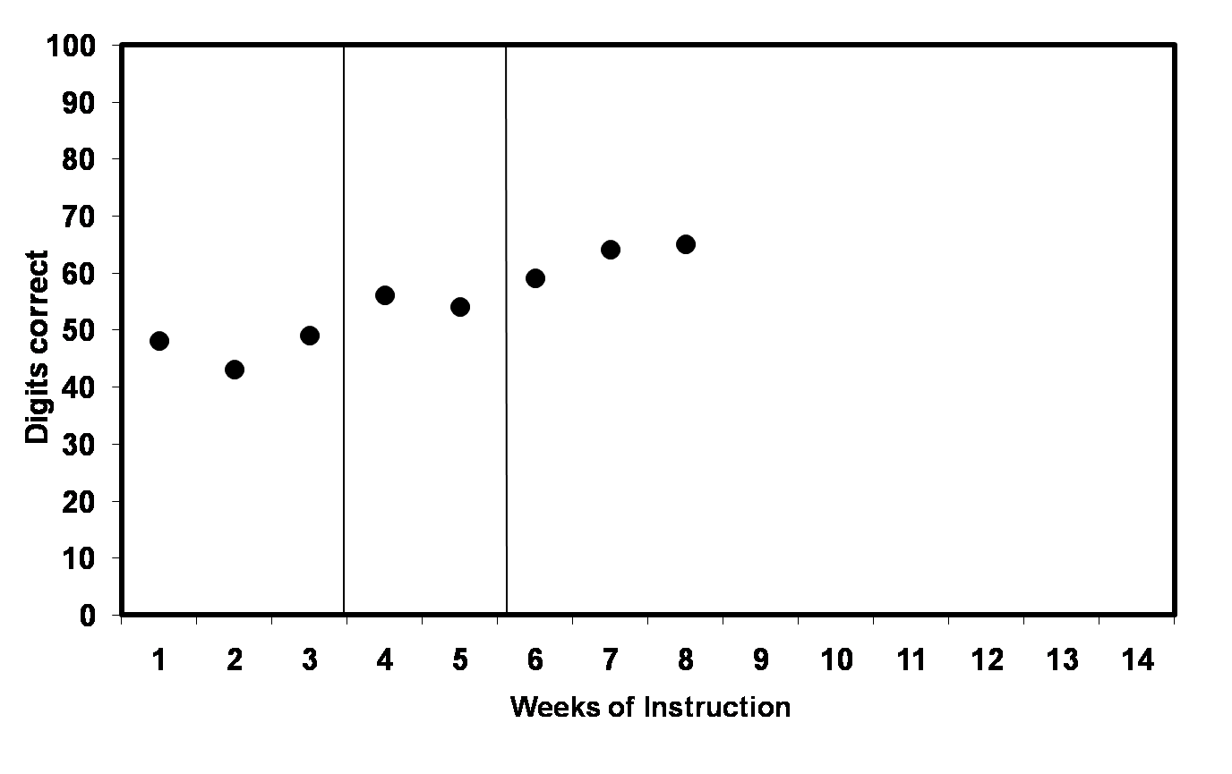
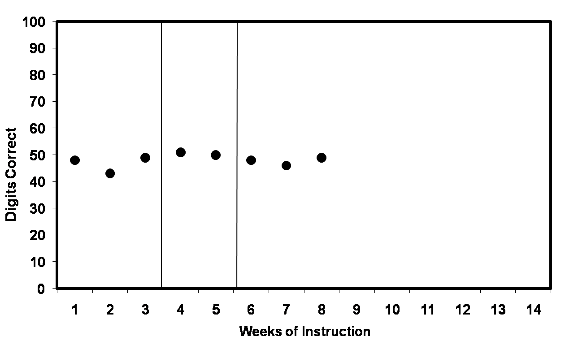
PM Data Can Identify Students Not Making Adequate Progress with Intervention
Flat Scores:
Increasing Scores:
trend line
goal line
X
X
X
X
X
goal line
X
X
X
trend line
        National Center on RTI (2012)
Notes:
Key messages:
Ideally, we use specific decisions rules to decide which students are not making adequate progress from intervention
Additional notes:
We can also see improvement by looking at trend lines in comparison to their goal lines.
On the graph on the left, the trend line is steeper than the goal line. The student is showing increasing scores; therefore, the student is making adequate progress and the end-of-year goal may need to be adjusted to provide more of a challenge.
On the graph on the right, the trend line is flatter than the goal line. The student is not profiting from the instruction and, therefore, the teacher needs to make a change in instructional program. Remember, you never lower the goal. Instead, the instructional program should be tailored to bring a student’s scores up so the scores match or surpass the goal line.

Slide 16
Use the Assessment and Coordination Plan to Document
Progress Monitoring Data Plans
Grade Level: |  | Screening | Progress Monitoring | Diagnostics | Lesson Mastery | Implementation
 | Measures
 | Purpose
 | Timeline
 | What students will be assessed? |  |  |  |  | n/a
 | Who is the school expert?
 | Who is collecting the data?
 | When is the training/ retooling?
 | Who is entering the data?
 | Where is the data stored?
 | What TEAM(S) are using this data? | MTSS-R Leadership PLCs SpEd Eligibility | MTSS-R Leadership PLCs SpEd Eligibility | MTSS-R Leadership PLCs SpEd Eligibility | MTSS-R Leadership PLCs SpEd Eligibility | MTSS-R Leadership PLCs SpEd Eligibility
Notes:
Record: (use the Assessment and Coordination Plan document)
What screening measure will be used?
Record the purpose of screening measures.
What is the timeline for collection?
What students will be assessed?
Who is the screening school expert? – Who can provide training and knows this tool better than anyone else in your building?
Who is collecting the data?
When is the training for the data collectors?
Who is entering the data?
Where is the data stored?
What school team, or teams, will use this data?

Slide 17

Diagnostic
Notes:
https://upload.wikimedia.org/wikipedia/commons/2/2d/Kindergarten_or_Special_Education_teacher_-_US_Census_Bureau.jpg

Slide 18
Diagnostic Assessments
Purpose | Identify specific literacy skill strengths and weaknesses to inform intervention intensification
Focus | Students identified through screening/PM as at-risk for poor literacy skill acquisition, and are not making adequate progress
Tools | Longer assessments often standardized; also quicker, less standardized assessments. Psychometric quality varies
Time Frame | Students are assessed on an as-needed basis

Slide 19
Diagnostic Assessments
Keys to diagnostic assessments?
  They assess or “diagnose” instructional need; they do NOT diagnose disabilities or dyslexia
  Increased specificity to tap individual student strengths and weaknesses
  Should provide data on areas of instruction to be intensified for an individual student
  Can be standardized (available through publishers) or informal (created by teachers)
  Can be combined with multiple data sources (e.g., parent feedback) to narrow in on instruction need

Slide 20
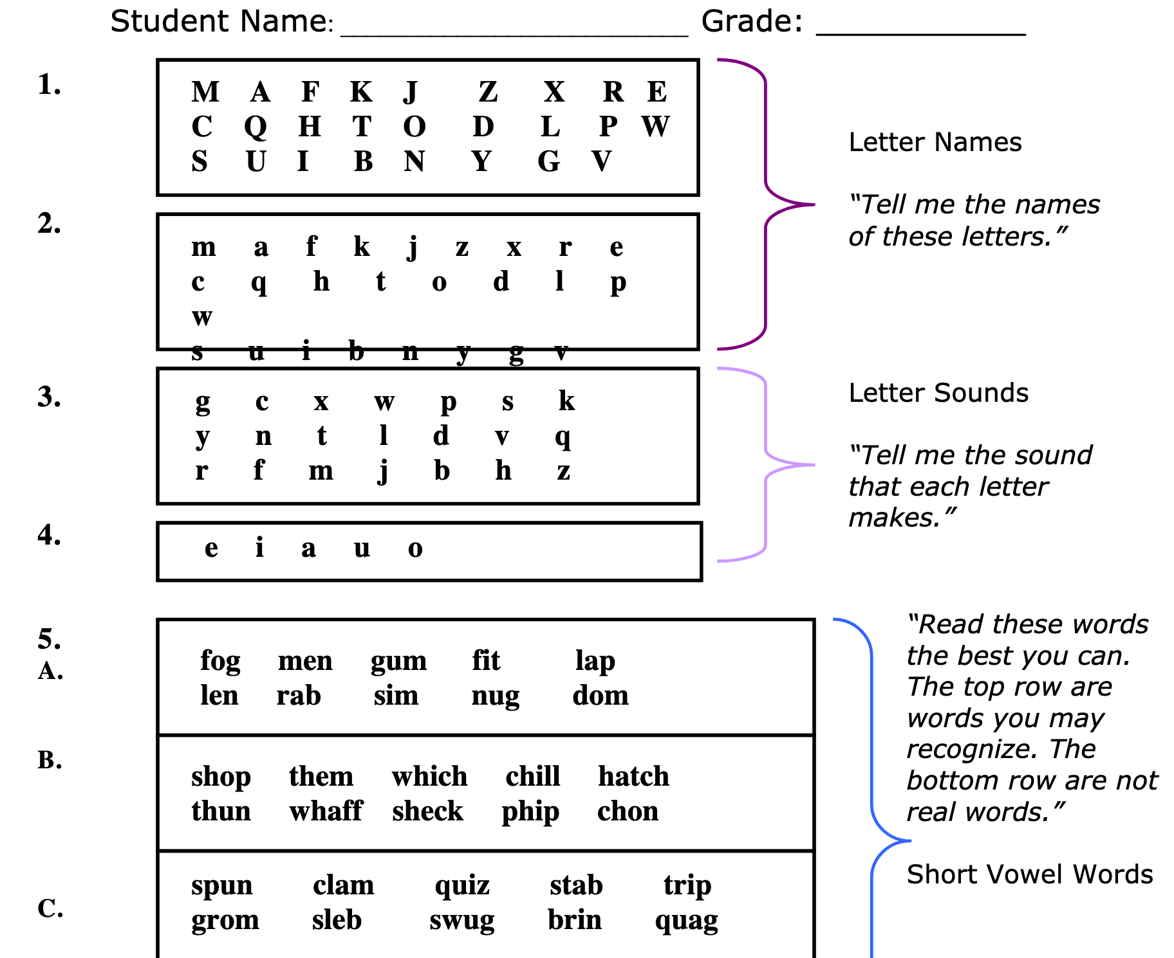
Diagnostic Assessment Examples
CORE Phonics Screener
Phonological Awareness Skills Test (PAST)
Teacher-made phonics assessment
Generic Phonics Screener
National Reading First Technical Assistance Center
Notes:
http://oregonliteracypd.uoregon.edu/sites/default/files/topic_documents/14-R3.3-GenericPhonicsScreener.pdf

Slide 21
Use the Assessment and Coordination Plan to Document
Diagnostic Data Plans
Grade Level: |  | Screening | Progress Monitoring | Diagnostics | Lesson Mastery | Implementation
 | Measures
 | Purpose
 | Timeline
 | What students will be assessed? |  |  |  |  | n/a
 | Who is the school expert?
 | Who is collecting the data?
 | When is the training/ retooling?
 | Who is entering the data?
 | Where is the data stored?
 | What TEAM(S) are using this data? | MTSS-R Leadership PLCs SpEd Eligibility | MTSS-R Leadership PLCs SpEd Eligibility | MTSS-R Leadership PLCs SpEd Eligibility | MTSS-R Leadership PLCs SpEd Eligibility | MTSS-R Leadership PLCs SpEd Eligibility
Notes:
Teams will document their data sources and coordination plan on this one page within their MTSS-R School Plan Workbook.
Record: (use the Assessment and Coordination Plan document)
What screening measure will be used?
Record the purpose of screening measures.
What is the timeline for collection?
What students will be assessed?
Who is the screening school expert? – Who can provide training and knows this tool better than anyone else in your building?
Who is collecting the data?
When is the training for the data collectors?
Who is entering the data?
Where is the data stored?
What school team, or teams, will use this data?

Slide 22

Lesson Mastery
Notes:
https://images.app.goo.gl/Jk2WirGKFiTt2z5q7

Slide 23
Lesson Mastery
Purpose | Identify lesson components where the learner has reached a mastery level of proficiency
Focus | ALL students who receive the lesson; especially critical to collect for students at risk
Tools | Brief assessments that are either curriculum-embedded or proximal to lesson content
Time Frame | Shortly after completion of a lesson, or within a lesson; interwoven throughout the year to ensure retention of mastery-level proficiency

Slide 24
1. Follow Tiers of instruction plans and deliver explicit and systematic instruction.
2. Collect progress monitoring data from students at risk for reading problems.
3. Collect lesson mastery data from all students to determine mastery level of proficiency.
4. Review student data monthly and determine specific instructional adjustments needed for groups or individuals.
How does lesson mastery data fit within your MTSS-R system?
Use universal screening data to determine Tiers of Instruction for each student.

Slide 25
Lesson Mastery Data
Spans all tiers of instruction and intervention
Is unique because it is narrowly focused on assessing for student understanding of lesson content
Is not a general outcome measure (e.g., not oral reading fluency)
Does not necessarily have to meet psychometric standards (e.g., reliability and validity)

Slide 26
Lesson Mastery Data
May be packaged with curriculum or teacher created
May be collected during instruction (error data), or after instruction
Should have high confidence that students can respond correctly to 85% of the items on the assessment
Should be delivered with consistency and linked with alterable instruction – WHAT instructional adjustments need to happen?

Slide 27
Selecting Lesson Mastery Tools
When choosing an appropriate lesson mastery tool to track student progress, consider:
what skill(s) the assessment measures (e.g., phonological awareness, phonics, fluency with connected text, vocabulary, comprehension)?
and
how will you use the data to inform instruction?

Slide 28
Example: Lesson Mastery Data collected during instruction
Daily lesson mastery is determined by recording errors made during the lesson (e.g., check for understanding)
Teacher records data on specific sounds or words students have not yet mastered during the lesson.
Recorded errors can be re-taught at the end of each lesson and at the start of the next lesson.

Slide 29
Example: Lesson Mastery Data collected during instruction
Accuracy and fluency of connected text reading data is gathered while students are reading decodable texts
Teacher records data on the extent to which students can apply the sounds and words they have just been taught to reading connected text.
Consistent accuracy errors indicate the need to re-teach specific sound-spellings or blending skills. Consistent fluency errors indicate the need to provide additional practice reading in decodable texts.

Slide 30

Example: Lesson Mastery Data collected during instruction
  Dictation:
Teacher has students use paper and pens to collect dictation data at least 1x/week to determine which students can apply the sounds to written words they have just been taught.
Consistent accuracy errors indicate the need to re-teach specific sound-spellings or segmenting skills.

Slide 31

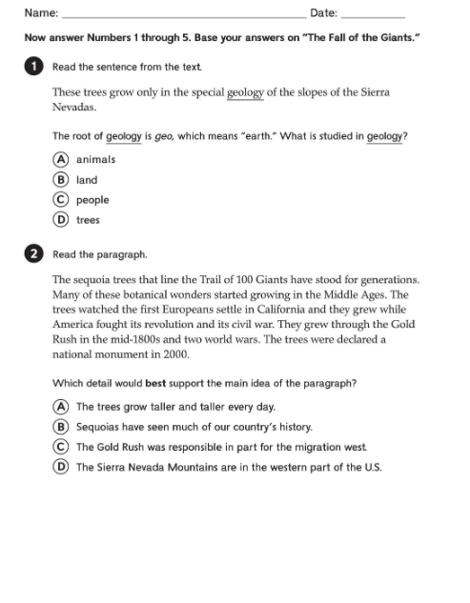
Example: Lesson Mastery Data collected after instruction
Unit Assessments from Core curriculum (because these assessment generally require reading skills, they are most appropriate for students who are at or above benchmark)
Teacher collects data on how well students have mastered the skills within a unit.
Errors indicate the need to re-teach specific skills. Results can also indicate areas of instruction to adjust, or improve, when moving on to the next unit of instruction.

Slide 32
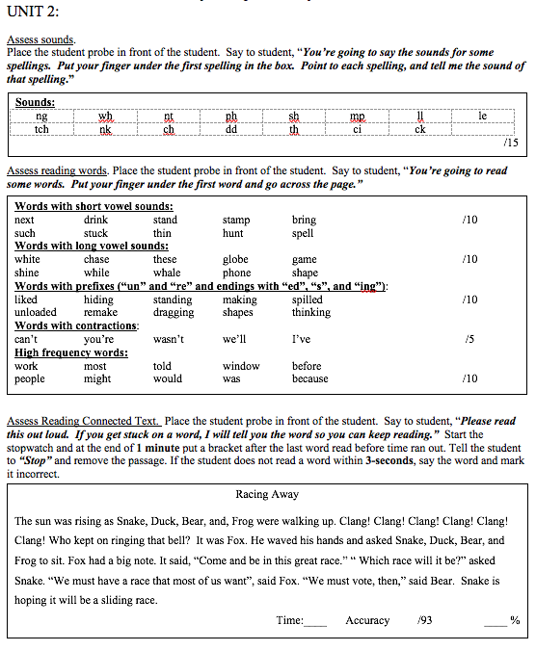
Example: Lesson Mastery Data collected after instruction
End-of-unit teacher created assessment that accurately assesses mastery of unit content.
Teacher collects data on how well students have mastered the skills within a unit.
Errors indicate the need to re-teach specific skills. Results can also indicate areas of instruction to adjust, or improve, when moving on to the next unit of instruction.
Notes:
When students are reading below grade level and are not 85% successful with the package Core assessments, teachers should work together to develop a method for collecting lesson master data that will accurately assess what the students have been taught.

Slide 33
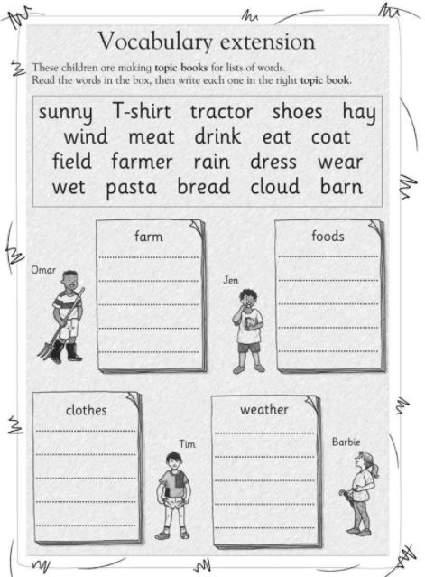
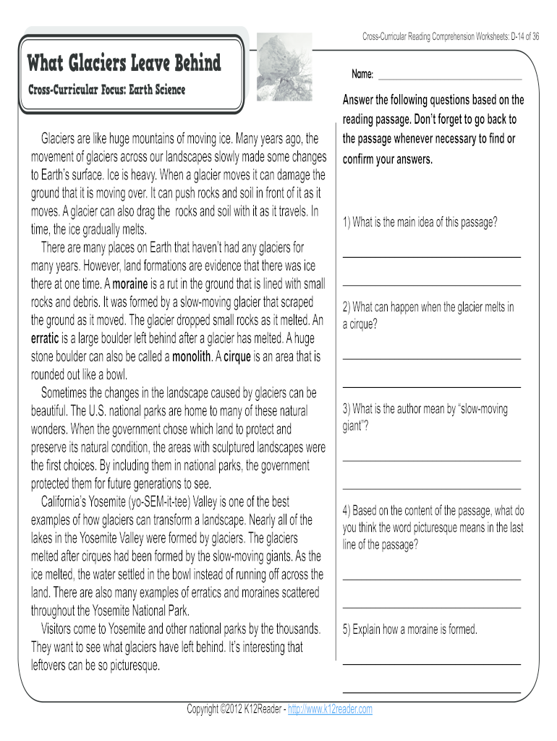
Example: Lesson Mastery Data collected after instruction
Other alternatives to students who may struggle with the packaged Core program assessment
  Vocabulary -- display weekly vocabulary words without definition – “Write the word that means [give the definition].” Students write the vocabulary word.
  Teacher groups identify Core program worksheets that students complete at the end of each week, or unit, that can accurately assess content mastery

Slide 34
Remember:
Lesson Mastery tools are narrowly focused on assessing for student understanding of lesson content
Lesson Mastery assessments should be delivered with consistency – follow a PLAN
BIG IDEA: Results are linked with alterable instruction – WHAT instructional adjustments need to happen as a result of the current data?
Lesson Mastery Results
Adjustments Example:
Notes:
Some other ideas of instructional adjustments based on specific data collected.

Slide 35
Using Lesson Mastery Data
Data can be used to make instructional decisions for individual students or groups of students. For example,
  DAILY: If 1 student in a group of 5 is struggling to master a skill, you may choose to reteach the skill to just that student for a few minutes at the end of each lesson.
  DAILY: If all 5 students are struggling with one or two skills, you may choose to reteach just those routines to the whole group at the end of the lesson, and at the beginning of the next lesson before moving on.
  WEEKLY: If all 5 students are struggling with many skills at the end of a week, you may choose to immediately reteach one lesson before moving on.

Slide 36
Use the Assessment and Coordination Plan to Document
Lesson Mastery Data Plans
Grade Level: |  | Screening | Progress Monitoring | Diagnostics | Lesson Mastery | Implementation
 | Measures
 | Purpose
 | Timeline
 | What students will be assessed? |  |  |  |  | n/a
 | Who is the school expert?
 | Who is collecting the data?
 | When is the training/ retooling?
 | Who is entering the data?
 | Where is the data stored?
 | What TEAM(S) are using this data? | MTSS-R Leadership PLCs SpEd Eligibility | MTSS-R Leadership PLCs SpEd Eligibility | MTSS-R Leadership PLCs SpEd Eligibility | MTSS-R Leadership PLCs SpEd Eligibility | MTSS-R Leadership PLCs SpEd Eligibility
Notes:
Teams will document their data sources and coordination plan on this one page within their MTSS-R School Plan Workbook.
Record: (use the Assessment and Coordination Plan document)
What screening measure will be used?
What is the timeline for collection?
What students will be assessed?
Who is the screening school expert?
Who is collecting the data?
When is the training for the data collectors?
Who is entering the data?
Where is the data stored?

Slide 37
ELEMENT II: DATA USE
Two types of data are used to make decisions to improve MTSS–R implementation and student outcomes
  Student data (Part I)
  MTSS–R implementation data (Part II)

Slide 38
MTSS–R Data Use: Implementation Data
What gets implemented?
Reading instruction and intervention is implemented
Professional development and coaching is implemented
School MTSS–R Leadership is implemented
Data on the implementation of each of these elements should be collected . . . and used to improve implementation and outcomes
Notes:
Use a comprehension plan for implementation data collection and use
Collect implementation data on each of the organized things adults in the school do to improve MTSS–R implementation and student reading outcomes
Make sure the main goals of data use are to improve (1) MTSS–R implementation and (2) student reading outcomes

Slide 39
Instruction and Intervention Implementation Data

Slide 40
Implementation Data: Reading Instruction & Intervention
Implementation data in Tiers I, II, and III should be collected systematically
Goal is to assess the difference between what is expected and observed during instruction
Three types of data are frequently collected:
  Completed by an observer (e.g. reading coach, principal)
    Direct data collection while watching reading instruction in the classroom
    Surveys / ratings based on watching reading instruction in the classroom
  Completed by staff delivering reading instruction
    Log of what has been taught

Slide 41
Types of Instruction and Intervention Implementation Data
Fidelity of Implementation (instruction and intervention were taught as intended)
Quality of Implementation (evidence-based implementation delivery practices: explanations, models, multiple practice opportunities for all students, checks of understanding, error corrections with feedback)
Evidence-Based Instructional Practices (positive learning environment, organization, classroom management, active student participation and engagement strategies, motivational strategies)
Instruction and intervention Intensity (group responses, individual responses, academic feedback, student error rates)
Notes:
Data collection and logs of reading instruction in the classroom can consider
Quick review and discussion of types of implementation data

Slide 42
Fidelity of Implementation: Instructional Areas
  Irregular Word Reading
  Phonemic Awareness
  Sound-Spelling Introduction and Practice
  Blending Sounds
  Regular Word Reading
  Reading in Connected Text
  Encoding Practice
  Vocabulary
  Comprehension

Slide 43
Quality of Implementation: Explicit Elements
Explanation/Objective
Models
All Students Practicing
  Appropriate Signal: Focus, Cue, Think Time, Signal
  Appropriate Pacing
Checks for Understanding
Error Corrections

Slide 44
Evidence-Based Instructional Practices:
Community of Positive Learning
Organization of Instructional Materials
Classroom Management Techniques
Student Participation and Engagement
Use of Motivational Strategies
Instructional Scaffolding

Slide 45
Instruction and Intervention Intensity
Group Responses
Individual Responses
Academic Feedback
Student Errors

Slide 46
PD and Coaching Implementation Data

Slide 47
Implementation Data: PD & Coaching
Consider ways to collect both quantity and quality data related to PD and Coaching services provided to school staff
Collect PD and Coaching quantity and quality data from:
  Recipients of services (e.g., reading instruction staff)
  Providers of services (e.g., school or district coach)
Have PD and Coaching providers (e.g., school coach) keep logs of the services they provide – (who, what, when, where, why, and how)
Notes:
We will PROVIDE EXAMPLES!!

Slide 48
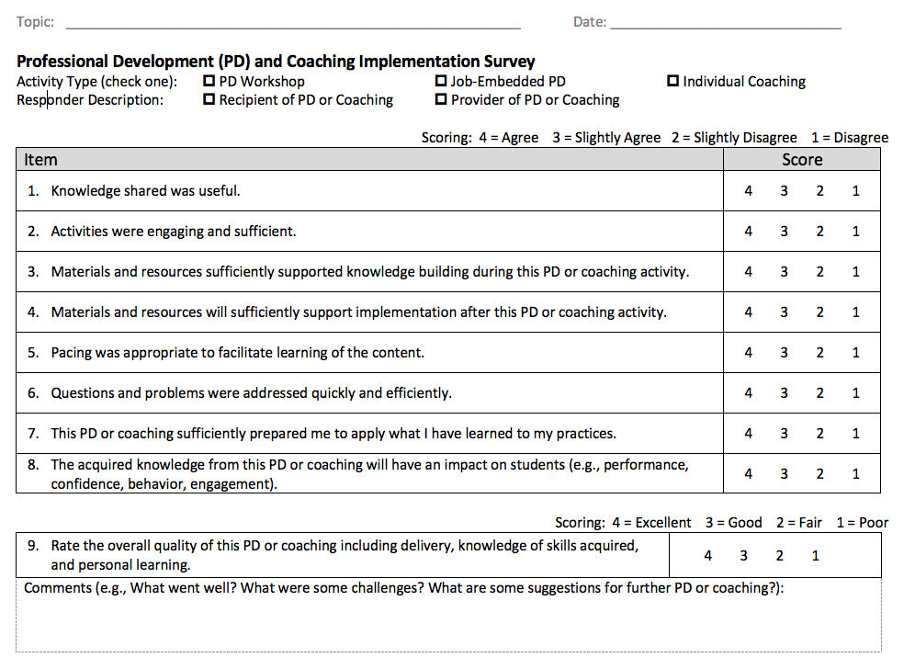
PD and Coaching Implementation Data
Notes:
This data should be collected after each PD and Coaching event throughout the school year.

Slide 49
MTSS-R Leadership Implementation Data

Slide 50
Implementation Data: MTSS-R School Leadership
Consider ways to collect both quantity and quality data related to MTSS-R School Teams:
Collect MTSS-R school-based teams’ quantity and quality data from members of the teams
Have members keep logs, or minutes, of the meetings – (who, what, when, where, why, and how)
Notes:
We will PROVIDE EXAMPLES!!

Slide 51
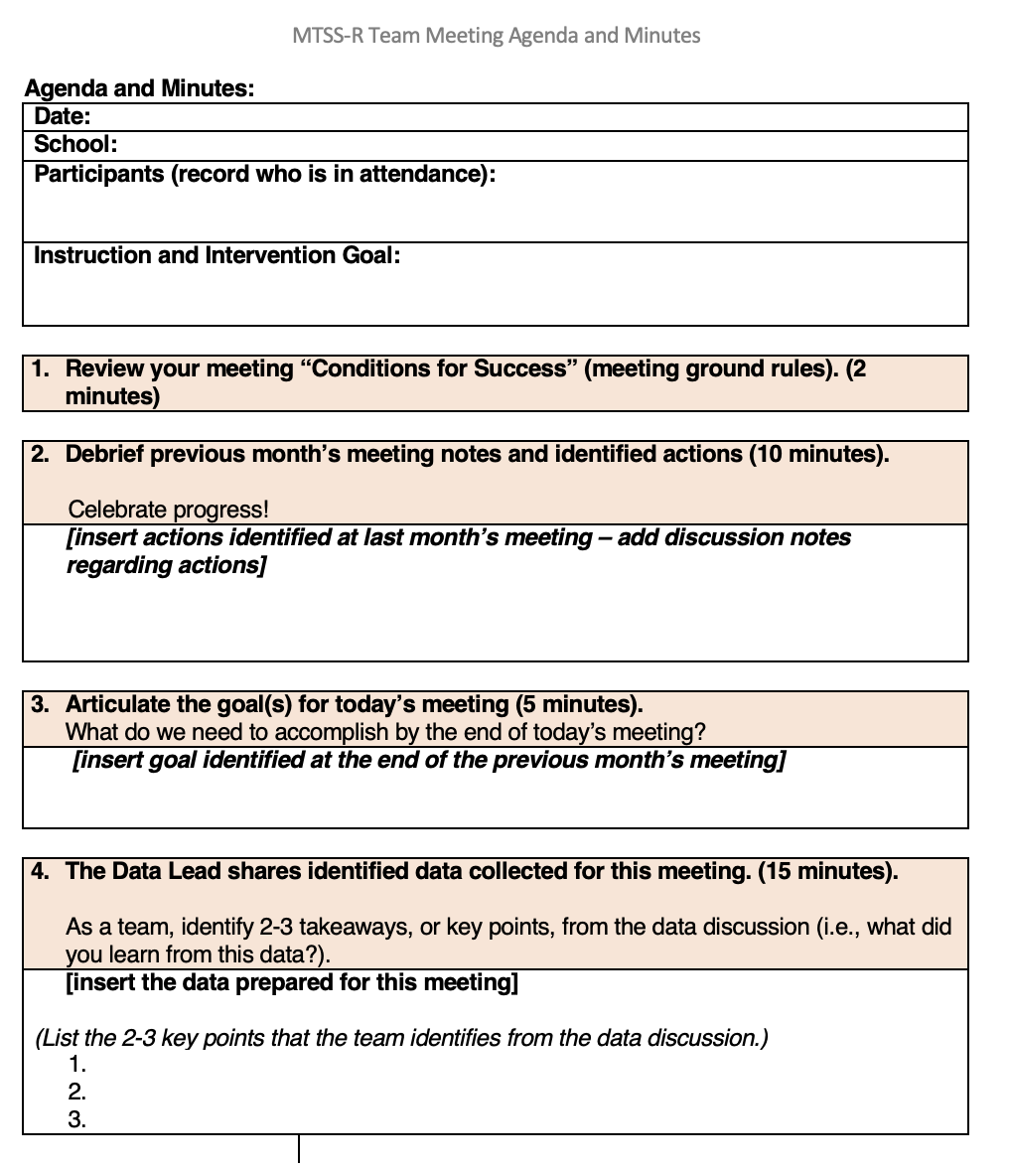
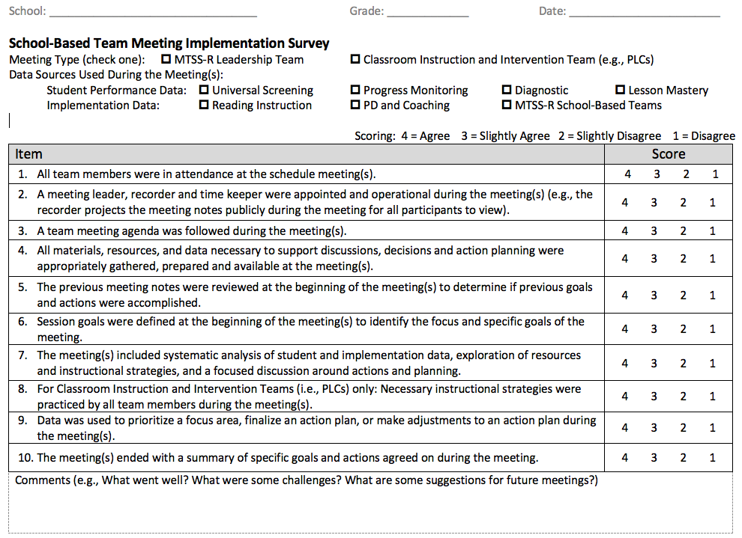
Collect MTSS-R Team Meeting Implementation Data – Meeting Minutes and Meeting Surveys
Notes:
Minutes are recorded at every meeting and survey data is collected at the end of each meeting.

Slide 52
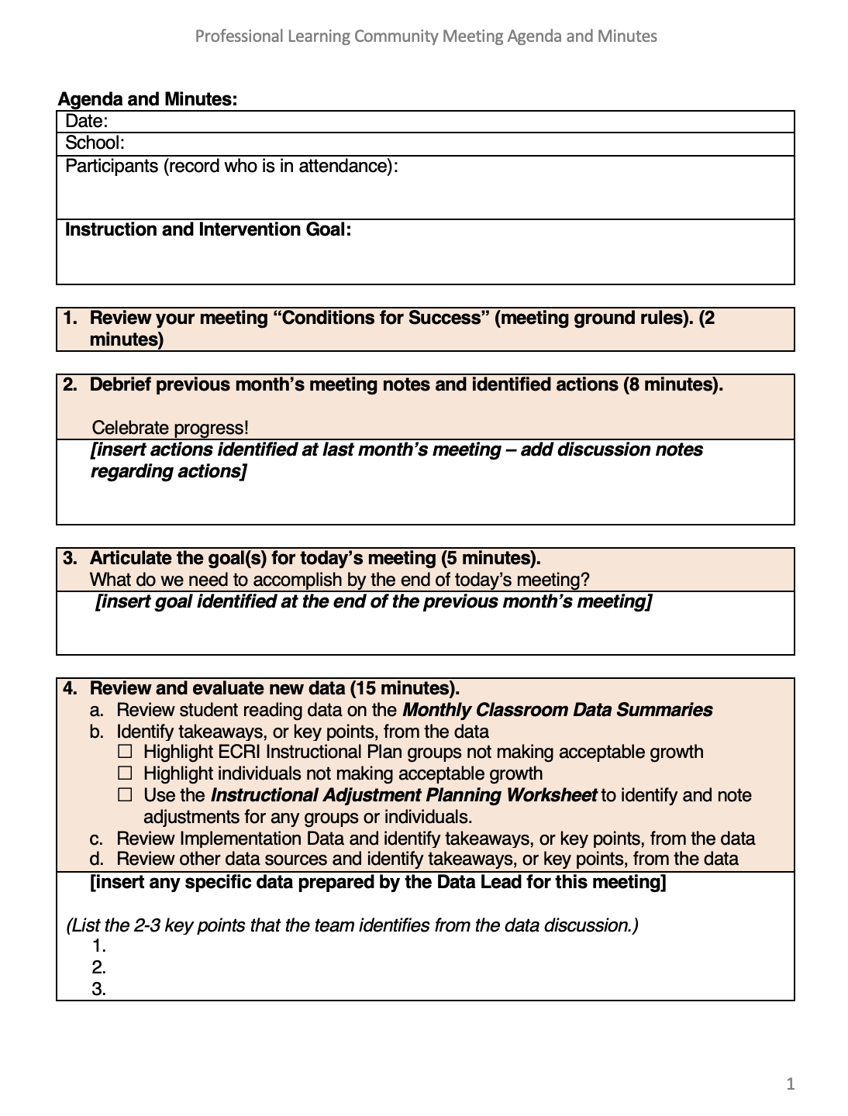
Collect PLC Team Meeting Implementation Data – Meeting Minutes and Meeting Survey Data
Notes:
The Local Coach should prepare the previous year’s PLC Team implementation data together and that data should be shared here!
Review previous year’s implementation data from PLC meeting evaluations.

Slide 53
Use the Assessment and Coordination Plan to Document
Implementation Data Plans
Grade Level: |  | Screening | Progress Monitoring | Diagnostics | Lesson Mastery | Implementation
 | Measures
 | Purpose
 | Timeline
 | What students will be assessed? |  |  |  |  | n/a
 | Who is the school expert?
 | Who is collecting the data?
 | When is the training/ retooling?
 | Who is entering the data?
 | Where is the data stored?
 | What TEAM(S) are using this data? | MTSS-R Leadership PLCs SpEd Eligibility | MTSS-R Leadership PLCs SpEd Eligibility | MTSS-R Leadership PLCs SpEd Eligibility | MTSS-R Leadership PLCs SpEd Eligibility | MTSS-R Leadership PLCs SpEd Eligibility
Notes:
Teams will document their data sources and coordination plan on this one page within their MTSS-R School Plan Workbook.
Record: (use the Assessment and Coordination Plan document)
What screening measure will be used?
What is the timeline for collection?
Who is the screening school expert?
Who is collecting the data?
When is the training for the data collectors?
Who is entering the data?
Where is the data stored?

Slide 54
Element II: Data Use
Evaluate and Score

Slide 55
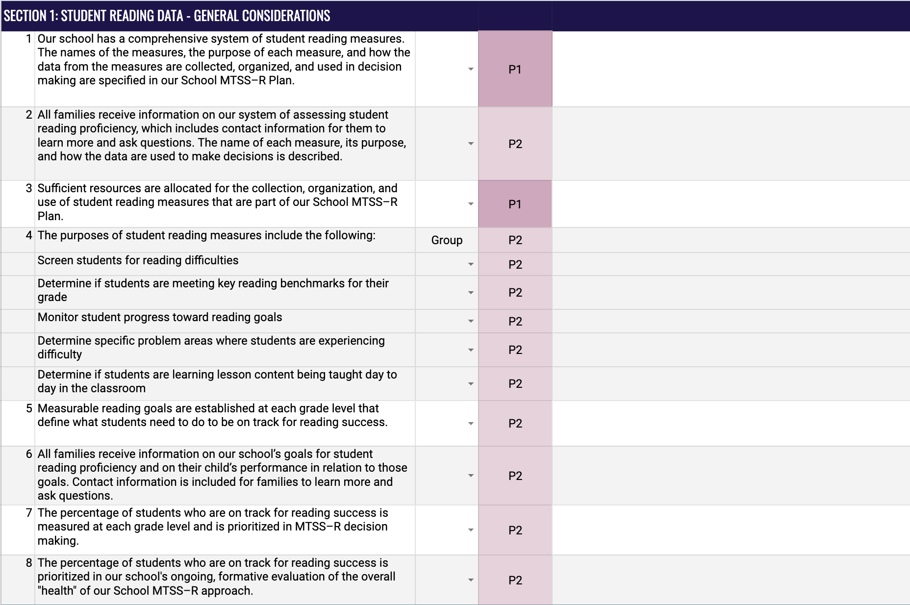
Evaluate and Score: Data Use
Rating Scale
Element Items
Phase Indicator
Discussion Notes

Slide 56

Element II. Data Use
Work with your team and score each section of this Element.
Section 1: Student Reading Data – General Considerations
Section 2: Student Reading Data – Universal Screening Data
Section 3: Student Reading Data – Progress Monitoring Data
Section 4: Student Reading Data – Diagnostic Assessment Data
Section 5: Student Reading Data – Lesson Mastery Data
Section 6: Implementation Data – General Considerations
Section 7: Implementation Data – Reading Instruction and Intervention
Section 8: Implementation Data – PD and Coaching
Section 9: Implementation Data – MTSS-R School Leadership
Notes:
.

