Slide 1
Element I: Instruction and Intervention
Overview
Notes:
We will begin with an overview of Element I: Core Instruction and Intervention.

Slide 2
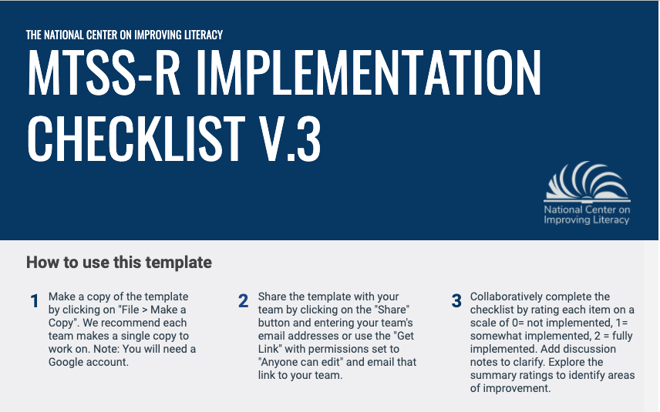
Element I. Core Instruction and Intervention
Reading instruction and intervention refers to all reading instruction and intervention students receive in school. In a three-tier MTSS–R approach, this is Tier I (core) instruction, Tier II supplemental intervention, and Tier III intervention. In the MTSS–R Checklist, there are sections that focus on reading instruction and intervention overall, or across tiers, and sections for each separate tier.
Section 1: Across Tiers
Section 2: Tier I Reading Instruction
Section 3: Tier II Reading Intervention
Section 4: Tier III Reading Intervention

Slide 3

Quality Reading Instruction and Intervention Are Central to MTSS-R Implementation
Data Use
Parents and Families
PD and Coaching
MTSS-R Leadership
Instruction and Intervention
Notes:
Effective reading instruction is the nucleus of a school’s MTSS–R system. The other four elements of the system—such as using data to determine how well MTSS–R is working; professional development to improve implementation and outcomes; MTSS–R teams to keep the entire system running smoothly; and mutual support involving families—work together to support effective reading instruction and intervention for all students.
The reason instruction is the nucleus of the MTSS–R system is simple. Quality reading instruction and intervention most strongly determines if students will learn to read successfully. No other consideration under a school’s control even comes close.

Slide 4
WHAT do we need to teach?

Slide 5
Teaching Reading is Complex
Decoding
Ability to transform print into spoken language
(read accurately and fluently)
Language Comprehension
Ability to understand spoken language
Reading Comprehension
Fluent execution and coordination of word recognition and text comprehension.
X
=
Reading is a multifaceted skill, gradually acquired over years
of instruction and practice.
(Gough and Tunmer,1986)
(Gough and Tunmer,1986)
Notes:
Teaching reading effectively is hard because reading itself is complex. In fact, skillful reading is one of the most complex of human inventions. There’s more to reading that just reading the words on the page, as everyone knows. But it turns out that even just reading the words on the page is remarkably complex. Then adding the weight of understanding, deciphering what is written, uncovering meaning, and discovering the layers of meaning in complex texts, takes years of teaching and practice.
Even with these challenges, making sure all students get off to a good start learning to read is possible. It takes a team effort, a sustained commitment, and instruction that focuses on the science of reading, but it can be done.

Slide 6
D X LC = Reading Comprehension
Decoding
X
Language
Comprehension
Print Concepts
Fluency
(accuracy, rate, expression)
Decoding Skills
Understand the organization and basic features of print
Read with sufficient accuracy and fluency to support comprehension
Phonological Awareness
Phonics and Word Recognition
Word Knowledge
(sight vocabulary)
Demonstrate understanding of spoken words, syllables, and sounds (phonemes)
Know and apply grade-level
phonics and word analysis skills in decoding words
Instant and effortless access to all, or almost all, words read

Slide 7
Successful Readers Decipher the Alphabetic Writing System’s Written Code
250
graphemes
44
phonemes
200,000
words
26
letters
Notes:
In all alphabetic writing systems, such as English, successful readers learn to decipher the system’s written code. [refer back to the simple view of reading slide] For most kids, this represents the toughest “work” in learning to read. In English, it means learning what letters and letter combinations are used to make all of the sounds in the English language. There are about 44 different sounds in the English language, and these sounds are represented by the 26 letters of the alphabet. Knowing these sounds and their letter representations is necessary to read and to write the nearly 200,000 words in the English language. When students learn this alphabetic code well, it means that reading words in English, even words the reader has never encountered before or seen in print, will be possible, and they will have mastered a reading skill they will use for a lifetime.

Slide 8
. . .but meaning matters too.

Slide 9
D X LC = Reading Comprehension
Decoding
X
Language Comprehension
Inferential Language Skills
Academic Language Skills
Background Knowledge
Ability to infer information that is not provided in the text
Formal communication structure and words common in books and school
Possesses general and topic-specific background knowledge
Literal Comprehension Skills
Narrative Language Skills
Academic
Vocabulary
Ability to answer literal,
text- dependent questions
Ability to clearly relate a
series of events
Ability to comprehend and
use words in formal writing
Notes:
But reading words accurately is not enough to be a good reader. Good readers also have to understand the meaning of what they read. [refer back to the simple view of reading slides] Breaking the code helps them read the words on the page accurately, making it possible for them to understand the text, the main purpose of reading. And the meaning of texts, especially complex texts is, like an onion, multi-layered. There are things the text literally says. It’s right there on the page. But there are also things the text does not say explicitly and the reader has to infer, like connecting the narrative dots in a complicated story. And in some texts, important dots may not be anywhere in the text. These dots represent the information readers have to know before they even read the text.

Slide 10
Expert Teachers Focus on Both Aspects of Texts
Decoding
Ability to transform print into spoken language
(read accurately and fluently)
Language Comprehension
Ability to understand spoken language
Reading Comprehension
Fluent execution and coordination of word recognition and text comprehension.
X
=
Phonological Awareness
Alphabetic Principle
Accuracy and Fluency
Vocabulary
Comprehension
(Gough and Tunmer,1986)
Notes:
Overall, these two aspects of texts—figuring out the code to read the words and determining the meaning of the text—are what expert teachers focus on in teaching young children to read.

Slide 11

Adopted Research-based Reading Curriculum
Tier I: developed based on scientific research on reading development and emphasizes the five essential components of reading instruction
Tier II and III: scientific studies have been conducted demonstrating improved student reading outcomes
Notes:
Schools need to have adopted research-based reading curriculum.
Tier I curriculum should be developed based…(read slide)
Tier II and Tier III curricula should have scientific studies that have been…(read slide)

Slide 12
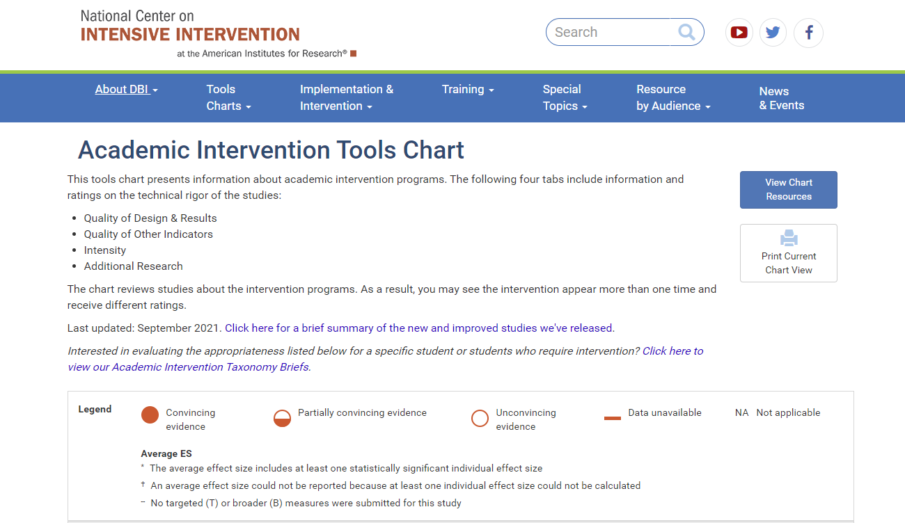
https://charts.intensiveintervention.org/aintervention
Notes:
There are tools, like this one from the National Center on Intensive Intervention that present information about academic intervention programs. School teams can use these tools to see reviews regarding ratings on the technical rigor of studies that have been conducted testing the effectiveness of intervention curricula.

Slide 13
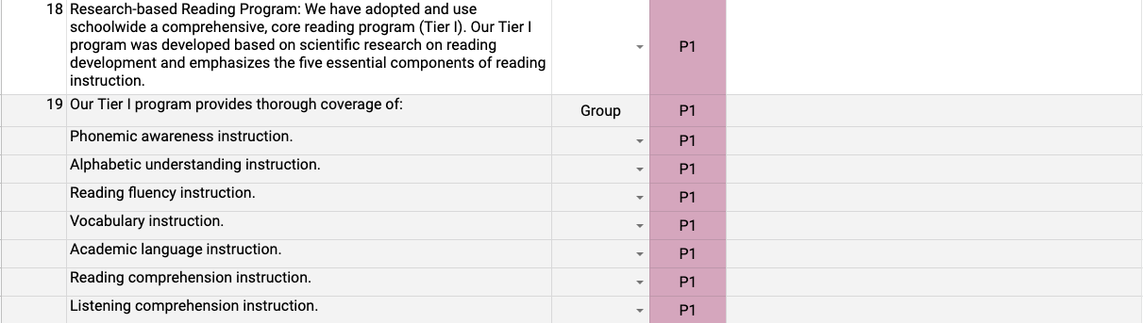
Evaluate Your Adopted Reading Programs

Slide 14
HOW do we need to teach?

Slide 15
Establish a Master Schedule
Specify time each day for Tier I instruction.
Specify time each day for Tier II instruction.
Specify time each day for Tier III instruction.
Master Schedule Example:
Leaders of Equity
https://www.leadersofequity.org/instructional-practices
Notes:
The school should establish a schoolwide schedule of reading instruction. This includes specifying the time each day core reading instruction (Tier I) and reading interventions (Tier II and III) are taught. Scheduling should be done for all grades and all classrooms

Slide 16
Instructional Emphasis Aligns with Student Needs
Tier I (Core) Instruction
(all students)
Foundational Reading Skills
(Phonemic Awareness, Phonics, Fluency, Vocabulary, Comprehension)
Tier II (Intervention) Instruction
(students who demonstrate risk)
Intensive, systematic instruction focused on
Foundational Reading Skills
Tier III (Intensifying Intervention) Instruction
(students who show minimal progress after Tier II instruction )
Intensive, systematic instruction focused on
Foundational Reading Skills with Strategic Integration, Integrated Cognitive processing and Mastery Monitoring
Tier I Differentiated Small Group Instruction
(instructional content based on student formative data)
Advanced
Grade
Level
Some
Risk
High
Risk
Notes:
http://www.fcrr.org/assessment/ET/diff/diff.html
What these intervention teachers do is similar to what regular classroom teachers do. They focus on the same five areas of reading development, and they teach in a way that is systematic and explicit. [refer back to earlier infographics] They will focus more on the specific areas where students are struggling. For most students this will be learning the code, especially how letters represent the sounds in language. Struggling with this part of learning to read makes it very difficult to read words accurately. Most reading interventions for students struggling with reading spend a great deal of time on helping students master the code so they can read words accurately and fluently.

Slide 17
Tier I Core Instruction (all students)
90+ minute Reading Block
30 minutes
Foundational Skills:
Phonological Awareness
Phonics
Connected Text Reading with Fluency
30 minutes
Vocabulary
Comprehension
30 minutes
Differentiated Small Group Instruction

Slide 18
Tier I Reading Block (90 minutes)
Differentiated Small Group Instruction Recommendations
(30 minutes):
Small(er) groups of varying size based on need.
The teacher does not need to meet with each group every day.
Differentiated Text Reading
Advanced | Grade Level | Some Risk | High Risk
Anthology Text Leveled Readers Chapter Books Literature Discussions Written Responses | Decodable Text Anthology Text Leveled Readers Reteaching of Any Skills Literature Discussions Written Responses | Decodable Text Reteaching of skills (2-3 areas based on mastery data) | Decodable Text Tier III Intensifications Reteaching of skills (2-3 areas based on mastery data)
Notes:
Big Ideas:
Small group instruction should be DIFFERENTIATED instruction (meaning not the same for each student).
It’s important to re-teach skills students still have not mastered or extend for those students that are ready to move further.
The skills in small group should be aligned with the Tier 1 whole class instruction whenever possible.
The group size should be variable based on what skill you are working on. For example, if you have a group of 12 students all needing additional decodable text reading practice with immediate teacher feedback, and are using the same text, meet with that small(er) group at the same time – instead of having two groups back to back doing the same thing.

Slide 19
Tier II and Tier III Reading Interventions Support Students Who Struggle with Reading
Tier I
Tier II
Tier III
ALL Students:
Prioritized content and teaching routines; high quality instruction
At-Risk Readers:
Core-aligned small group instruction for strategic intervention
Whole group/small group instruction-CORE
Scaffold as needed
Significantly below grade level/not responding to HQ Tier 1/2:
Core-aligned small group for intensified intervention
Shift to intensification
Notes:
We provide systematic and explicit instruction in foundational reading areas for students across tiers of instruction. For most students, needs are met in Tier 1 core instruction. For students who struggle, schools provide interventions to support them. These interventions might be for students who are having some difficulty but are also making some progress. These interventions are usually referred to as Tier II interventions. Some interventions may be for students who are struggling quite a bit, and these interventions are usually referred to as Tier III interventions. All interventions are usually taught by other reading teachers, sometimes teachers with specific expertise in helping students who are having difficulty learning to read.

Slide 20
Student Support Across Tiers
Tier I:
90-minute reading block that includes whole group instruction and differentiated small groups.
Tier II:
30 minute daily small group to address instructional needs
(core-aligned preteach)
Tier III:
45 minute daily small group to address instructional needs (remediation)
7
T
22
2
4
10
T
9
6
1
T
1
2
8
18
12
11
5
1
4
19
14
3
2
3
23
13
15
25
21
16
20
24
26
17
Explicit, systematic instruction with Increase in intensity
Notes:
Students 1 and 2 are focus for this slide...
They are involved in Tier I, Tier II, and Tier III instruction with delivery of instruction intensifying for each tier. Dose intensity, dose form, and dose group size intensified for Tier III intervention. Also- within instruction, pace may also change depending on student mastery of material in Tier III.
Decreased group size, heterogenous small(er) groups, increased instructional minutes

Slide 21
Tier I: Foundational Skills Lesson (30 minutes)
Irregular Word Reading
Decoding Skills: Phonemic Awareness Sound-Spelling Introduction and Review Blending Practice Regular Word Reading
Decodable Text Reading
Encoding (Dictation)
10-15 minutes
12-15 minutes
3-5 minutes

Slide 22
Tier II: Preteach an Aligned Foundational Skills Lesson (30 minutes)
Irregular Word Reading
Decoding Skills: Phonemic Awareness Sound-Spelling Introduction and Review Blending Practice Regular Word Reading
Decodable Text Reading
Encoding (Dictation)
10-15 minutes
12-15 minutes
3-5 minutes

Slide 23
Tier III: Intensify Instruction Based On Student Needs
Identify specific literacy skill strengths and weaknesses from Tier I and II instruction to inform intensification of intervention (using lesson mastery and diagnostic data)
Irregular Word Reading
Decoding Skills: Phonemic Awareness Sound-Spelling Introduction and Review Blending Practice Regular Word Reading
Decodable Text Reading
Encoding (Dictation)
For example:
Intensify and add more phonemic awareness instruction
Intensify and add more word reading instruction

Slide 24
Implementation Delivery

Slide 25
Quality Teaching Requires Explicit and Systematic Instruction
ex•plic•it
stated clearly and in detail, leaving no room for confusion or doubt.
sys•tem•at•ic
having, showing, or involving a system, method, or plan.
in•struc•tion
the act and art of teaching.
Notes:
Skilled classroom teachers expertly ensure instruction is focused and efficient and teach in a way that is commonly referred to as systematic and explicit. By systematic, we mean what is taught each day is determined before the lesson, and what is taught builds “systematically” from one lesson to the next. By explicit, we mean teachers explain clearly what they want students to learn, and they show them exactly what they want students to do to demonstrate they are learning what’s important. Expert teachers support what students are learning by doing it with them, especially when students are first learning new concepts and ideas. Then, when students try to demonstrate that they can do it on their own, teachers give lots of feedback to help and encourage them, and they give lots of practice with feedback so students learn really well the key ideas and concepts.

Slide 26
Explicit and Systematic Instruction Components Across All Tiers of Instruction
Components of Explicit Instruction | Components of Systematic Instruction
Teacher explanation (Learning Target) Teacher model Practice opportunities for all Use of signal Judicious review Appropriate pacing Immediate corrective feedback Checks for understanding | Break activities into small steps Steps are sequential Steps progress from simple → more complex Students have prior knowledge and prerequisite skills required for new skill
(The Meadows Center for Preventing Educational Risk, 2010)
Notes:
Our ECRI Foundational Skills routines ensure explicit and systematic instruction is occurring. We want to make sure we are also using explicit and systematic instruction strategies for vocabulary and comprehension lessons.

Slide 27


Video Example
Follow the elements of explicit instruction!
Notes:
This is the Sound Review (Advanced). Using the Implementation Data collection form, follow along looking for the different routine components as they are being delivered. You will see that the progression of the routine components is down the rows on the left-hand side.
We have labeled each of the routine components as they are delivered. You will notice that the teacher uses quick pacing but is ensuring that all students are practicing each item with accuracy and checks individuals for mastery at the completion of the routine.
Let’s watch!

Slide 28
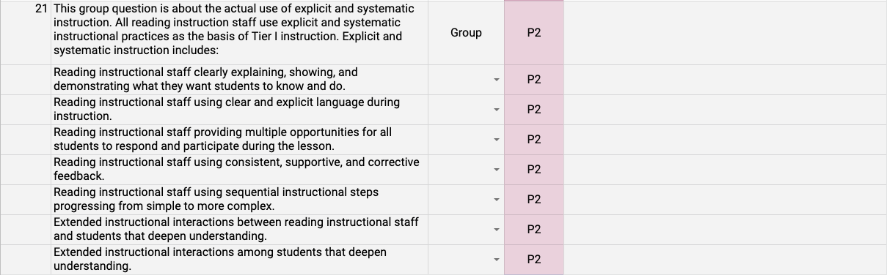
Evaluate the Actual Use of Explicit and Systematic Instruction

Slide 29
Element I: Instruction and Intervention
Evaluate and Score

Slide 30
MTSS-R Checklist Scoring
Access the MTSS-R Checklist by following the Google Drive Link:
https://docs.google.com/spreadsheets/d/1fg5xVSB_Jvlmh9RC92QUnhG75iwQxL-bepGlsVm_ZTA/copy?usp=sharing
Notes:
Your school teams will now have an opportunity to practice using the MTSS-R Checklist to evaluate your own school’s current systems. We will walk through the process with you, step-by-step.

Slide 31
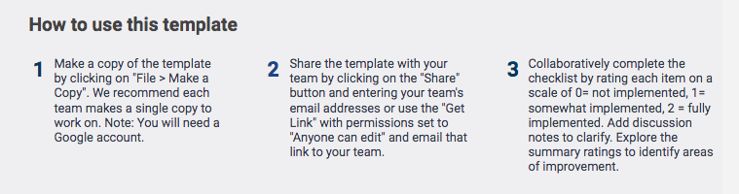
Work from a single copy to record responses for the team.

Slide 32
Score each item on the MTSS-R Checklist to evaluate your current implementation based on clear evidence.
0 = Implementation is either NOT underway OR is in an early stage of development. Evidence of quality is either NOT being collected OR is in an early stage of development.
1 = Implementation is clearly underway BUT substantial room for improvement exists. Evidence of quality is being collected BUT use of evidence to make improvements could be substantially improved.
2 = Implementation is clearly underway AND implementation is strong or close to desired levels of quality. Evidence of quality is being collected AND use of evidence to make improvements is running smoothly.

Slide 33
Evaluate and Score: Instruction and Intervention

Slide 34
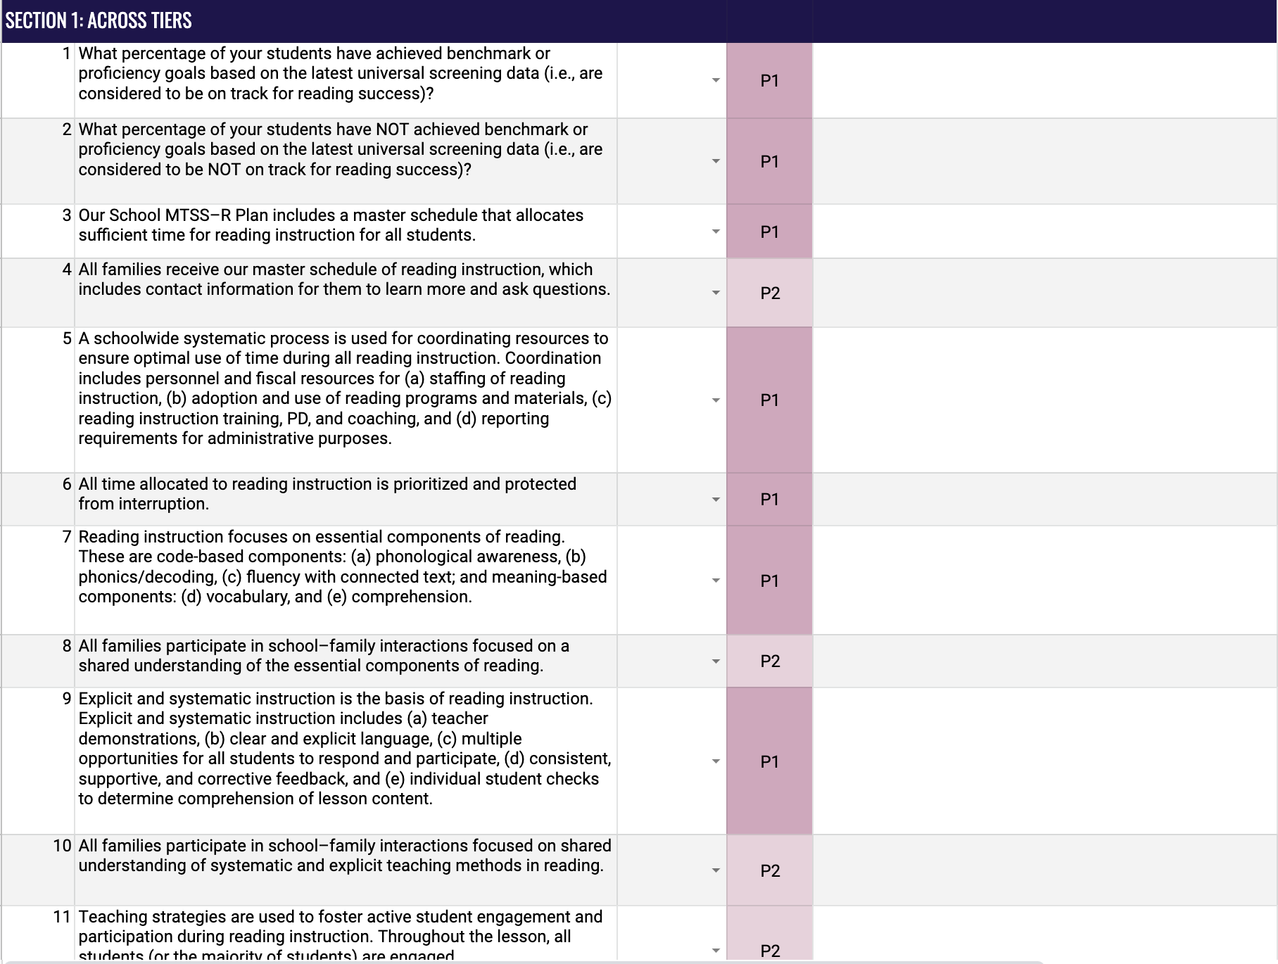
Evaluate and Score: Instruction and Intervention
Rating Scale
Element Items
Phase Indicator
Discussion Notes

Slide 35


Element I. Core Instruction and Intervention
Work with your team and score each section of this Element.
Section 1: Across Tiers
Section 2: Tier I Reading Instruction
Section 3: Tier II Reading Intervention
Section 4: Tier III Reading Intervention
Notes:
.

